Slide 1
Calculus II for MGMT – Introduction to Vectors & Matrices Matrix Computations
Mathematics for Management
Supplementary Electronic Materials
Matrix Computations
Matrix-matrix computations
A primer on eigenvalues and eigenvectors
Inverse matrices

Slide 2
The eigenvectors of a (square) matrix are those vectors that, mapped to a multiple of themselves by multiplication with the matrix

Slide 3
This defining property of an eigenvector leads to a linear system …

Slide 4
… that can be solved by Gaussian elimination

Slide 5
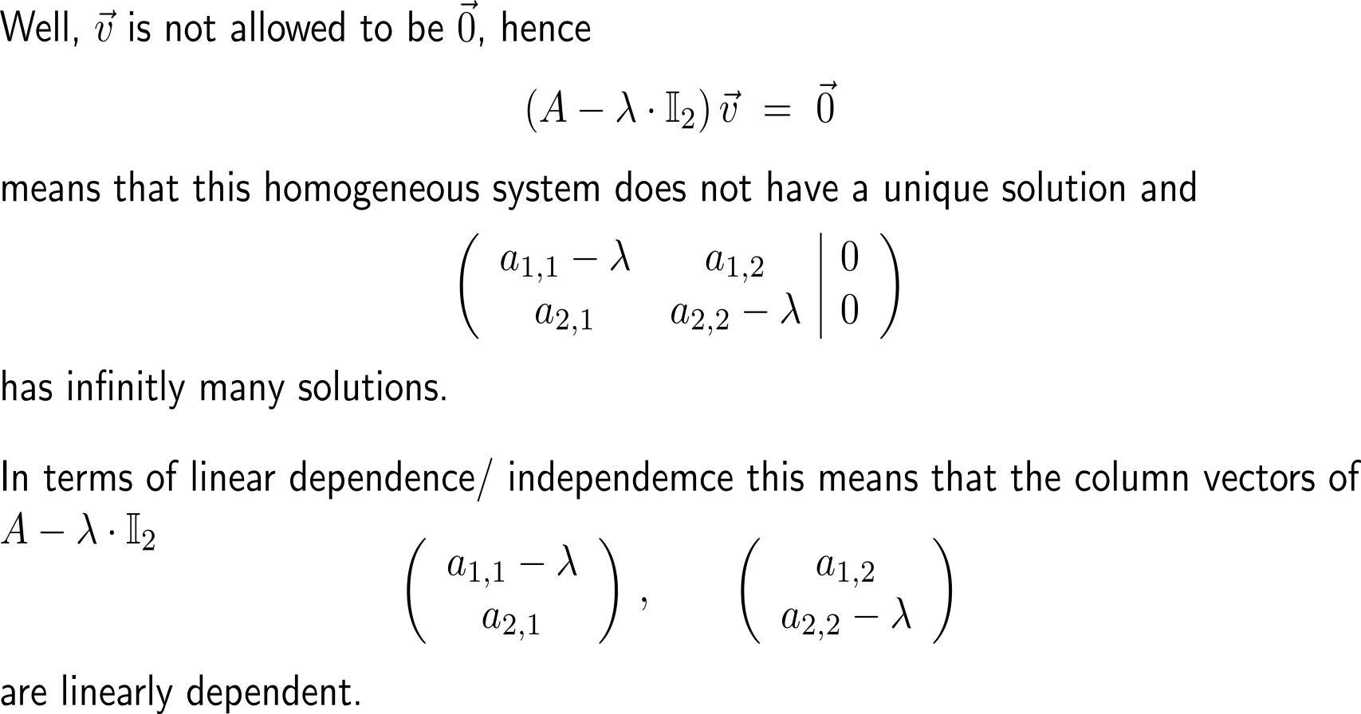
The eigenvalue that corresponds to an eigenvector is the specific value that generates linearly dependent columns in the coefficient matrix …

Slide 6
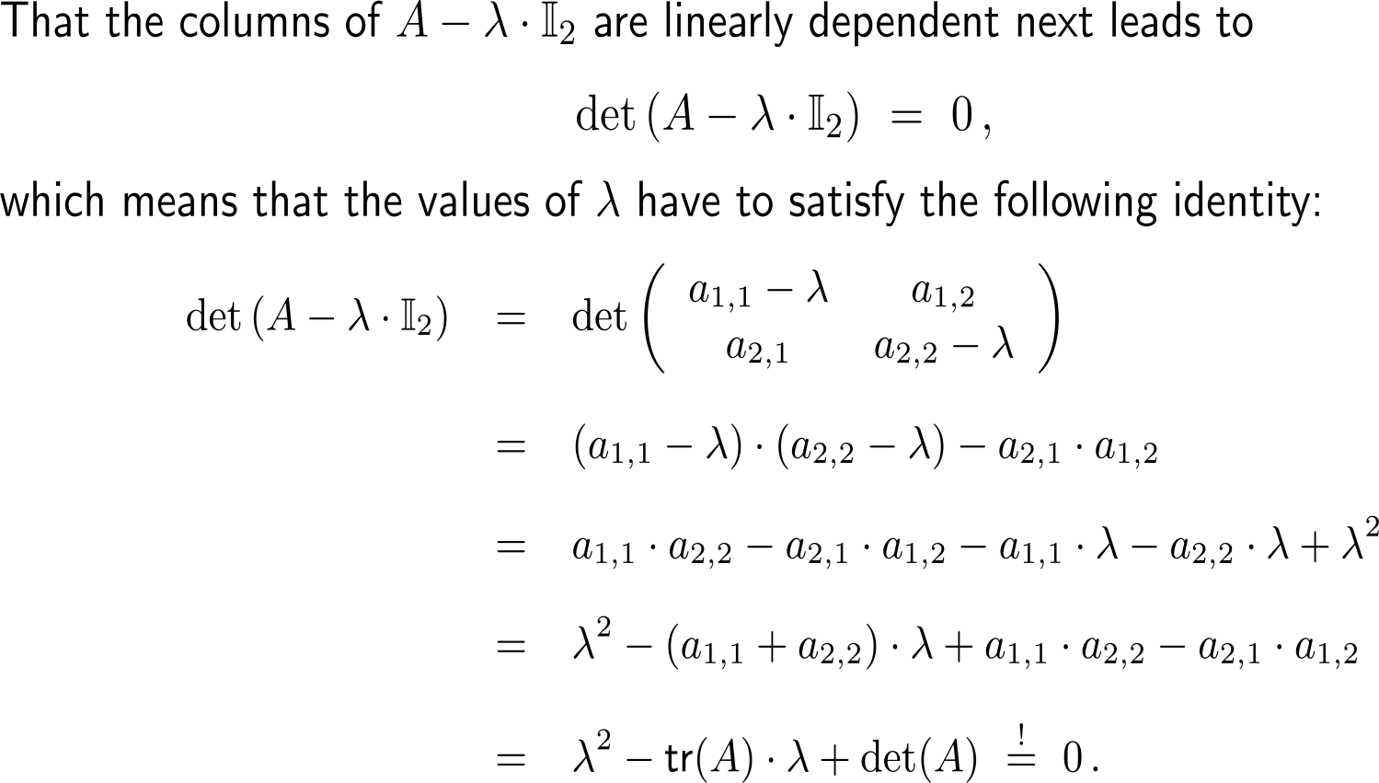
… or, stated differently, that leads to a vanishing determinant of the coefficient matrix (1/ 2)

Slide 7
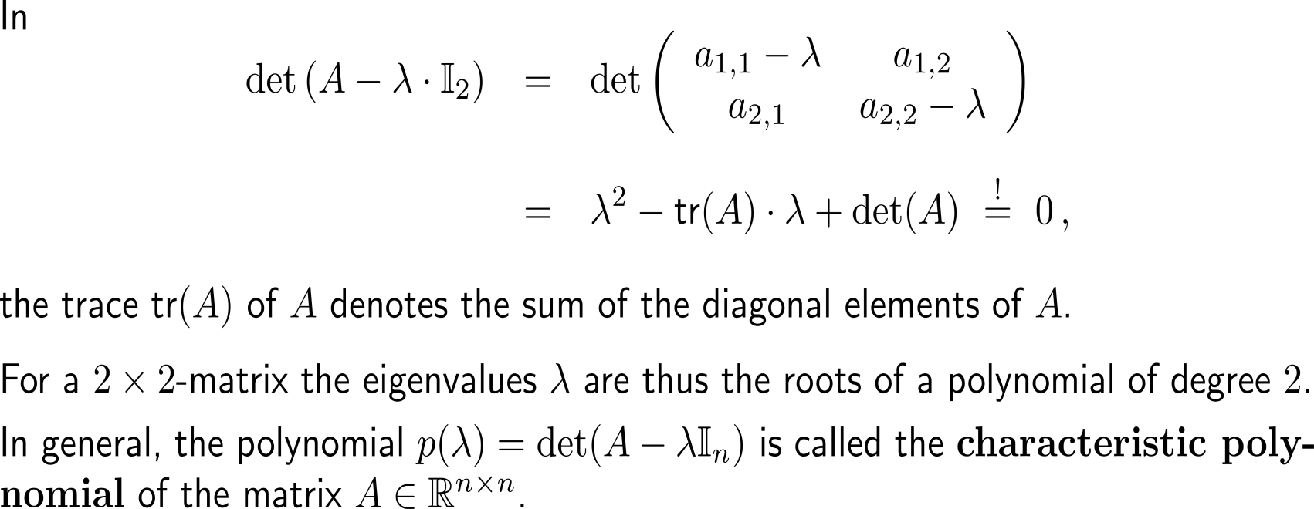
… or, stated differently, that leads to a vanishing determinant of the coefficient matrix (2/ 2)

Slide 8
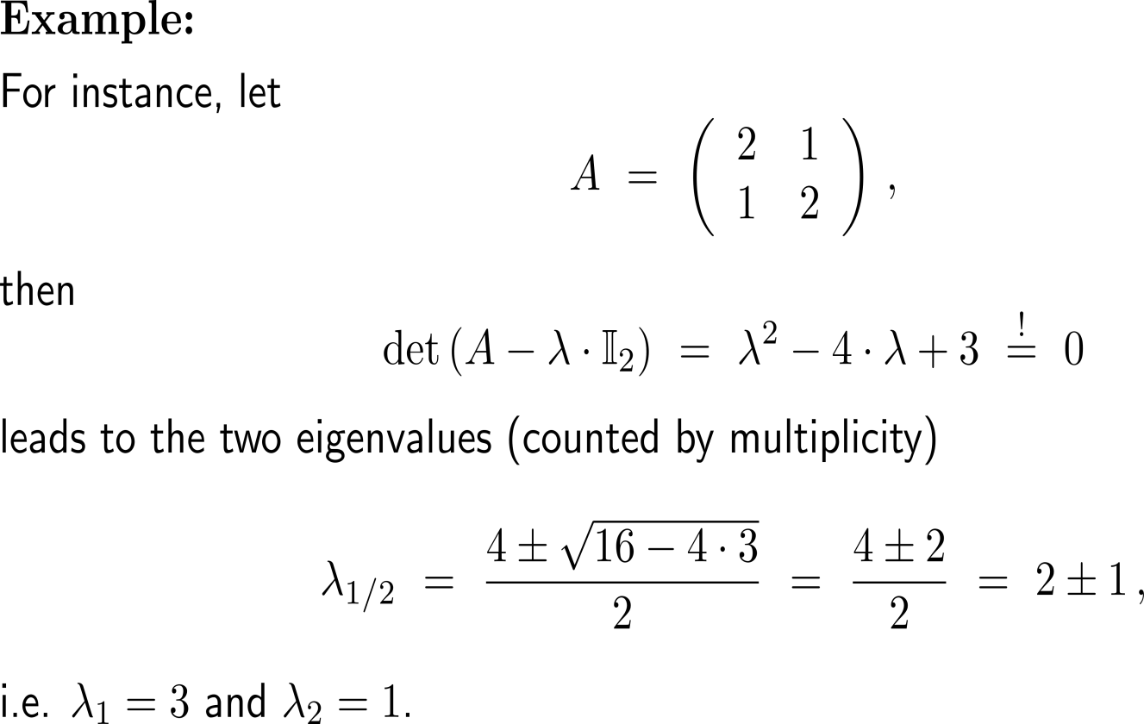
Example: Determining the eigenvalues & eigenvectors of a 2x2-matrix

Slide 9
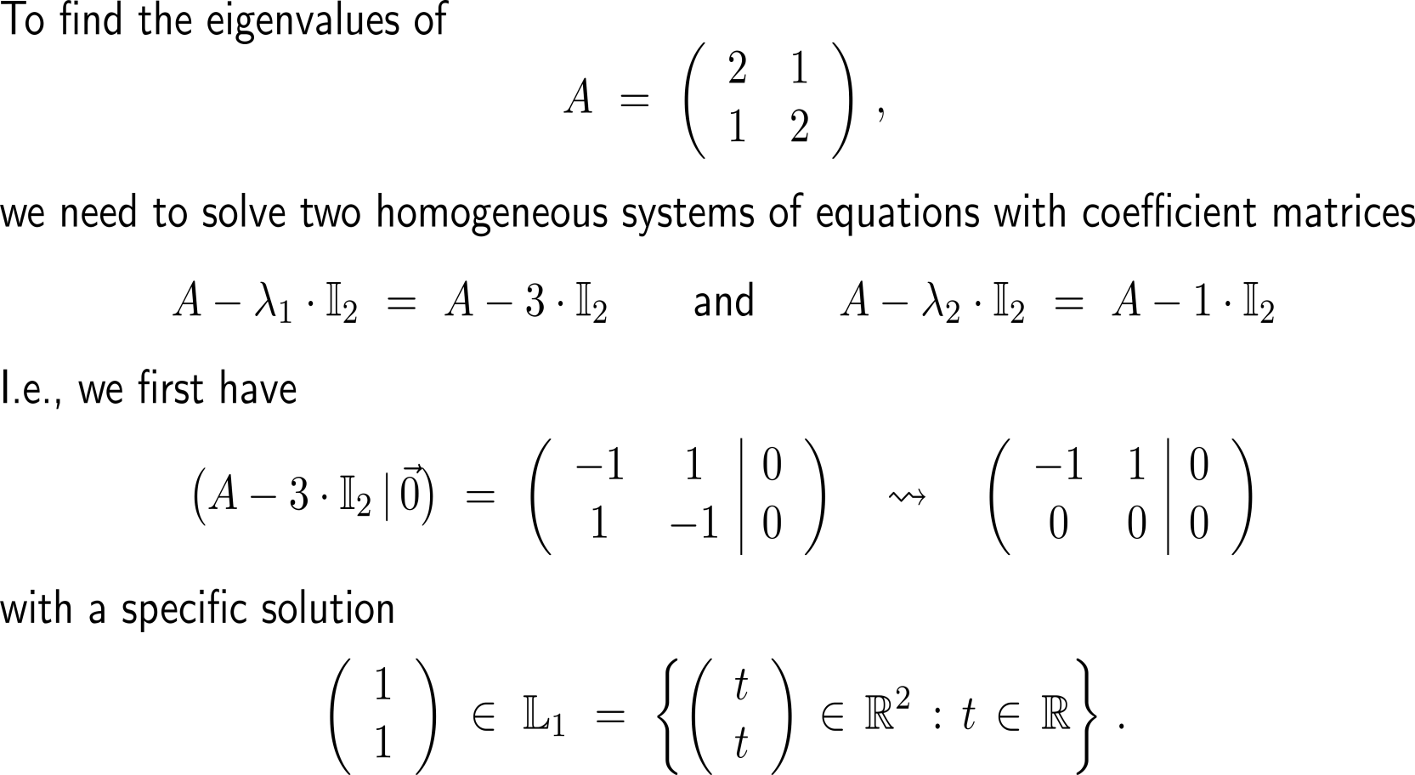
Example: Determining the eigenvalues & eigenvectors of a 2x2-matrix

Slide 10
Example: Determining the eigenvalues & eigenvectors of a 2x2-matrix

Slide 11
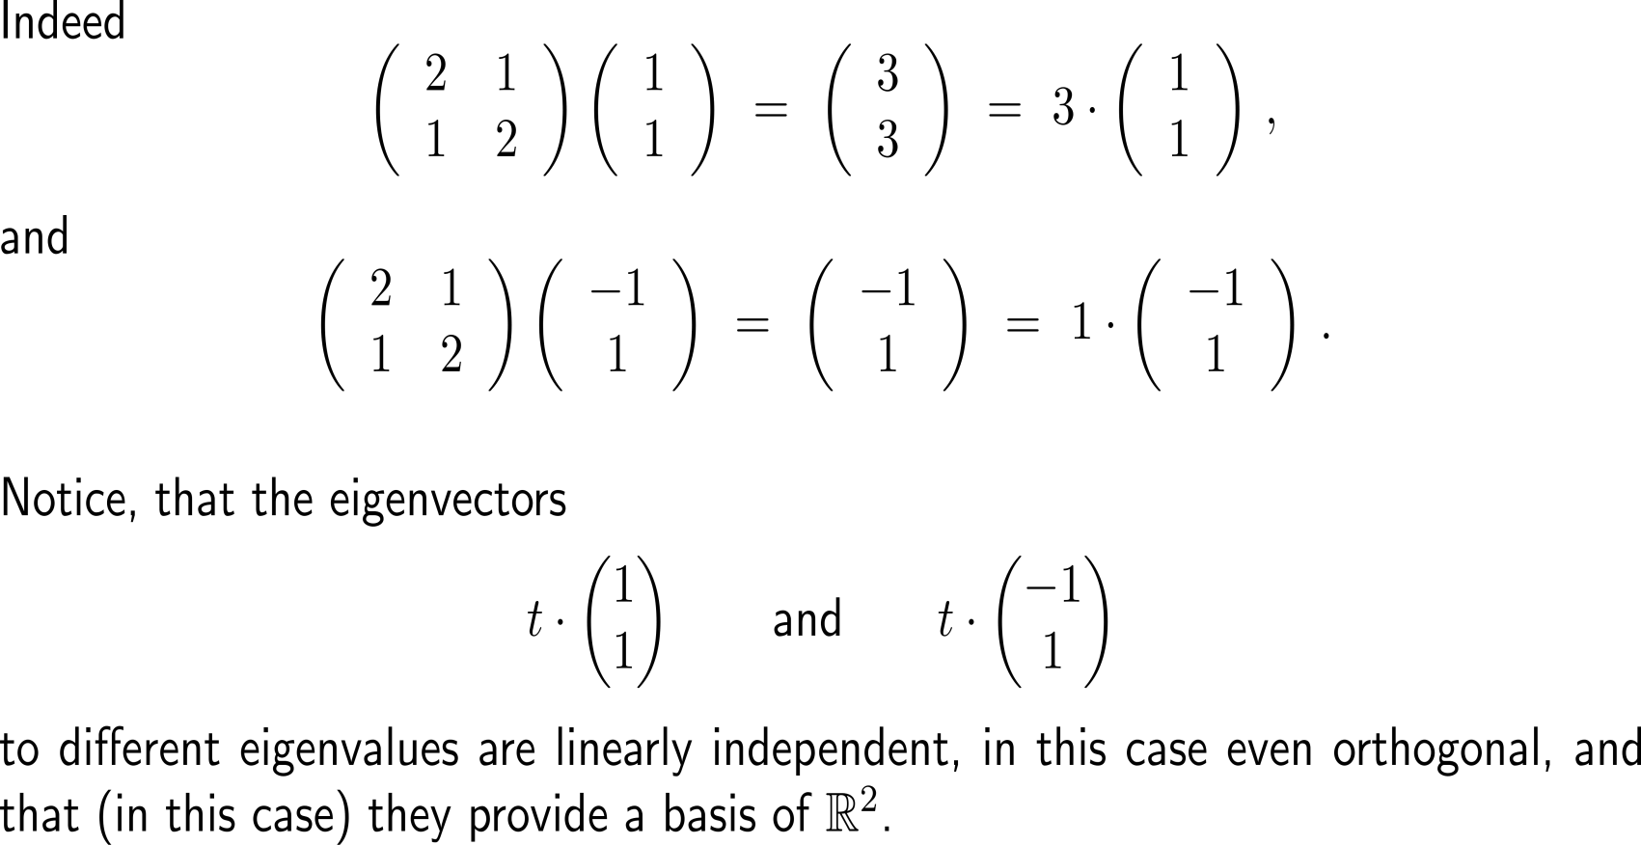
Example: Determining the eigenvalues & eigenvectors of a 2x2-matrix

Slide 12
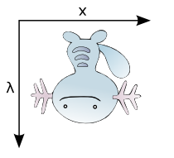
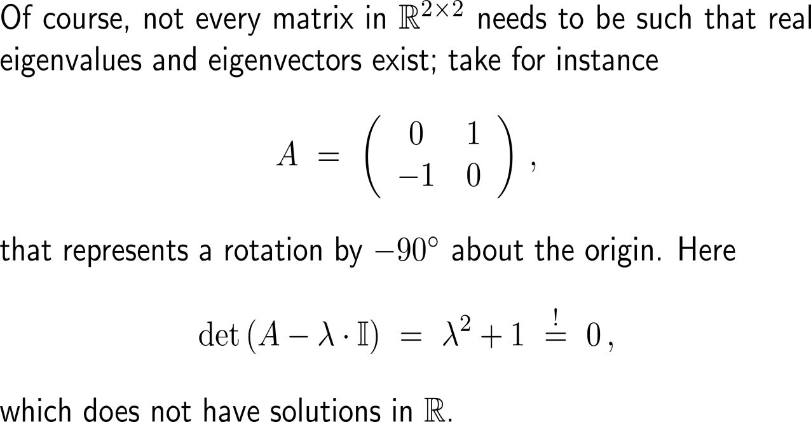
Note, not every matrix needs to have (real) eigenvales and eigenvectors
A

Slide 13
Calculus II for Management

