Slide 1
Calculus II for MGMT – Introduction to Vectors & Matrices Matrix Computations
Mathematics for Management
Supplementary Electronic Materials
Matrix Computations
Matrix-matrix computations
A primer on eigenvalues and eigenvectors
Inverse matrices

Slide 2
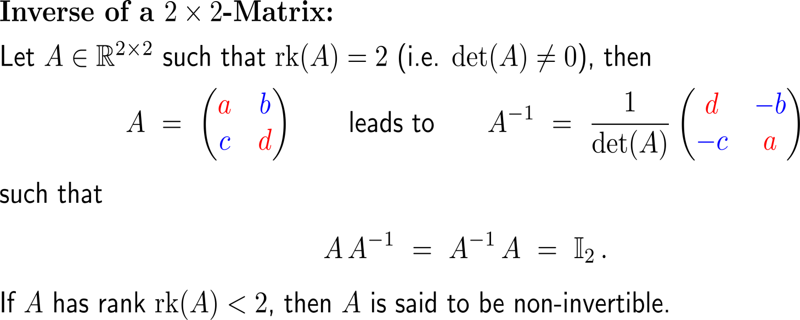
The inverse of a 2x2-matrix is easily obtained by virtue of an rather effortlessly to remember formula

Slide 3
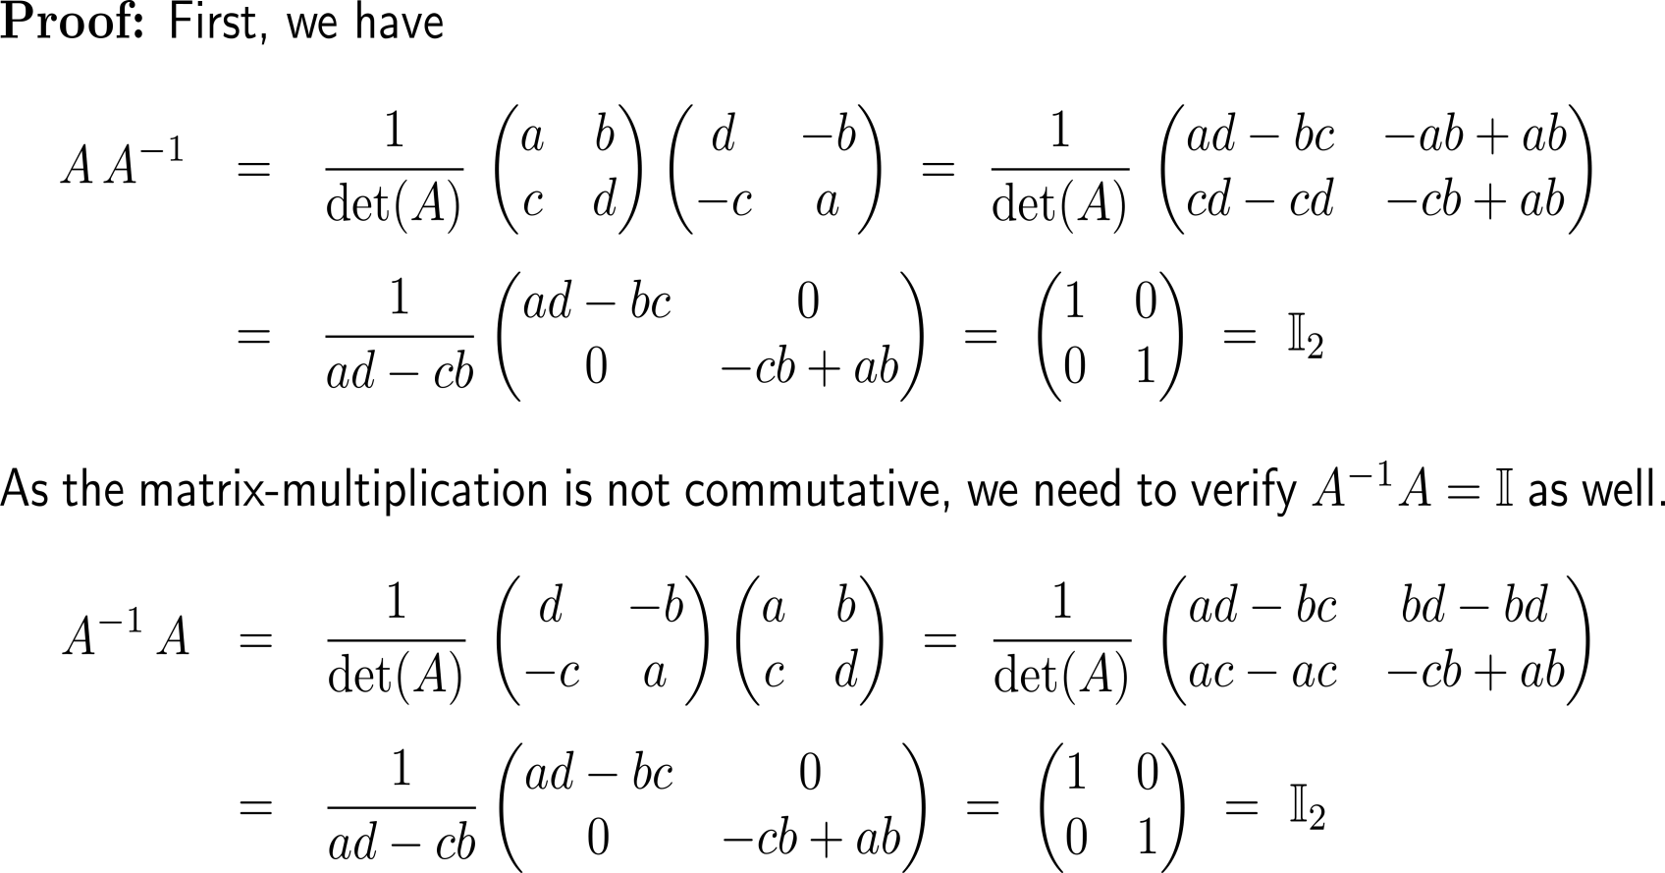
Proof: Formula for the inverse of a 2x2 matrix

Slide 4
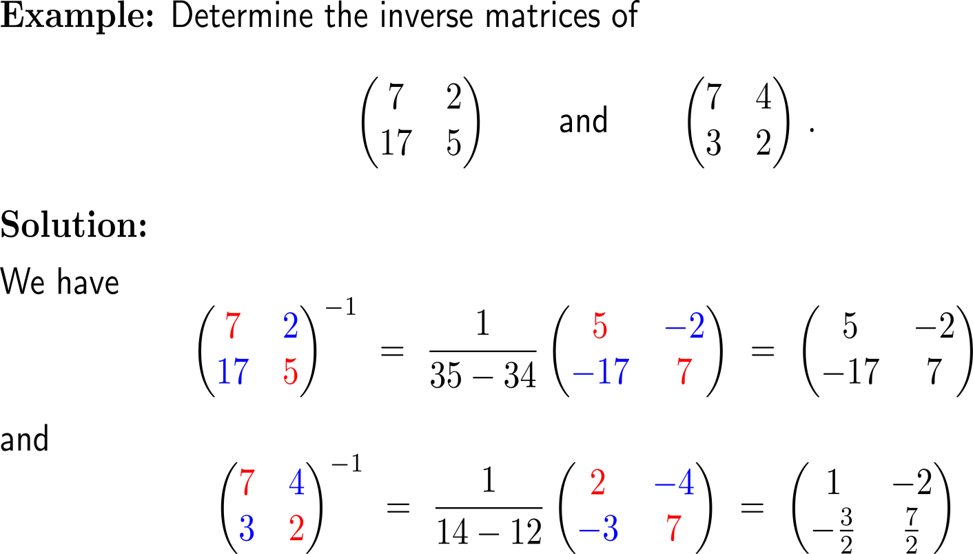
Example: Application of the formula for the inverse of a 2x2-matrix

Slide 5
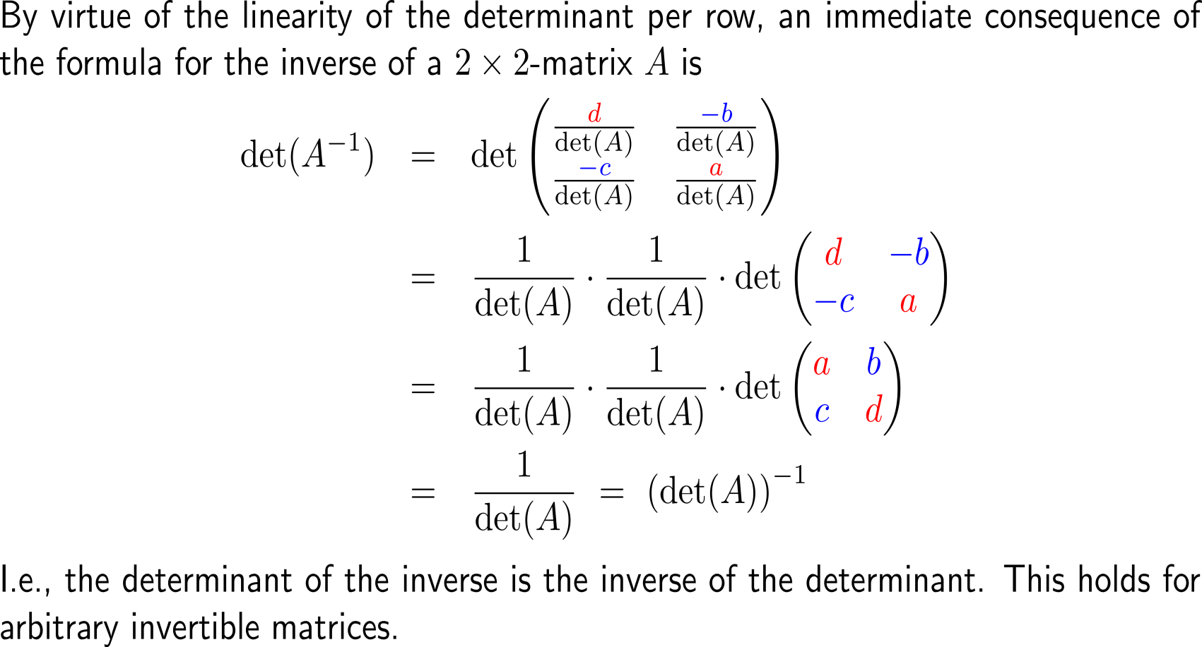
The determinant of the inverse is the inverse of the determinant (1/ 2)

Slide 6
The determinant of the inverse is the inverse of the determinant (2/ 2)

Slide 7
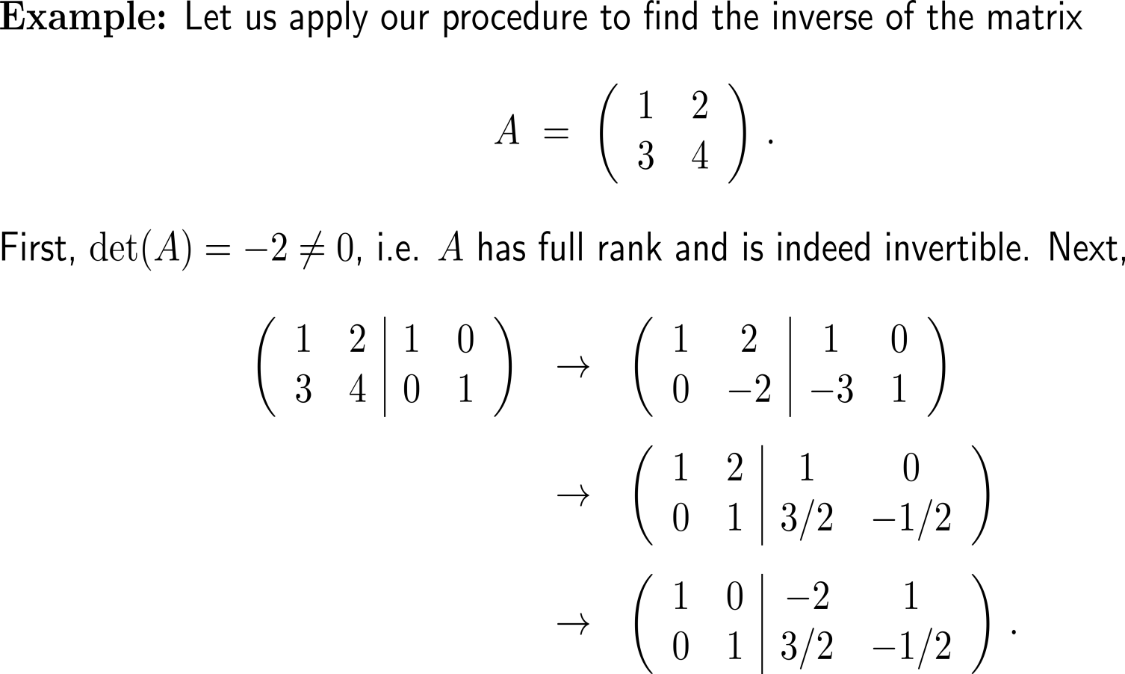
Example: Computation of the inverse of a 2x2 matrix

Slide 8
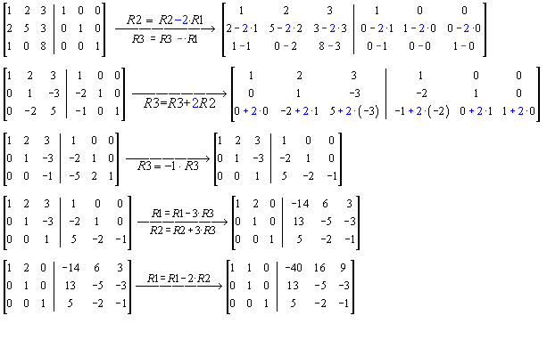
Example: Computation of the inverse of a 3x3 matrix
A
A⁻¹

Slide 9
Calculus II for Management

