Slide 1
Calculus II for Management
Determinants II & Linear Combinations of Vectors
week 3
Lecture 3
General properties & computation rules
Vectors & their linear combinations

Slide 2
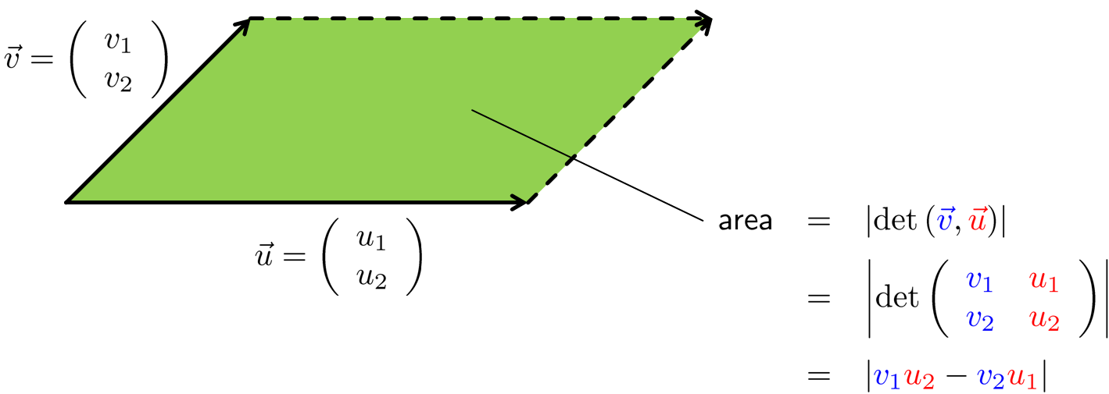
Recap: The determinant function in 2D

Slide 3
Recap: The determinant function in 3D

Slide 4
Only, in 2D and 3D can the determinate be computed by utilizing a diagonal crossing scheme

Slide 5
Topics
Determinants: General Properties & Computation Rules
Vectors & Their Linear Combinations

Slide 6
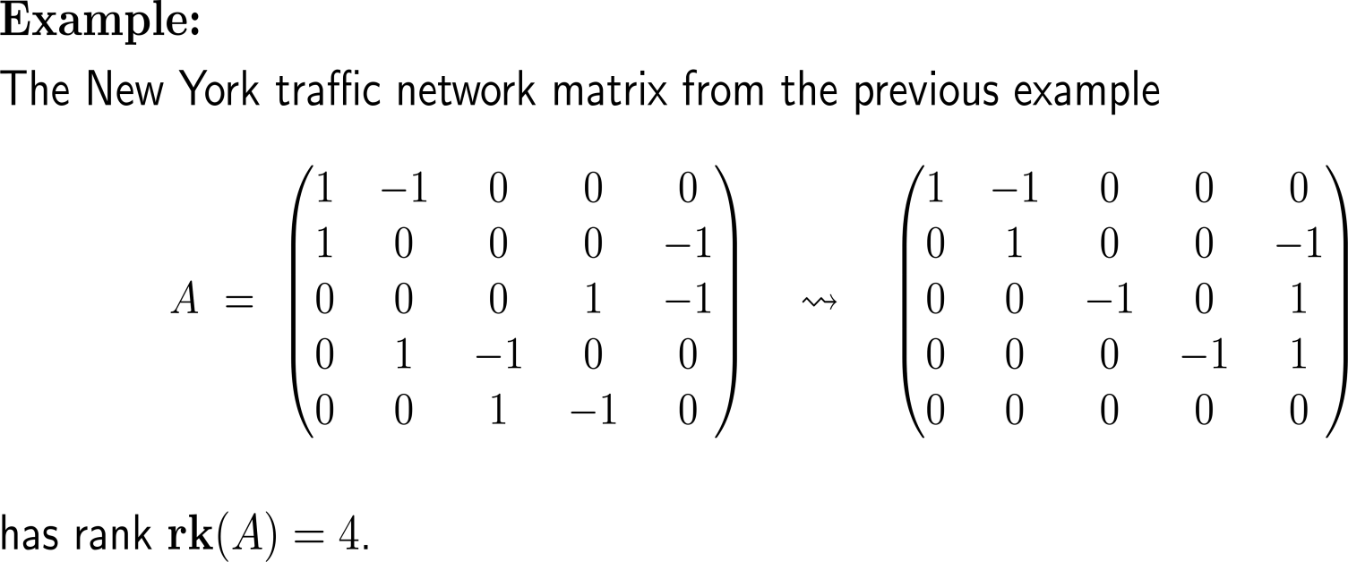
In the last lecture, we already defined the rank of a matrix by means of the number of pivot elements that remain after Gaussian elimination

Slide 7
To establish the general definition of the determinant function we require the notion of linearity

Slide 8
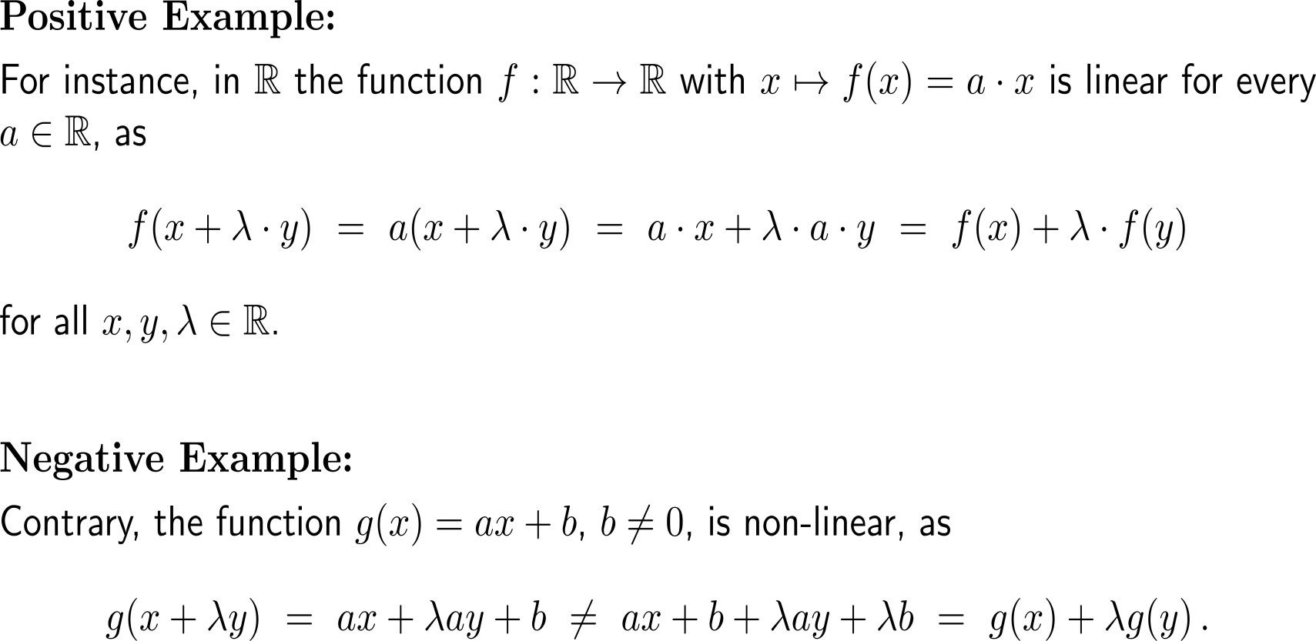
Example: Linear functions

Slide 9
Example: Linear functions

Slide 10
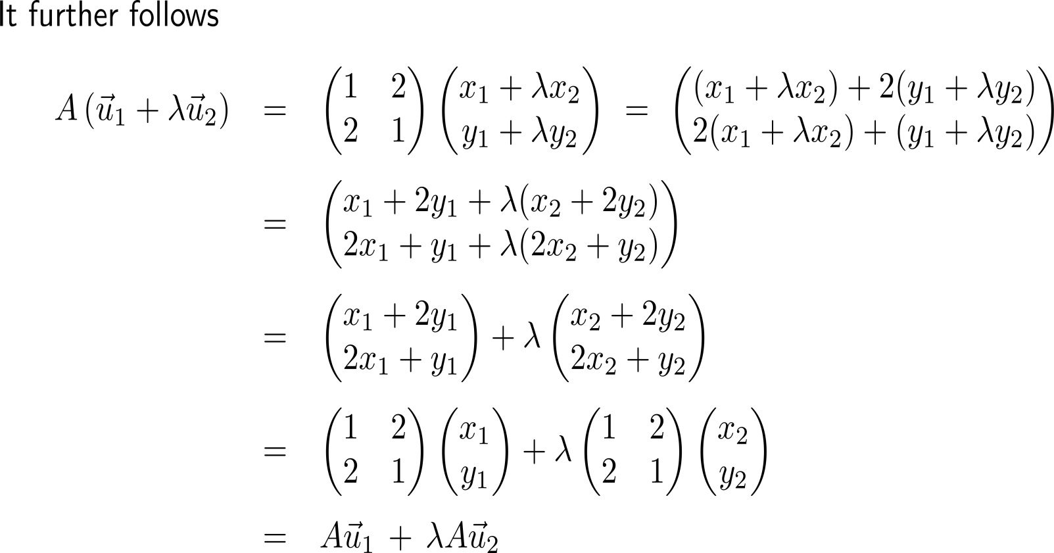
Example: Linear functions

Slide 11
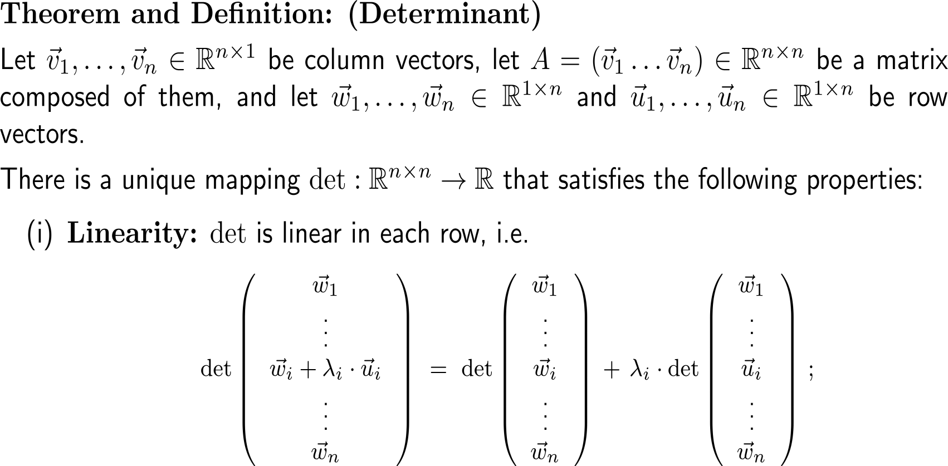
The determinant is a multi-linear form that maps the unit matrix to one and not-full rank matrices to zero (1/ 2)

Slide 12
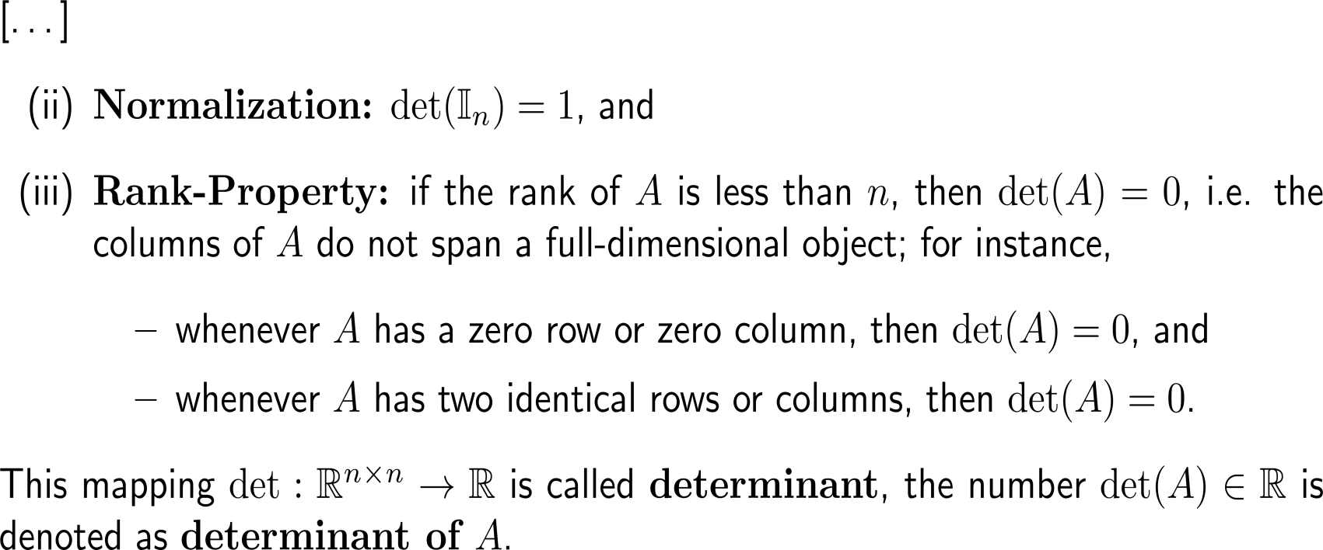
The determinant is a multi-linear form that maps the unit matrix to one and not-full rank matrices to zero (2/ 2)

Slide 13
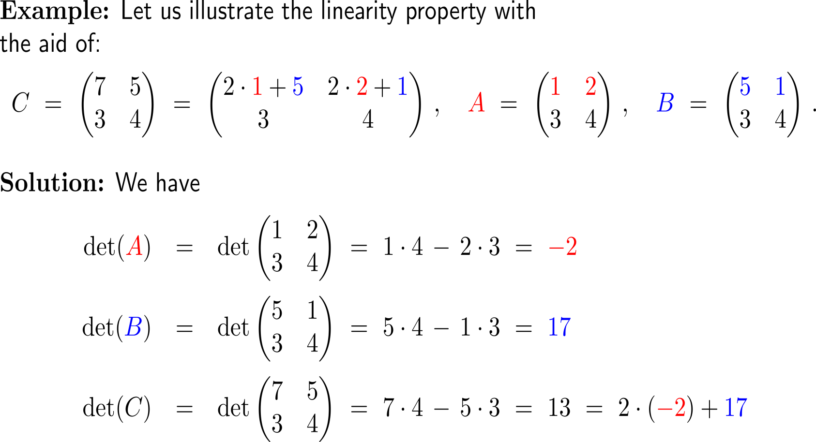
Example: Properties of the determinant

Slide 14
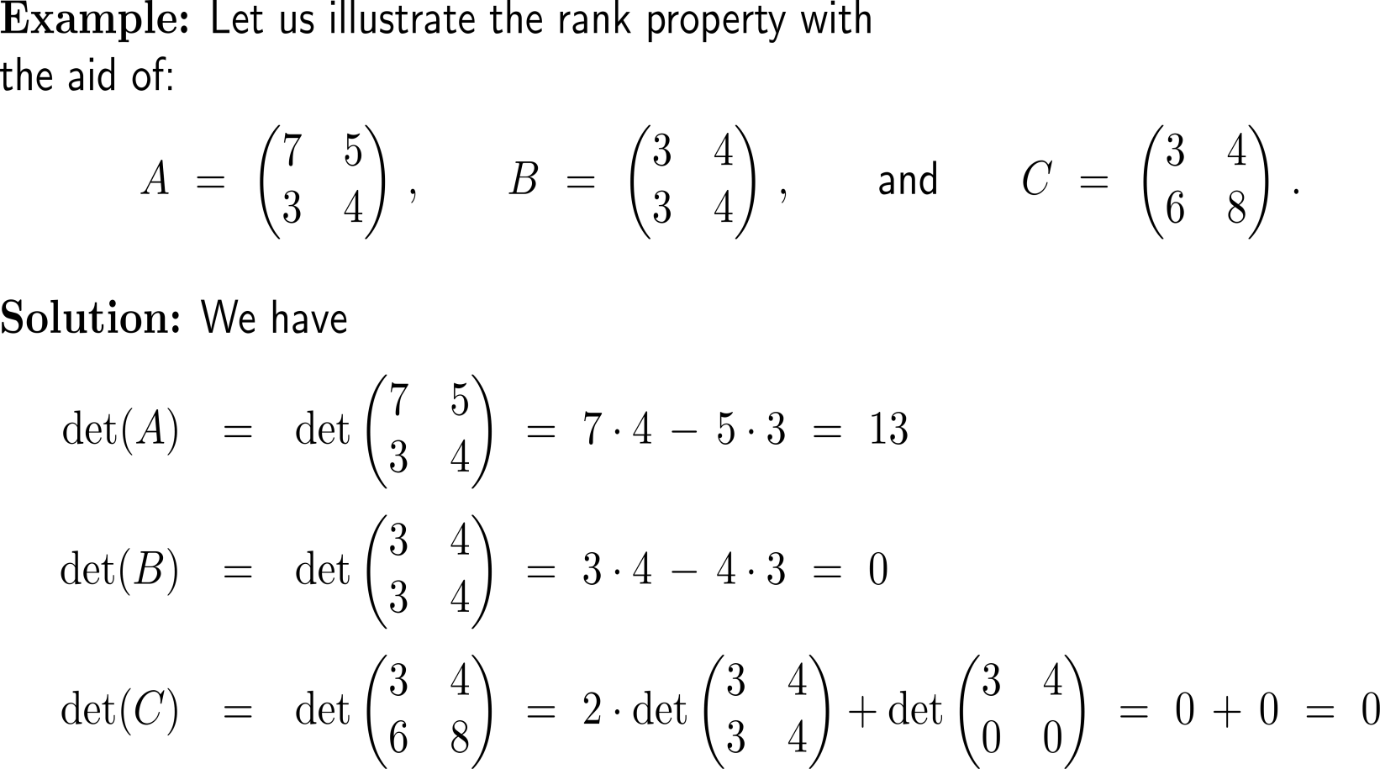
Example: The value of a determinant in 2D

Slide 15
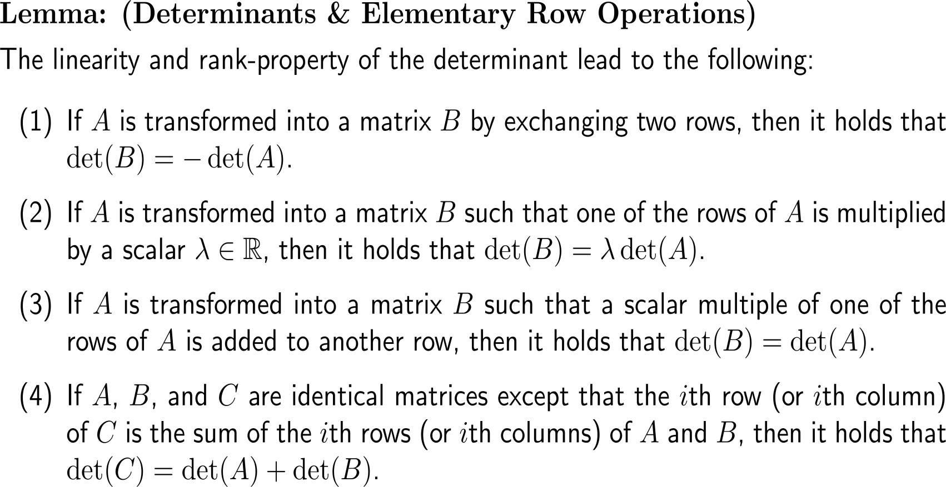
The lemma sheds light on the behavior of determinants on elementary row operations and thus on possibilities to compute the determinant

Slide 16
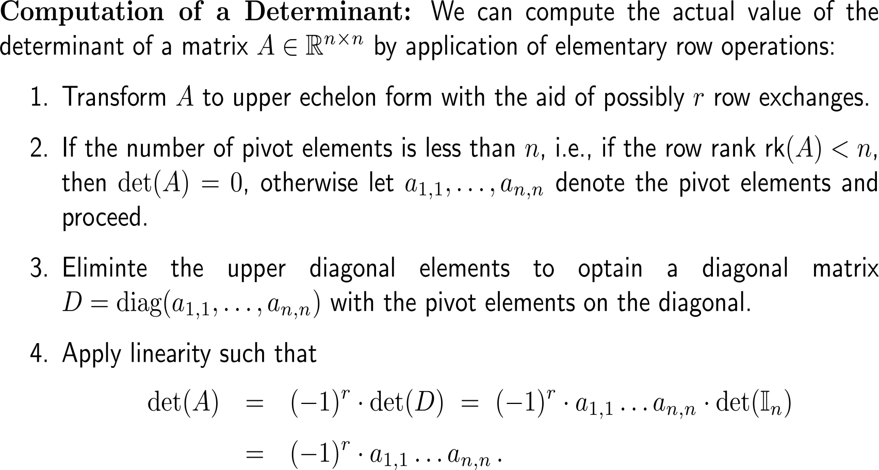
The computation of a determinant boils down to a careful application of Gaussian elimination

Slide 17
Example: Computation of a determinant
| (III) +2 (I)

Slide 18
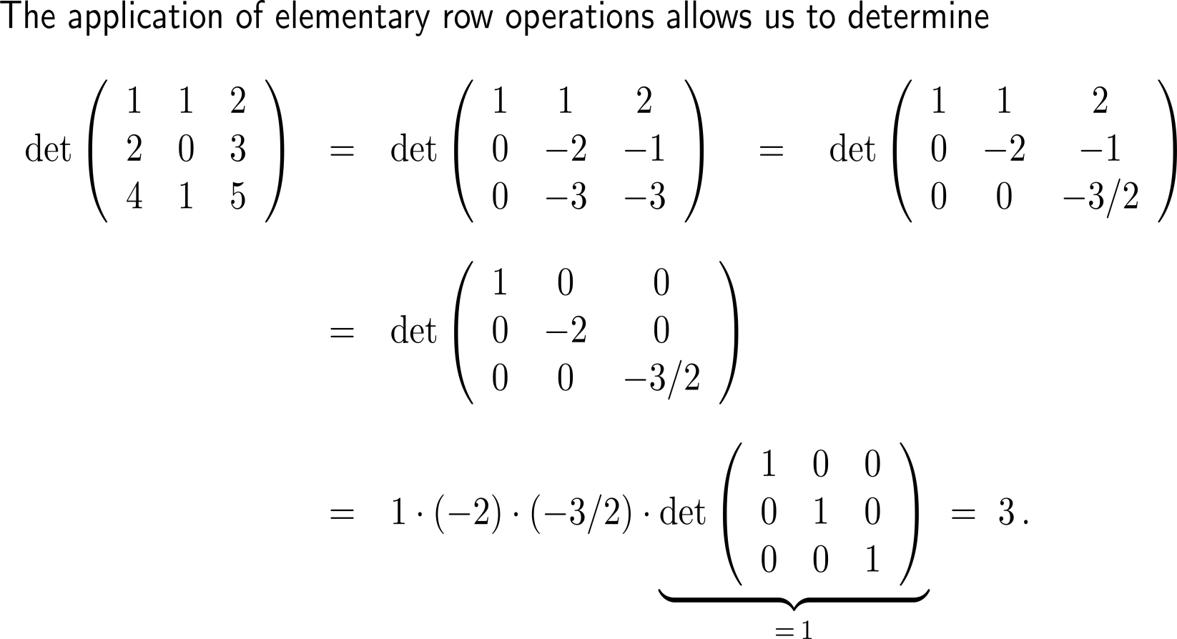
Example: Computation of a determinant
| (II) –2 (I)
| (III) – ³/₂ (II)
| (III) – 4 (I)
| further elementary
row operations
Of course, we get the same result when applying the rule of Sarrus.

Slide 19
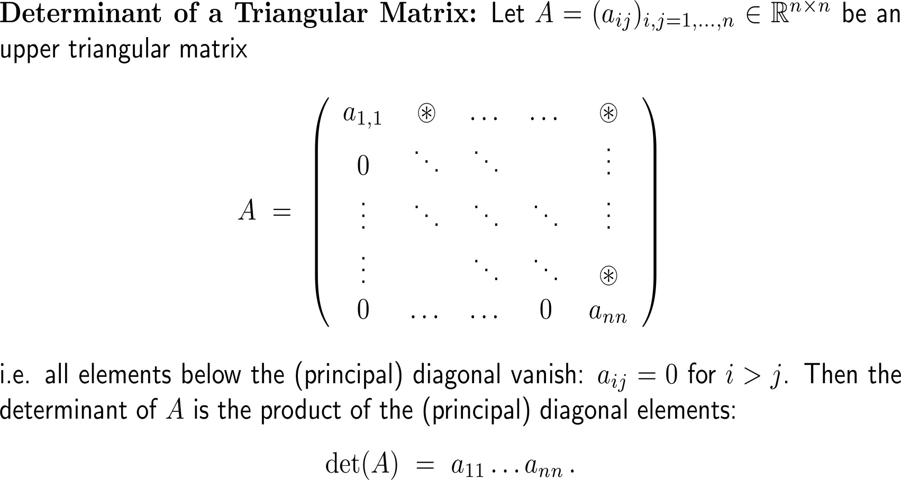
The determinant of a triangular matrix is the product of the diagonal elements

Slide 20
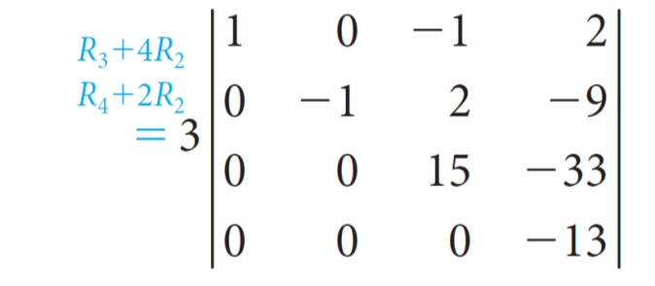
Example: Computation of a determinant
= 3 · 1 · (−1) · 15 · (−13) = 585

Slide 21
Finally, let us study the properties of a matrix whose rows and columns are interchanged: the transposed matrix

Slide 22
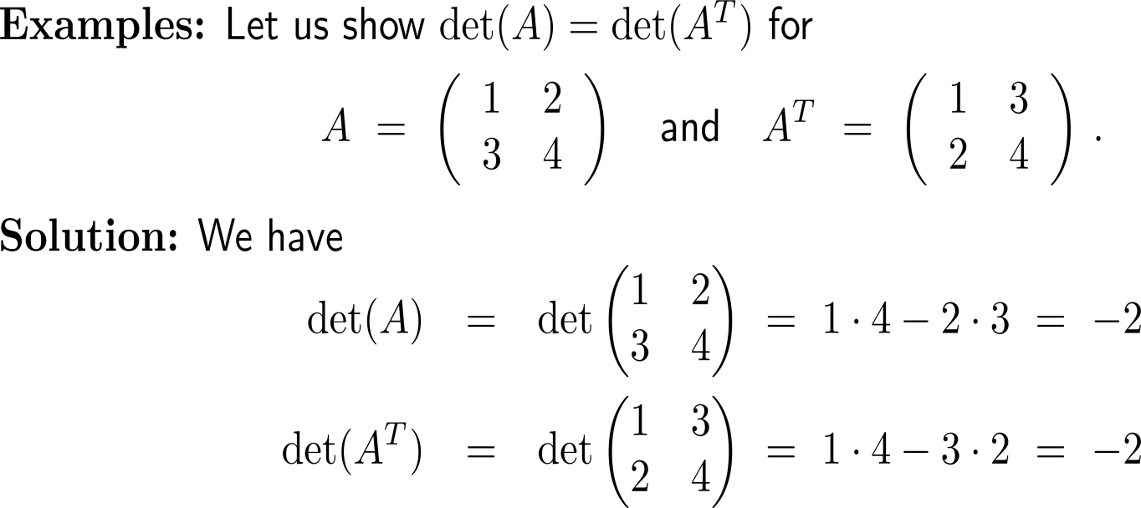
In particular, transposition of a matrix does not change the value of the determinant (1/ 2)

Slide 23
In particular, transposition of a matrix does not change the value of the determinant (2/ 2)

Slide 24
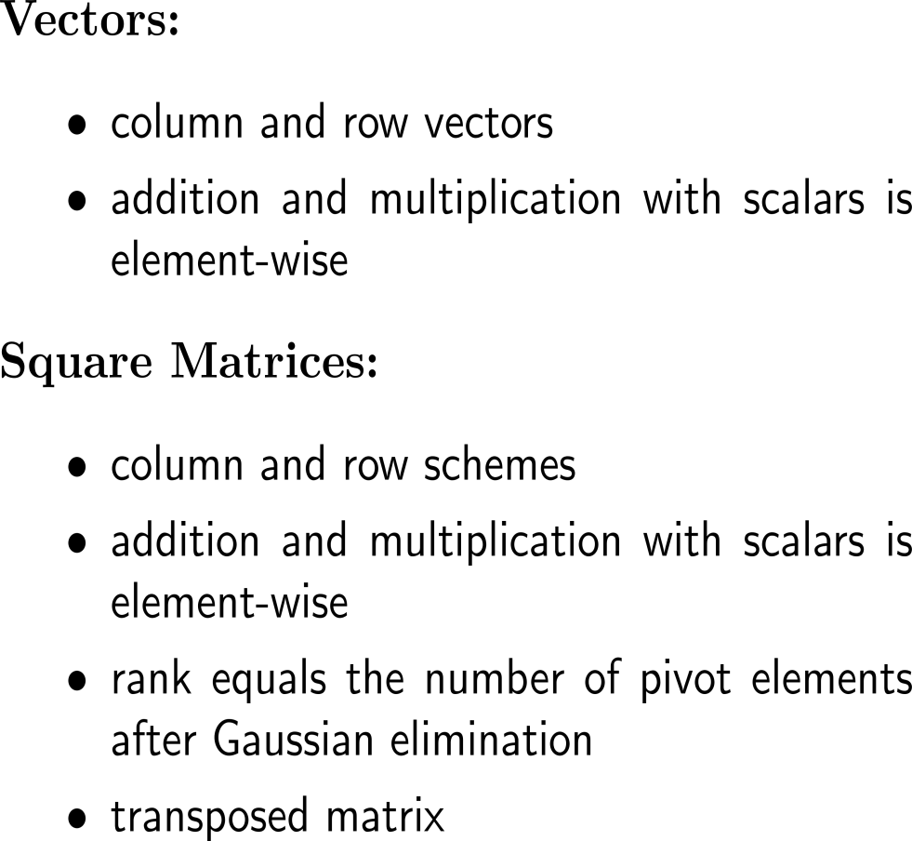
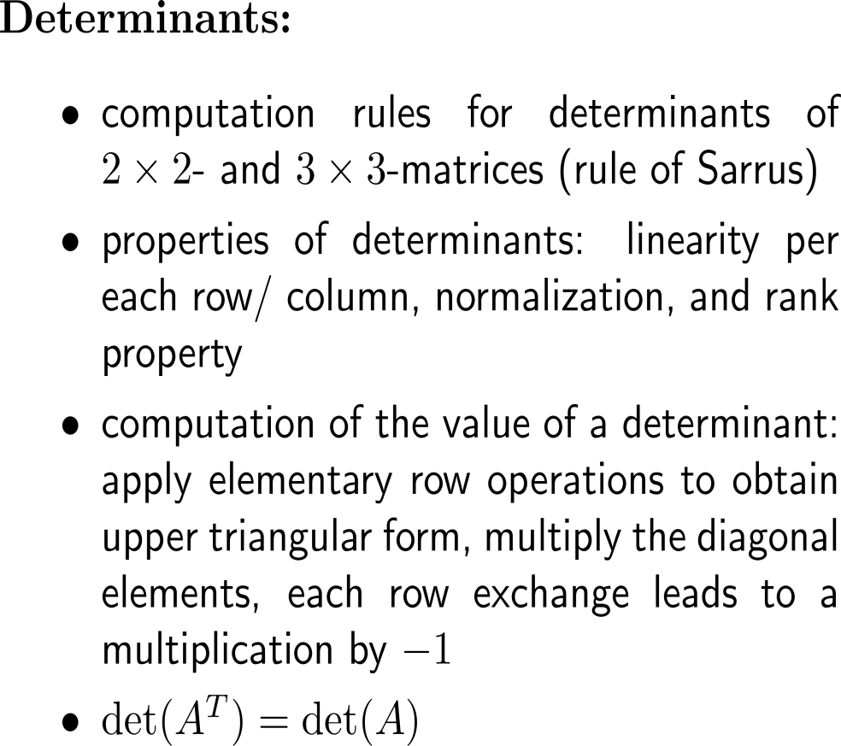
Summary

Slide 25
Topics
Determinants: General Properties & Computation Rules
Vectors & Their Linear Combinations

Slide 26
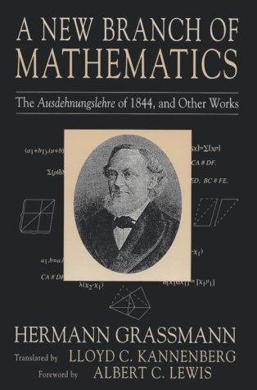
The structure of space

Slide 27
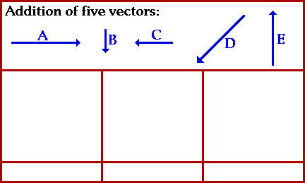
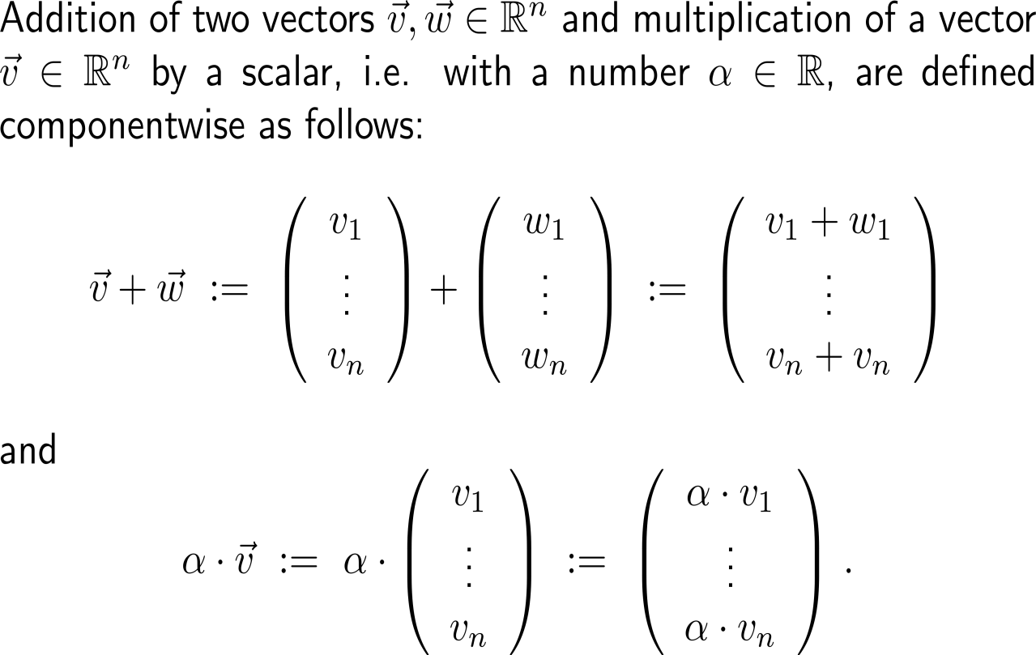
Let us summarize our knowledge on vectors by generalizing the concepts of addition of two vectors and multiplication of a vector with a scalar (1/ 3) …

Slide 28
Let us summarize our knowledge on vectors by generalizing the concepts of addition of two vectors and multiplication of a vector with a scalar (2/ 3) …

Slide 29
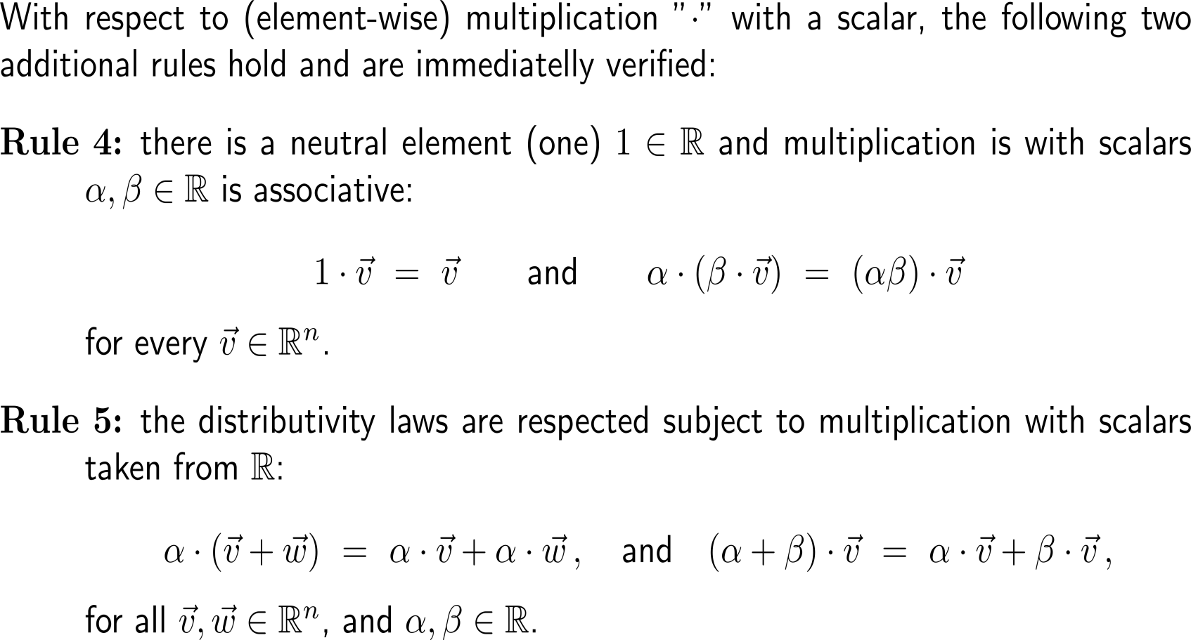
Let us summarize our knowledge on vectors by generalizing the concepts of addition of two vectors and multiplication of a vector with a scalar (3/ 3) …

Slide 30
… such that we obtain the notion of a “vector space”

Slide 31
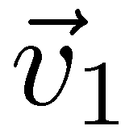
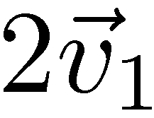
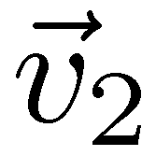
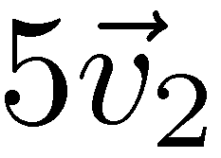
The notions of linear combination, …

Slide 32
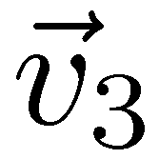
… linear hull/ span, …

Slide 33
… and linear independence/ dependence belong to the most fruitful insights into the structure of vector spaces
linearly dependent
linearly independent

Slide 34
For instance, a set of vectors is linearly independent if and only if none of these vectors is a linear combination of the other ones

Slide 35
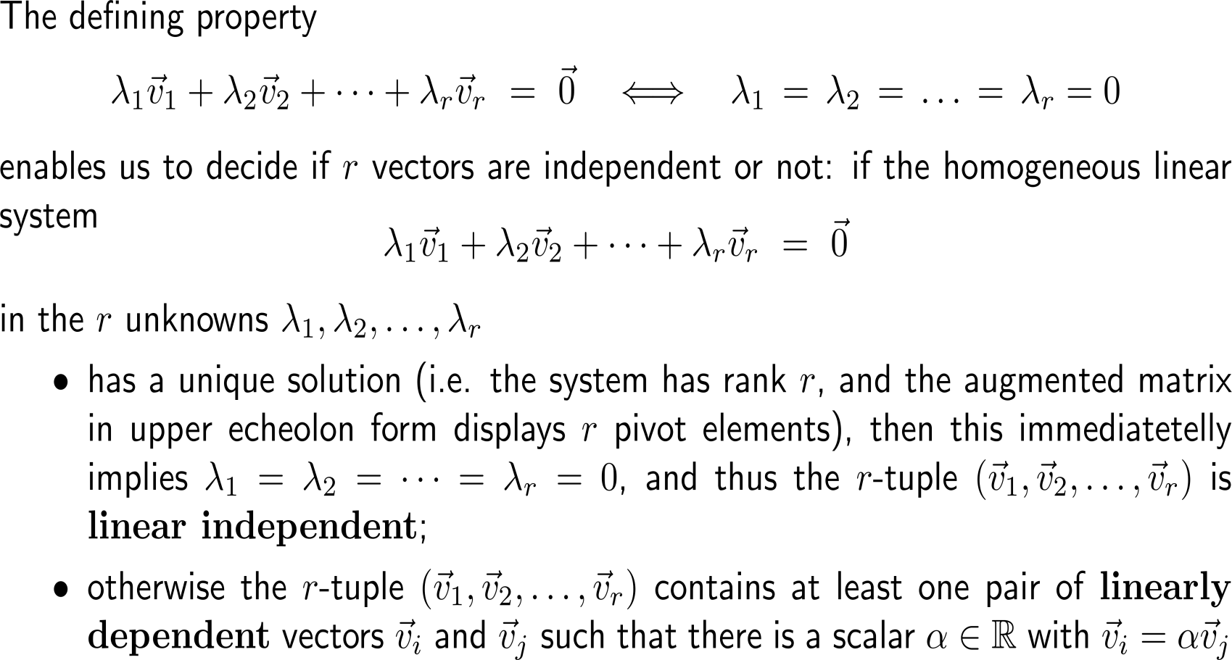
The method to decide upon linear independence/ dependence is to solve a linear system of equations

Slide 36
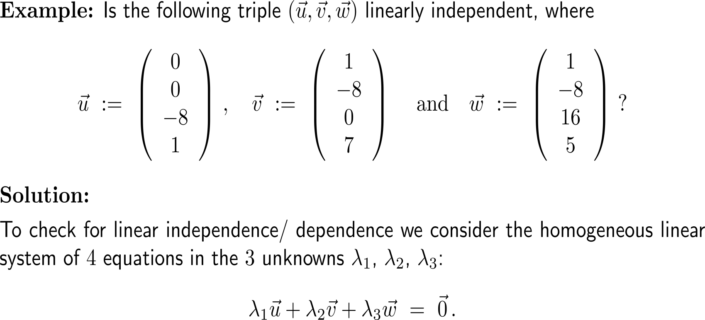
Example: Independence/ dependence of 3 vectors in 4D

Slide 37
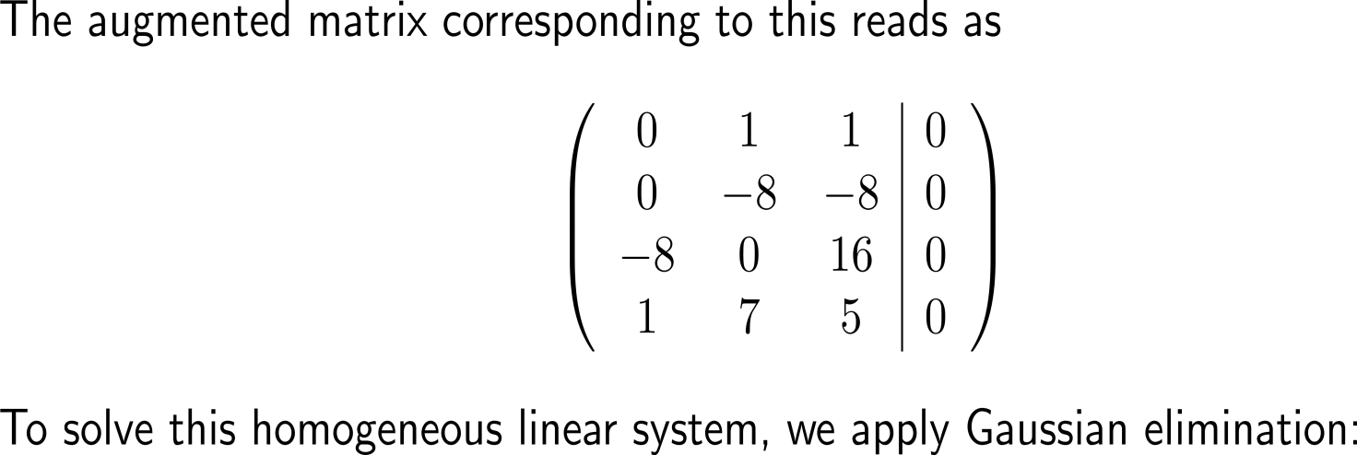
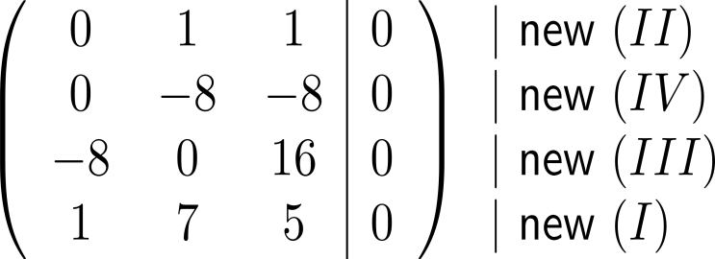
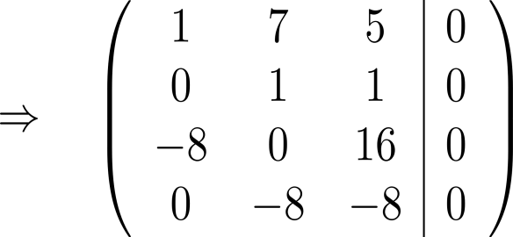
Example: Independence of 3 vectors in 4D

Slide 38
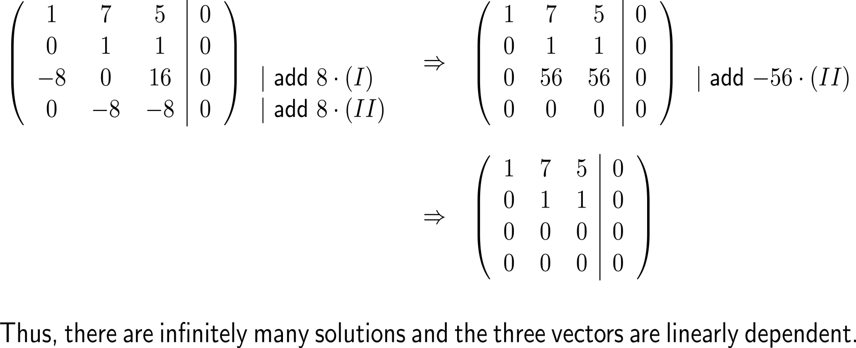
Example: Independence of 3 vectors in 4D

Slide 39
Remark: The determinant can serve as an easy test for linear independence/ dependence
linearly dependent
linearly independent
0

Slide 40
A basis of a vector space is a collection of linearly independent vectors that span the whole space

Slide 41
Example: The canonical basis
e₂ = (0, 1)^{T}
e₃ = (0, 0, 1)^{T}
0
e₁ = (1, 0, 0)^{T}
0
e₁ = 1
0
e₁ = (1, 0)^{T}
e₂ = (0, 1, 0)^{T}

Slide 42
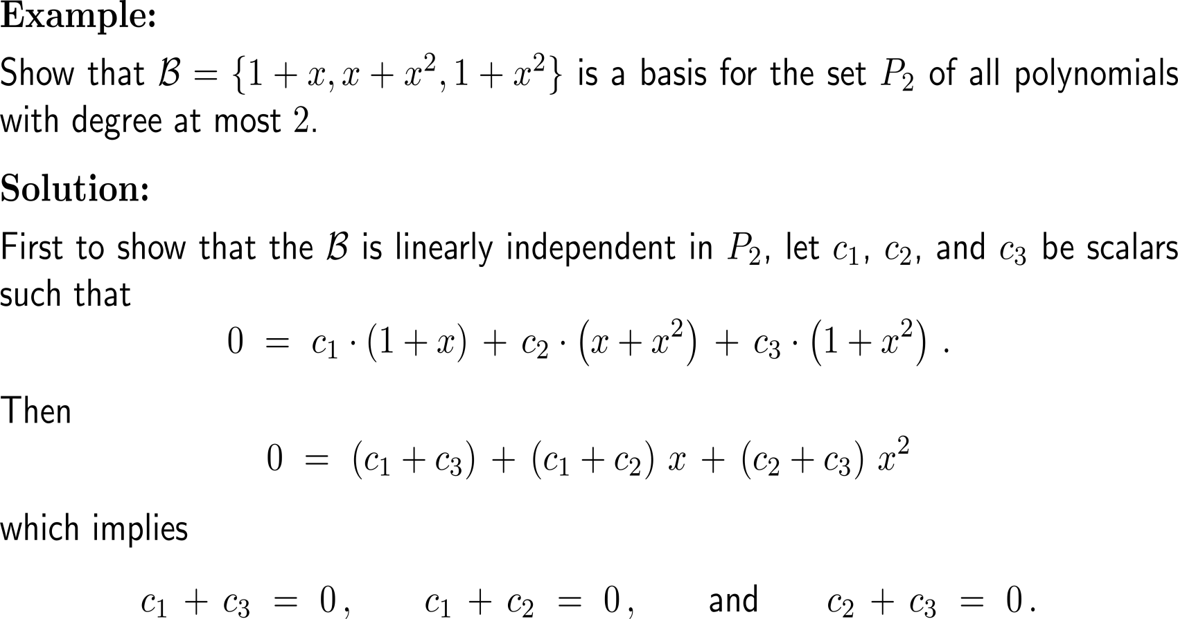
Example: A basis for the space P₂ of polynomials of degree of at most 2

Slide 43
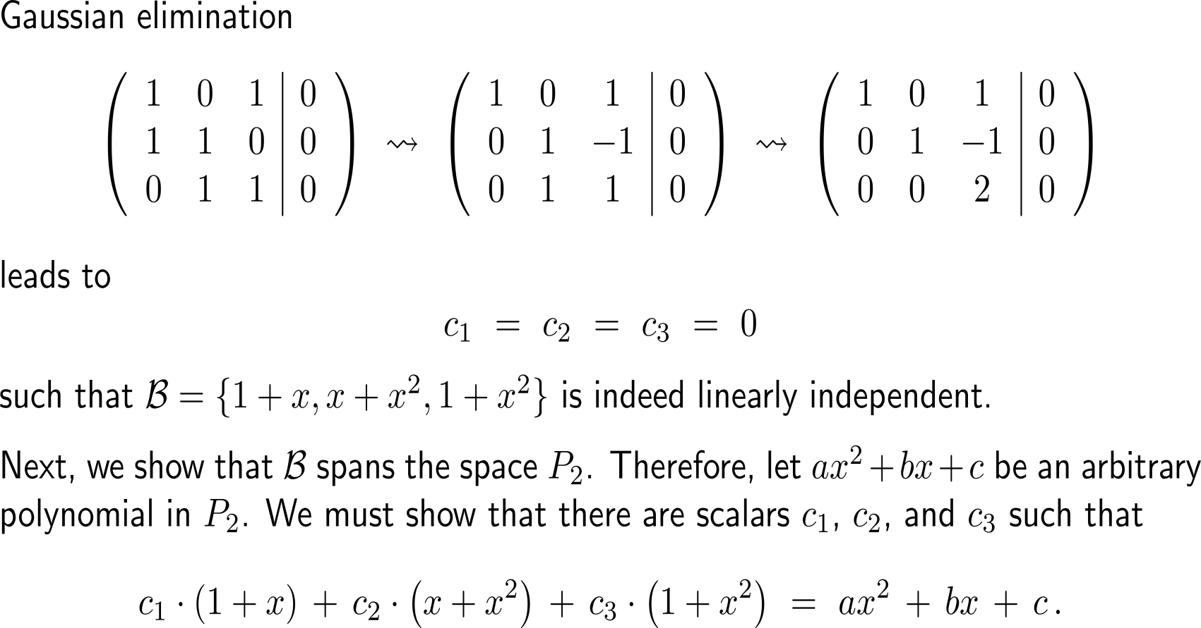
Example: A basis for the space P₂ of polynomials of degree of at most 2

Slide 44
Example: A basis for the space P₂ of polynomials of degree of at most 2

Slide 45
All basis sets of a vector space have the same lengths. This allows us to assign a dimension to each vector space

Slide 46
Further Worked-Out Exercises:
Calculus II for Management
Topics
Properties of determinants
Vectors & their linear combinations

Slide 47
Exercise

Slide 48
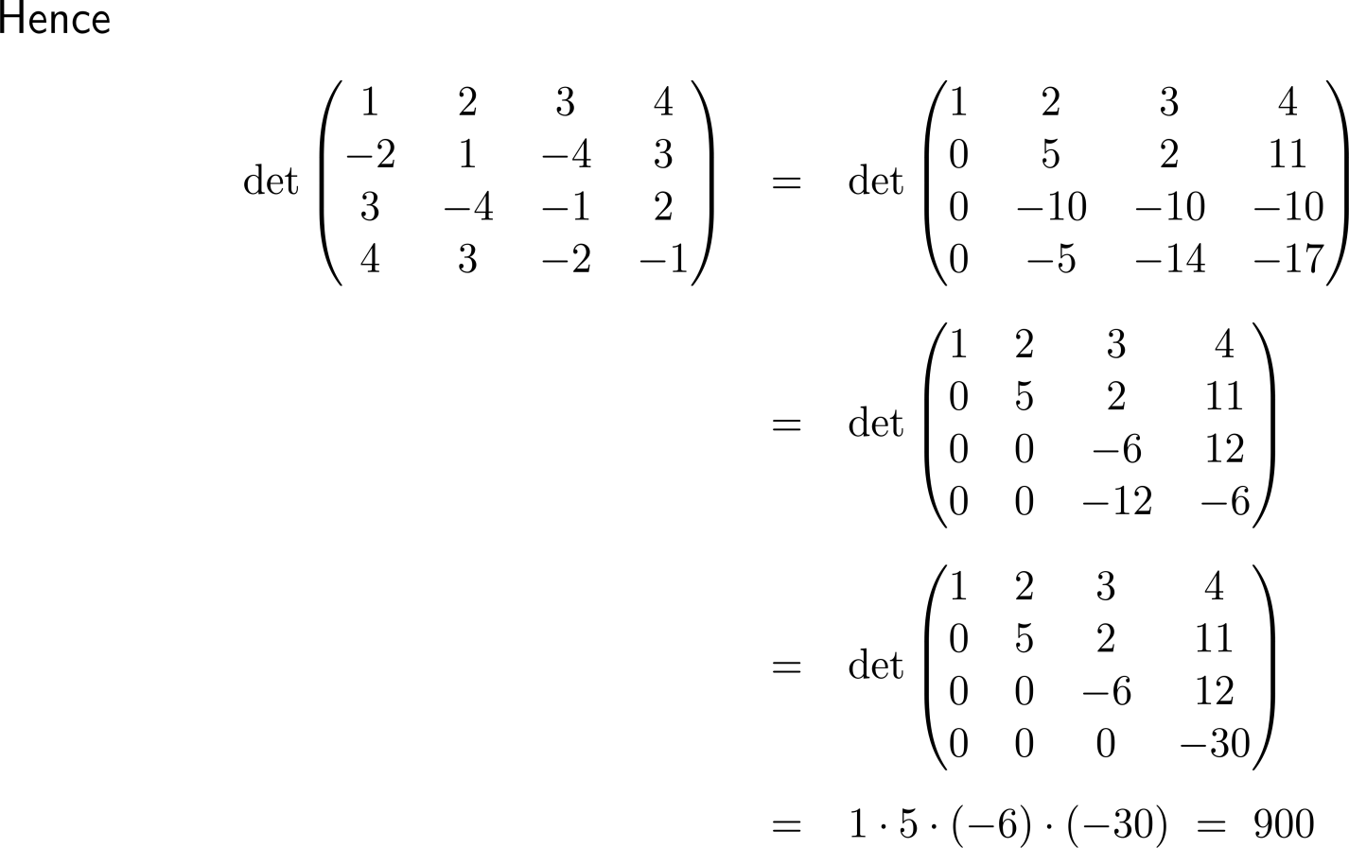
Exercise
(II) + 2 (I)
(III) – 3 (I)
(IV) – 4 (I)
(III) + 2 (II)
(IV) – (II)
(IV) – 2 (III)

Slide 49
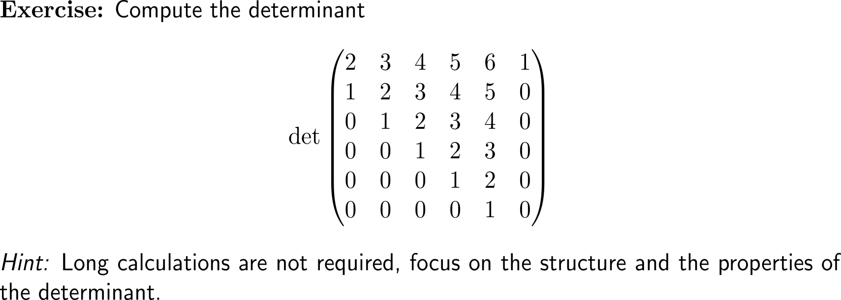
Exercise

Slide 50
Exercise

Slide 51
Exercise

Slide 52
Exercise

Slide 53
Exercise
swap rows
(II) – 2x (I), (III) – 2x (I), (IV) – (I)
(II)/2, and (III)/(-1)
(IV) + (II) – (III)

Slide 54
Exercise

Slide 55
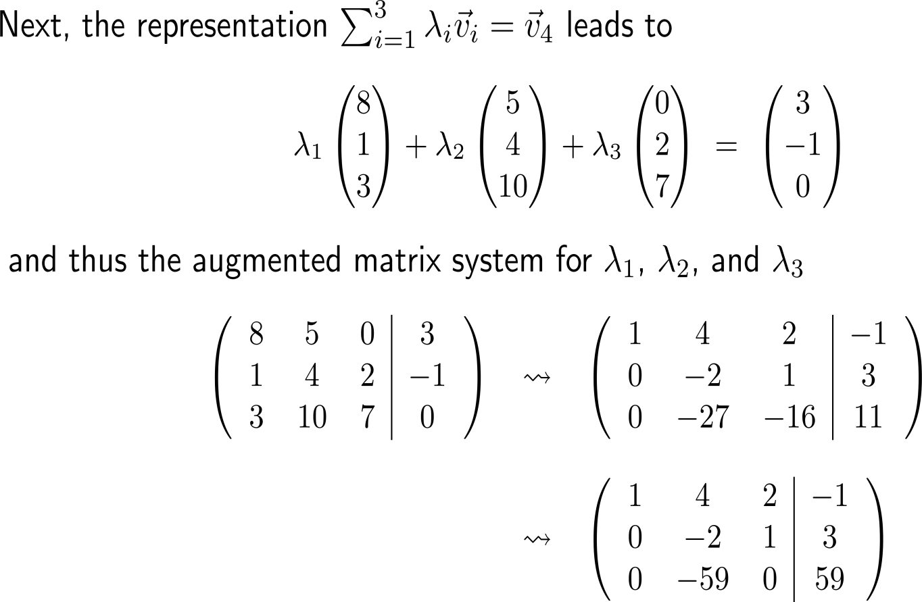
Exercise
(III) + 16x (II)
reorder rows (II), (III) and (I)
then
(II^{new}) – 3x (I^{new})
(III^{new}) – 8x (I^{new})

Slide 56
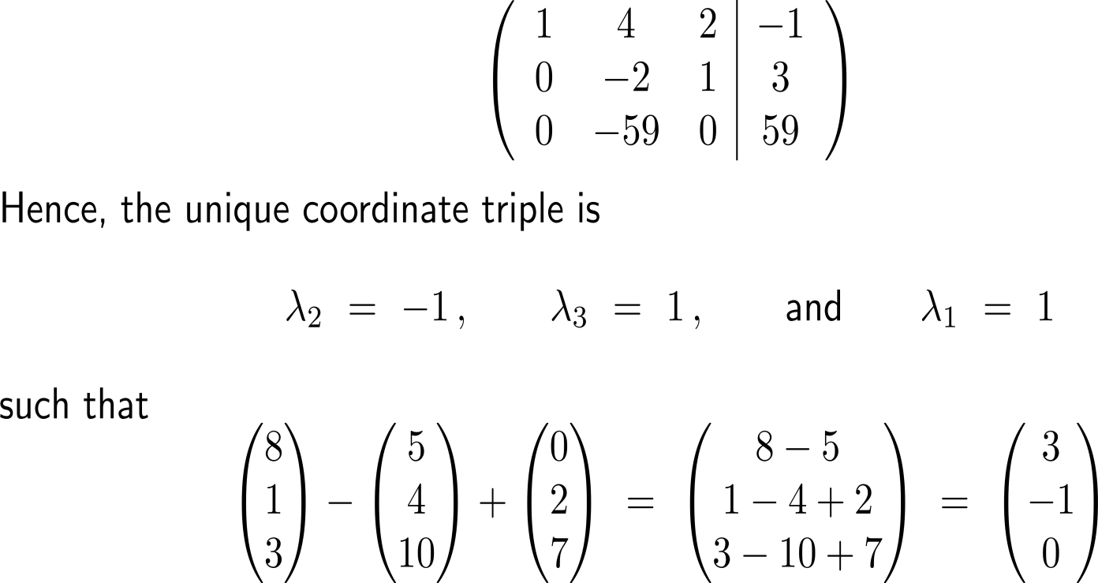
Exercise

Slide 57
Calculus II for Management

