Slide 1
Calculus II for Management
Vector & Matrix Computations
week 4
Lecture 4
Scalar-product, vector-product & spat-product
Matrix-matrix multiplication

Slide 2
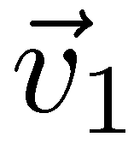
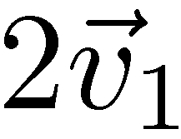
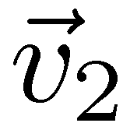
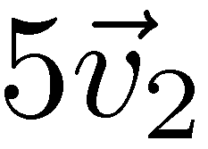
The notions of linear combination, …

Slide 3
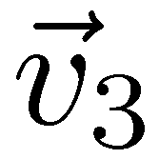
… linear hull/ span, …

Slide 4
… and linear independence/ dependence belong to the most fruitful insights into the structure of vector spaces
linearly dependent
linearly independent

Slide 5
For instance, a set of vectors is linearly independent if and only if none of these vectors is a linear combination of the other ones

Slide 6
A basis of a vector space is a collection of linearly independent vectors that span the whole space

Slide 7
All basis sets of a vector space have the same lengths. This allows us to assign a dimension to each vector space

Slide 8
Topics
Scalar-Product, Vector-Product & Spat-Product
Matrix-Matrix Multiplication

Slide 9
The (standard) scalar product is the same as a row-column vector multiplication

Slide 10
The norm of a vector is the square root of the scalar product of the vector with itself

Slide 11
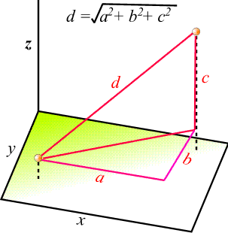
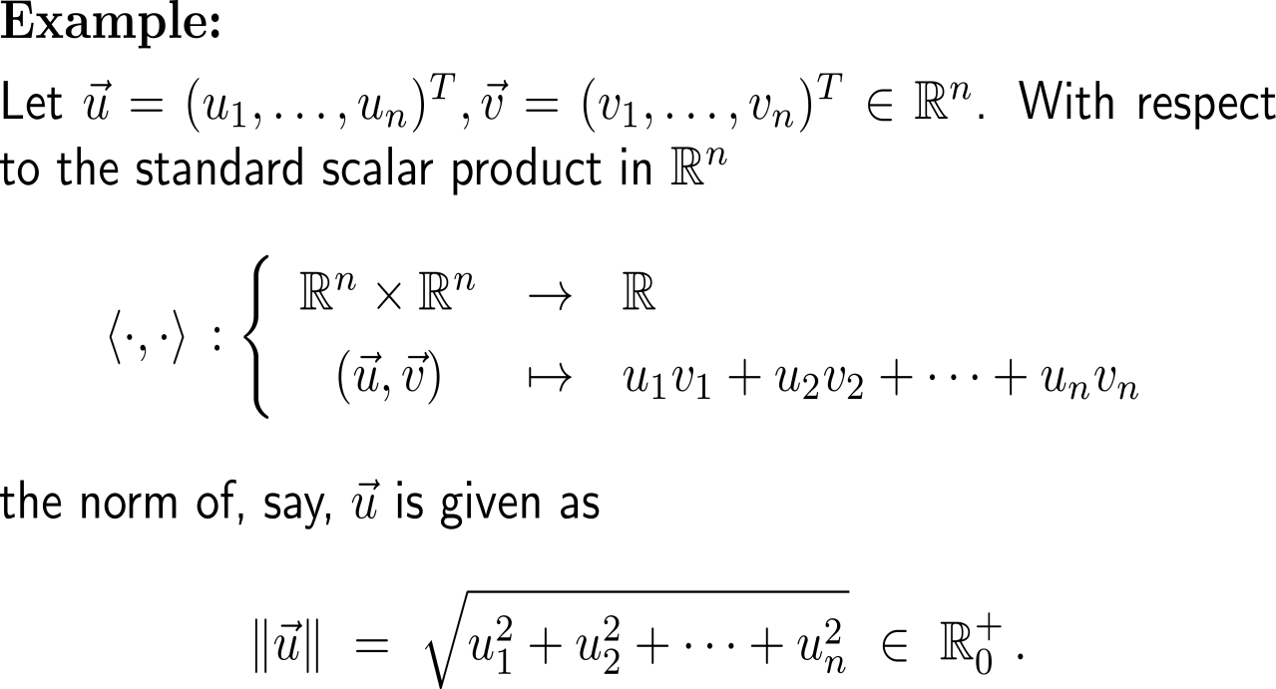
Example: Euclidean norm with respect to the scalar product

Slide 12
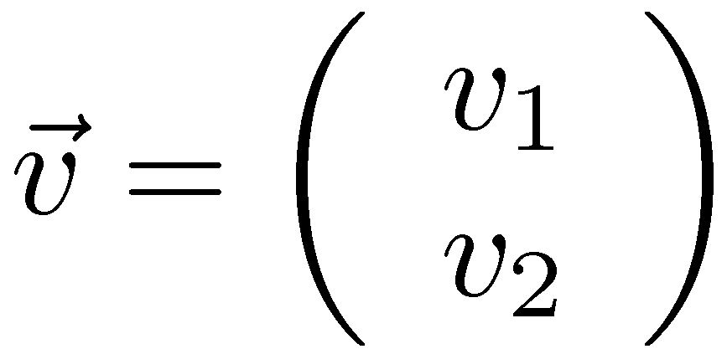
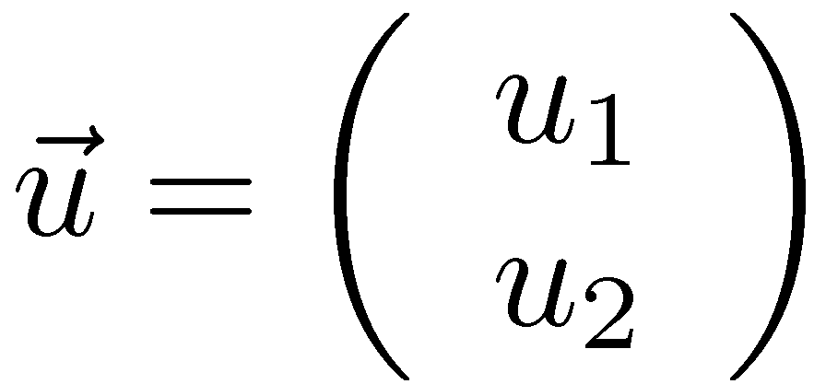
Geometric interpretation of the scalar product (1/ 3)
self study: do the computation

Slide 13
Geometric interpretation of the scalar product (2/ 3)

Slide 14
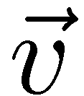
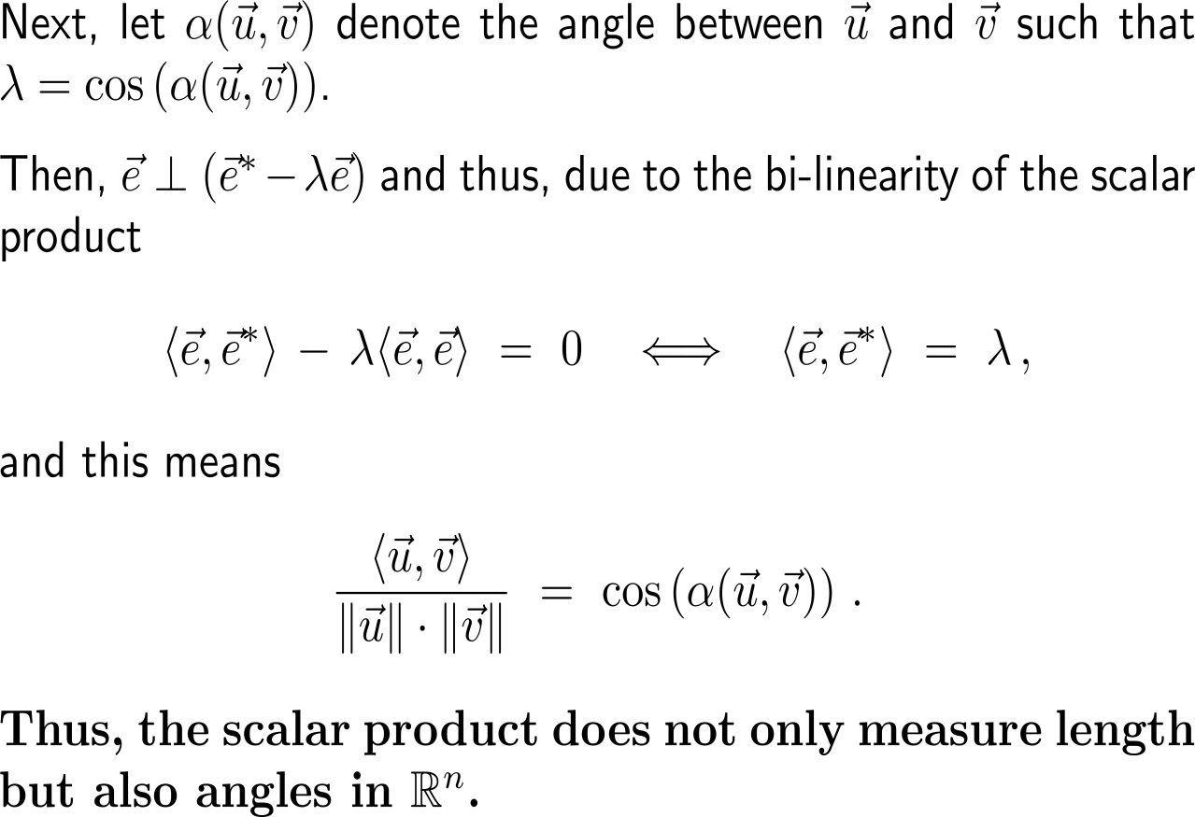
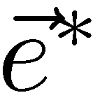
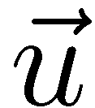
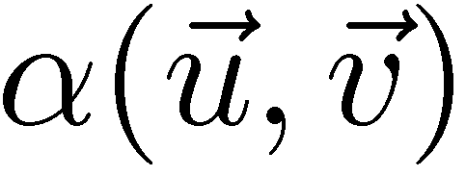
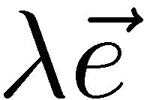
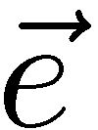
Geometric interpretation of the scalar product (3/ 3)

Slide 15
Consequently, we can defined the angle between two angles and especially have a way to see when two vectors are orthogonal to each other

Slide 16
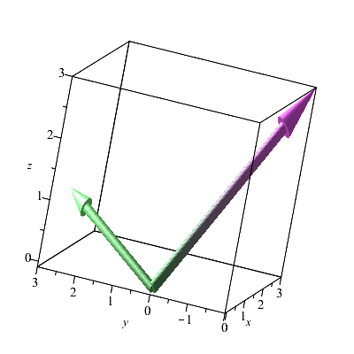
Example: Computing the area between two vectors
with(plots);
arrow({<1, 3, 1>, <3, -2, 3>});

Slide 17
For every two vectors in 3D their vector product gives a third vector that is orthogonal to both of them

Slide 18
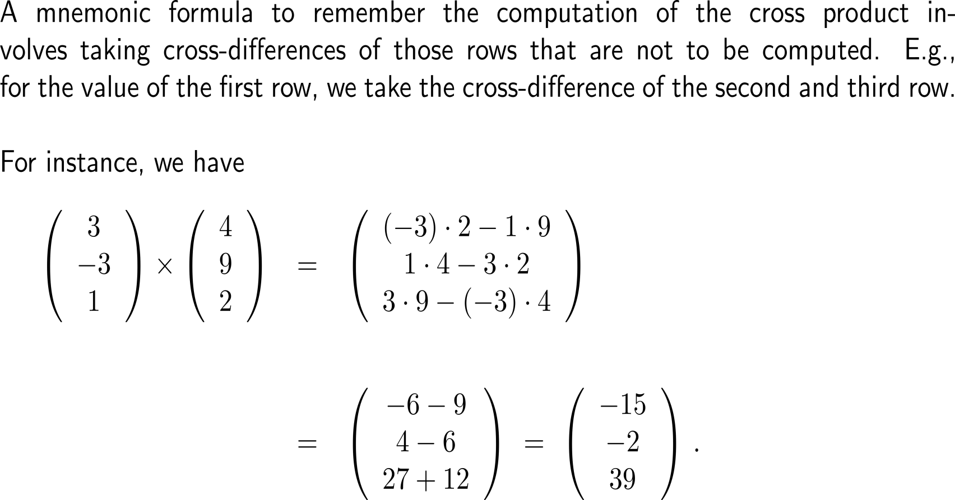
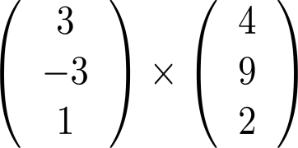
A mnemonic formula to remember the computation of the cross product involves taking cross-differences
+
-

Slide 19
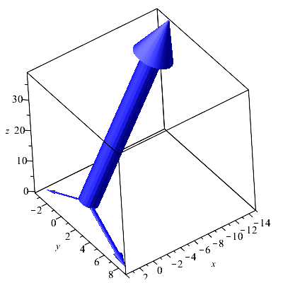
Example: Computing the vector product of two vectors

Slide 20
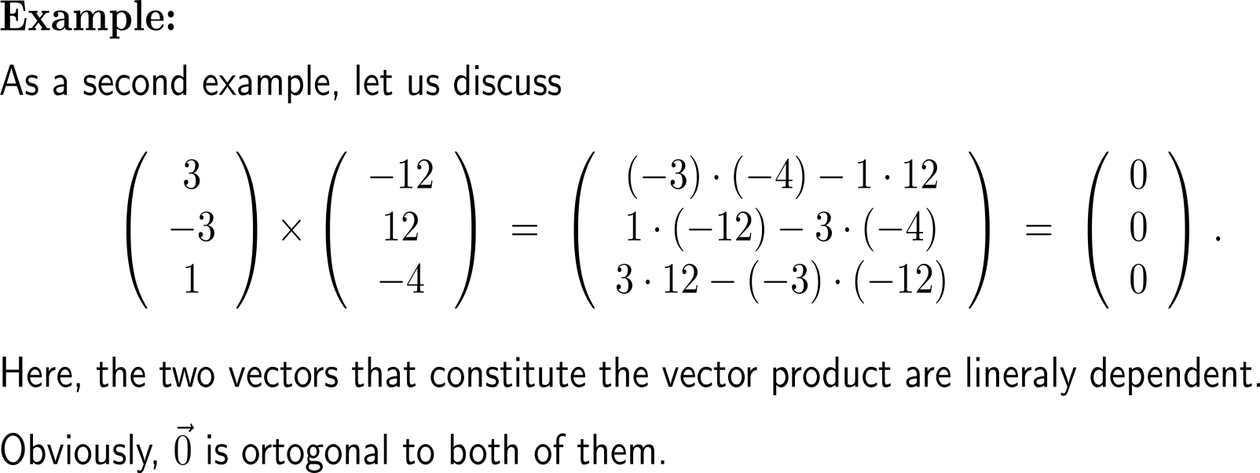
Example: Computing the vector product of two vectors

Slide 21
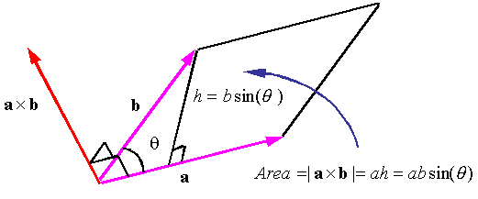
Geometrically, the magnitude of a vector product of two vectors can be interpreted as the area of the parallelogram spanned these vectors (1/ 2)

Slide 22
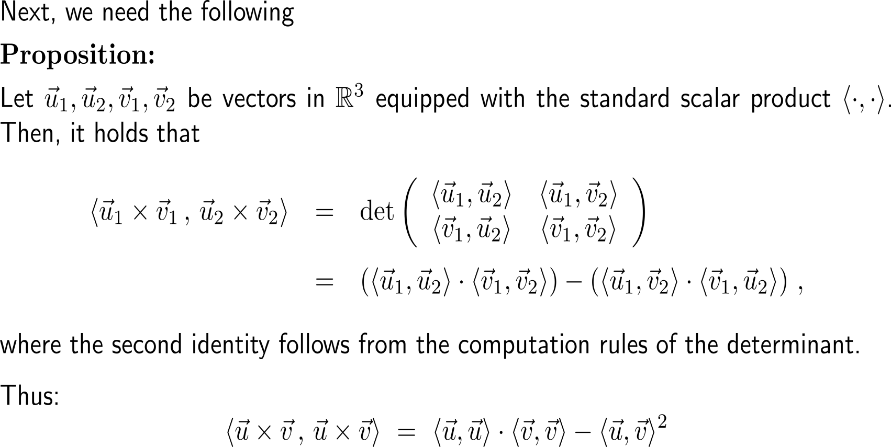
Geometrically, the magnitude of a vector product of two vectors can be interpreted as the area of the parallelogram spanned these vectors (2a/ 2)

Slide 23
Geometrically, the magnitude of a vector product of two vectors can be interpreted as the area of the parallelogram spanned these vectors (2b/ 2)
self study: do the computation

Slide 24
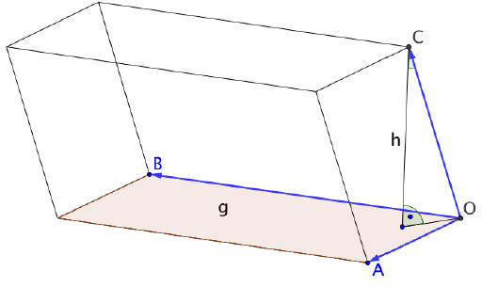
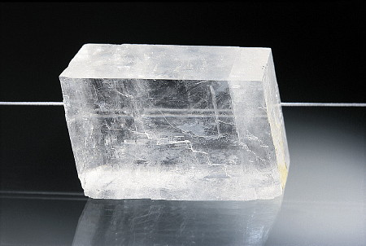
The volume of a parallelepiped (or spat) follows immediately from our previous discussions …
Calcite which is called “Feldspat” in German crystallizes in the form of parallelepipeds

Slide 25
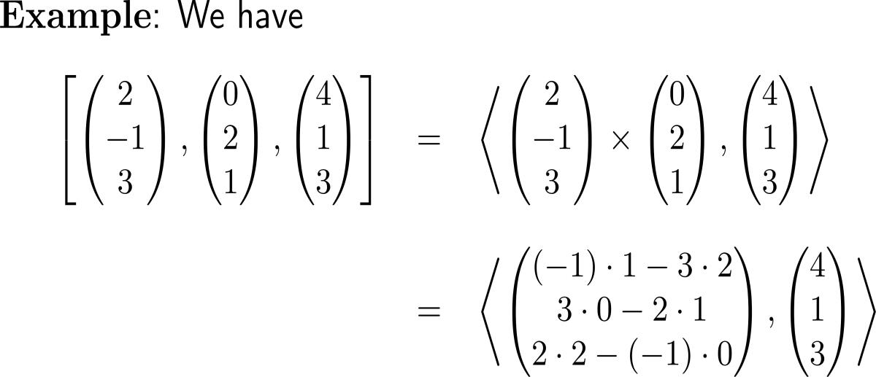
… and elementary geometric considerations (1/ 2)
Calcite which is called “Feldspat” in German crystallizes in the form of parallelepipeds

Slide 26
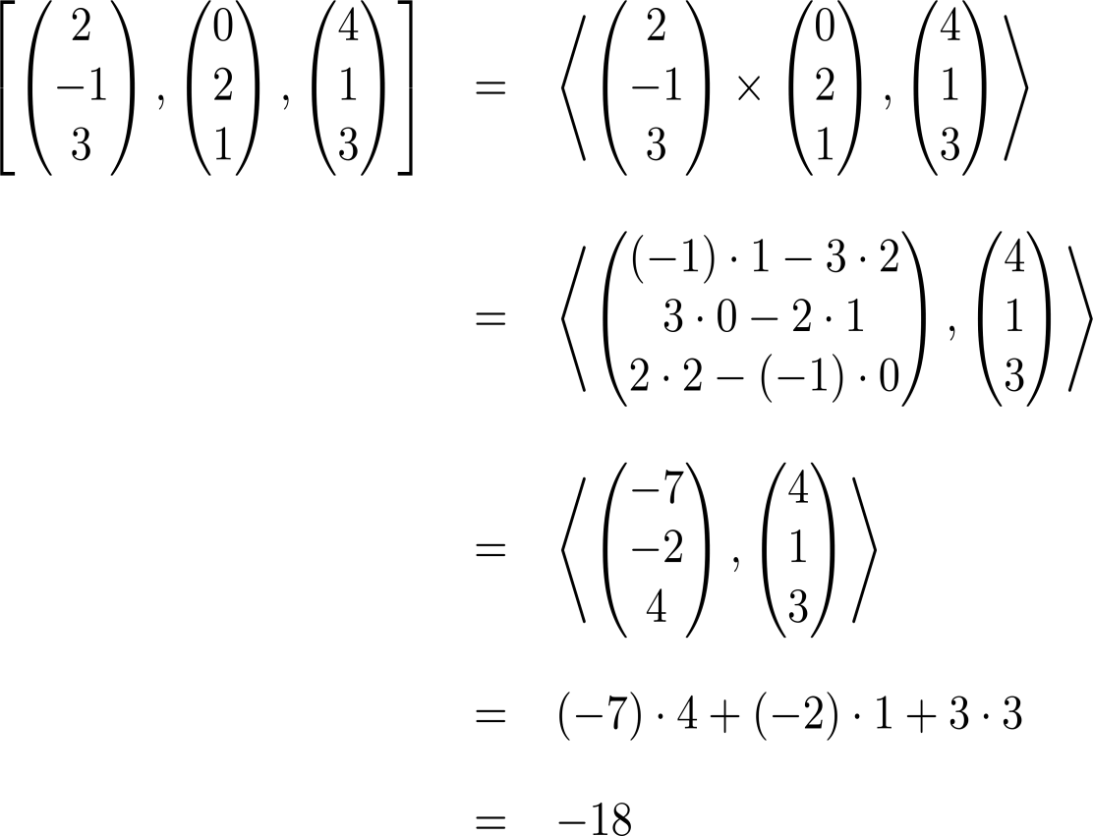
… and elementary geometric considerations (2/ 2)
Calcite which is called “Feldspat” in German crystallizes in the form of parallelepipeds

Slide 27
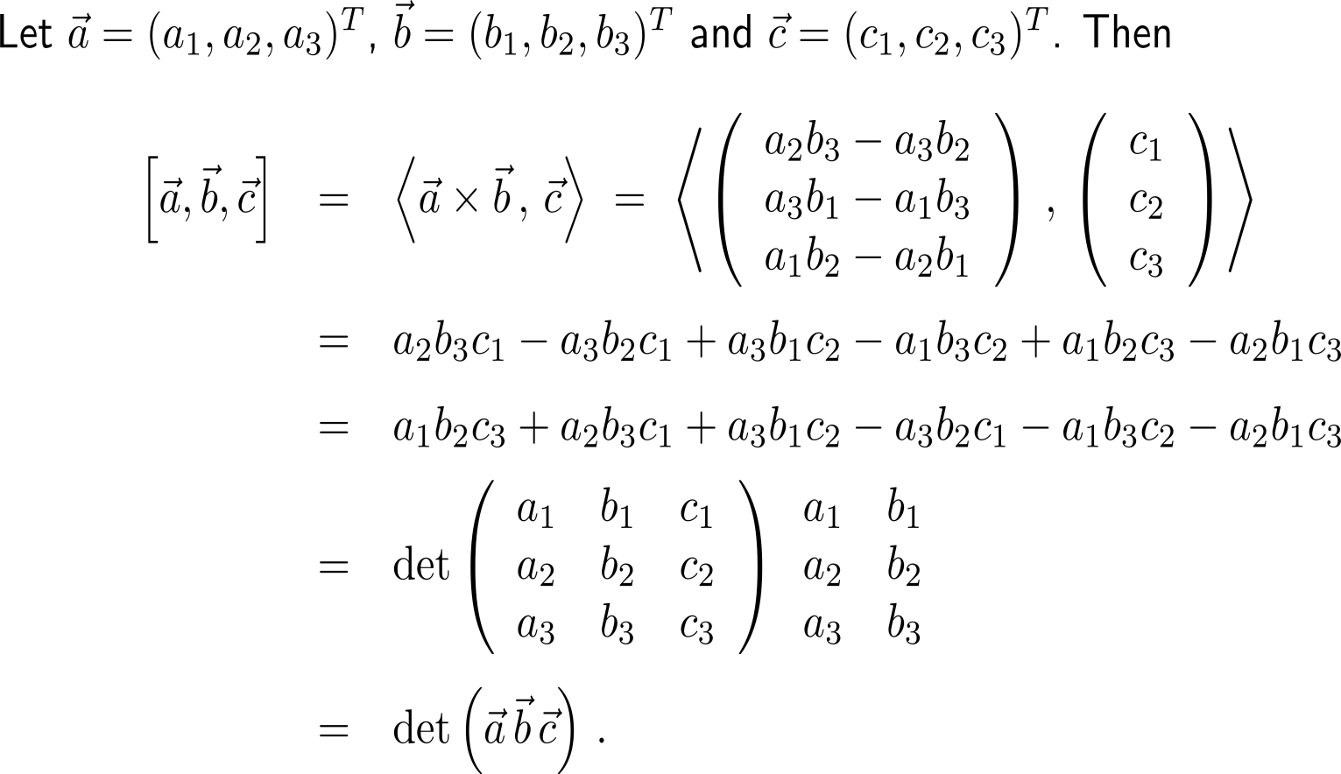
The spat product is the same as the determinant built of the spanning vectors
This actually verifies our previous geometric understanding of the determinant as a way to compute the area of a parallelepiped

Slide 28
Topics
Scalar-Product, Vector-Product & Spat-Product
Matrix-Matrix Multiplication

Slide 29
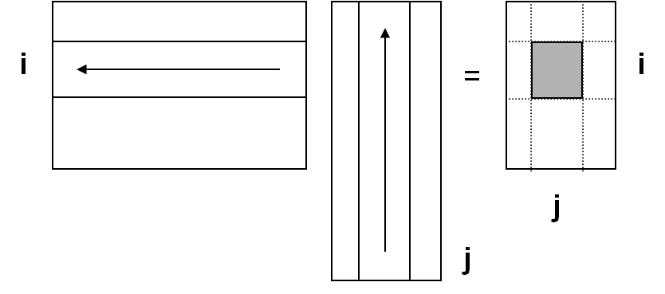
The product of two matrices is defined as multiple application of scalar products: row times column (1/ 3)
lay over each other
multiply
sum

Slide 30
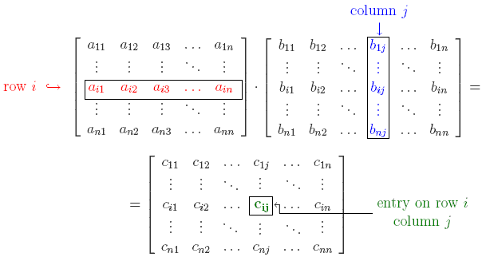
The product of two matrices is defined as multiple application of scalar products: row times column (2/ 3)

Slide 31
The product of two matrices is defined as multiple application of scalar products: row times column (3/ 3)
lay over each other
multiply
sum

Slide 32
Example: Matrix-matrix multiplication

Slide 33
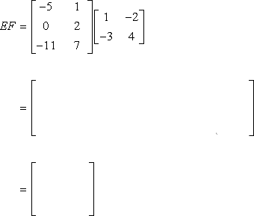
Example: Matrix-matrix multiplication

Slide 34
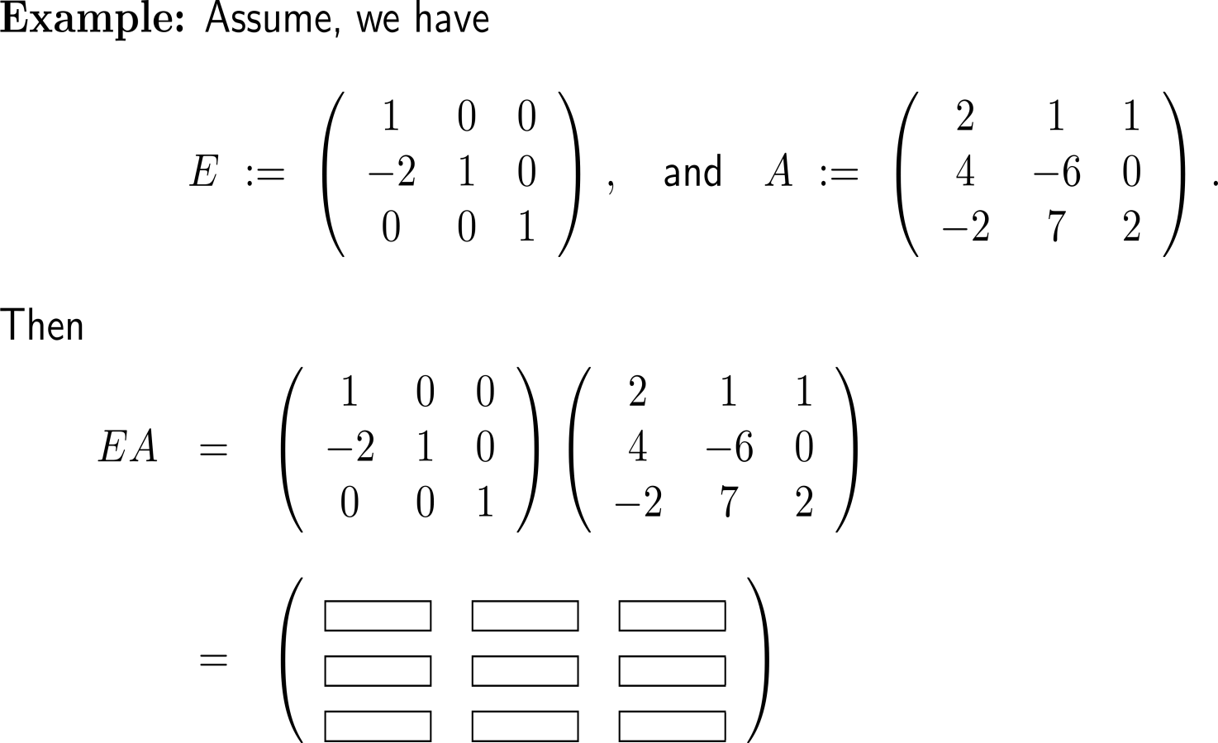
Example: Matrix-matrix multiplication

Slide 35
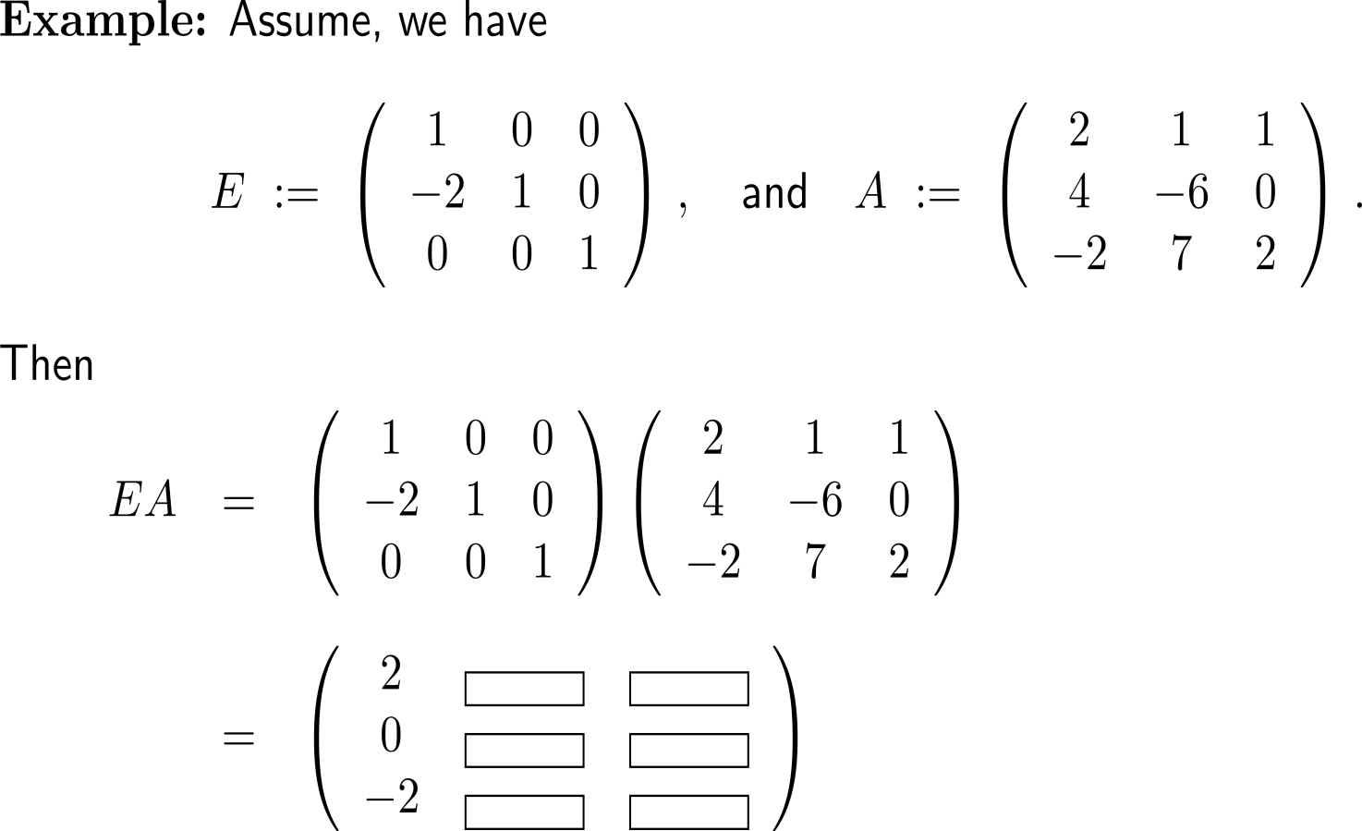
Example: Matrix-matrix multiplication

Slide 36
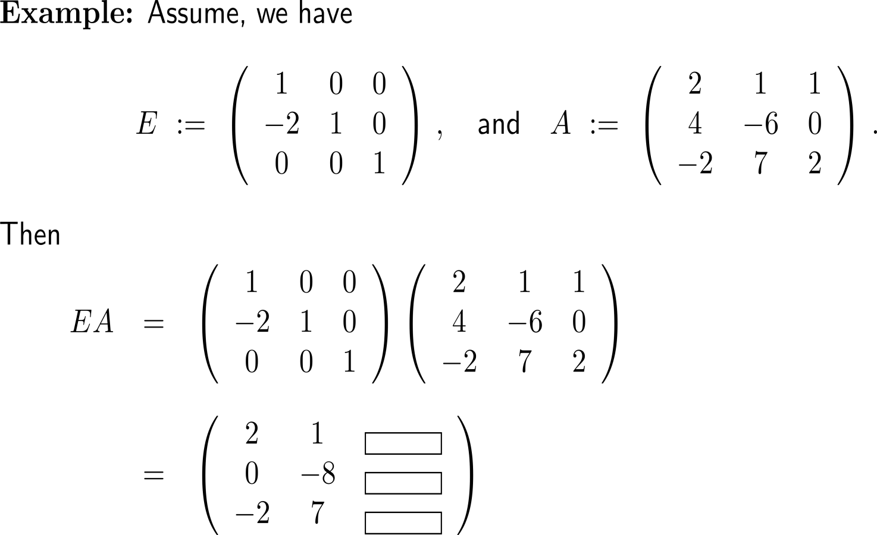
Example: Matrix-matrix multiplication

Slide 37
The matrix multiplication is, unlike the multiplication of real numbers, not commutative and not free of zero divisors

Slide 38
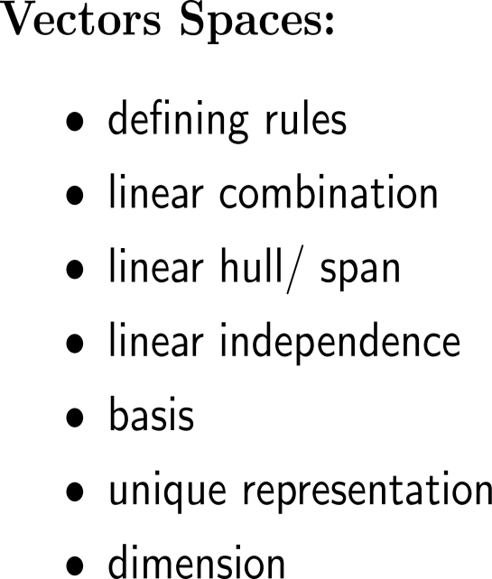
Summary

Slide 39
Putting it all together
Linear Combinations
Linear Systems of Equations
Matrix-Matrix Multiplication
Vector Space
Linear Independence
Gaussian Elimination
Matrix-Vector Multiplication
applying elementary operations to get upper echelon form
checking the result
rank, pivot variables & free variables
Basis
Scalar Product
Determinants
Norm &
Distance
Angle Between Vectors
Special Rules for 2x2 & 3x3 Systems
Spat Product
in 3D
Vector Product
in 3D
Orthogonality

Slide 40
Further Worked-Out Exercises:
Calculus II for Management
Topics
Scalar-product, vector-product & spat-product
Matrix-matrix multiplication

Slide 41
Exercise

Slide 42
Exercise
10 minutes
self/ group work
please, upload your solutions to the chat

Slide 43
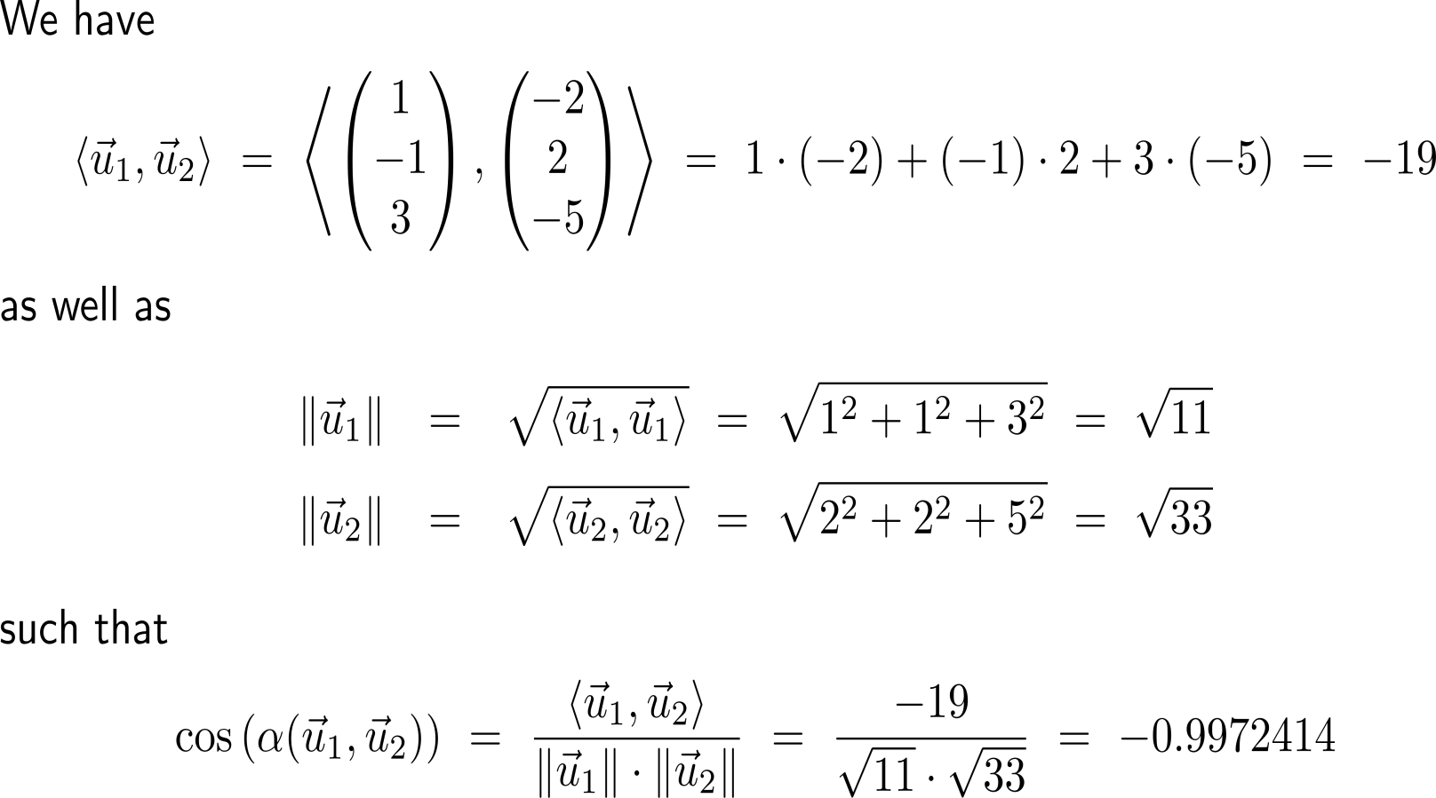
Exercise

Slide 44
Exercise
15 minutes
self/ group work
please, upload your solutions to the chat

Slide 45
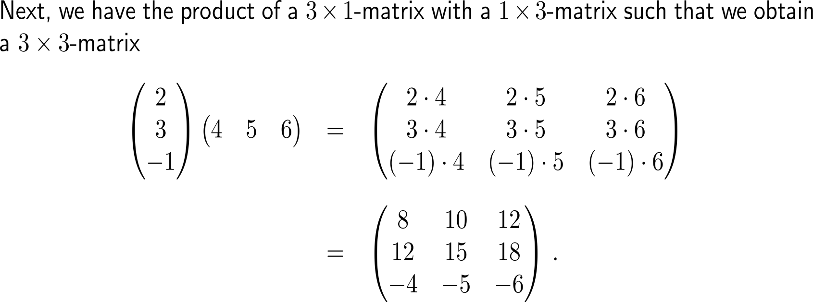
Exercise

Slide 46
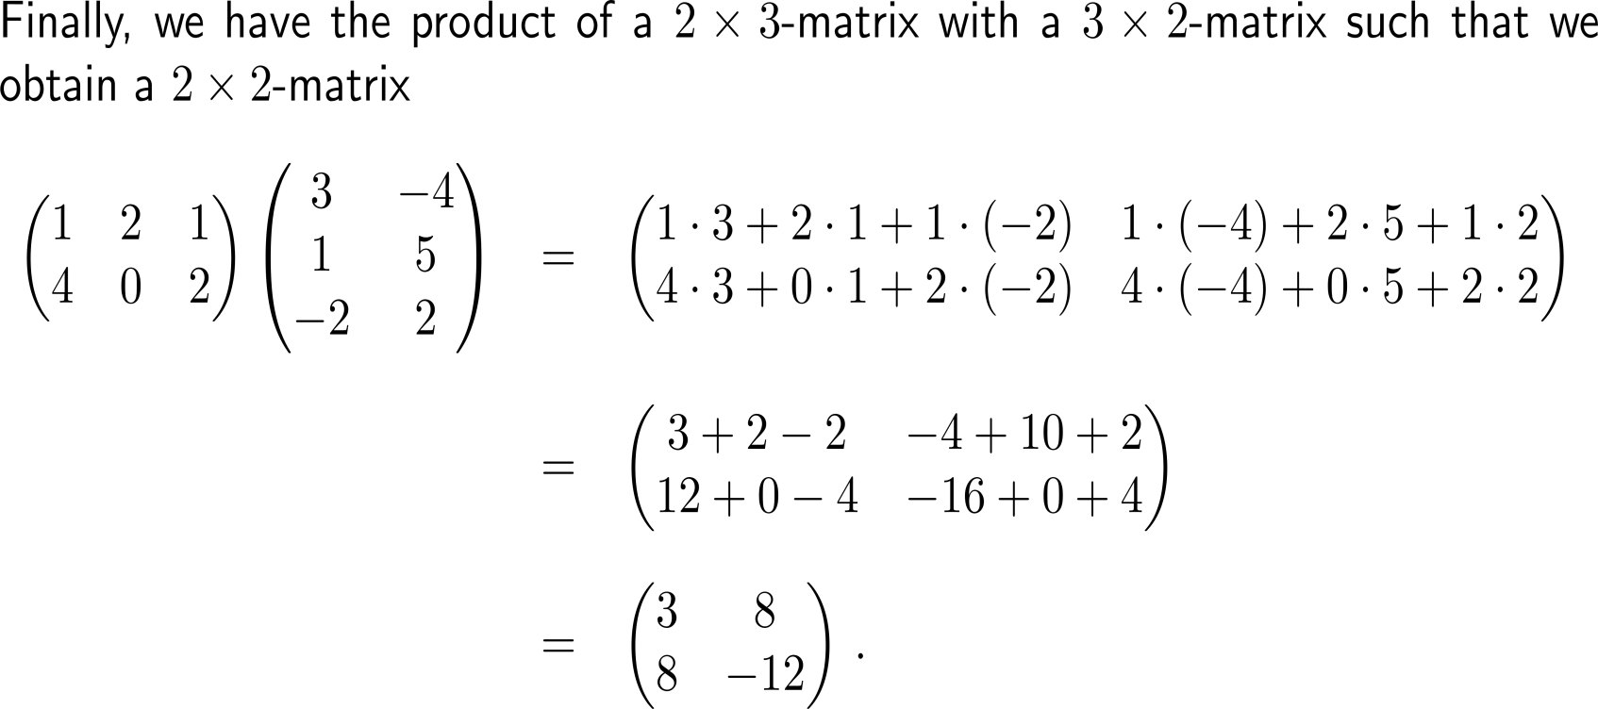
Exercise

Slide 47
Exercise

Slide 48
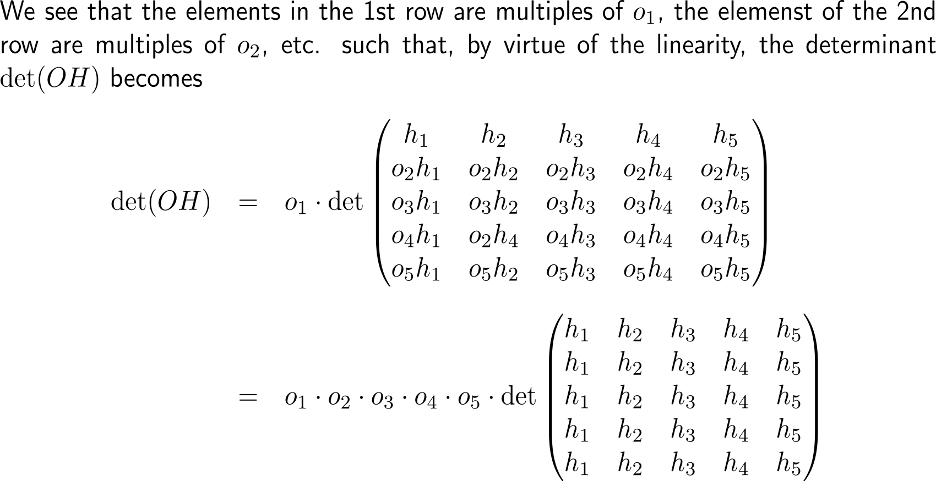
Exercise

Slide 49
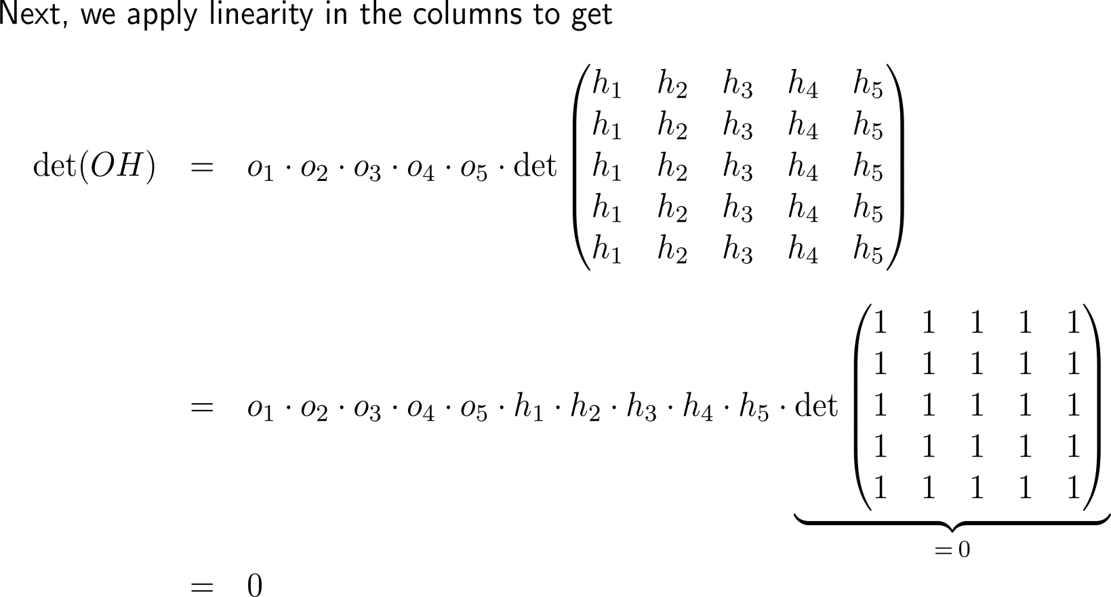
Exercise

Slide 50
Calculus II for Management

