Slide 1
Calculus II for Management
Introduction to Ordinary Differential Equations
week 5
Lecture 5
Ordinary Differential Equations (ODEs)
Separable ODEs
Continuous compounding
Linear ODEs
Diffusion of innovation, epidemics, and rumor

Slide 2
Topics
Differential Equations and the Method of Separation of Variables
Continuous Compounding Using a Separable Differential Equation
Linear Differential Equations
Diffusion of Innovation, Epidemics, and Rumor

Slide 3
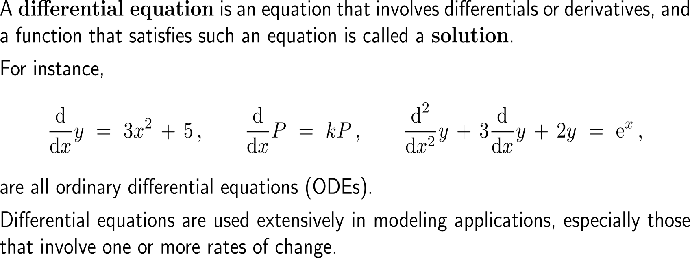
A differential equation is an equation that involves differentials or derivatives

Slide 4
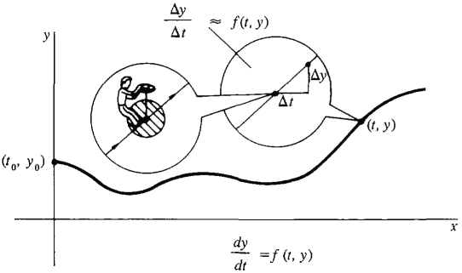
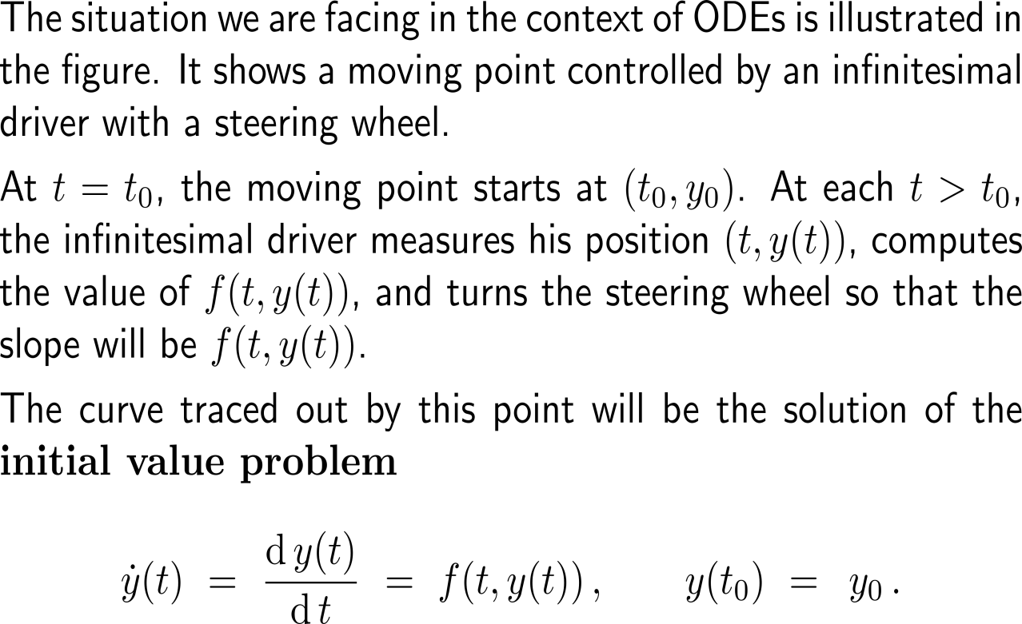
In this course, we will focus on ordinary differential equations and especially the solutions of their initial value problems
A moving point controlled by an infinitesimal driver with a steering wheel
http://www.vias.org/calculus/

Slide 5
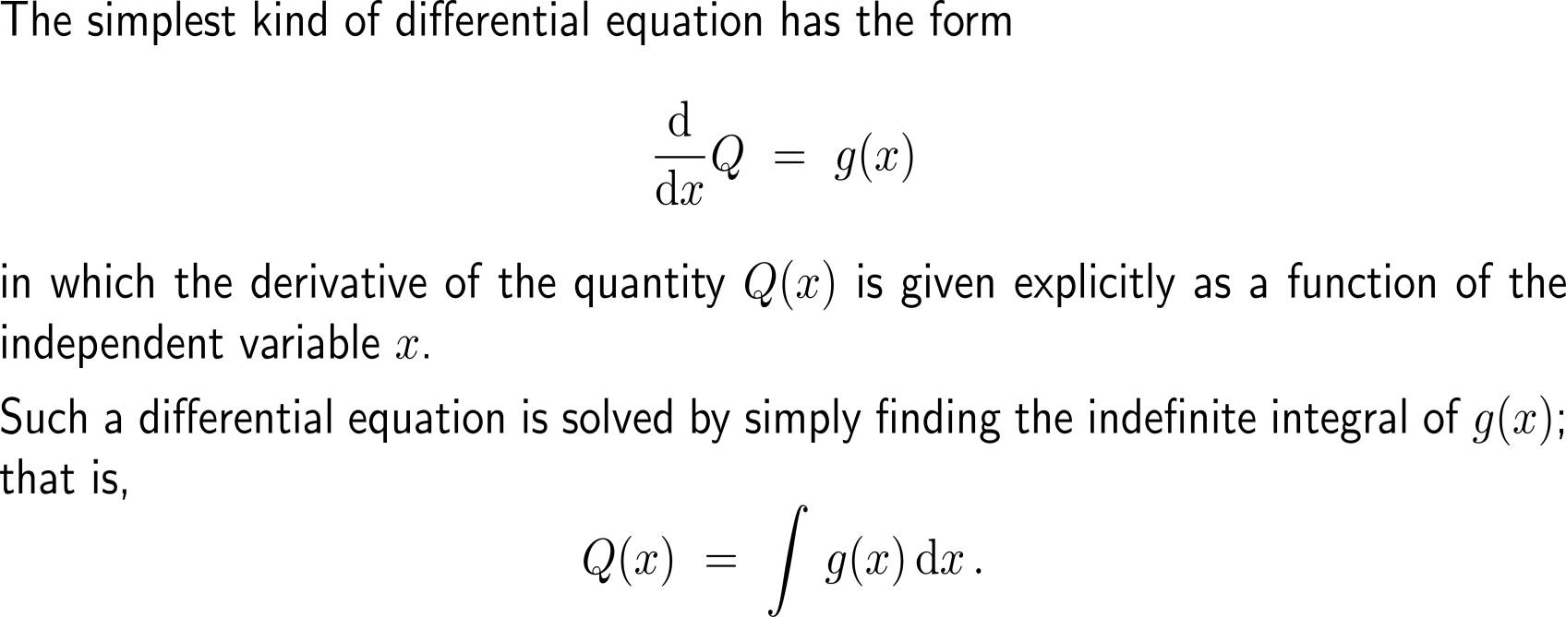
The most simplest kind of differential equations is solved by integration (1/2)

Slide 6
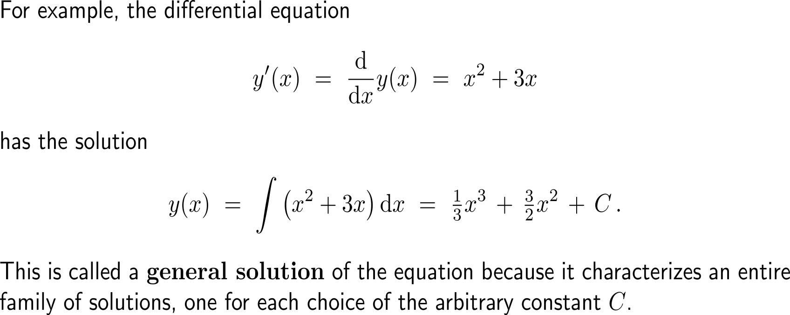
The most simplest kind of differential equations is solved by integration (1/2)

Slide 7
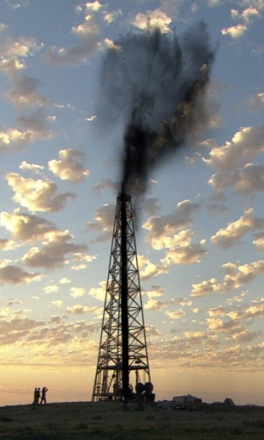
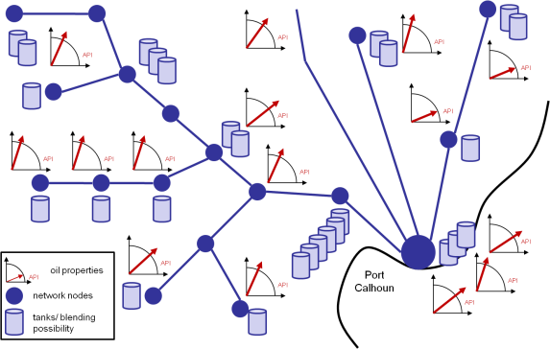
Example: Solving a differential equation to find revenue
Real Case (together with TUMinternational):
Curde oil transport and blending solution with a focus on the Texas light oil fracking market and shipment to the Central European oil refineries from Port Calhoun

Slide 8
Example: Solving a differential equation to find revenue
rate of change
of revenue
USD per
barrel
barrels
per month

Slide 9
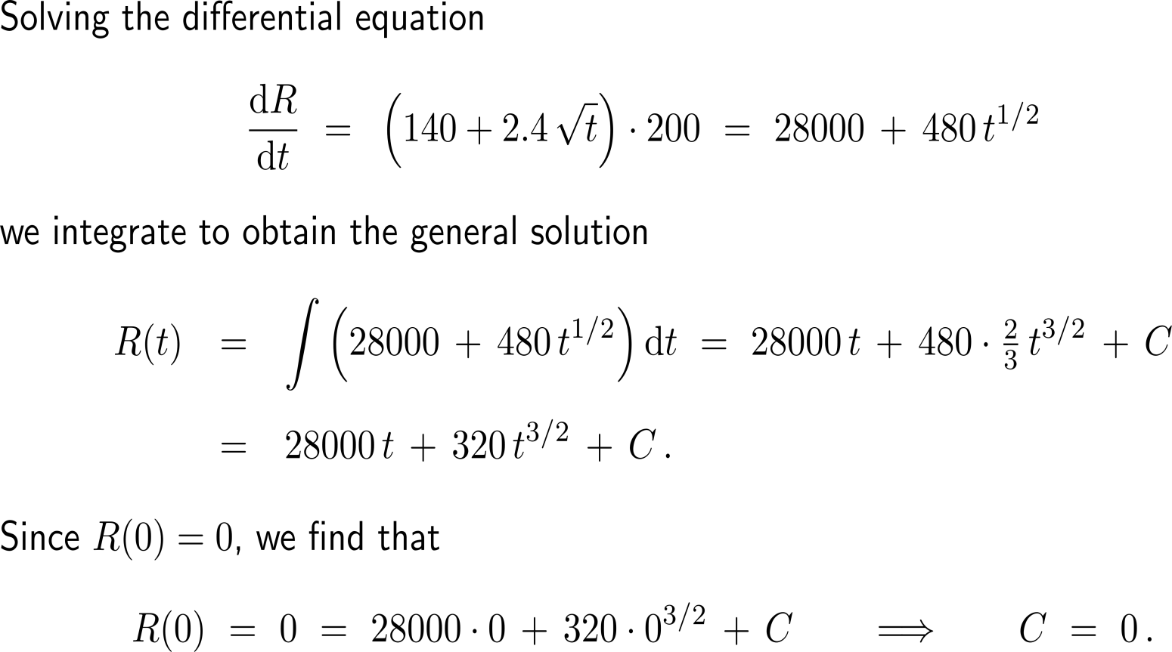
Example: Solving a differential equation to find revenue

Slide 10
Example: Solving a differential equation to find revenue

Slide 11
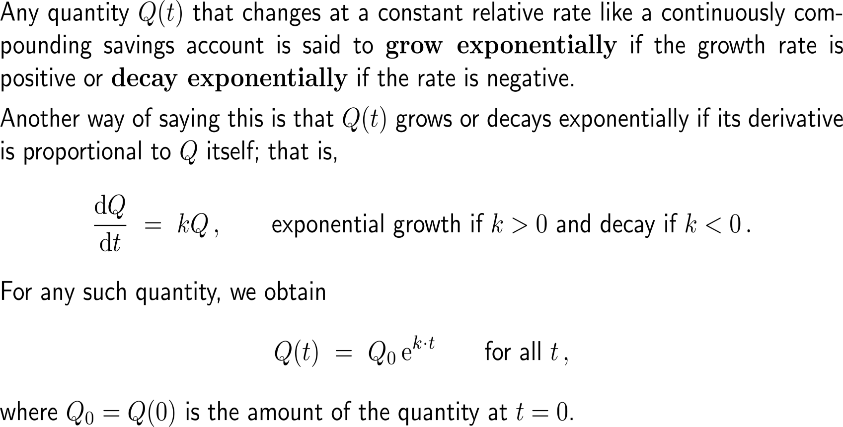
The differential equation for exponential growth/ decay and its solution formula (1/ 2)

Slide 12
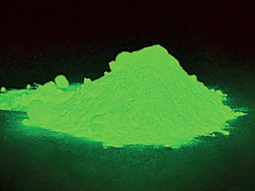
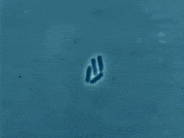
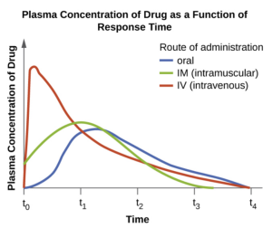
The differential equation for exponential growth/ decay and its solution formula (2/ 2)

Slide 13
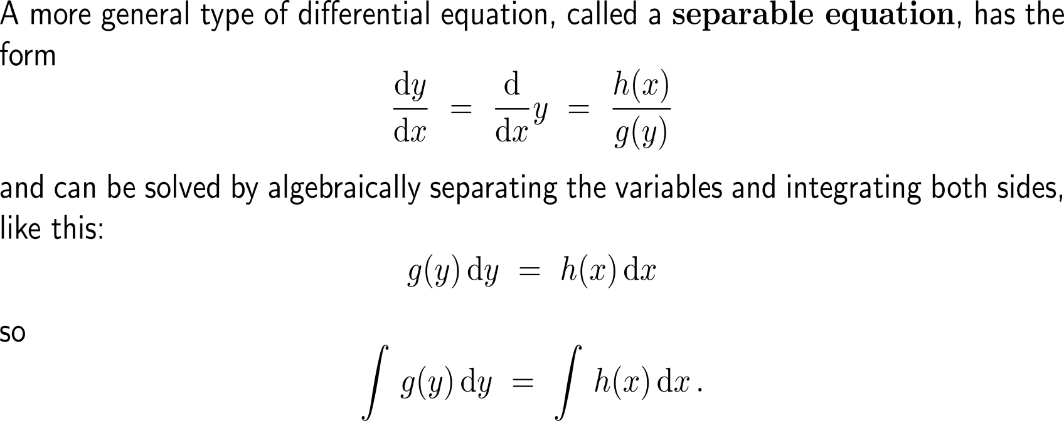
The next simplest kind of differential equations is given by separable differential equations

Slide 14
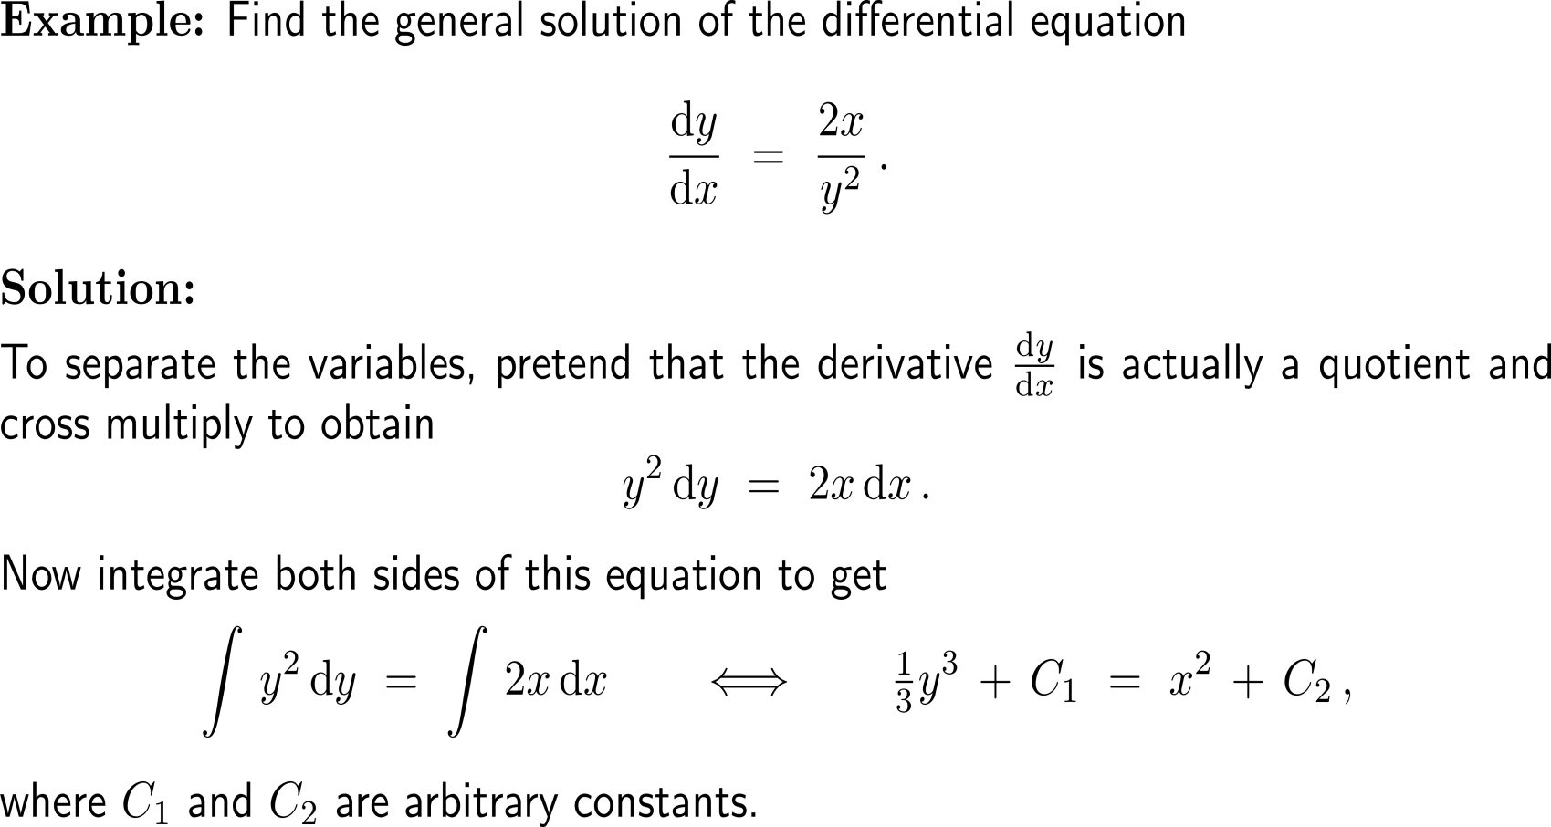
Example: Solving a separable differential equation

Slide 15
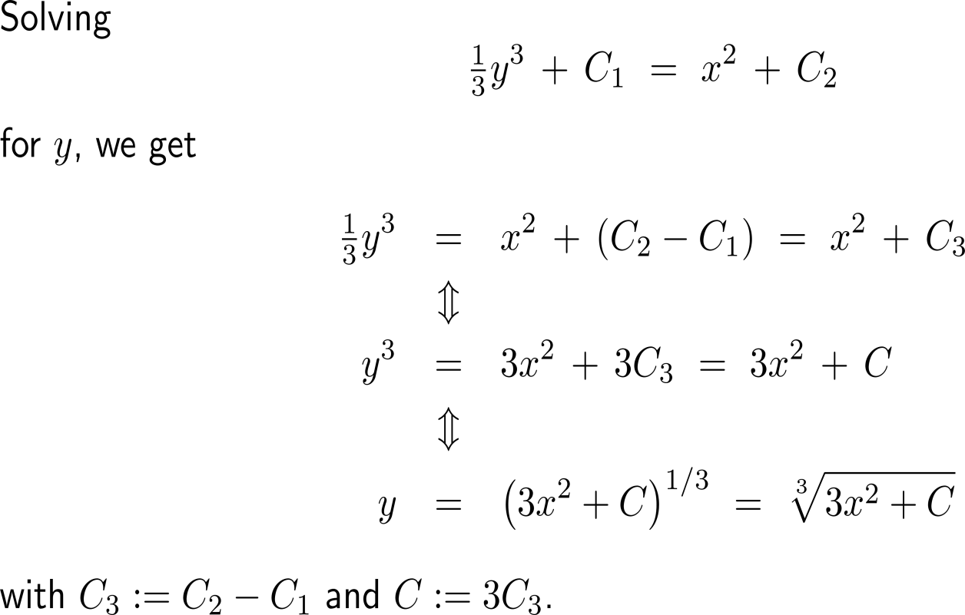
Example: Solving a separable differential equation

Slide 16
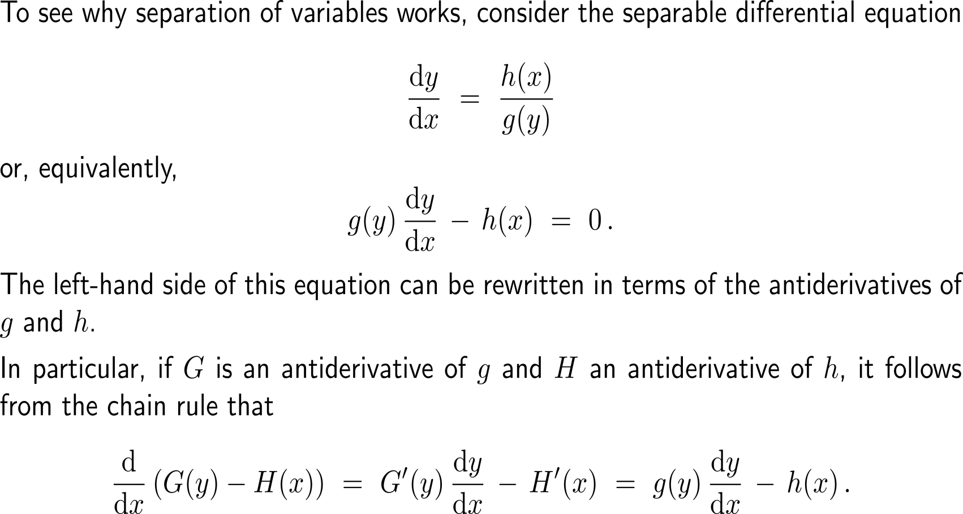
Proof: Separation of variables (1/ 2)

Slide 17
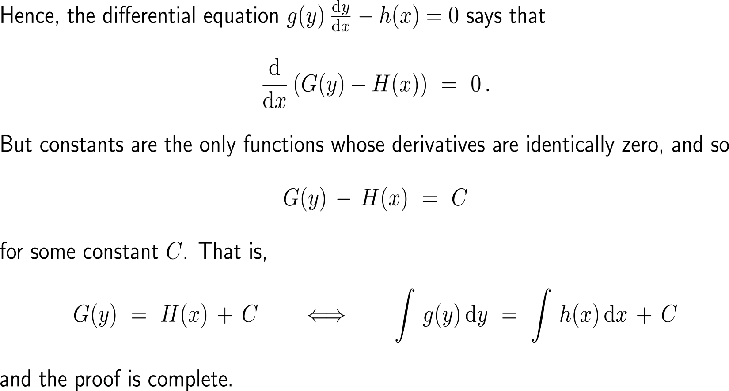
Proof: Separation of variables (2/ 2)

Slide 18
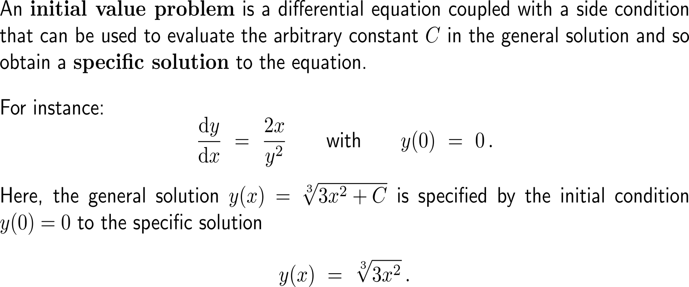
An initial value problem is a differential equation coupled with a side condition

Slide 19
Topics
Differential Equations and the Method of Separation of Variables
Continuous Compounding Using a Separable Differential Equation
Linear Differential Equations
Diffusion of Innovation, Epidemics, and Rumor

Slide 20
Deriving the differential equation for continuous compounding …
percentage
growth rate of B
interest
rate

Slide 21
… and its general solution formula
relative
growth rate of B
interest rate
in decimal form

Slide 22
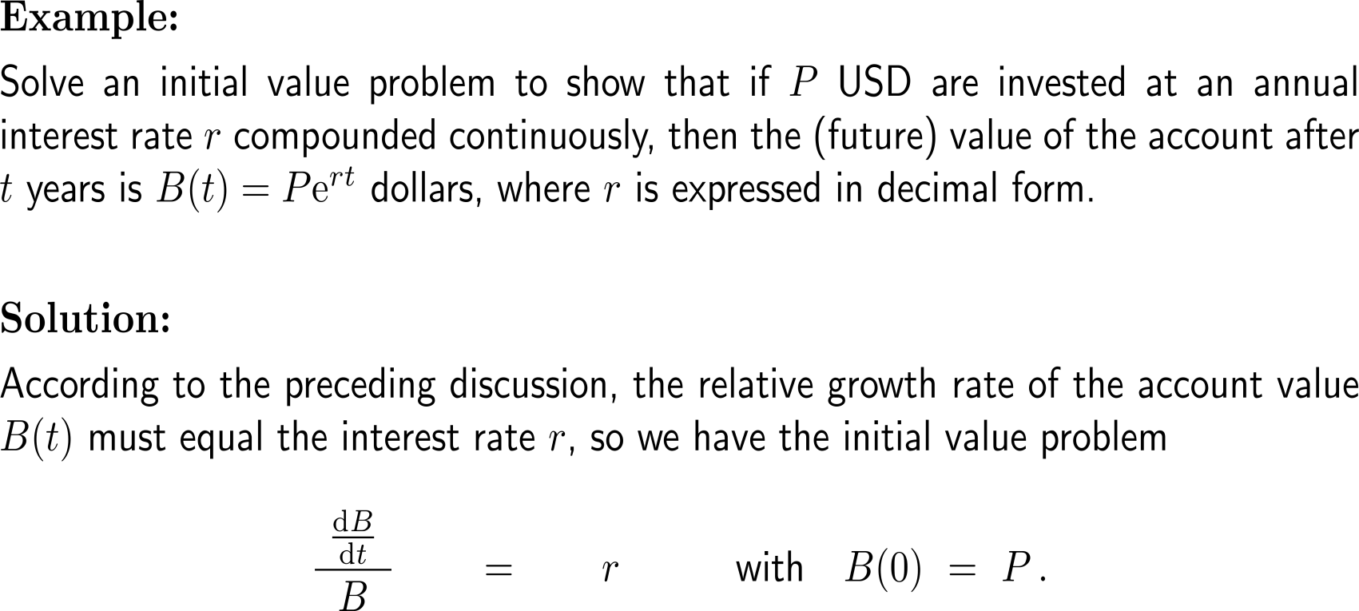
Example: Deriving the continuous compounding formula
relative
growth rate of B
interest rate
in decimal form

Slide 23
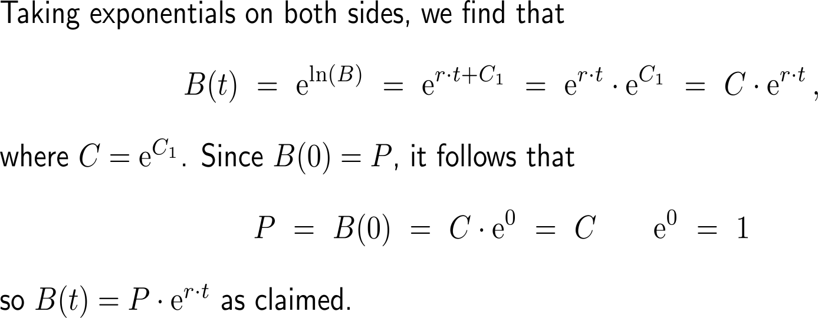
Example: Deriving the continuous compounding formula
|B(t)| = B(t) since B(t) > 0 for all t

Slide 24
Topics
Differential Equations and the Method of Separation of Variables
Continuous Compounding Using a Separable Differential Equation
Linear Differential Equations
Diffusion of Innovation, Epidemics, and Rumor

Slide 25
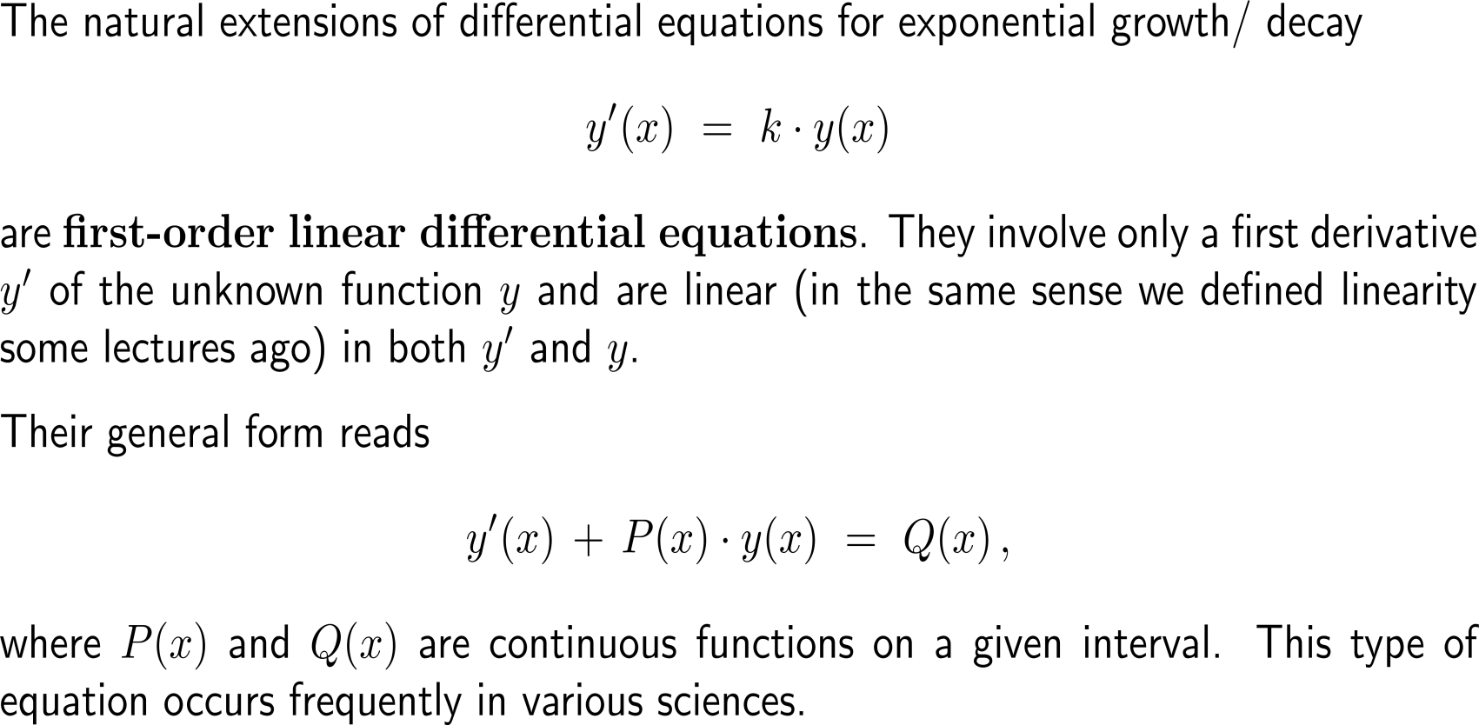
First-order linear differential equations are natural extension of the differential equations for exponential growth/ decay

Slide 26
Example: Linear differential equation

Slide 27
Example: Linear differential equation

Slide 28
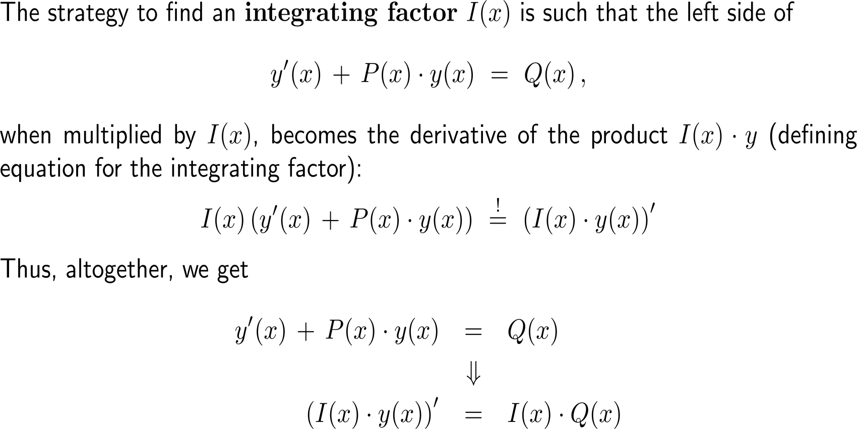
The general strategy for an integrating factor is to reduce the left-hand side of the differential equation to a first derivative …

Slide 29
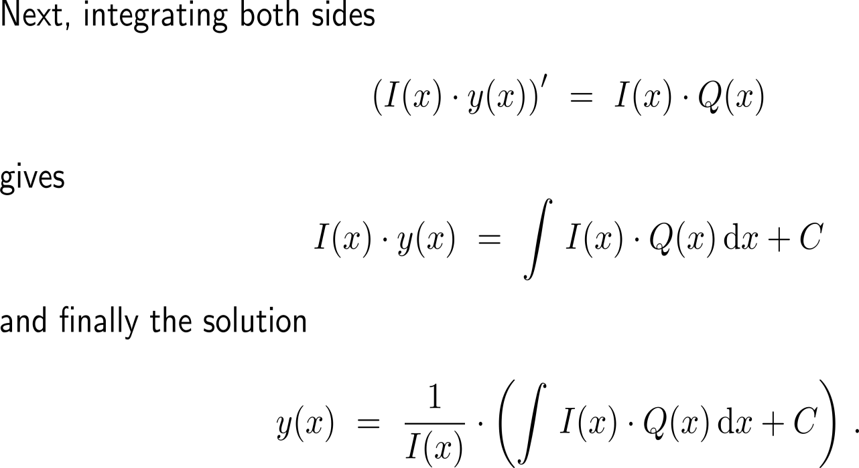
… such that the solution is easily obtained by integrating both sides

Slide 30
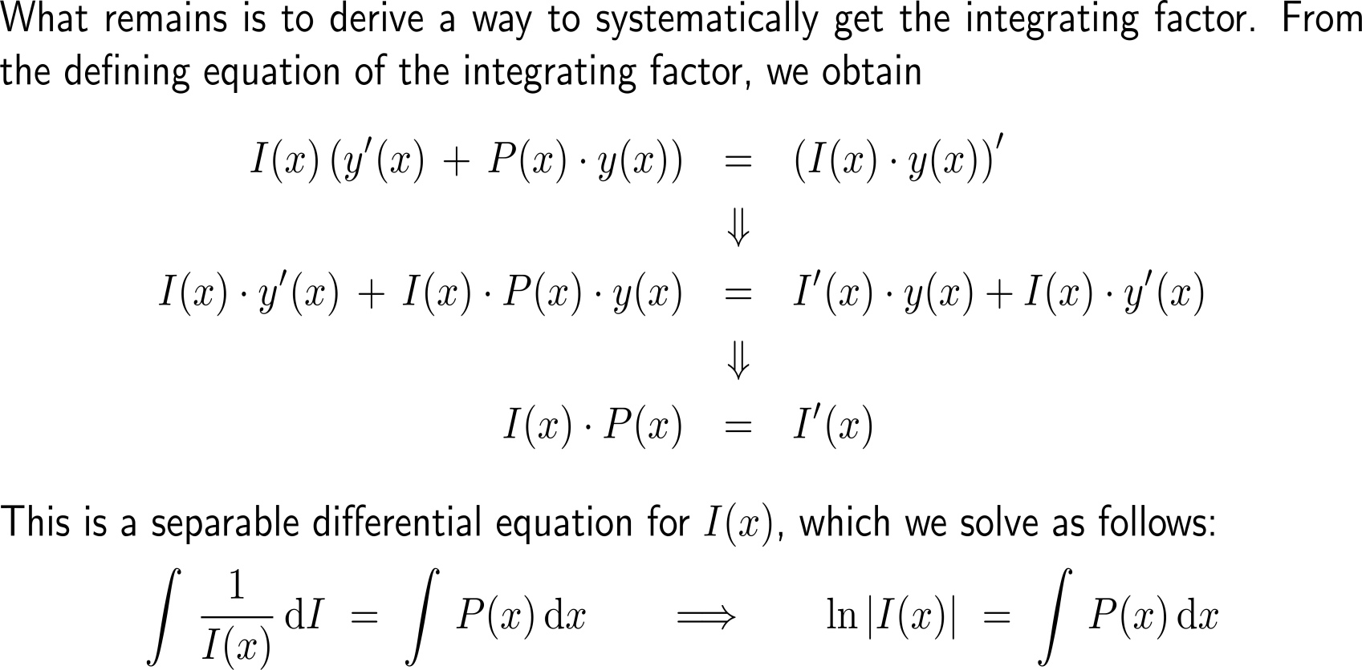
With separation of variables we obtain the direct expression of an integrating factor from its defining equation (1/ 2)

Slide 31
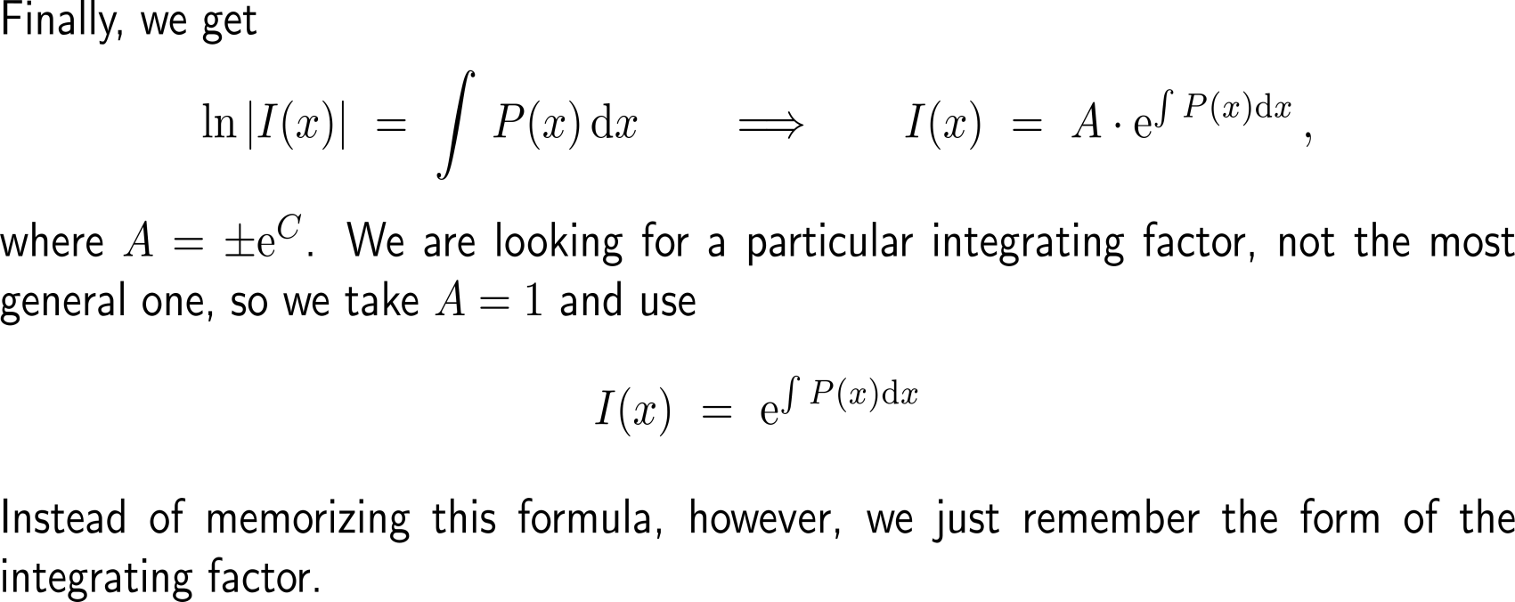
With separation of variables we obtain the direct expression of an integrating factor from its defining equation (2/ 2)

Slide 32
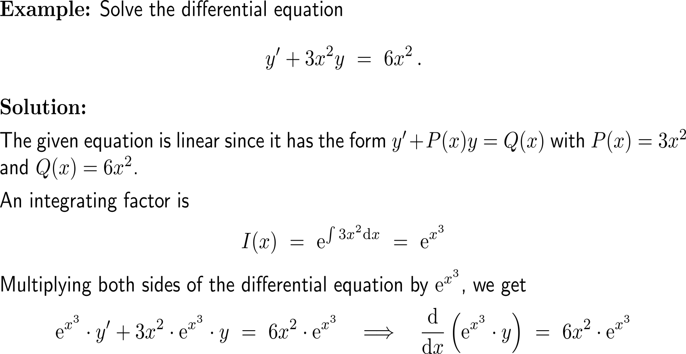
Example: Linear differential equation & integrating factor

Slide 33
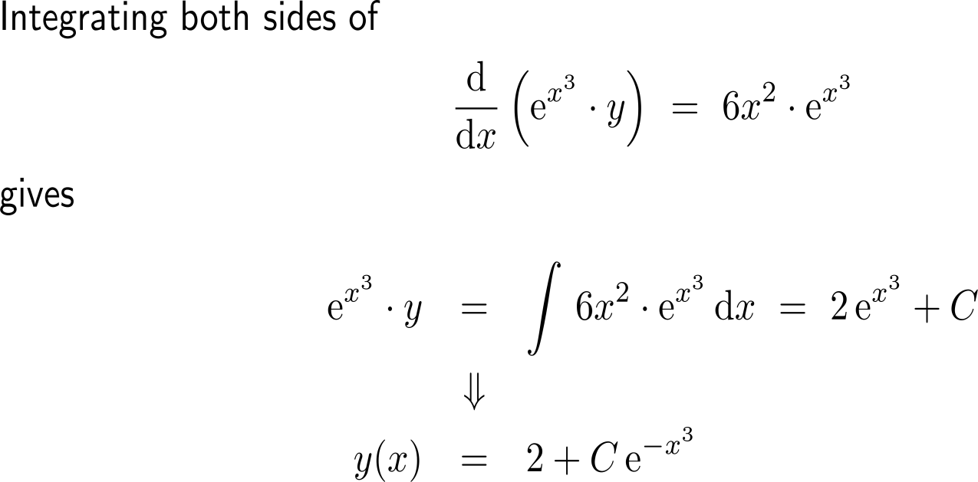
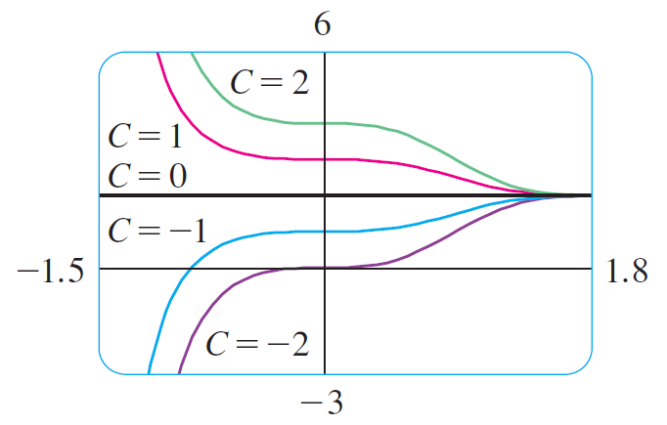
Example: Linear differential equation & integrating factor
Several members of the family of solutions. Notice that they all approach 2 as x → ∞.

Slide 34
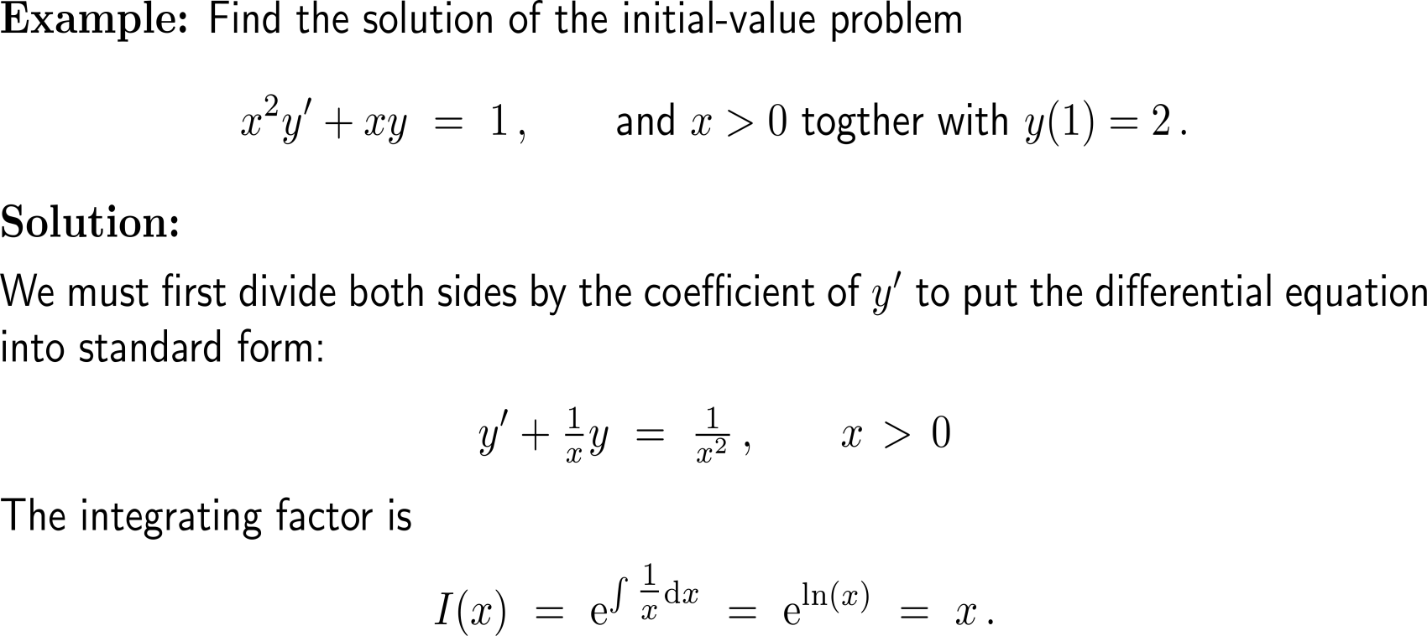
Example: Initial value problem & integrating factor

Slide 35
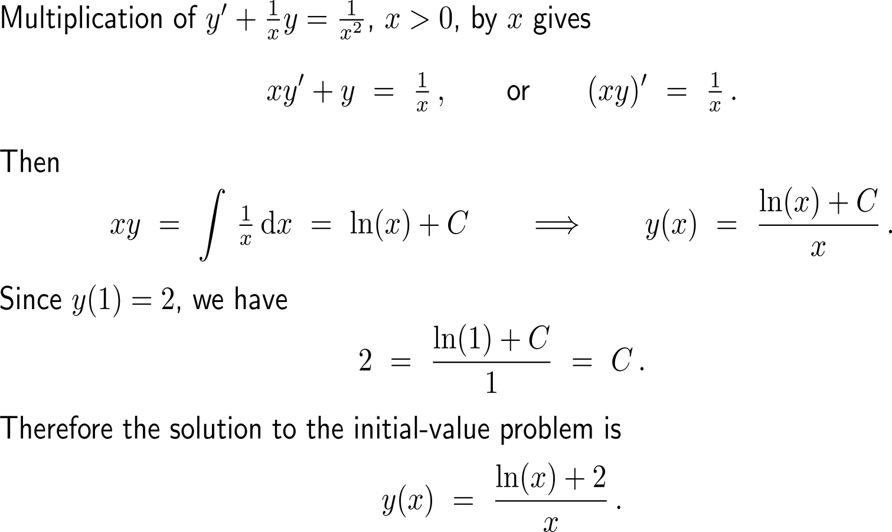
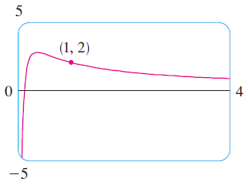
Example: Initial value problem & integrating factor

Slide 36
Topics
Differential Equations and the Method of Separation of Variables
Continuous Compounding Using a Separable Differential Equation
Linear Differential Equations
Diffusion of Innovation, Epidemics, and Rumor

Slide 37
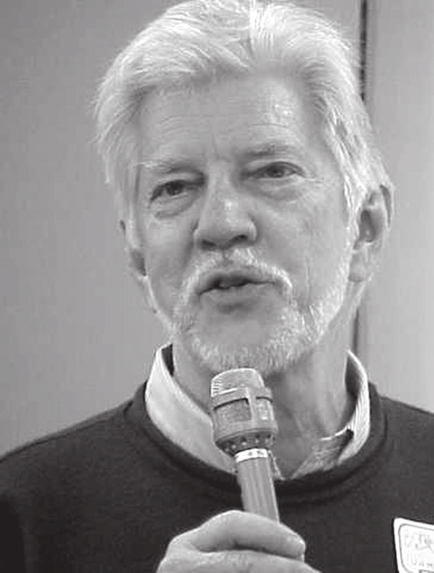
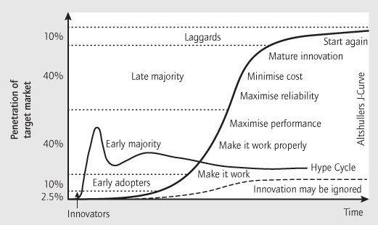
Diffusion is the process by which an innovation is communicated over time among the participants in a social system (1/ 2)
Everett M. Rogers
(1931 – 2004)
Diffusion is the process by which an innovation is communicated over time among the participants in a social system
Four main elements influence the spread of a new idea: the innovation itself, communication channels, time, and a social system. This process relies heavily on human capital.
The innovation must be widely adopted in order to self-sustain. Within the rate of adoption, there is a point at which an innovation reaches critical mass.

Slide 38
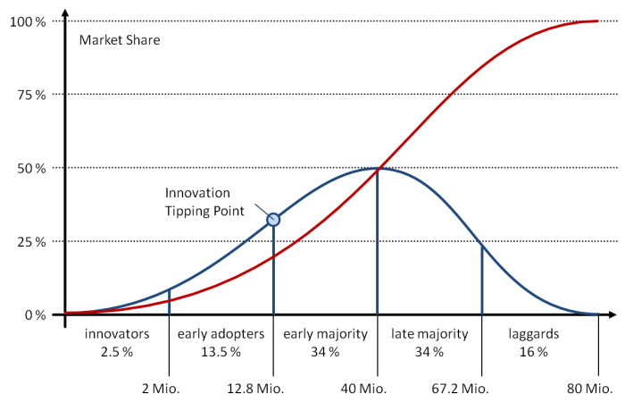
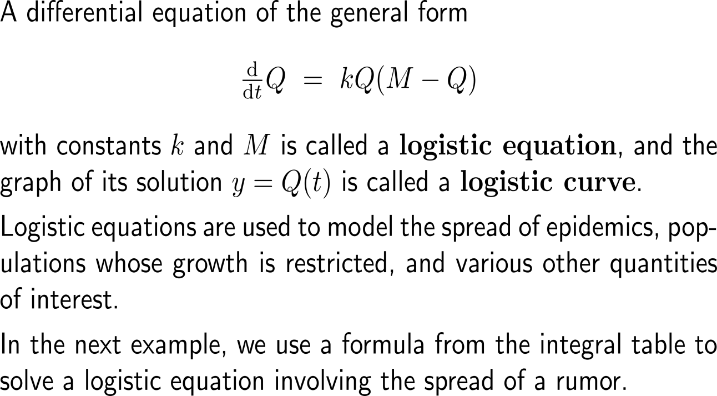
Diffusion is the process by which an innovation is communicated over time among the participants in a social system (2/ 2)

Slide 39
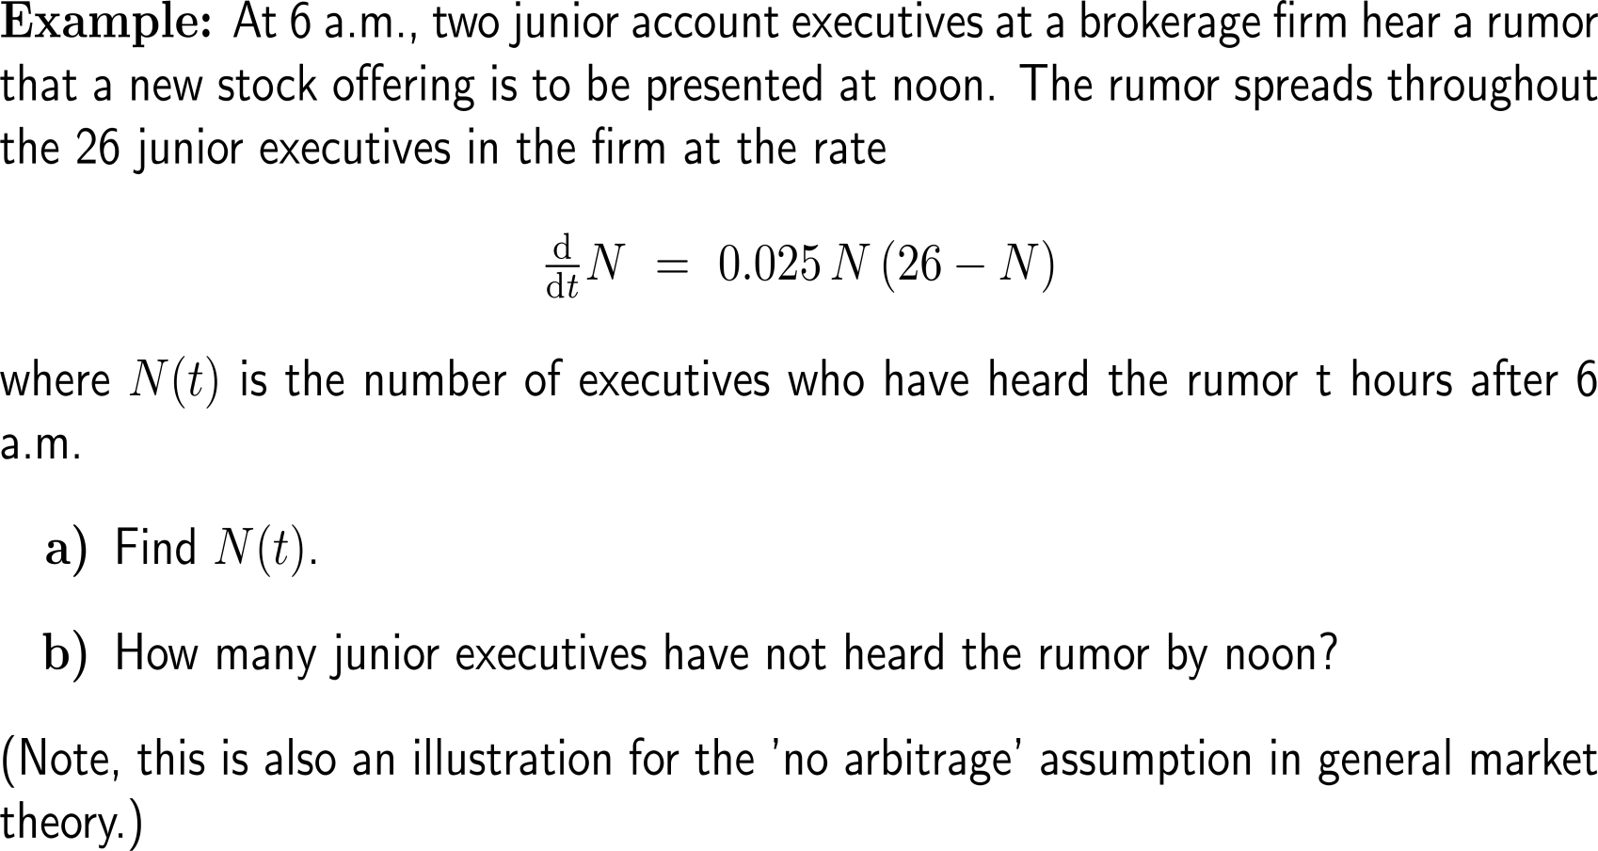
Example: Using an integral table to study the spread of a rumor

Slide 40
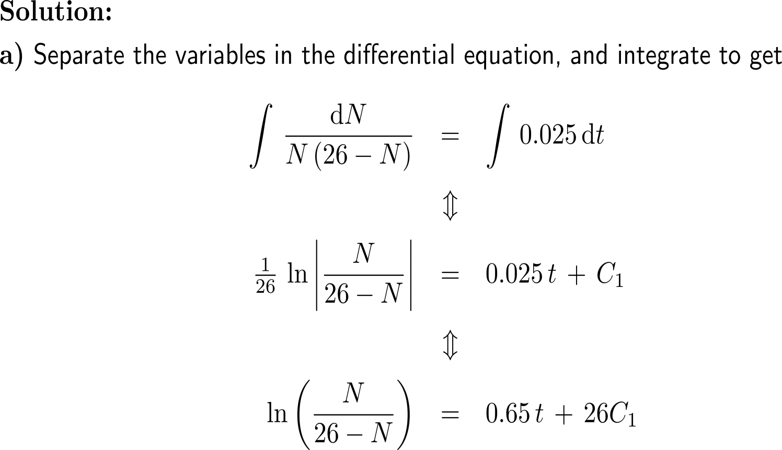
Example: Using an integral table to study the spread of a rumor
|26 – N| = 26 – N
since N ≤ 26

Slide 41
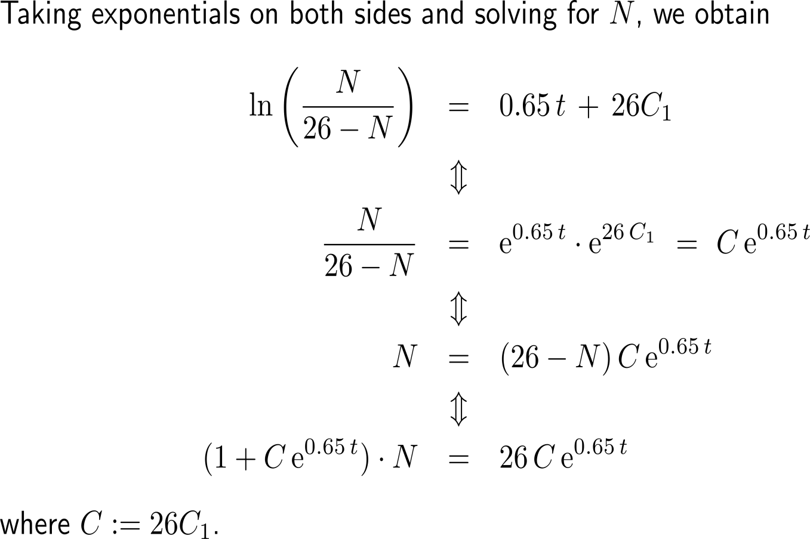
Example: Using an integral table to study the spread of a rumor

Slide 42
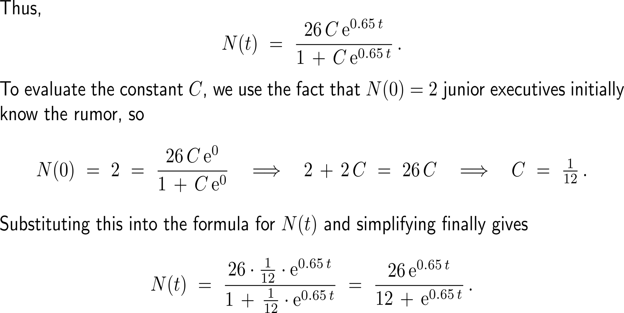
Example: Using an integral table to study the spread of a rumor

Slide 43
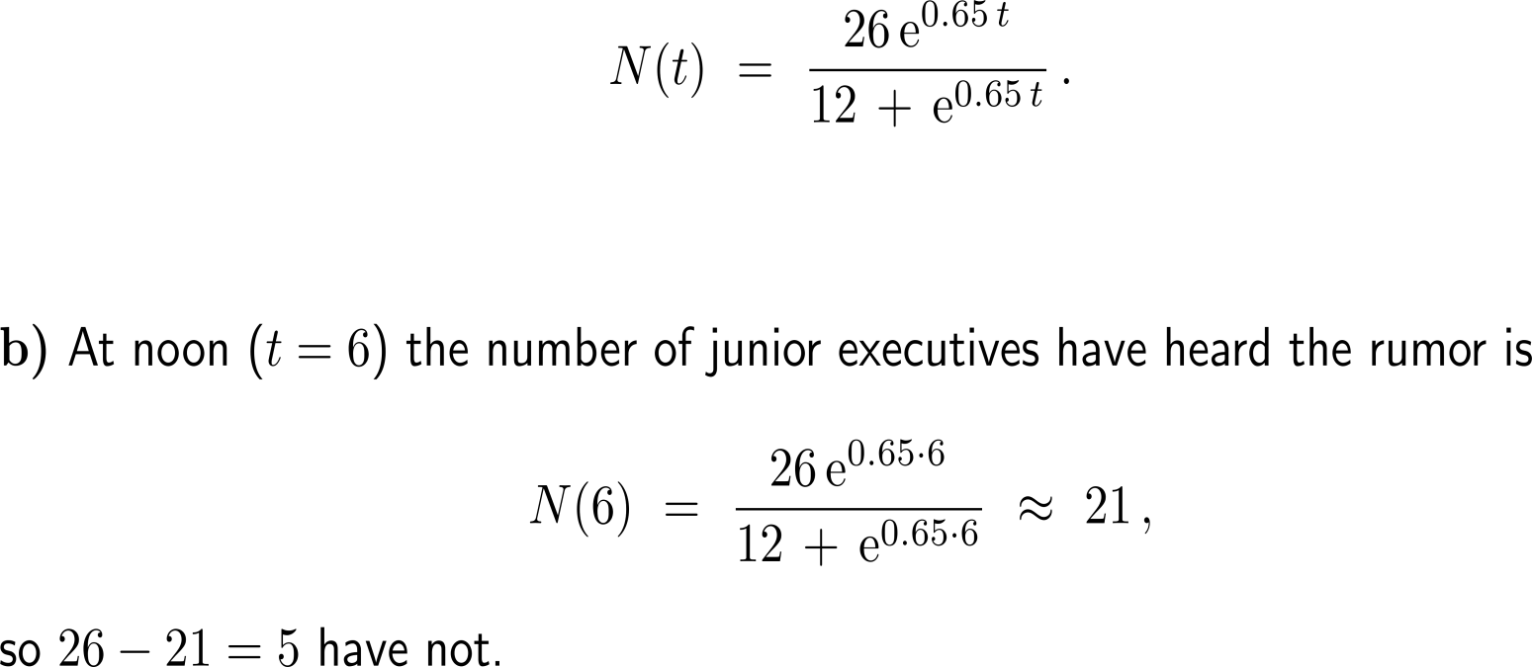
Example: Using an integral table to study the spread of a rumor

Slide 44
Further Worked-Out Exercises:
Calculus II for Management
Topics
Separable differential equations
Linear differential equations

Slide 45
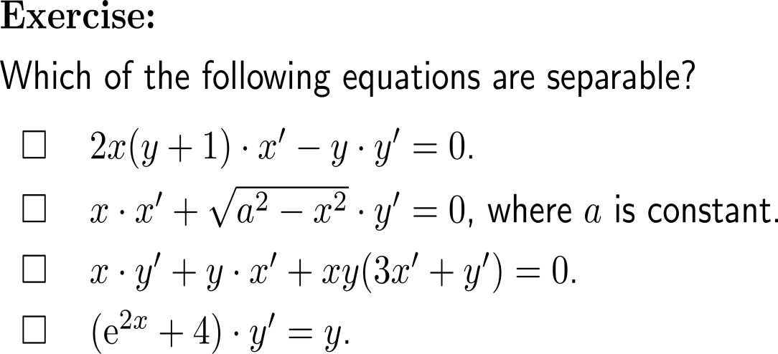
Exercise

Slide 46
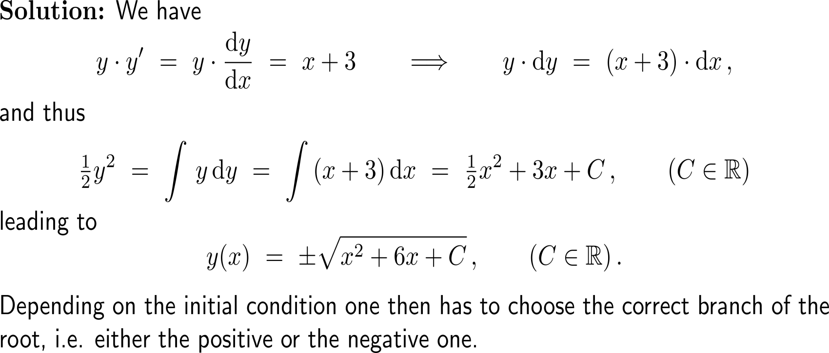
Exercise

Slide 47
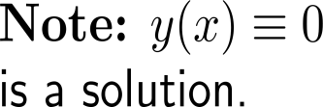
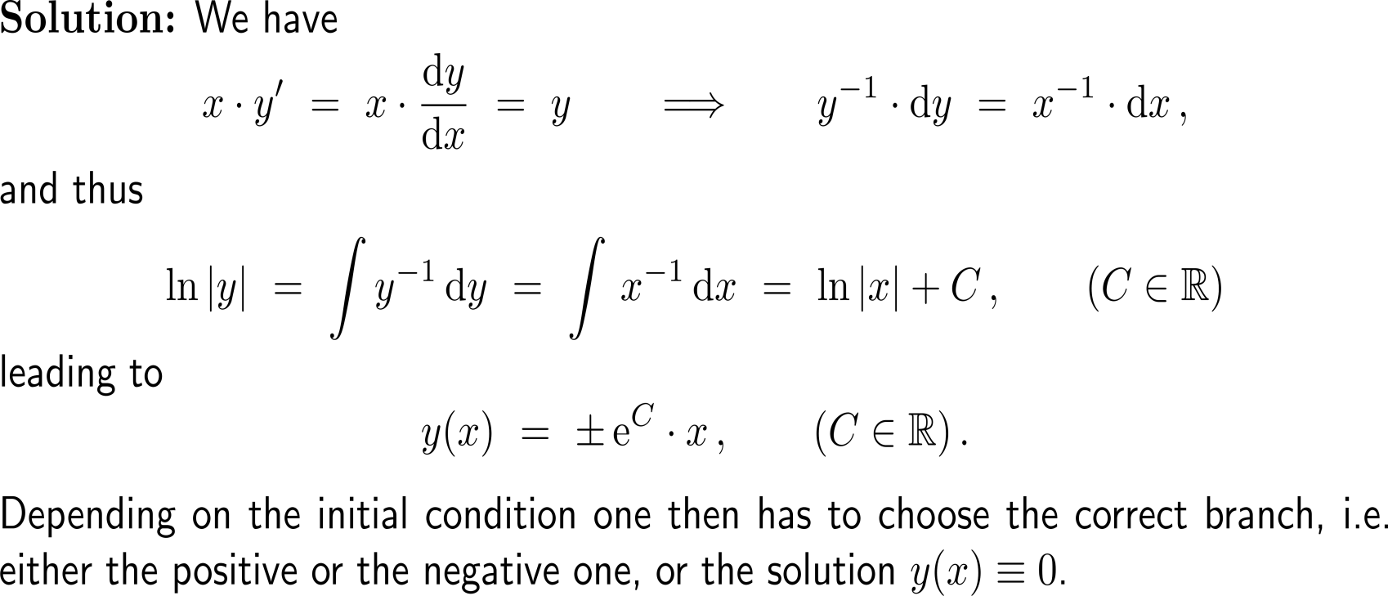
Exercise
10-15 minutes
self/ group work
please, upload your solutions to the chat

Slide 48
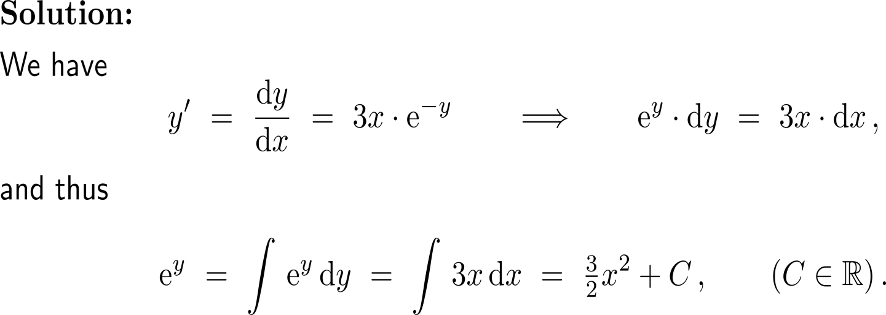
Exercise

Slide 49
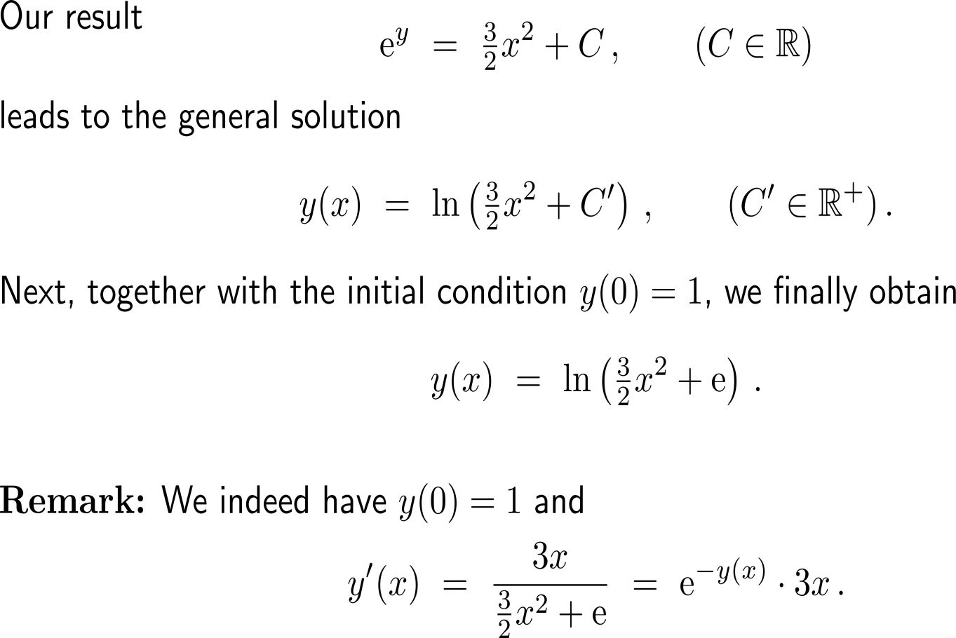
Exercise

Slide 50
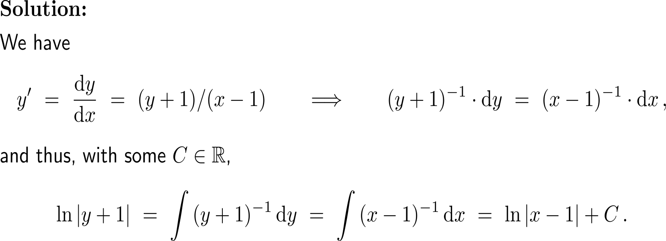
Exercise

Slide 51
Exercise

Slide 52
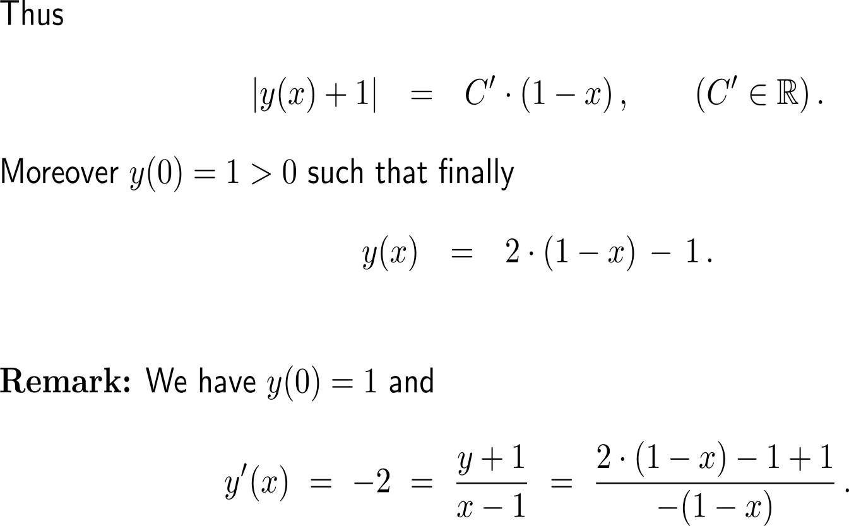
Exercise

Slide 53
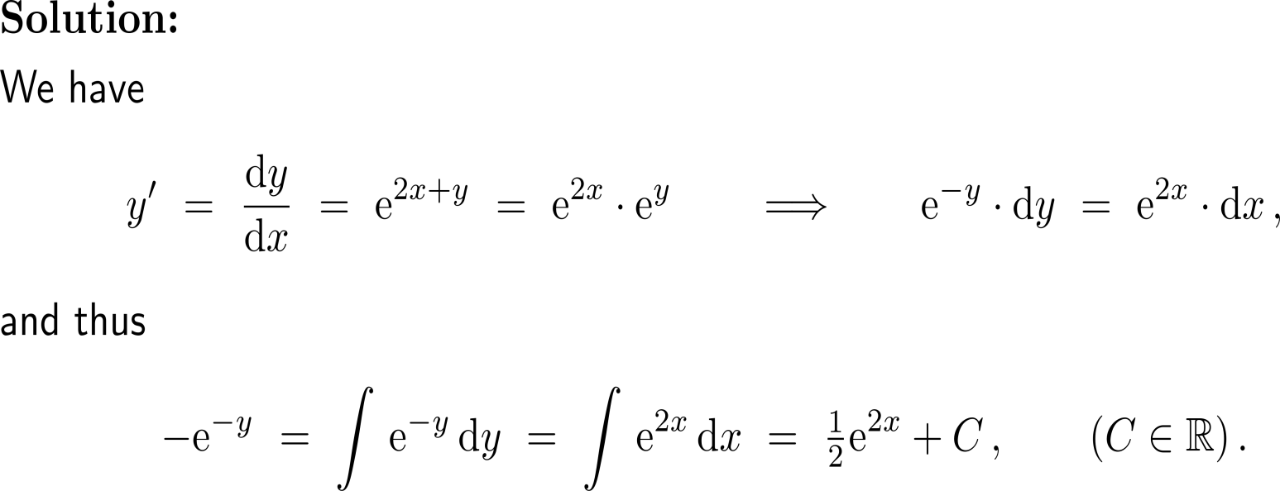
Exercise
10-15 minutes
self/ group work
please, upload your solutions to the chat

Slide 54
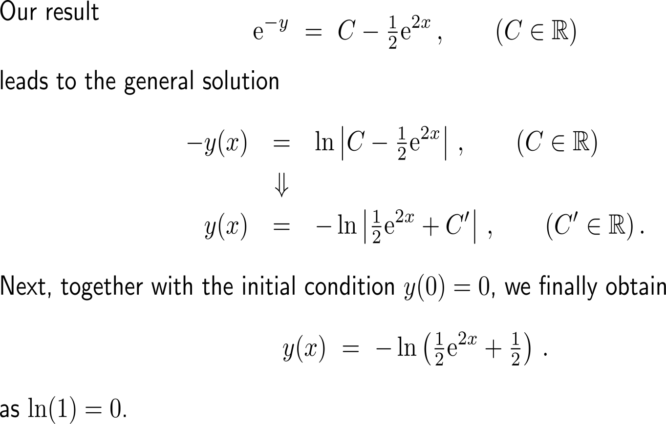
Exercise

Slide 55
Exercise

Slide 56
Exercise
Even though the solutions are expressed in terms of an integral, they can still be graphed by a computer algebra system

Slide 57
Calculus II for Management

