Slide 1
Calculus II for Management
Numeric Integration & Linear ODEs
week 7
Lecture 7
Approximation by rectangles, trapezoids and by using Simpson’s Rule
Interpreting data with numerical integration
A primer on inverse matrices

Slide 2
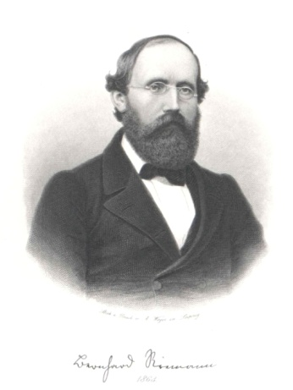
Topics
Approximation by Rectangles
Approximation by Trapezoids
Approximation Using Parabolas: Simpson’s Rule
Interpreting Data with Numerical Integration
A Primer on Inverse Matrices
Bernhard Riemann
(1826 - 1866)

Slide 3
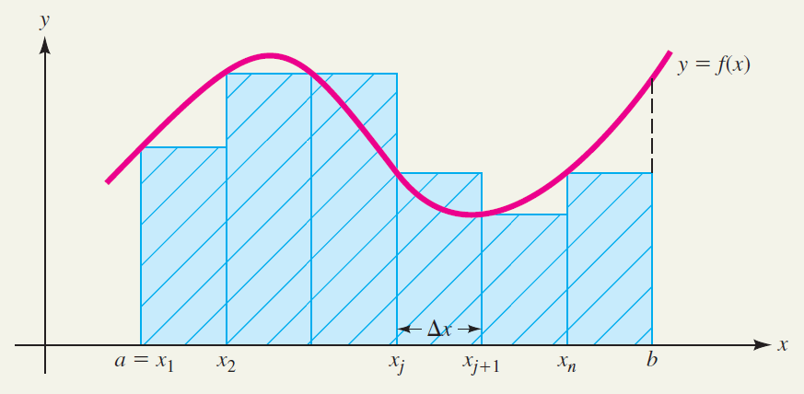
Approximation by rectangles follows the ideas we already discussed while introducing the definite integral as an area (1/ 2)

Slide 4
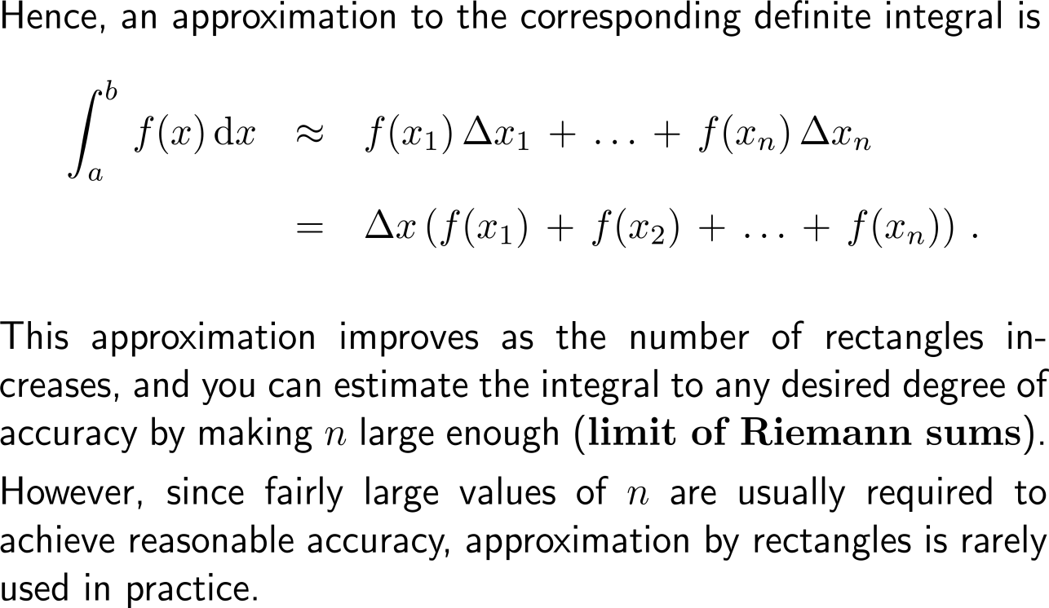
Approximation by rectangles follows the ideas we already discussed while introducing the definite integral as an area (2/ 2)

Slide 5
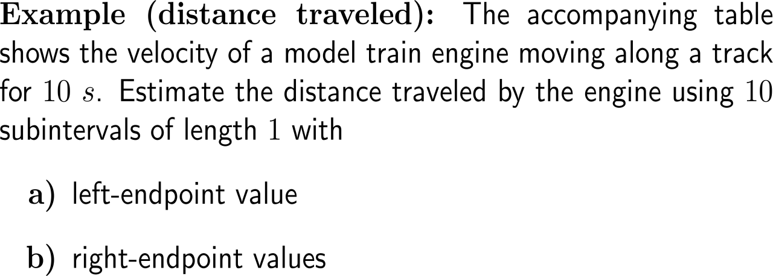
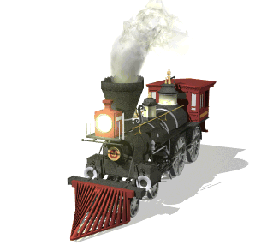
Example: Area & estimating with finite sums
time [s] | velocity [cm/ s]
0 | 0
1 | 30
2 | 56
3 | 25
4 | 38
5 | 33
6 | 28
7 | 15
8 | 5
9 | 15
10 | 0

Slide 6
Example: Area & estimating with finite sums
time [s] | velocity [cm/ s]
0 | 0
1 | 30
2 | 56
3 | 25
4 | 38
5 | 33
6 | 28
7 | 15
8 | 5
9 | 15
10 | 0

Slide 7
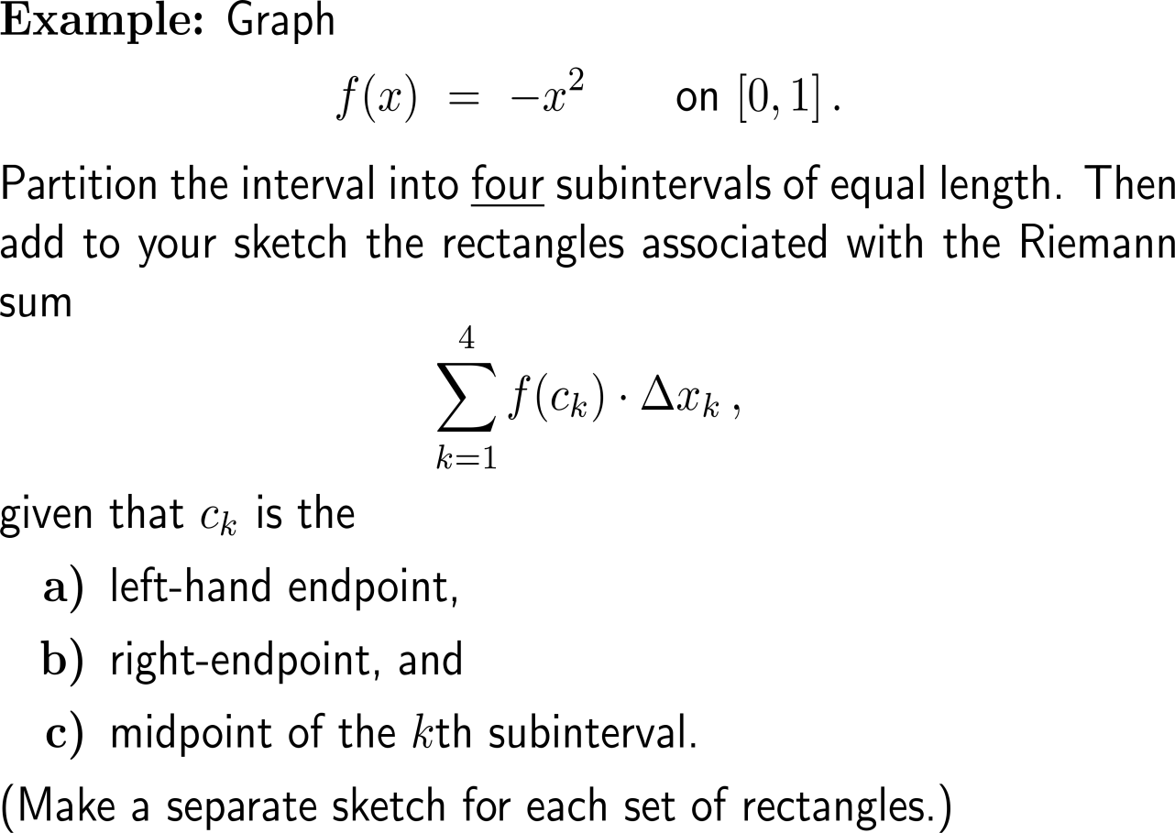
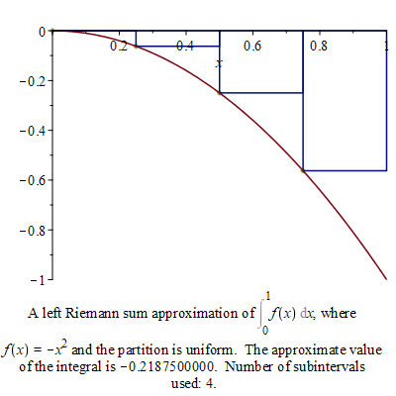
Example: Riemann Sums
a)

Slide 8
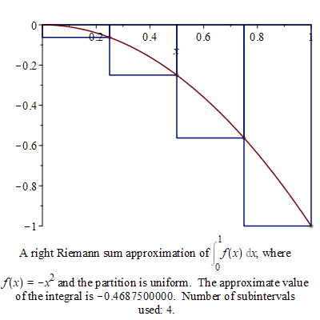
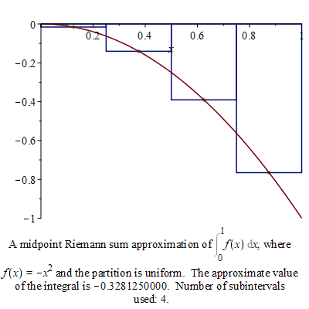
Example: Riemann Sums
b)
right endpoint evaluation
c)
midpoint evaluation

Slide 9
Topics
Approximation by Rectangles
Approximation by Trapezoids
Approximation Using Parabolas: Simpson’s Rule
Interpreting Data with Numerical Integration
A Primer on Inverse Matrices

Slide 10
The accuracy of the approximation improves when changing from a rectangular rule to the trapezoidal rule

Slide 11
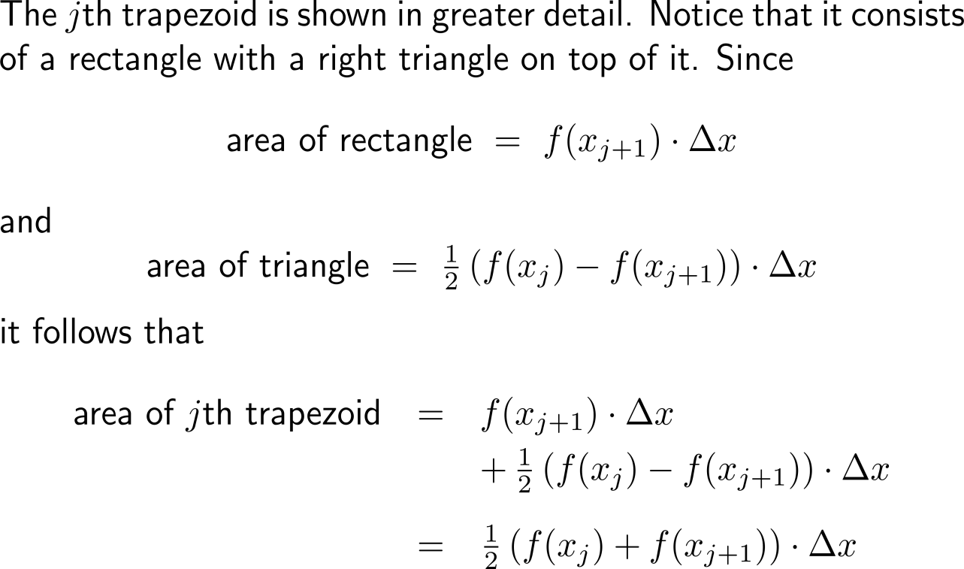
The value obtained for the area of an arbitrary trapezoid is that of the sum of a triangle and a rectangle …

Slide 12
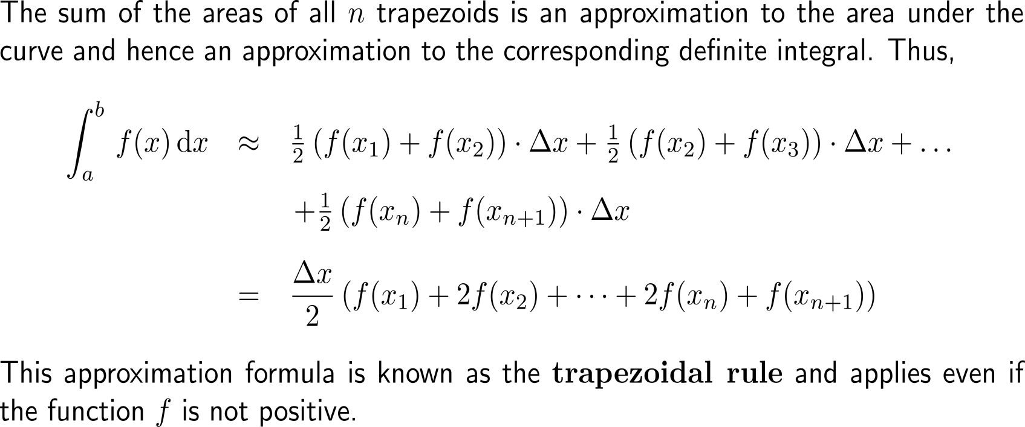
… such that we obtain a formula that uses the evaluation of the function at the start/ end point of the subintervals times a weighting factor (1/ 2)

Slide 13
… such that we obtain a formula that uses the evaluation of the function at the start/ end point of the subintervals times a weighting factor (2/ 2)

Slide 14
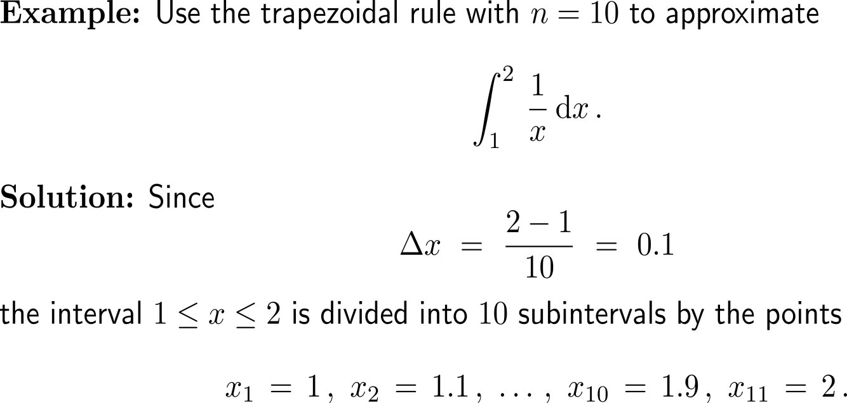
Example: Application of the Trapezoidal Rule

Slide 15
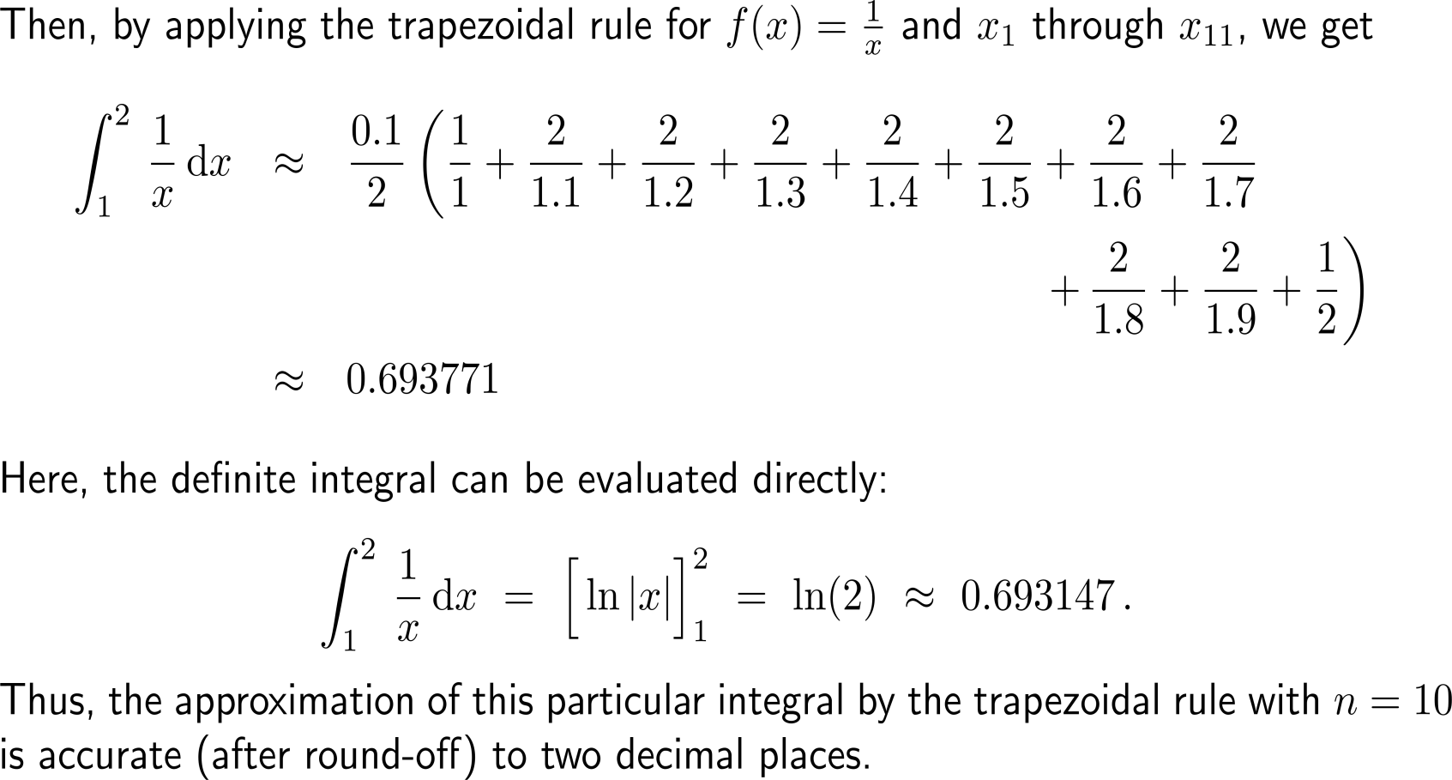
Example: Application of the Trapezoidal Rule

Slide 16
The error estimate for the trapezoidal rule allows to specify (i) the accuracy of the approximation and (ii) the required number of subintervals

Slide 17
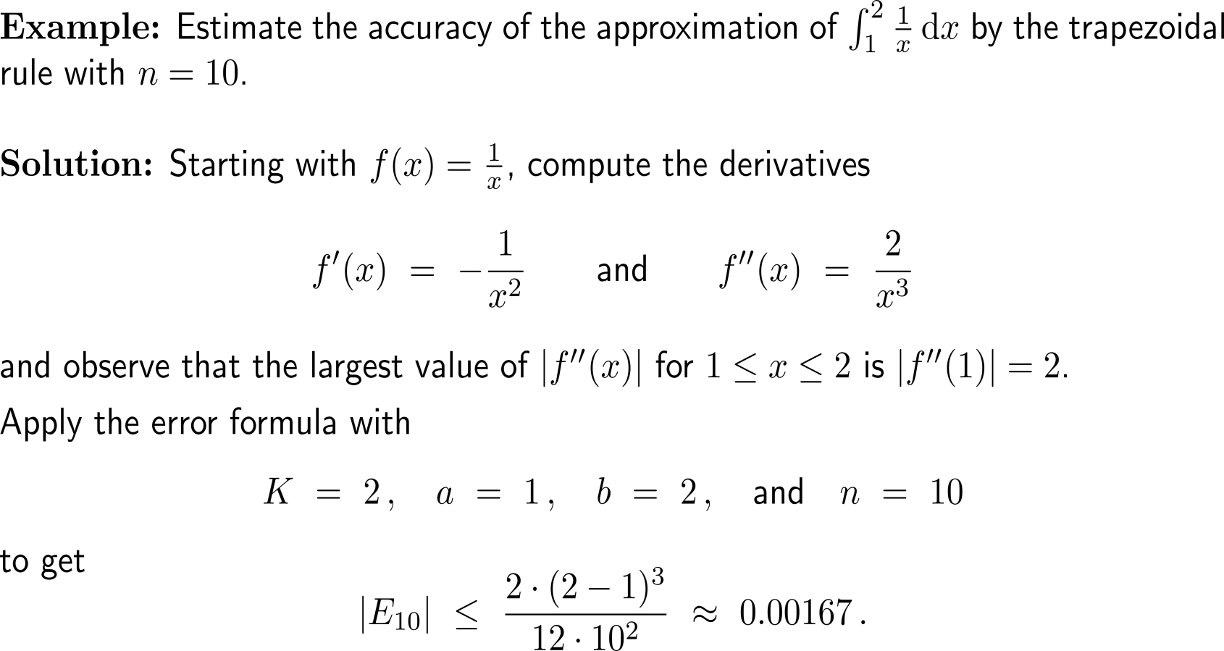
Example: Using error estimates for the Trapezoidal Rule

Slide 18
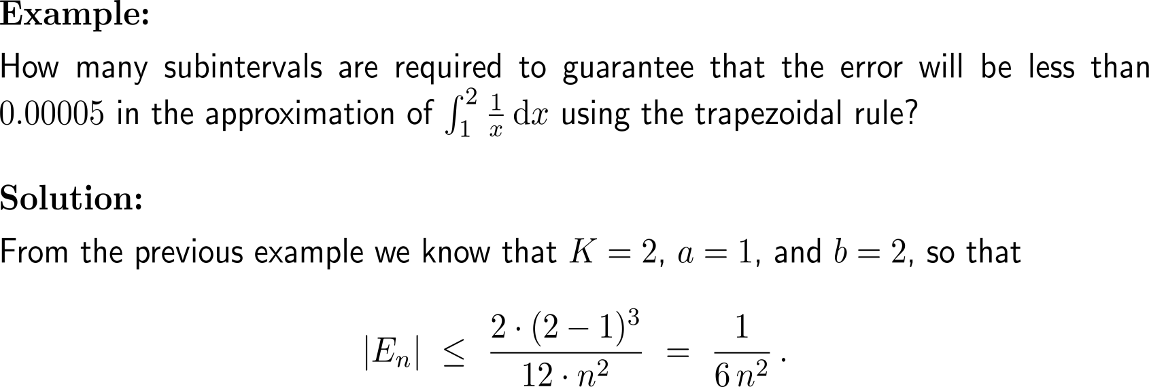
Example: Ensuring a certain level of accuracy

Slide 19
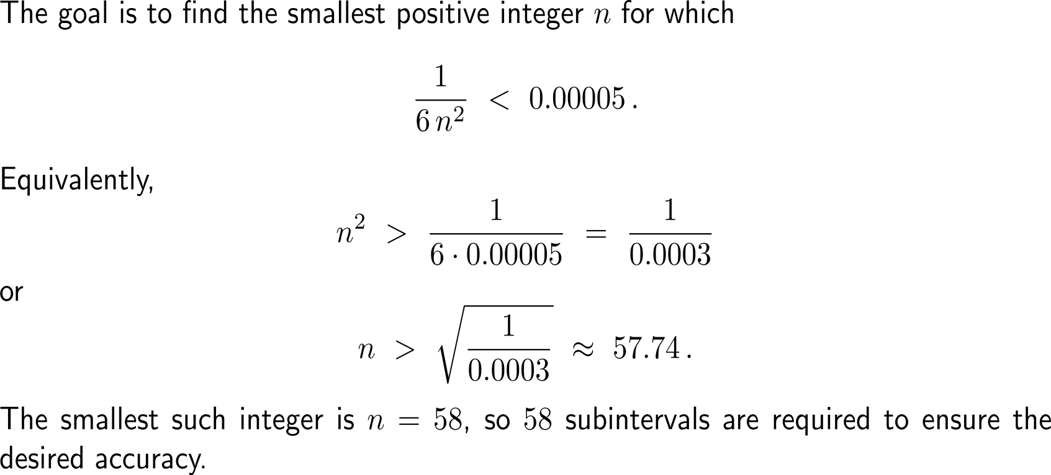
Example: Ensuring a certain level of accuracy

Slide 20
Topics
Approximation by Rectangles
Approximation by Trapezoids
Approximation Using Parabolas: Simpson’s Rule
Interpreting Data with Numerical Integration
A Primer on Inverse Matrices

Slide 21
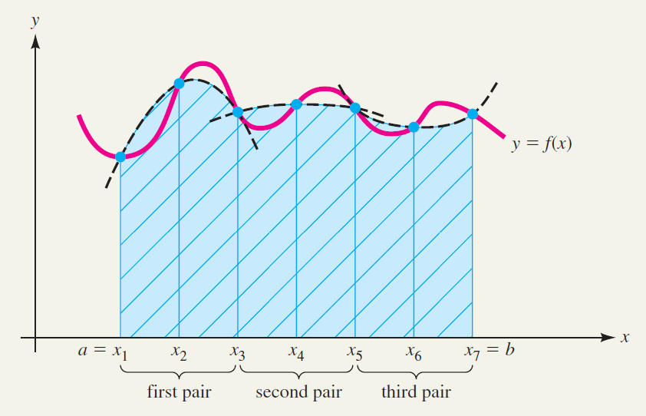
Simpson’s rule uses parabolas for the estimation of a definite integral and often leads to significantly better results with fewer calculations (1/ 2)

Slide 22
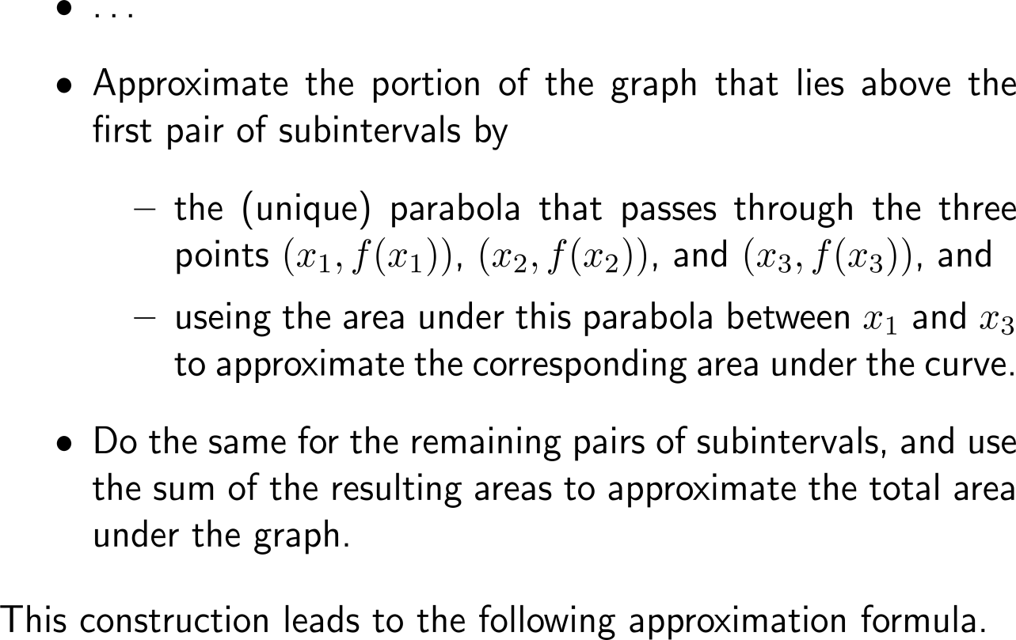
Simpson’s rule uses parabolas for the estimation of a definite integral and often leads to significantly better results with fewer calculations (2/ 2)

Slide 23
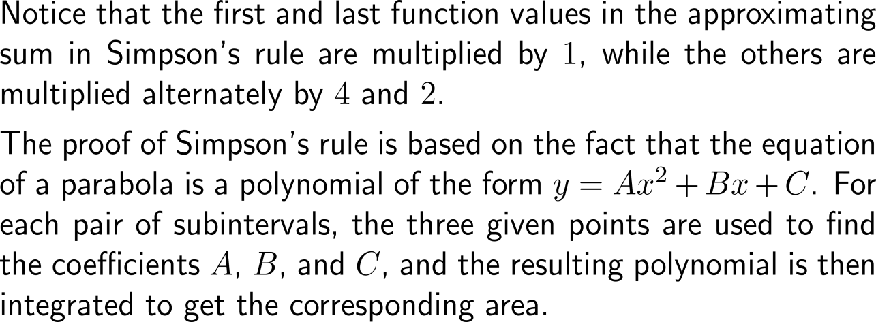
As the trapezoidal rule, Simpson’s rule uses the evaluation of the function at the start/ end point of the subintervals times a weighting factor

Slide 24
Example: Application of Simpson’s Rule

Slide 25
Example: Application of Simpson’s Rule

Slide 26
The error estimate for Simpson’s rule allows to specify (i) the accuracy of the approximation and (ii) the required number of subintervals

Slide 27
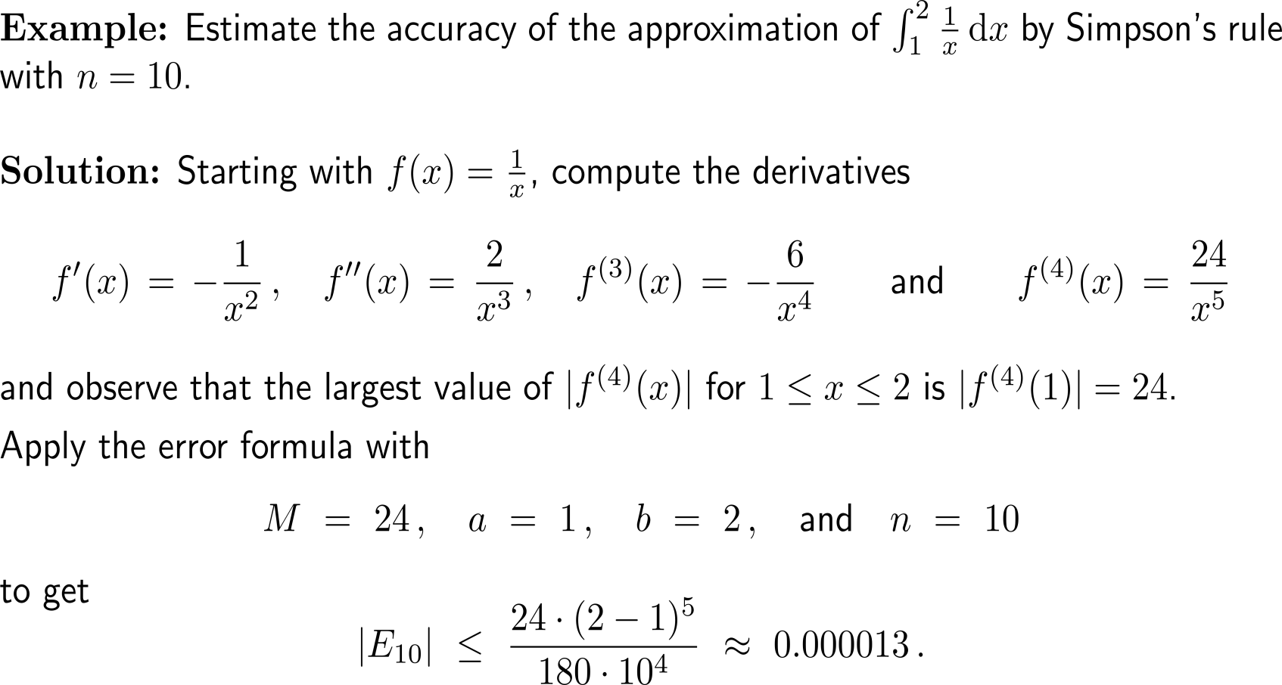
Example: Using error estimates for Simpson’s Rule

Slide 28
Example: Ensuring a certain level of accuracy

Slide 29
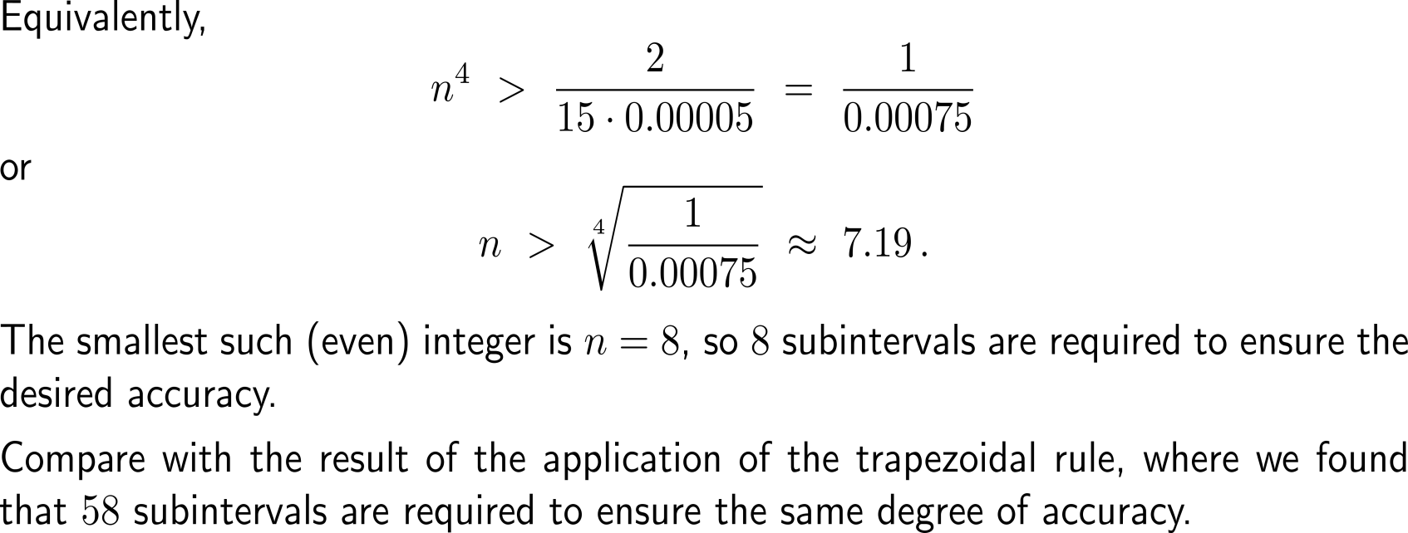
Example: Ensuring a certain level of accuracy

Slide 30
Topics
Approximation by Rectangles
Approximation by Trapezoids
Approximation Using Parabolas: Simpson’s Rule
Interpreting Data with Numerical Integration
A Primer on Inverse Matrices

Slide 31
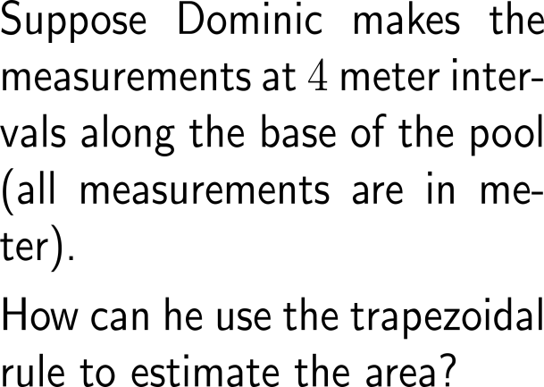
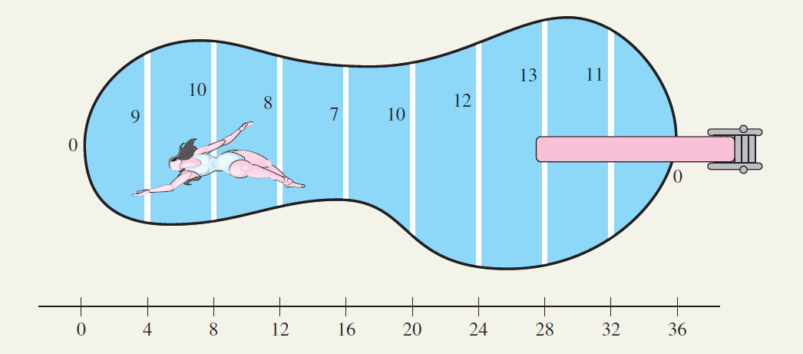
Example: Finding an area using numerical integration

Slide 32
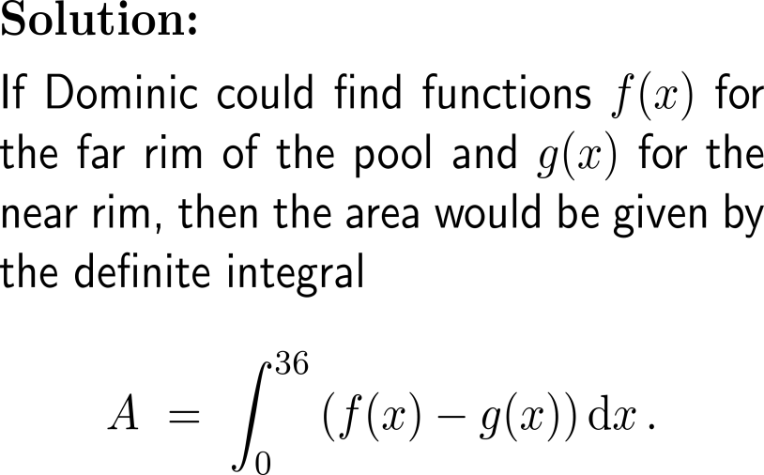
Example: Finding an area using numerical integration
x | f(x) – g(x)
0 | 0
4 | 9
8 | 10
12 | 8
16 | 7
20 | 10
24 | 12
28 | 13
32 | 11
36 | 0

Slide 33
Example: Finding an area using numerical integration
x | f(x) – g(x)
0 | 0
4 | 9
8 | 10
12 | 8
16 | 7
20 | 10
24 | 12
28 | 13
32 | 11
36 | 0
Note, Simpson’s rule is not applicable as we have a odd number of subintervals

Slide 34
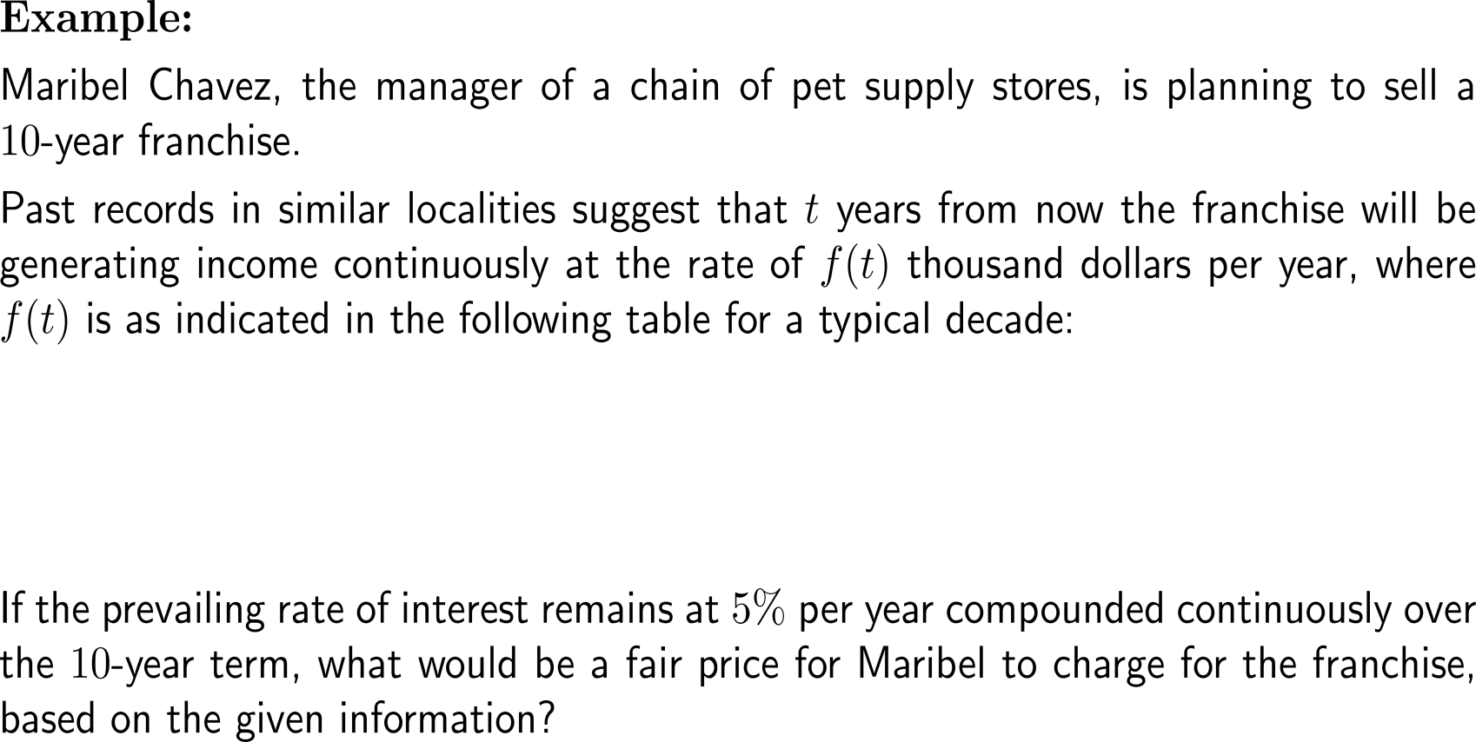
Example: Finding a fair price using numerical integration
year t | 0 | 1 | 2 | 3 | 4 | 5 | 6 | 7 | 8 | 9 | 10
rate of income flow f(t) | 510 | 580 | 610 | 625 | 654 | 670 | 642 | 610 | 590 | 732 | 550

Slide 35
Example: Finding a fair price using numerical integration

Slide 36
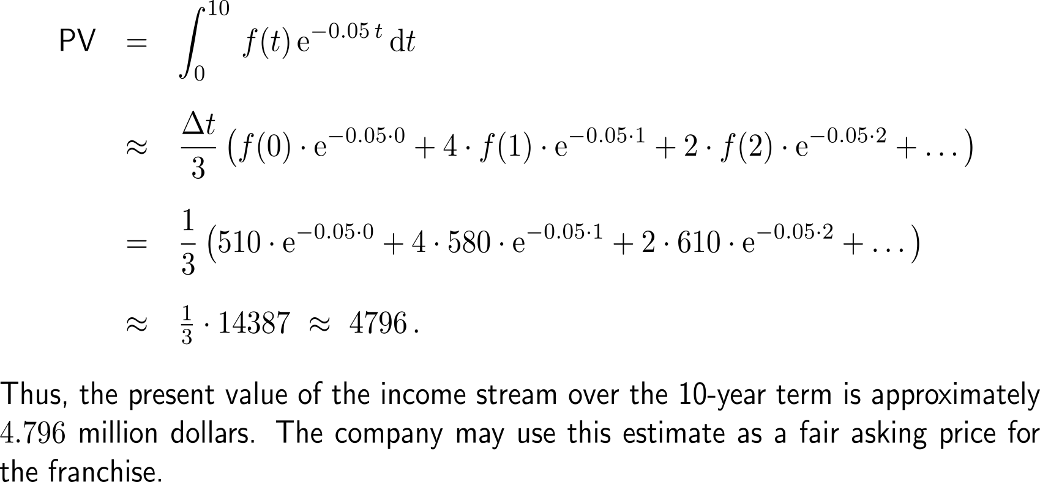
Example: Finding a fair price using numerical integration

Slide 37
Topics
Approximation by Rectangles
Approximation by Trapezoids
Approximation Using Parabolas: Simpson’s Rule
Interpreting Data with Numerical Integration
A Primer on Inverse Matrices

Slide 38
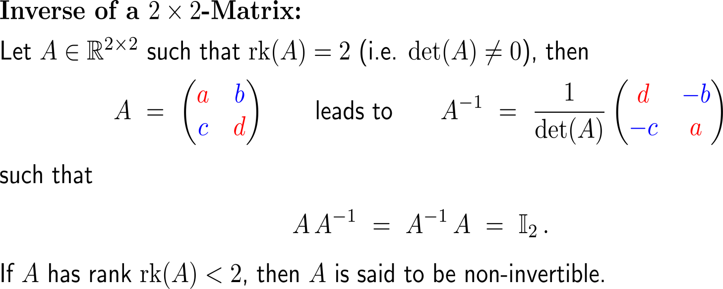
The inverse of a 2x2-matrix is easily obtained by virtue of an rather effortlessly to remember formula

Slide 39
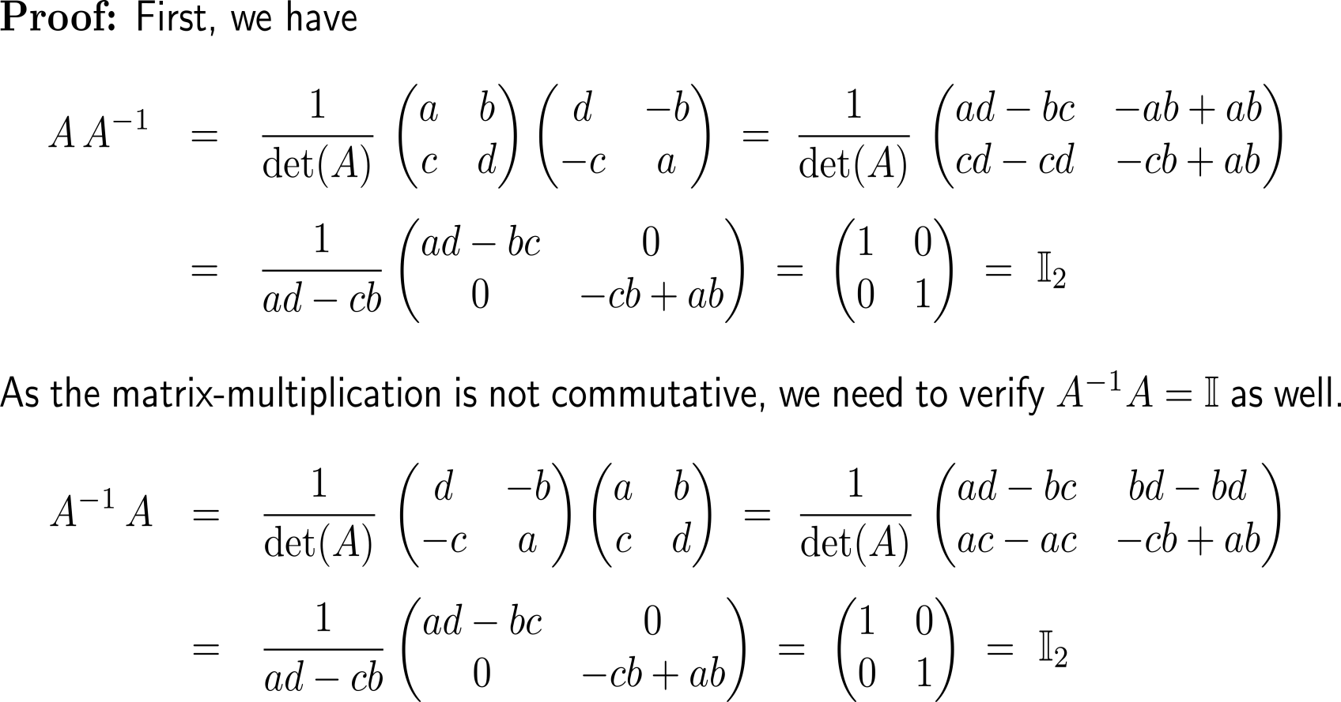
Proof: Formula for the inverse of a 2x2 matrix

Slide 40
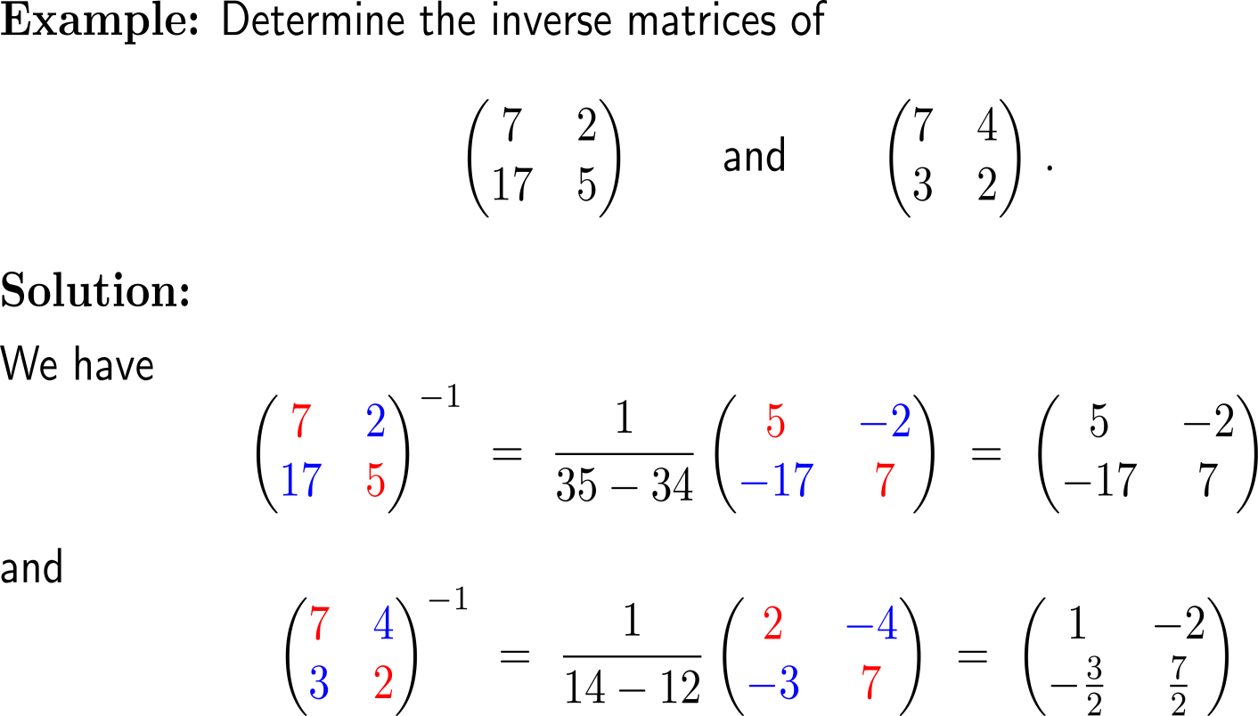
Example: Application of the formula for the inverse of a 2x2-matrix

Slide 41
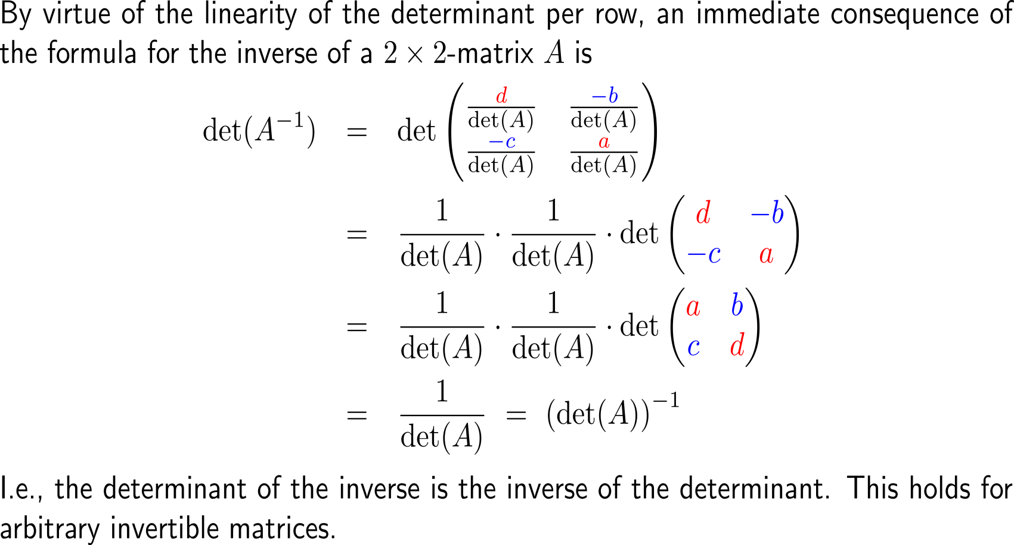
The determinant of the inverse is the inverse of the determinant (1/ 2)

Slide 42
The determinant of the inverse is the inverse of the determinant (2/ 2)

Slide 43
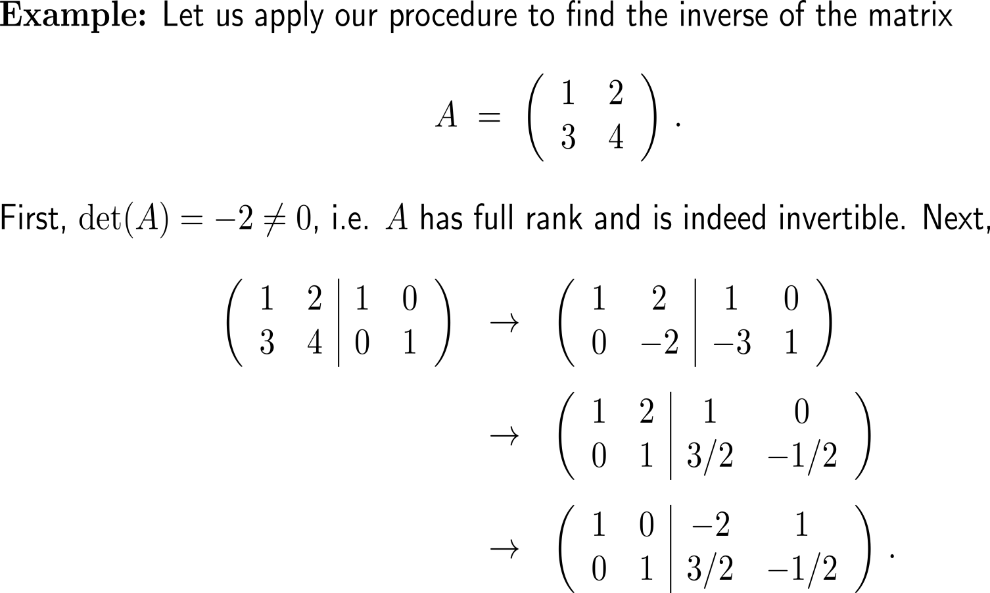
Example: Computation of the inverse of a 2x2 matrix

Slide 44
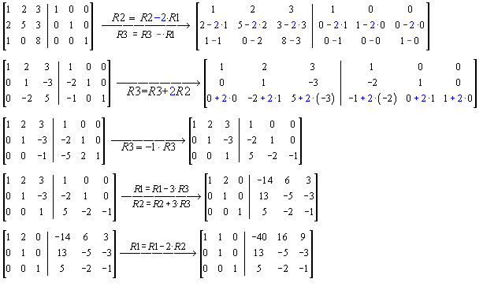
Example: Computation of the inverse of a 3x3 matrix
A
A⁻¹

Slide 45
Further Worked-Out Exercises:
Calculus II for Management
Topics
Approximation by Rectangles
Approximation by Trapezoids
Approximation by Simpson’s Rule
Inverse Matrices

Slide 46
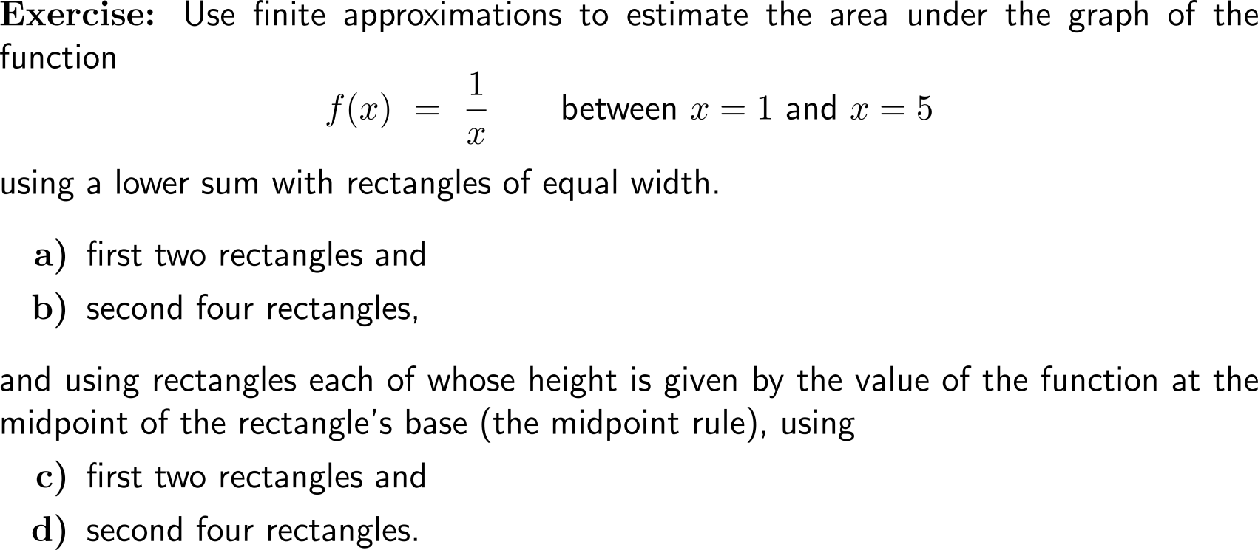
Exercise: Area & estimating with finite sums
7 minutes
self/ group work
Lower Sum Rule
Midpoint
Rule
Please, upload your solutions to the chat.

Slide 47
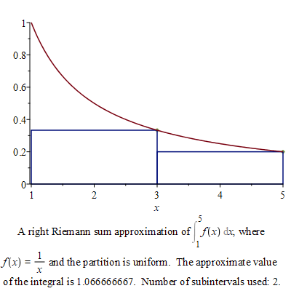
Exercise: Area & estimating with finite sums
Discussion
Lower Sum Rule

Slide 48
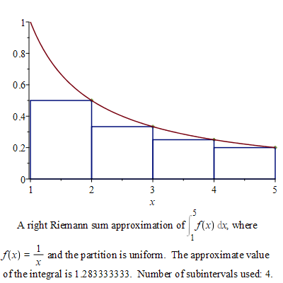
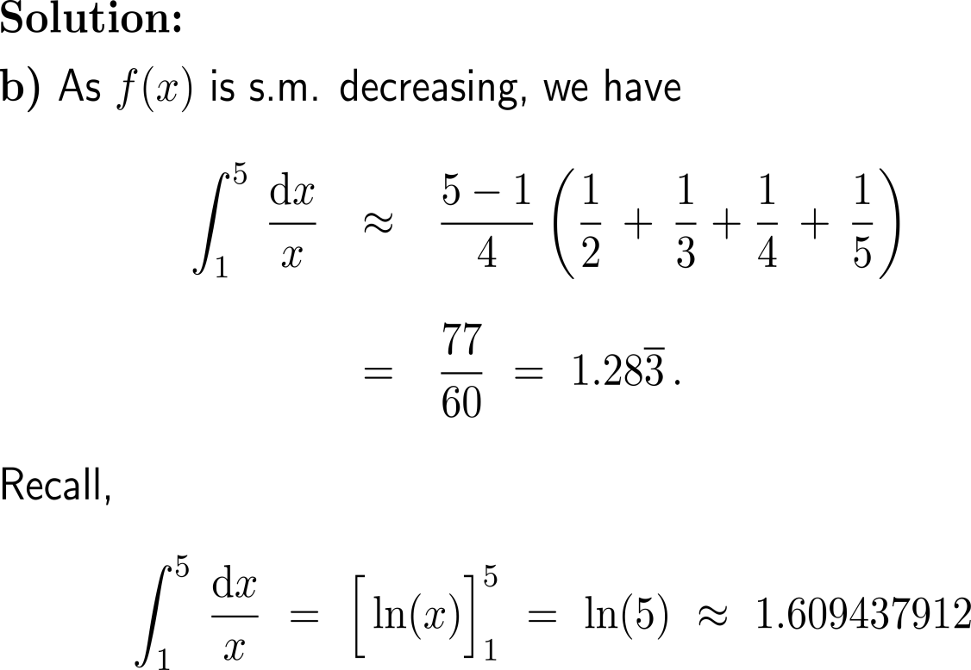
Exercise: Area & estimating with finite sums
Discussion
Lower Sum Rule
with(Student[Calculus1])
RiemannSum(1/x, x = 1 .. 5, method = right, partition = 4, output = plot)

Slide 49
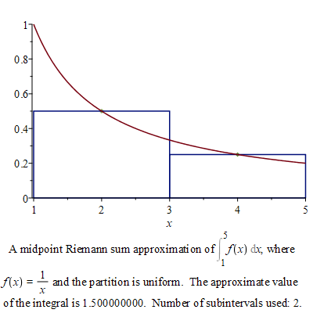
Exercise: Area & estimating with finite sums
Discussion
Midpoint
Rule

Slide 50
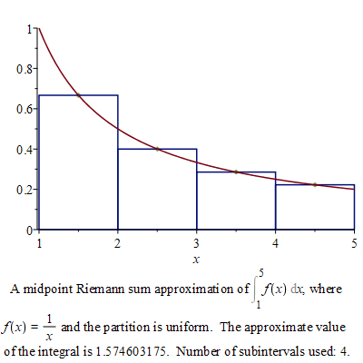
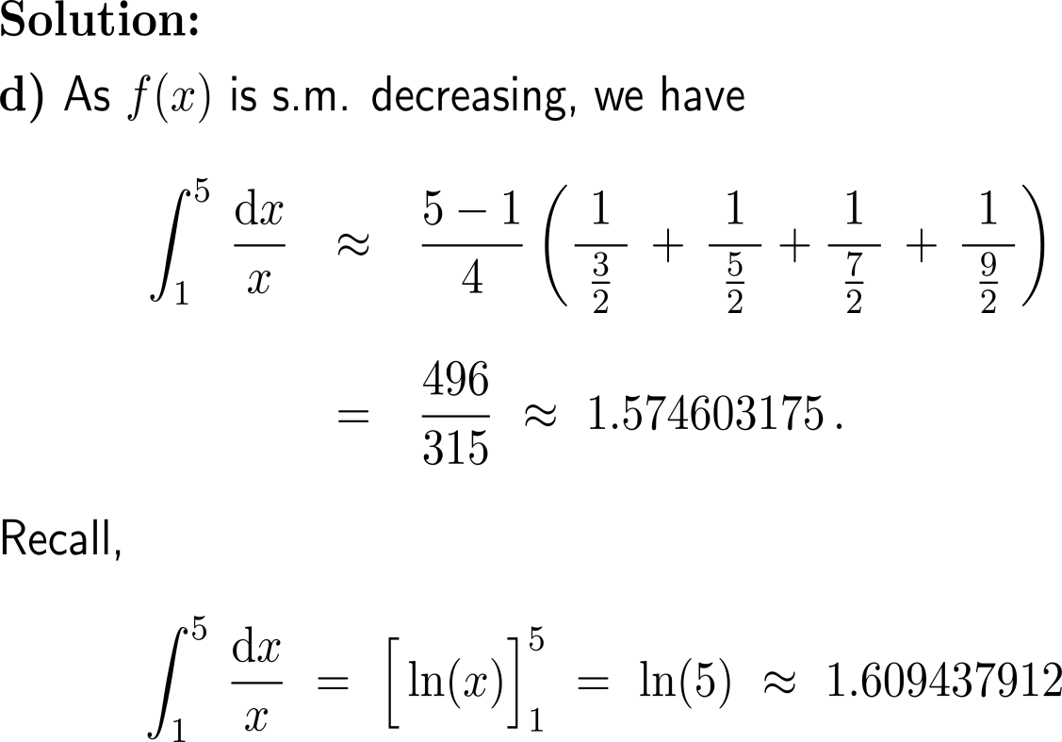
Exercise: Area & estimating with finite sums
Discussion
Midpoint
Rule
with(Student[Calculus1])
RiemannSum(1/x, x = 1 .. 5, method = midpoint, partition = 4, output = plot)

Slide 51
Exercise: Limits of Riemann Sums
0
3

Slide 52
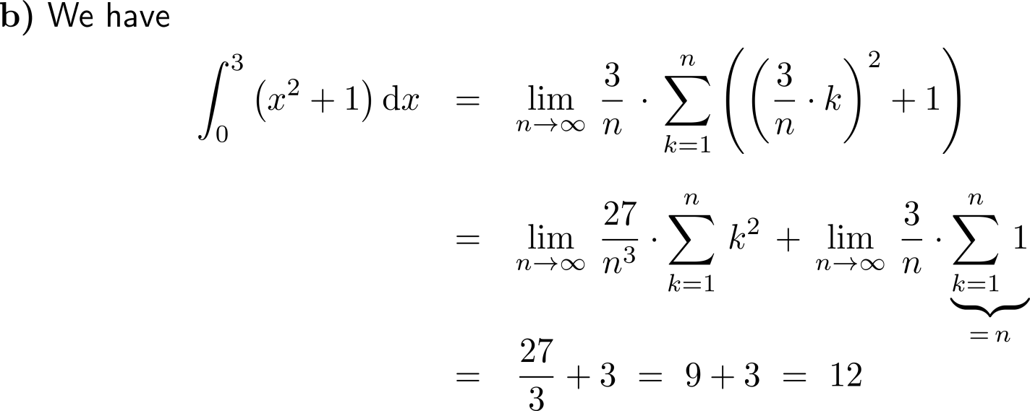
Exercise: Limits of Riemann Sums
0
3
(proof by induction)

Slide 53
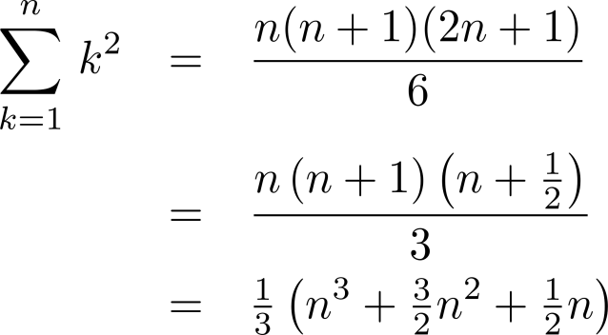
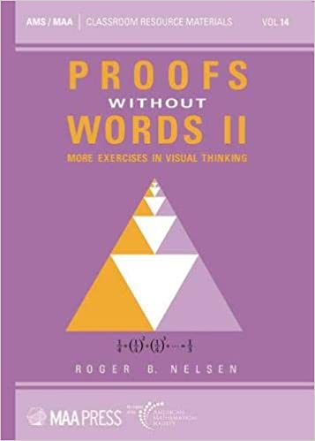
For you self-study discussion: a proof without words for the formula of the sum of the first n squares

Slide 54
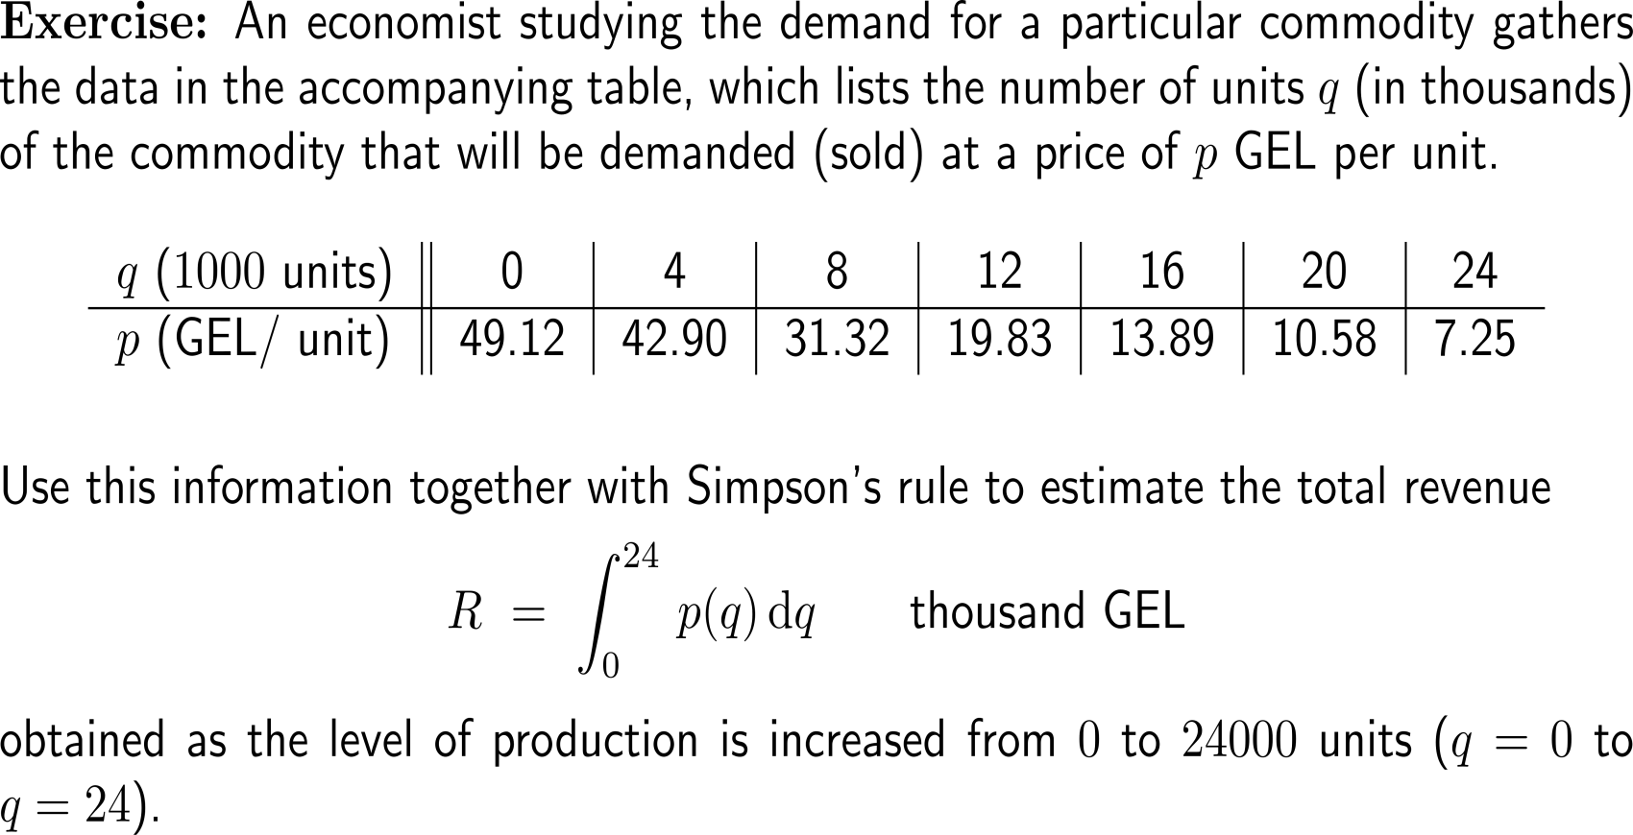
Exercise: Application of the Simpson’s rule

Slide 55
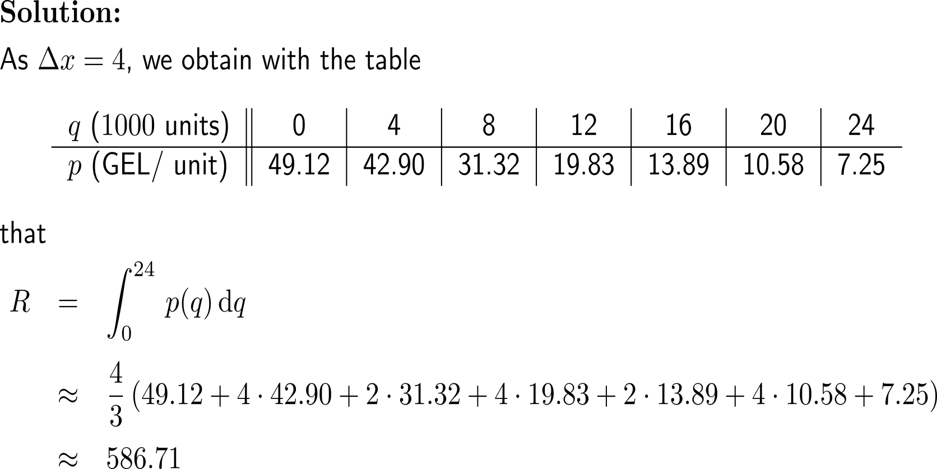
Exercise: Application of the Simpson’s rule

Slide 56
Exercise: Application of the Simpson’s rule

Slide 57
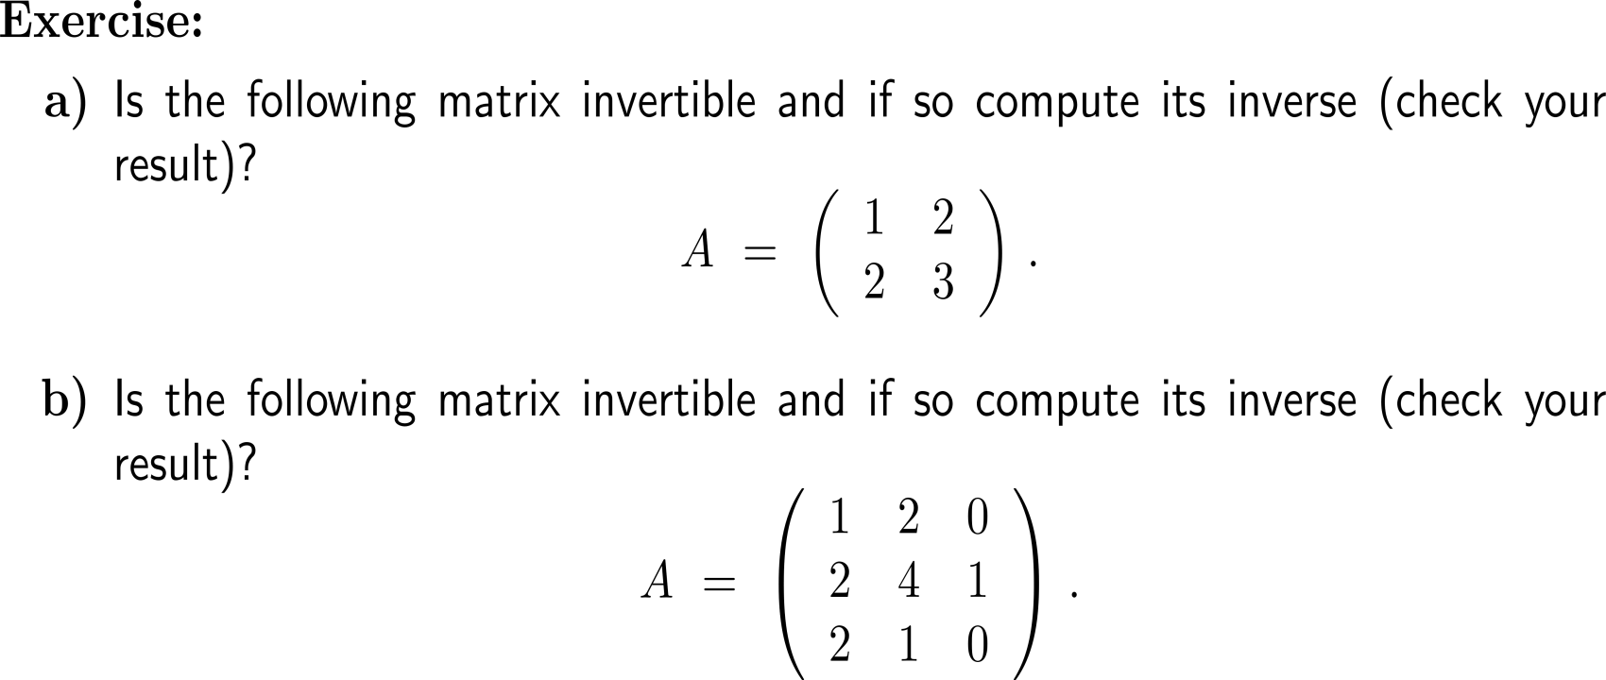
Exercise Invertible matrices

Slide 58
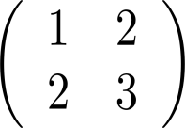
Exercise Invertible matrices

Slide 59
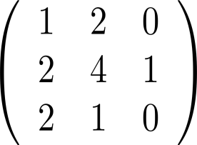
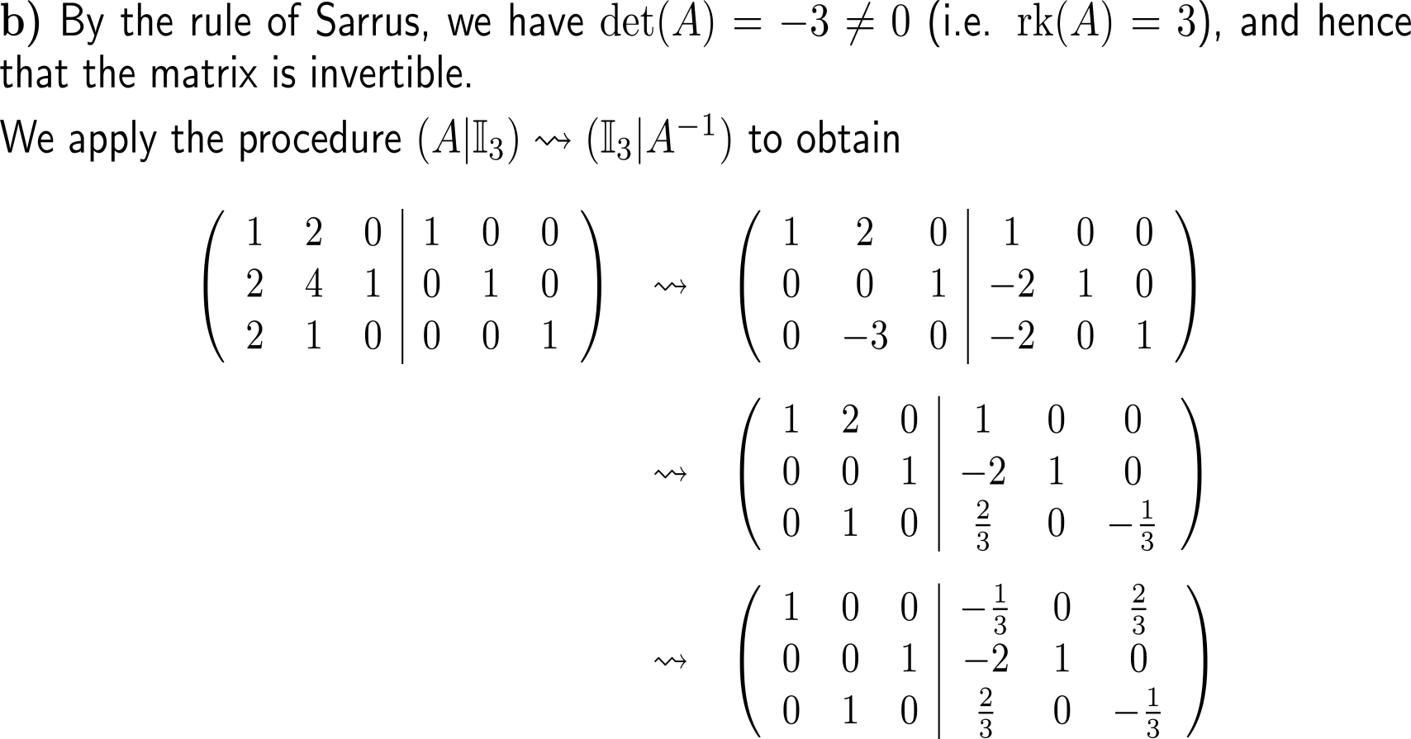
Exercise Invertible matrices
(II) – 2x (I)
(III) – 2x (I)
A
(III)/ (-3)
(I) – 2x (III)

Slide 60
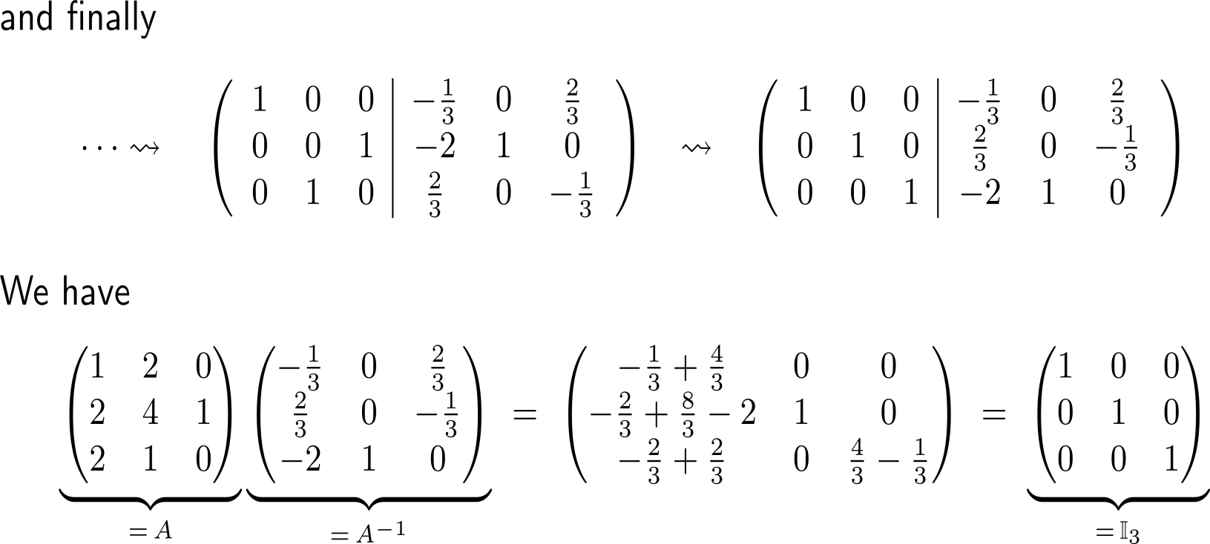
Exercise Invertible matrices
swap (II) and (III)
A⁻¹

Slide 61
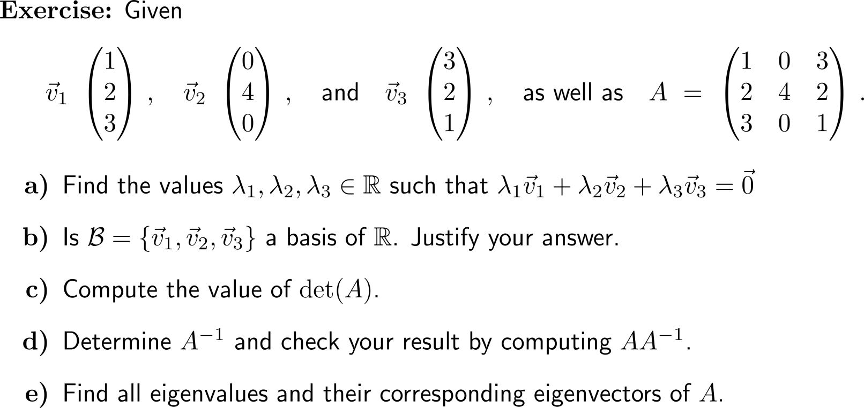
Exercise: Summarizing our findings

Slide 62
Exercise: Summarizing our findings

Slide 63
Exercise: Summarizing our findings
A
A⁻¹

Slide 64
Exercise: Summarizing our findings

Slide 65
Exercise: Linear Algebra 1

Slide 66
Exercise: Linear Algebra 1

Slide 67
Calculus II for Management

