Slide 1
Calculus II for Management
Introduction to Continuous Probability
week 8
Lecture 7
  Continuous random variables & probability density functions (PDF)
  Examples:
  Uniform PDF
  Exponential PDF
  Normal PDF

Slide 2
Topics
  Continuous Random Variables & Probability Density Functions
  Uniform Density Functions
  Exponential Density Functions
  Normal Density Functions

Slide 3

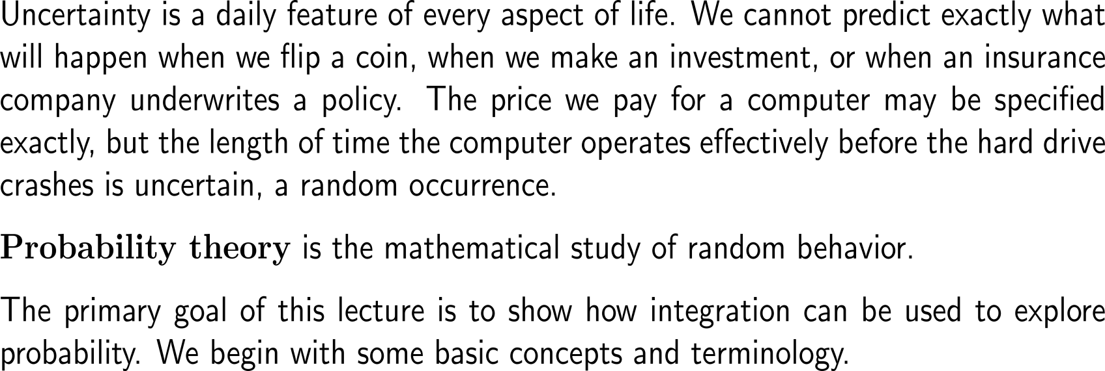
The primary goal of this lecture is to show how integration can be used to explore probability

Slide 4
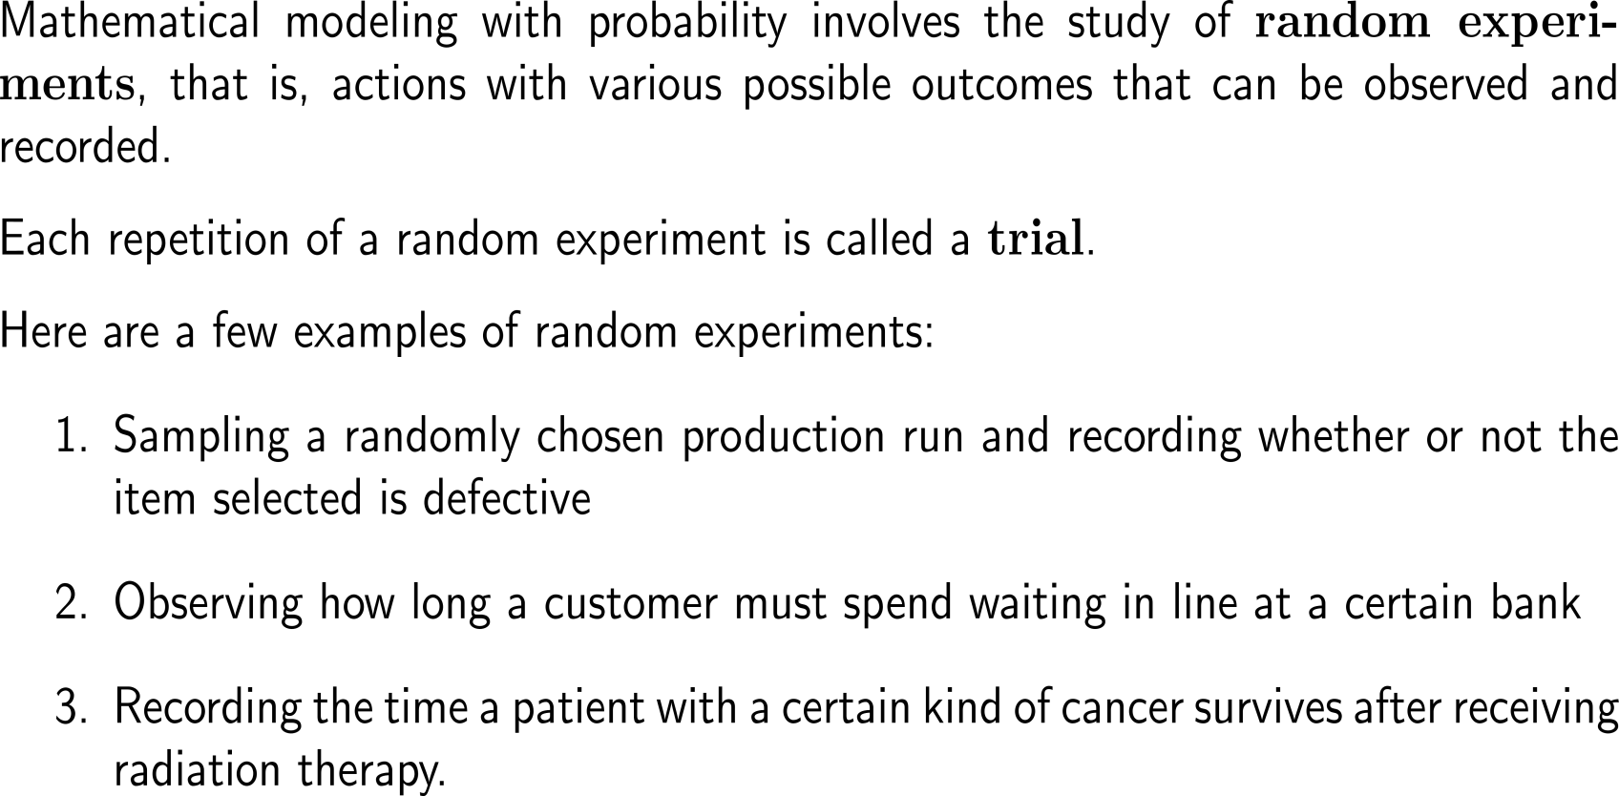
Mathematical modeling with probability involves the study of random experiments, …

Slide 5
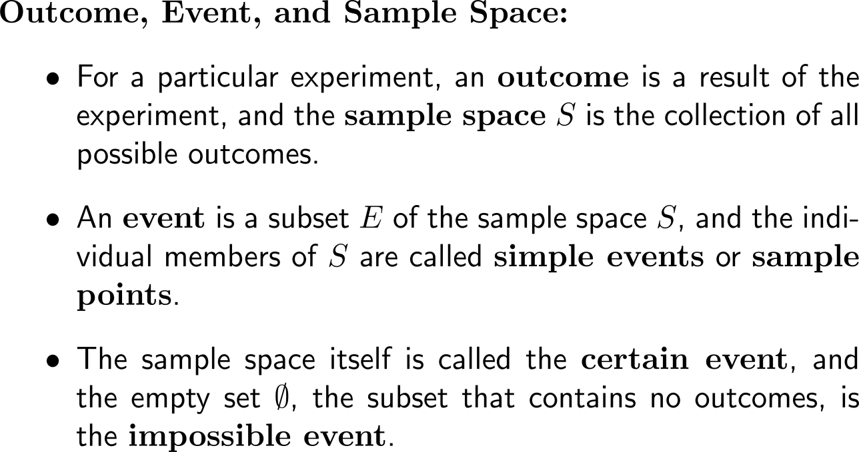
… which is based on the discussion of sub-sets of the sample space (i.e. the collection of all possible outcomes)
Sample Space
S
E

Slide 6
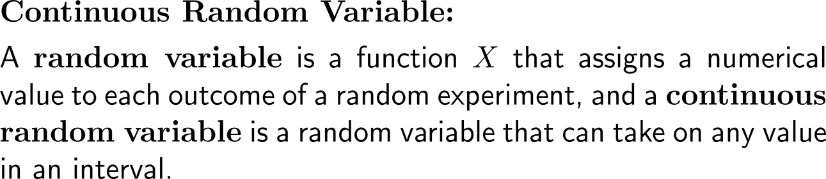
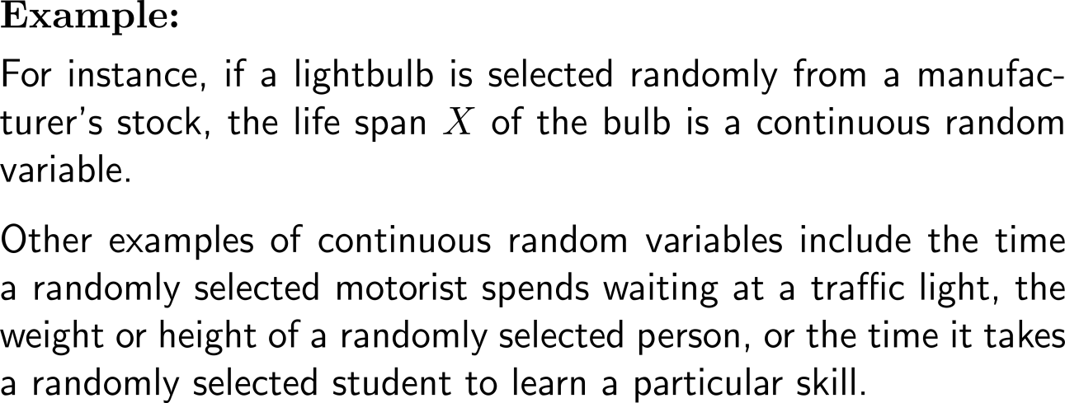
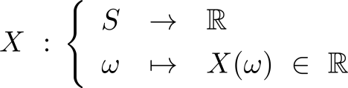
A random variable assigns a numerical value to each outcome of a random experiment
Sample Space
S
E
Cont. Random Variable

Slide 7
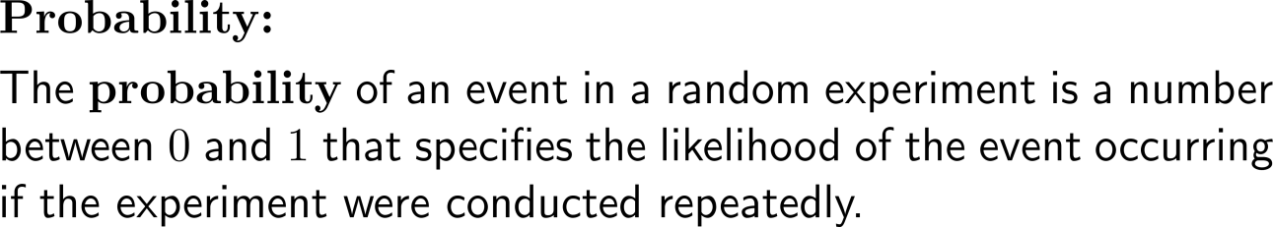
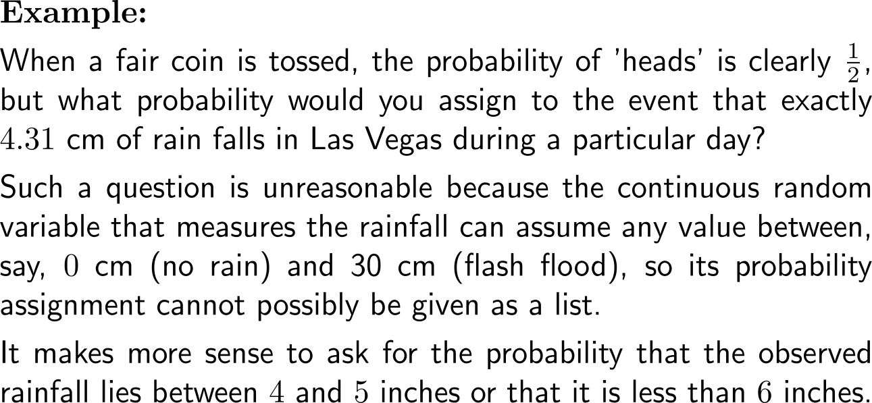
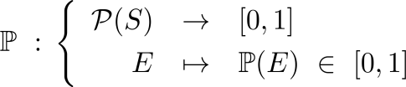
The probability assigns a likelihood between 0 and 1 to each outcome of a random experiment in the long run
Sample Space
S
E
Cont. Random Variable
Probability

Slide 8
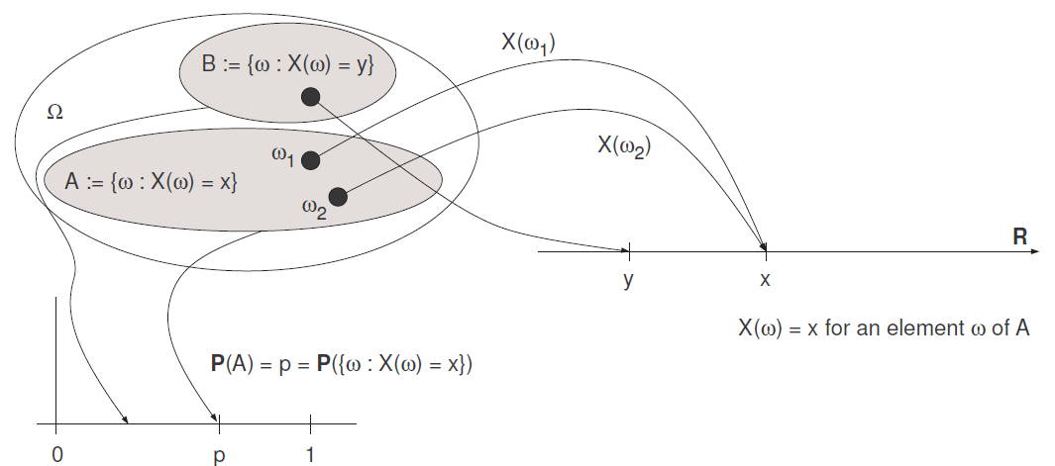
Intermediate Summary:
Sample space, random variable, and probability
S
Probabilities are set-functions that assign a number between 0 and 1 to a set of points of the sample space S. Their domain is the set of events of a random experiment and their range is contained in the interval [0; 1].
A random variable is also a function whose range is a set of real numbers, but whose domain is the set of sample points ! 2 S making up the whole sample space S (not subsets of S).

Slide 9
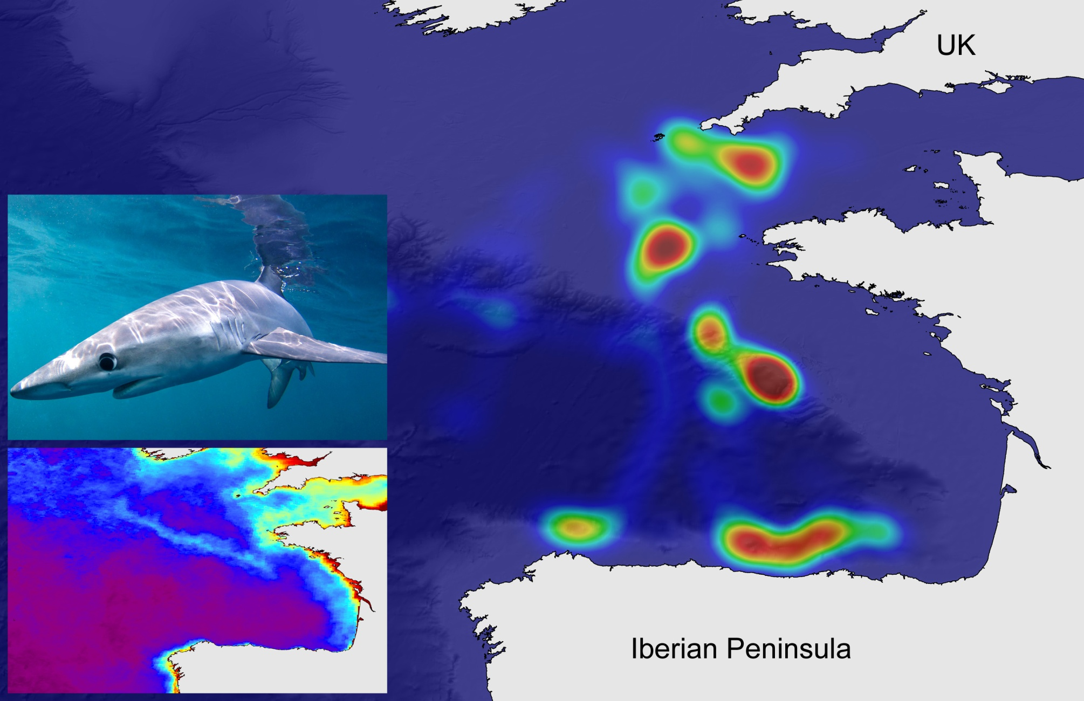
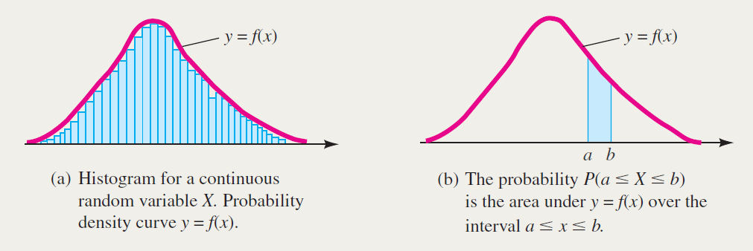
It is common to describe stochastic phenomena by means of (probability) densities
(probability) densities link random variables with probabilities

Slide 10
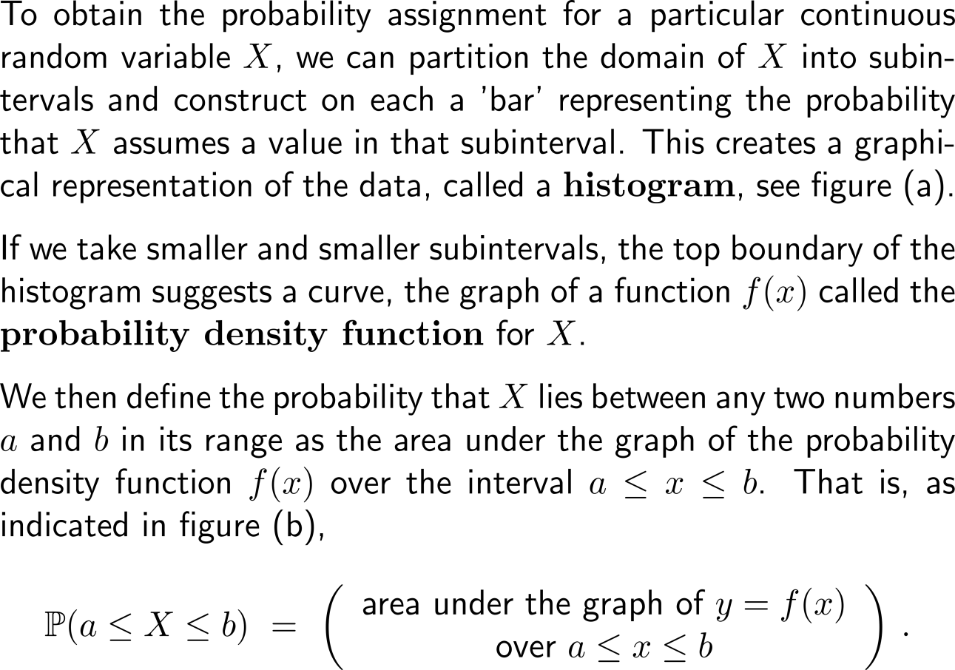
Probability density functions are the limits of histograms of the corresponding random variable for infinitesimal refined subintervals

Slide 11
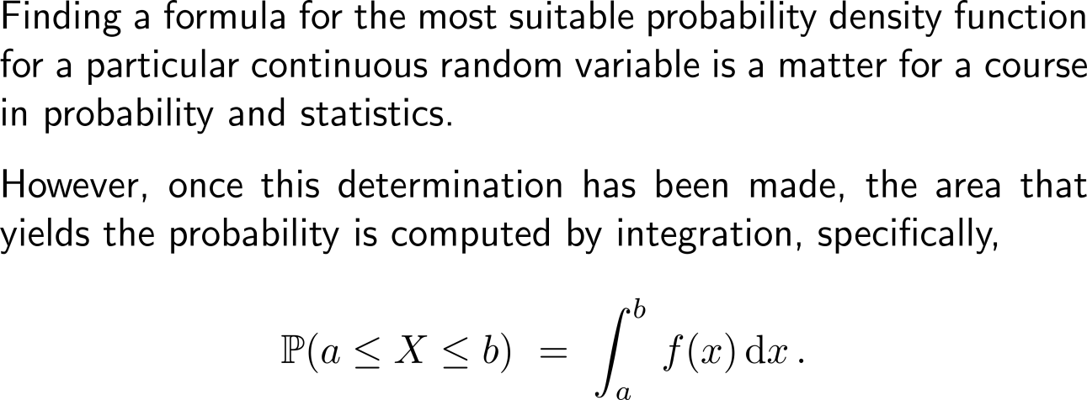
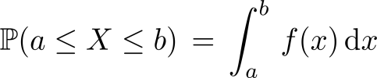
A probability can be represented as an integral of the probability density function of the corresponding random variable
Sample Space
S
E
Cont. Random Variable
Probability

Slide 12
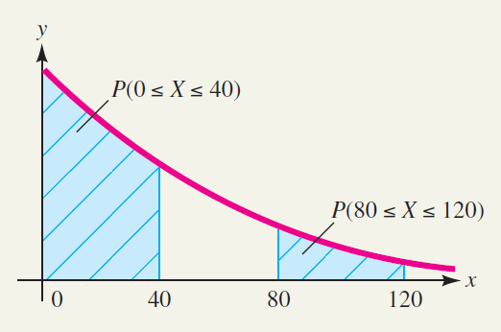
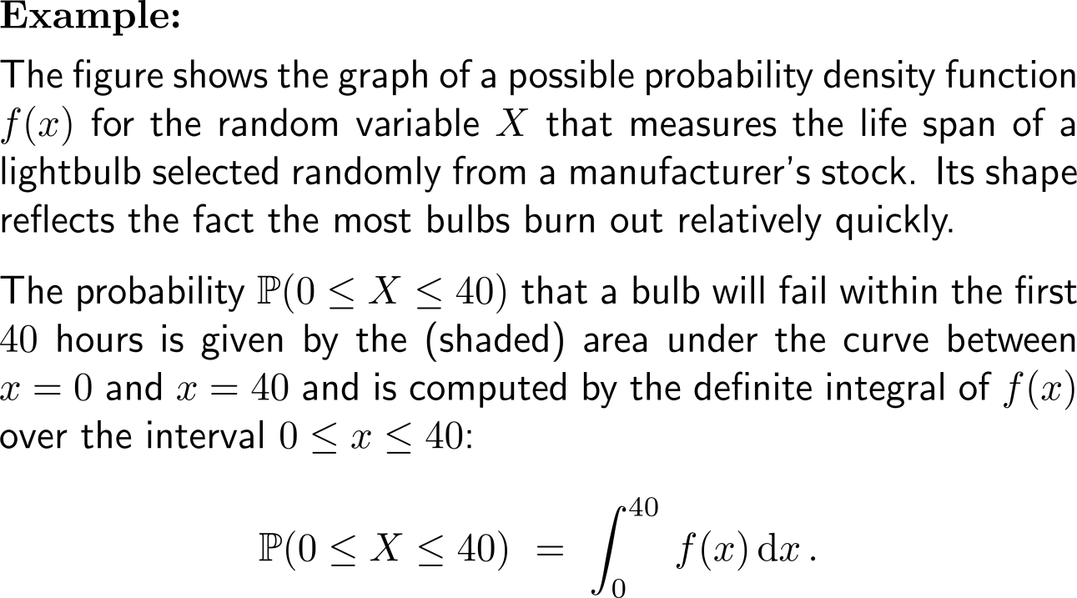
Example:
Probability density function and probability

Slide 13
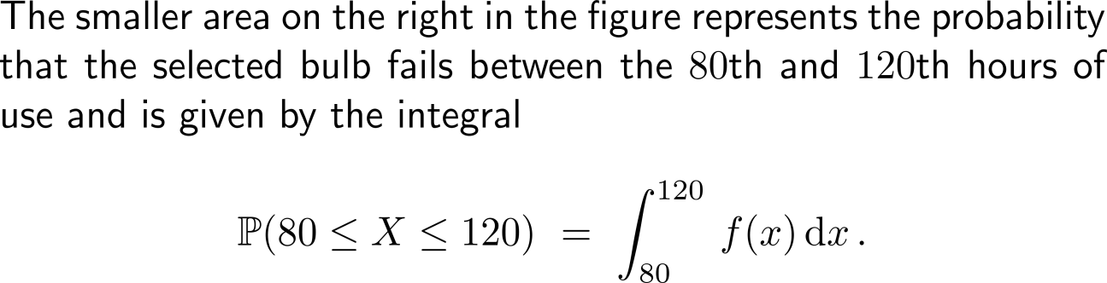
Example:
Probability density function and probability

Slide 14
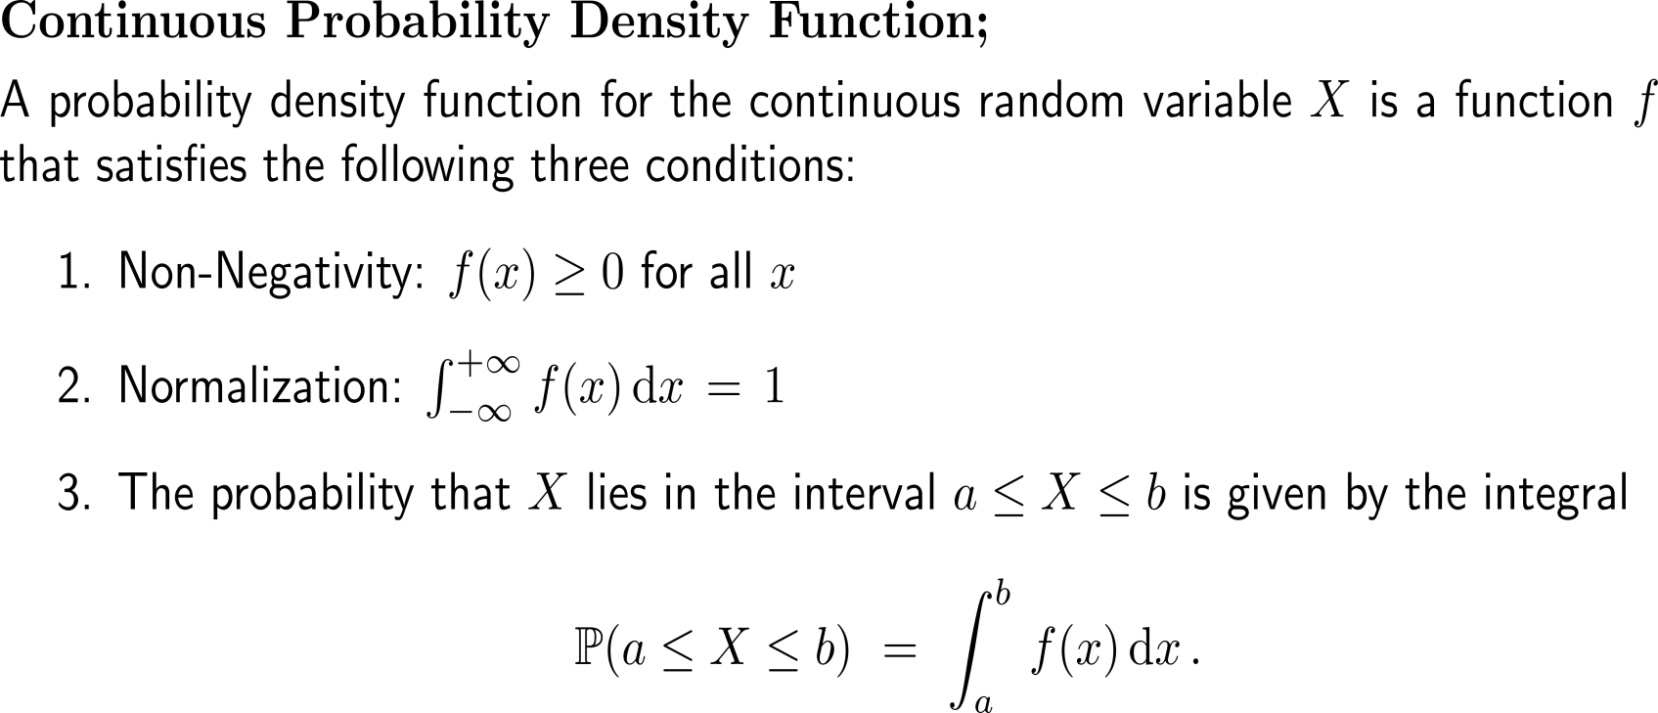
Definition of the probability density function in terms of the integrals required to compute the areas representing probability (1/ 3)

Slide 15
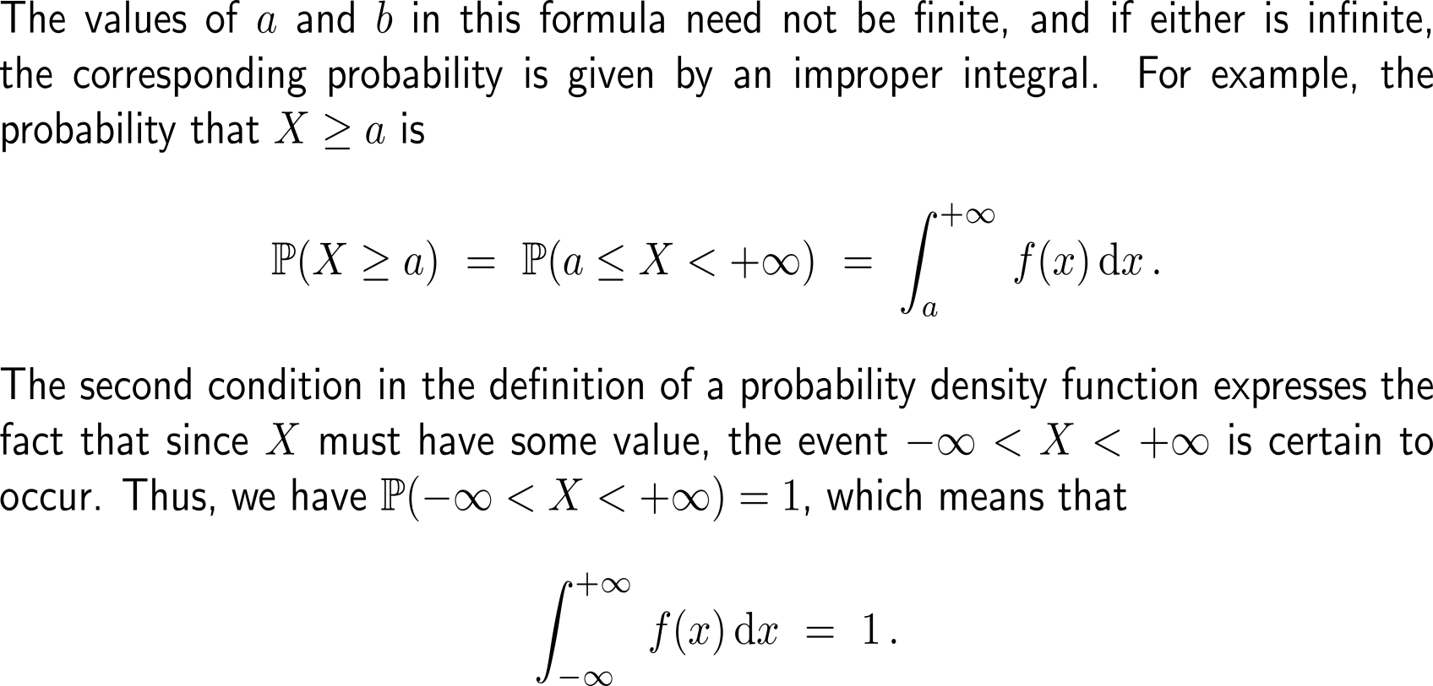
Definition of the probability density function in terms of the integrals required to compute the areas representing probability (2/ 3)

Slide 16
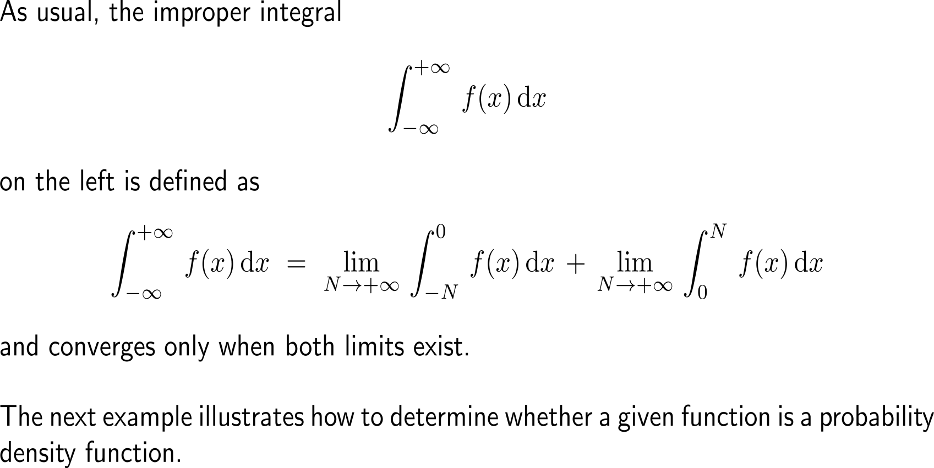
Definition of the probability density function in terms of the integrals required to compute the areas representing probability (3/ 3)

Slide 17
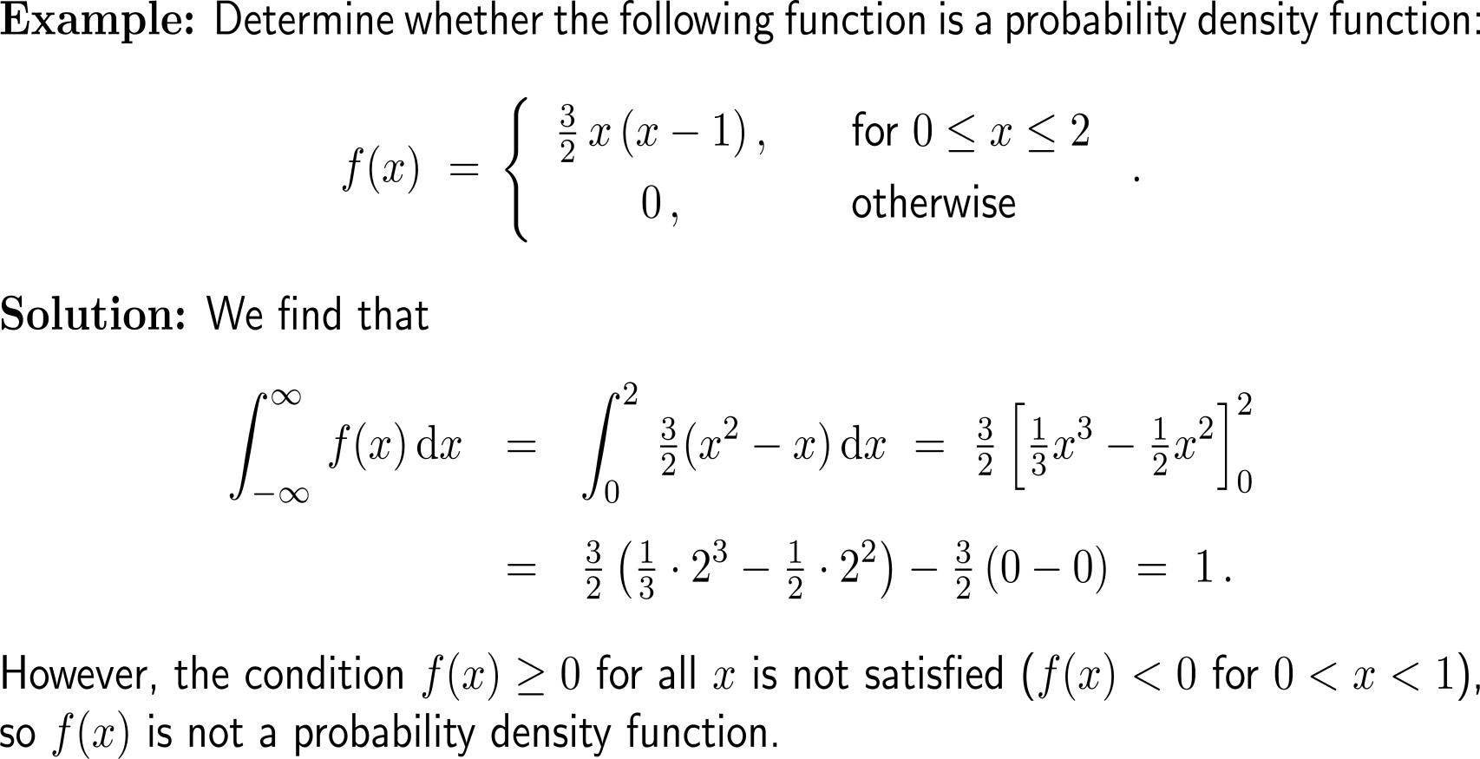
Example:
Recognizing a probability density function
Non-Negativity
Normalization

Slide 18
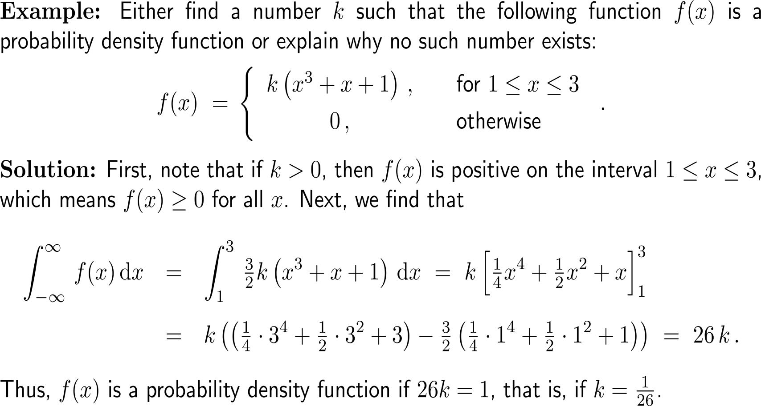
Example:
Forming a probability density function
Non-Negativity
Normalization

Slide 19
Topics
  Continuous Random Variables & Probability Density Functions
  Uniform Density Functions
  Exponential Density Functions
  Normal Density Functions
There are many probability density functions.
Next, we consider uniform, exponential and normal density functions, three general forms that prove to be especially useful in modeling applications.

Slide 20
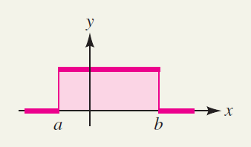
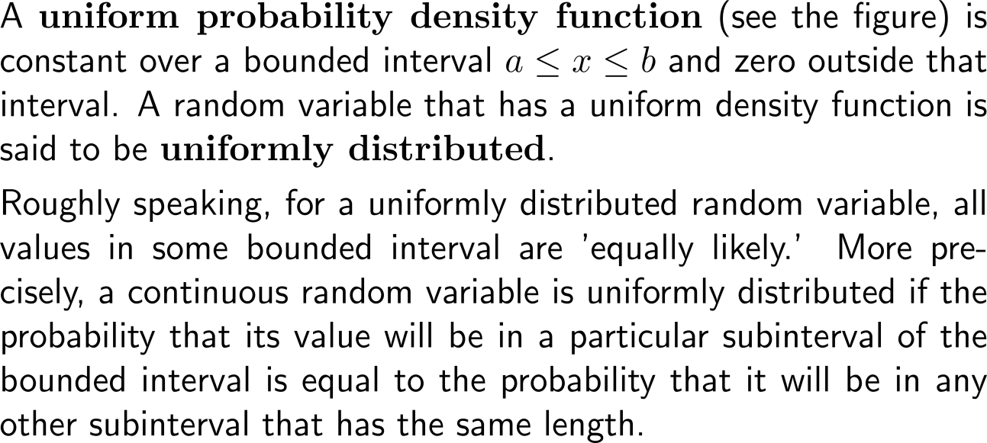
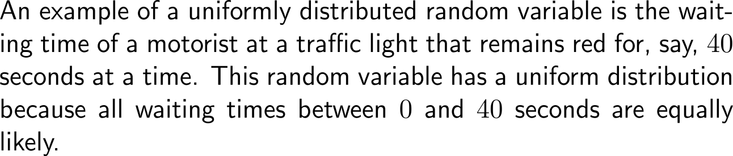
A uniform probability density function is constant over abounded interval and zero outside (1/ 3)

Slide 21
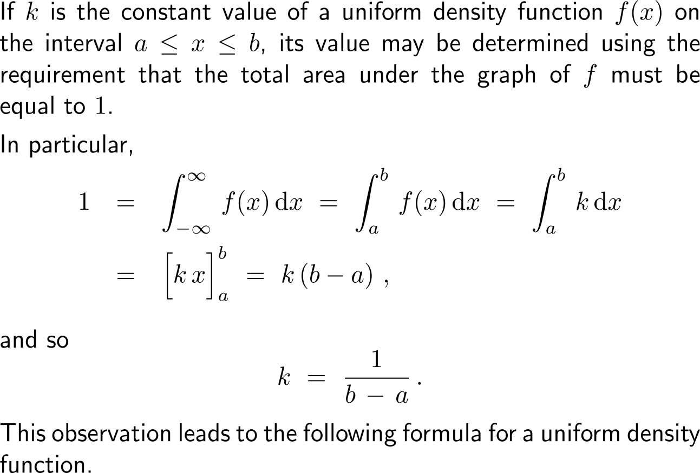
A uniform probability density function is constant over abounded interval and zero outside (2/ 3)

Slide 22
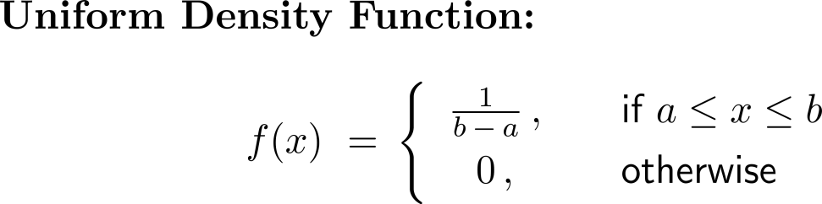

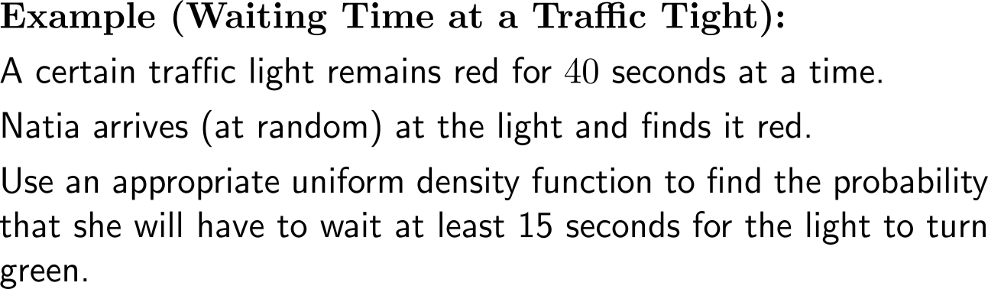
A uniform probability density function is constant over abounded interval and zero outside (3/ 3)

Slide 23
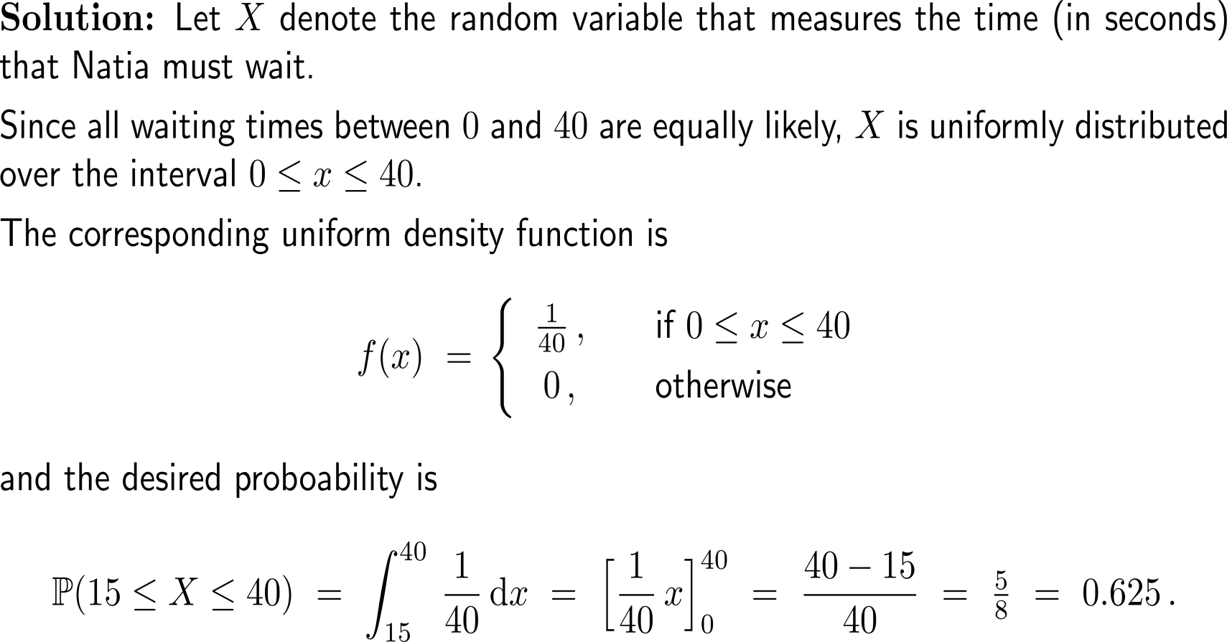
Example:
Waiting time at a traffic light

Slide 24
Topics
  Continuous Random Variables & Probability Density Functions
  Uniform Density Functions
  Exponential Density Functions
  Normal Density Functions

Slide 25
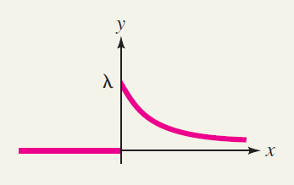
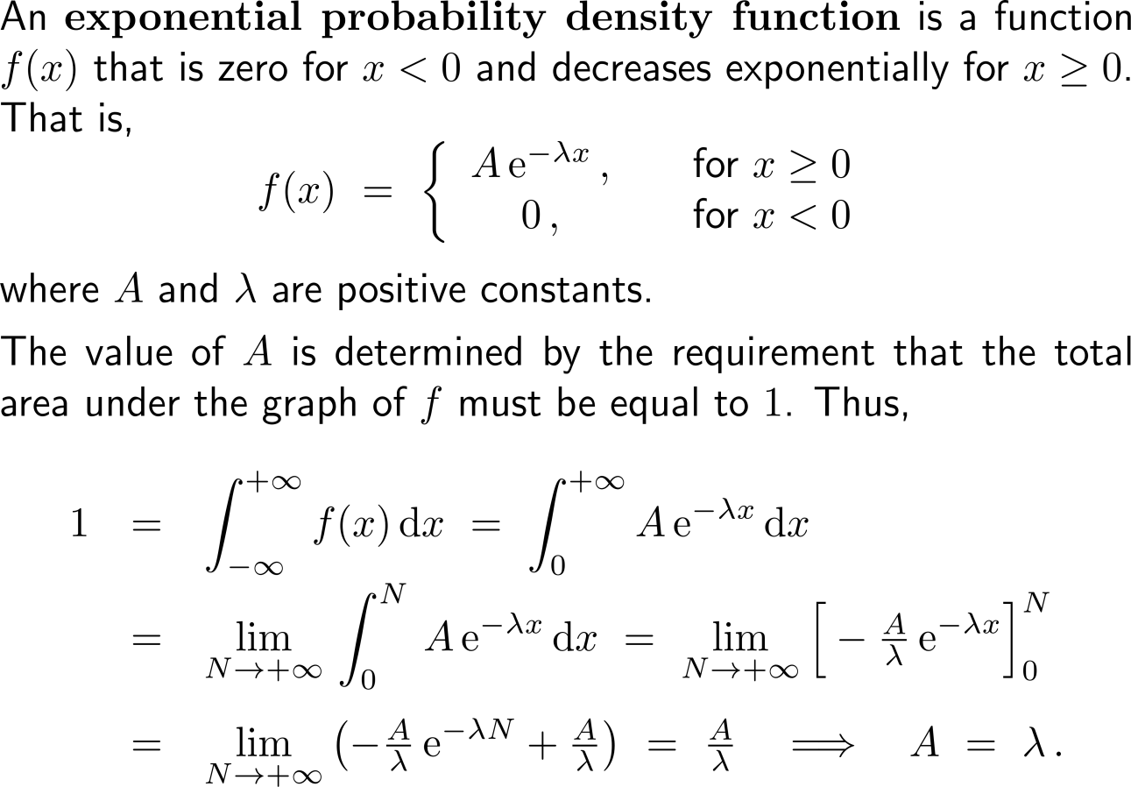
An exponential probability density function is exponentially decreasing for non-negative numbers and zero elsewhere (1/ 2)

Slide 26
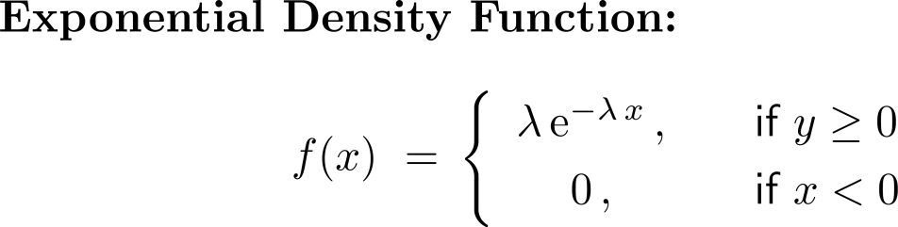
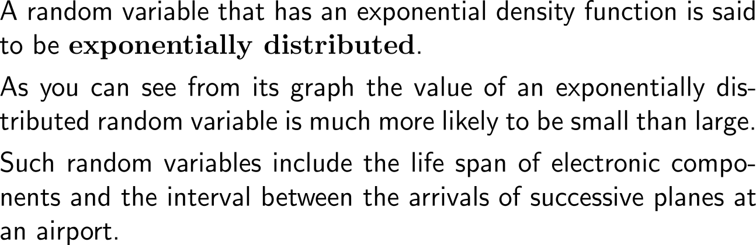
An exponential probability density function is exponentially decreasing for non-negative numbers and zero elsewhere (2/ 2)

Slide 27

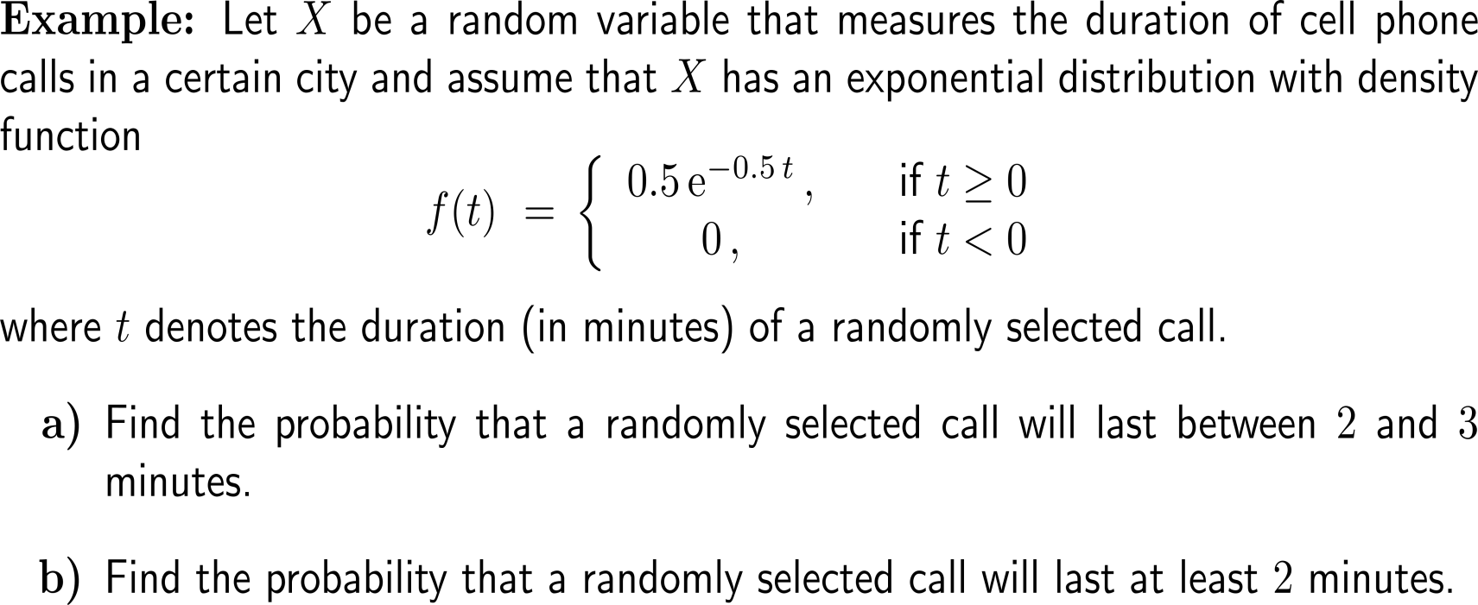
Example:
Duration of a telephone call

Slide 28
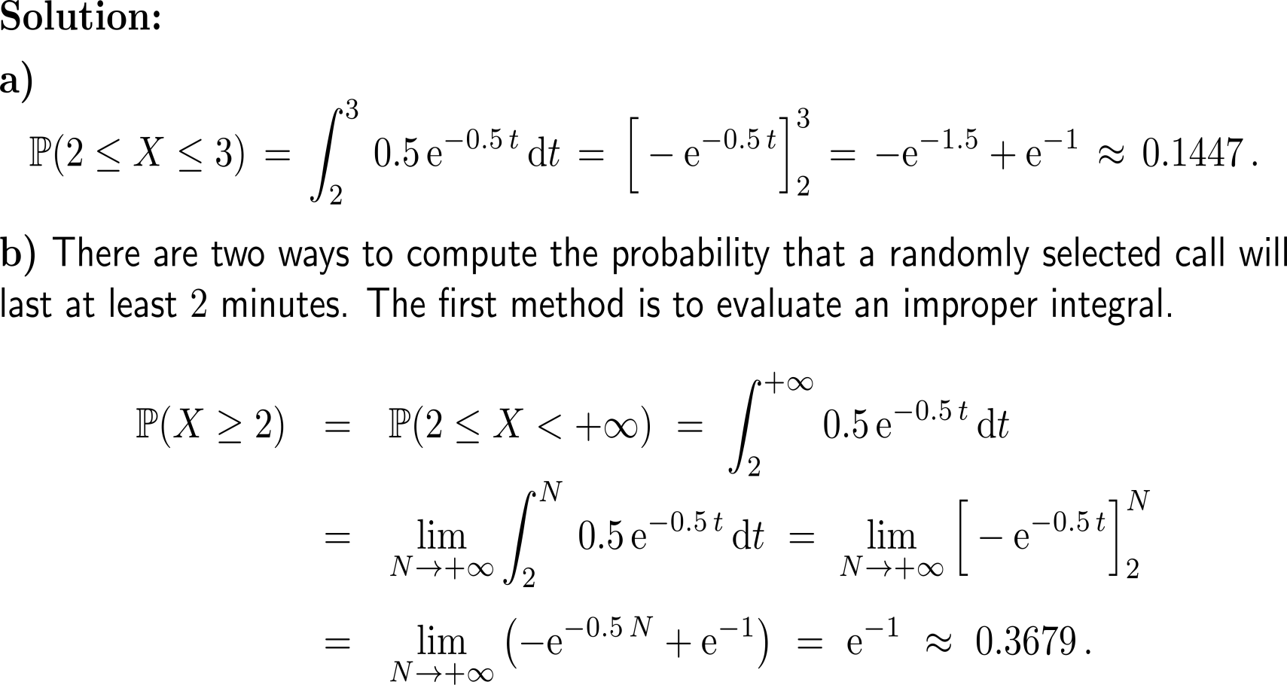
Example:
Duration of a telephone call

Slide 29
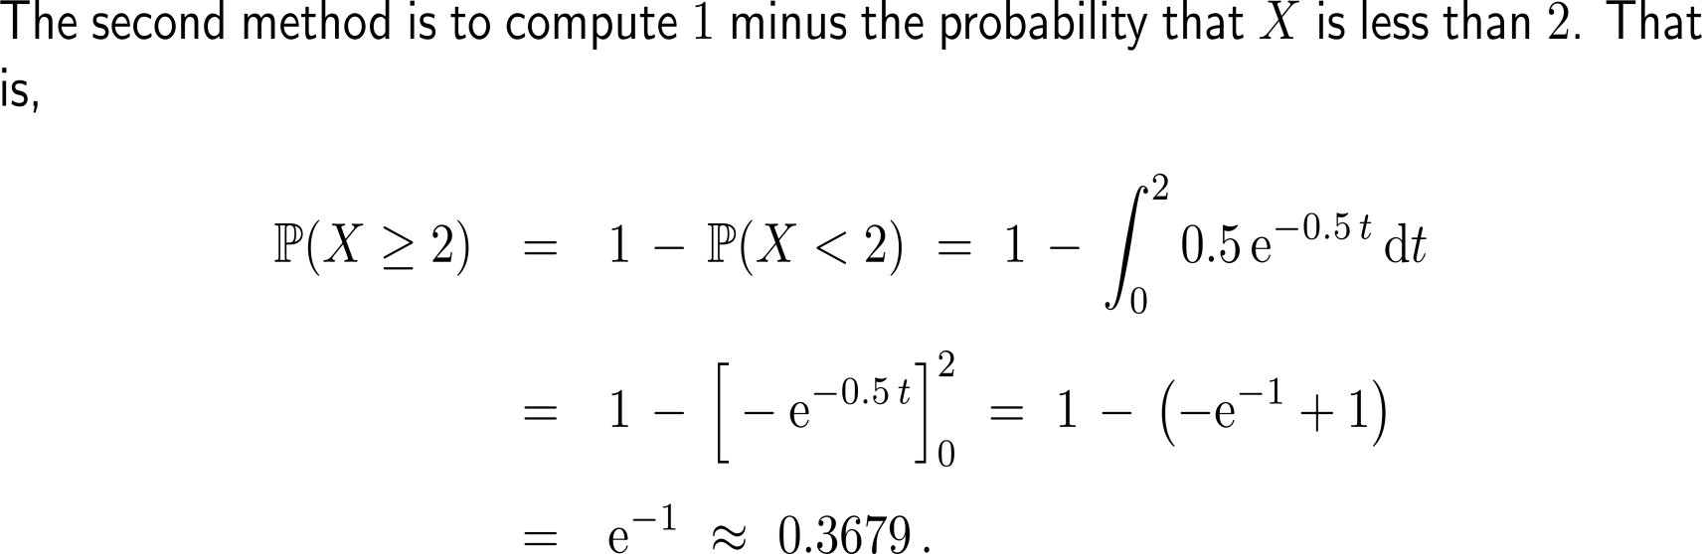
Example:
Duration of a telephone call

Slide 30
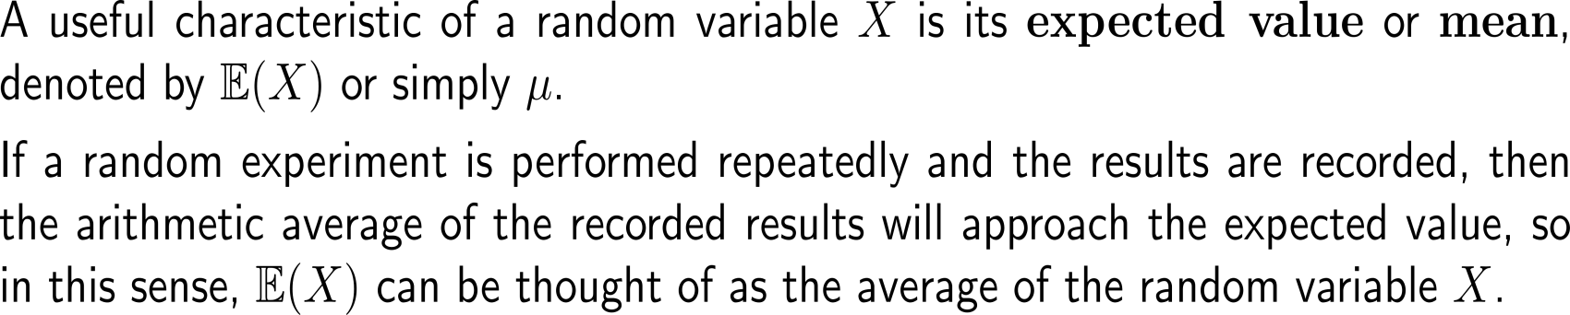
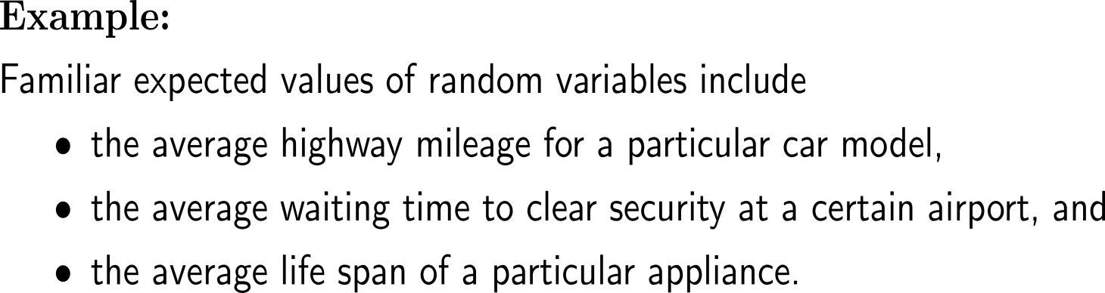
The expected value or mean of a random variable can be thought of as the average of this random variable

Slide 31
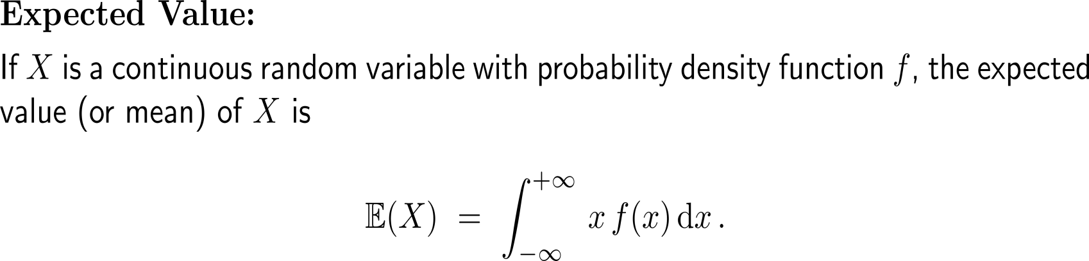
The expected value of a continuous random variable is computed as an integral of x times the random variable’s density function …

Slide 32
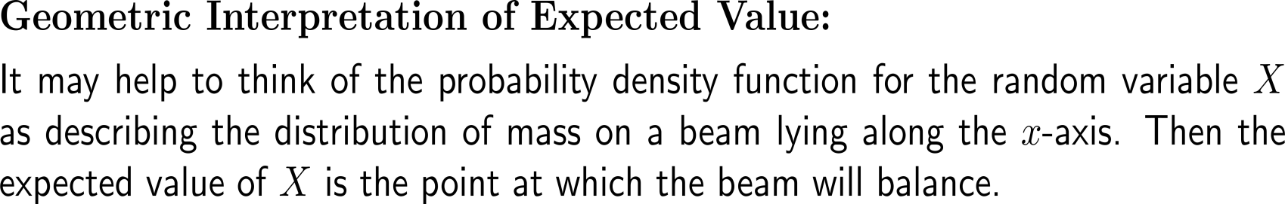
… and can be interpreted as the point of balance under the given density distribution
f(x)

Slide 33
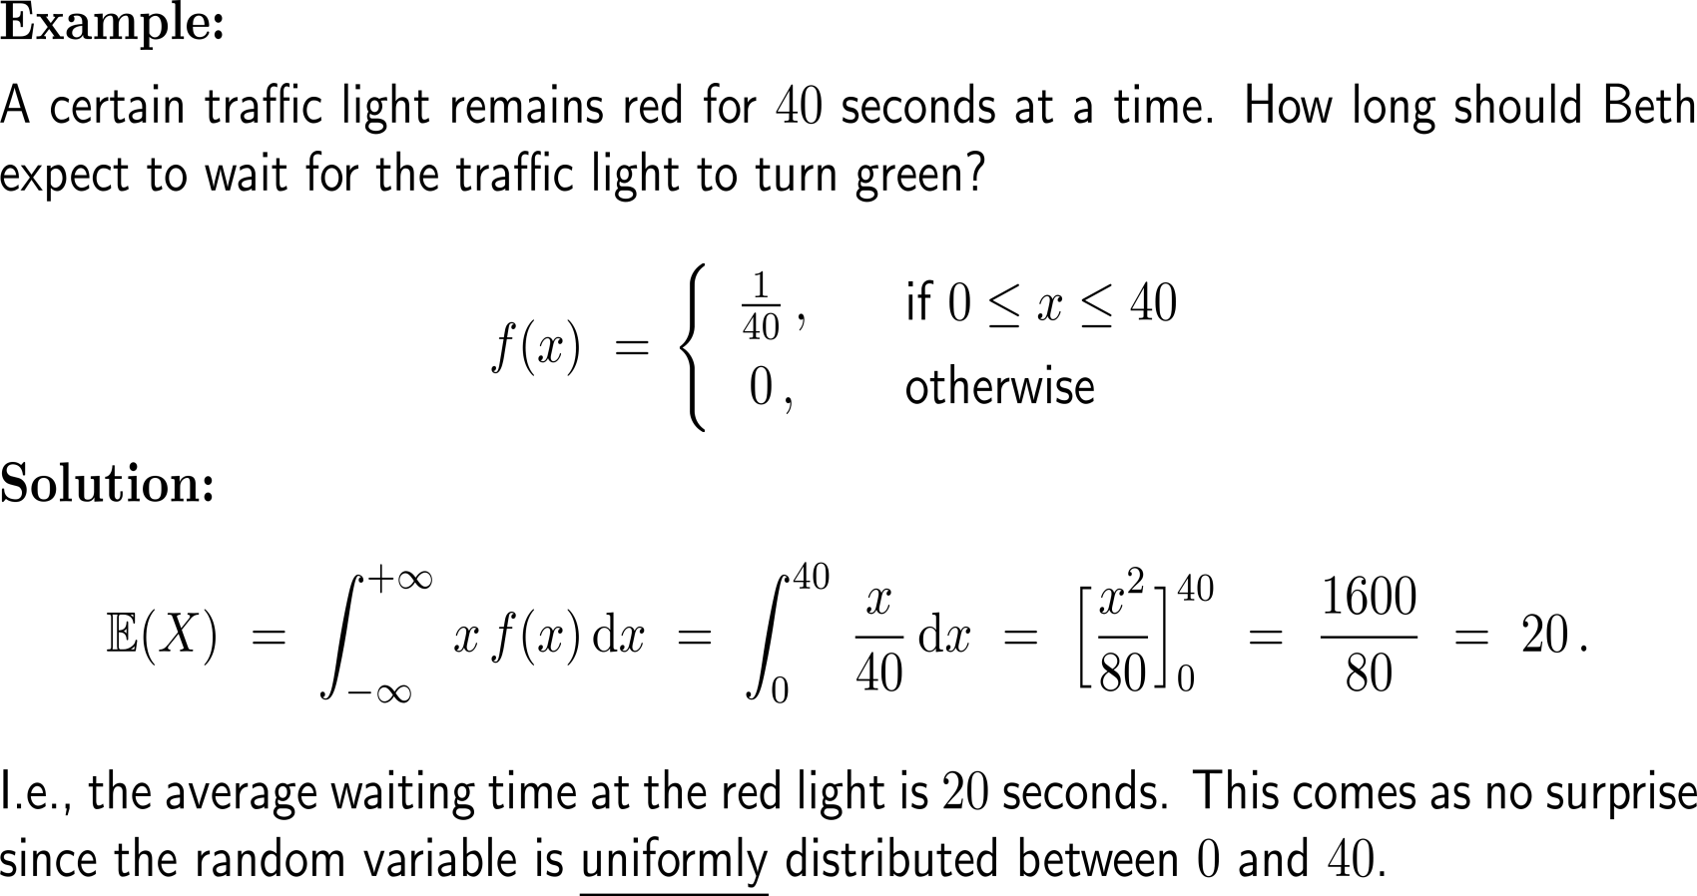
Example:
Expected waiting time at a traffic light

Slide 34
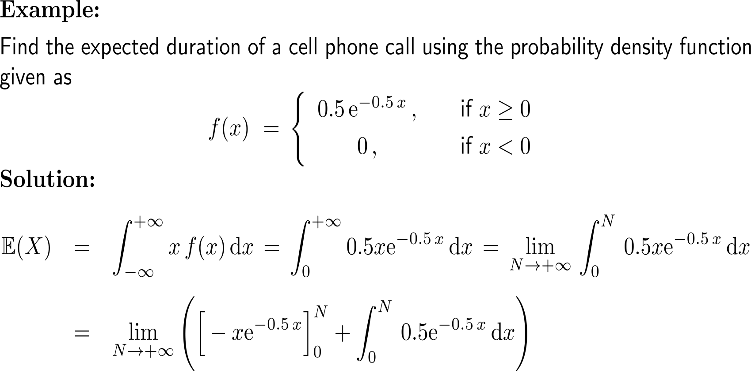
Example:
Expected duration of a telephone call
integration by parts

Slide 35
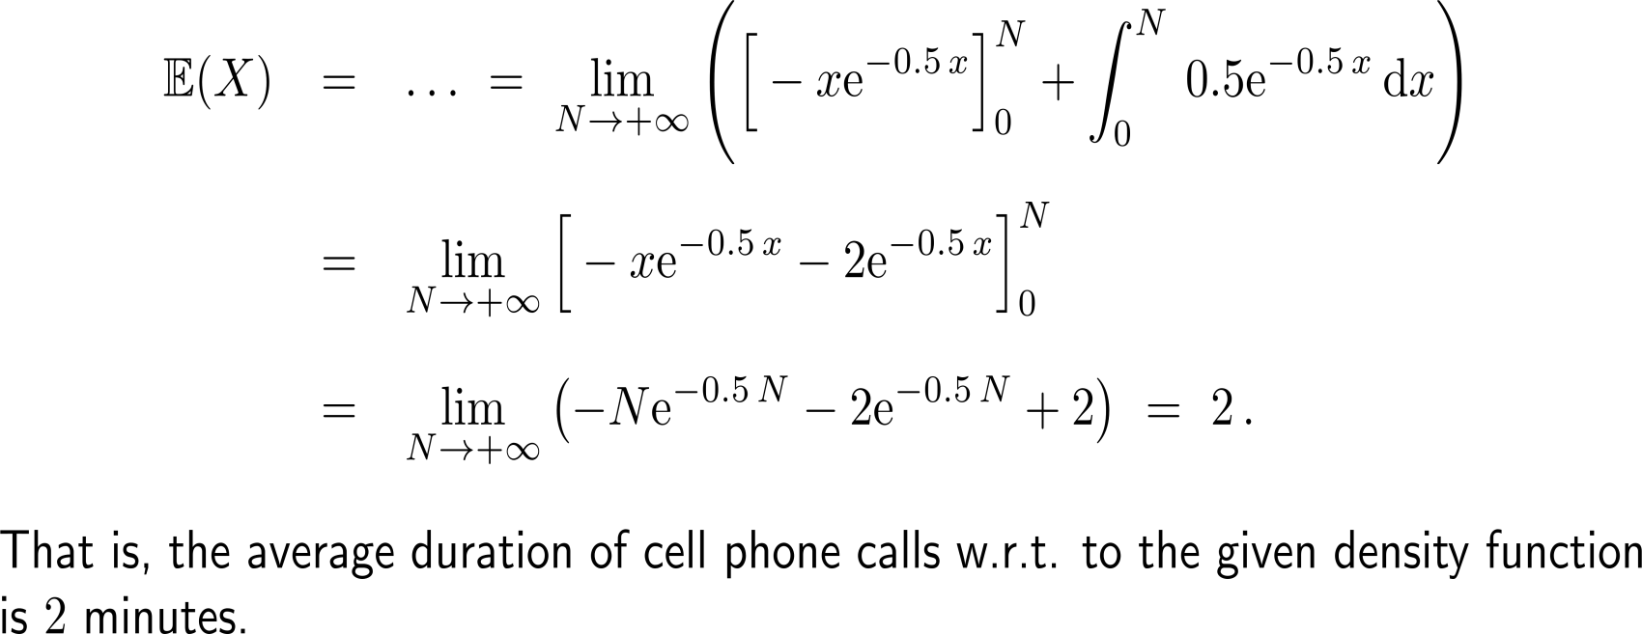
Example:
Expected duration of a telephone call

Slide 36
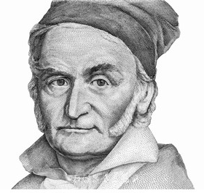
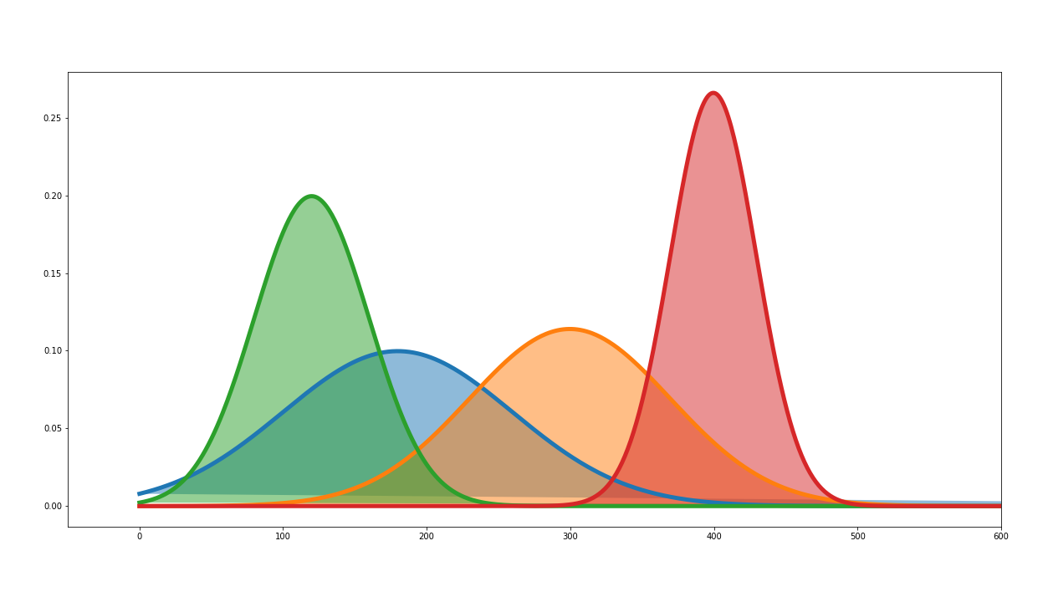
Topics
  Continuous Random Variables & Probability Density Functions
  Uniform Density Functions
  Exponential Density Functions
  Normal Density Functions

Slide 37
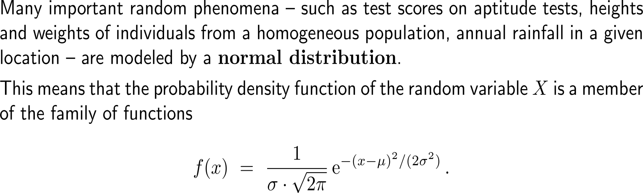
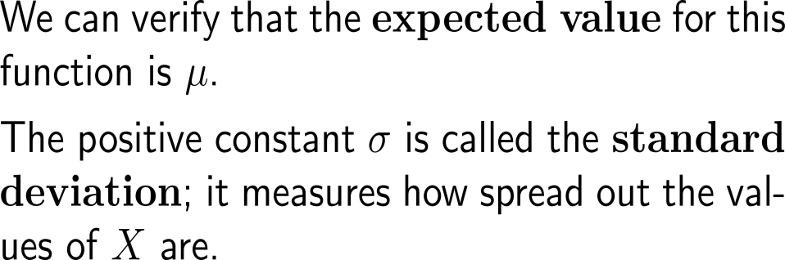
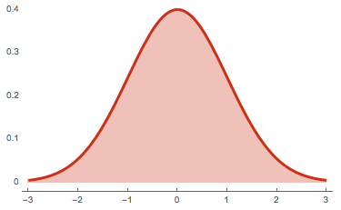
The normal probability density function is characterized by the expected value and the standard deviation (1/ 2)

Slide 38
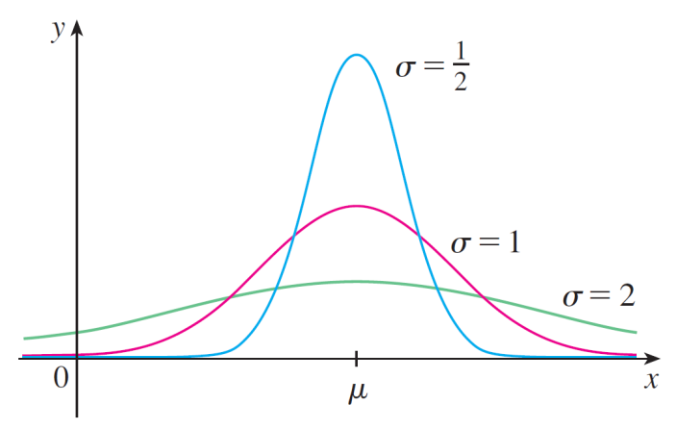

The normal probability density function is characterized by the expected value and the standard deviation (2/ 2)

Slide 39



Example:
The normal distribution of IQ scores

Slide 40


Example:
The normal distribution of IQ scores

Slide 41

Example:
The normal distribution of IQ scores

Slide 42



Especially in todays fast-paced and optimally scheduled economy, the impact of the highly improbable is not to be overlooked (black swans)

Slide 43


Central Exercises:
Calculus II for Management
Prof. Dr. Giorgi Chelidze & Prof. Dr. Florian Rupp
Kutaisi International University
Topics
  Continuous random variables & probability density functions (PDF)
  Examples for PDFs
  Recap:
    Linear Algebra
    Intergation
the problems are also given in compact form on a separate work sheet

Slide 44


Exercise
Non-Negativity
Normalization

Slide 45

Exercise

Slide 46


Exercise
5 minutes
self/ group work
please, upload your solutions to the chat
Non-Negativity
Normalization

Slide 47


Exercise

Slide 48

Exercise

Slide 49



Exercise

Slide 50

Exercise

Slide 51

Exercise

Slide 52


Exercise
10 minutes
self/ group work
please, upload your solutions to the chat
¹/₃
2
3
4
5
3.5

Slide 53

Recap Exercise:
Mid-Term preparation
A Short Review of Linear Algebra Topics:
Gaussian Elimination
Basis & Linear Independence
Determinants
Scalar- & Vector-Product
Matrix-Multiplication
Inverse Matrix
Eigenvalues & Eigenvectors

Slide 54

Recap Exercise:
Mid-Term preparation
Discussion

Slide 55

Recap Exercise:
Mid-Term preparation
Discussion
A
A⁻¹

Slide 56

Recap Exercise:
Mid-Term preparation
Discussion

Slide 57

Recap Exercise:
Mid-Term preparation
Discussion

Slide 58

Recap Exercise:
Mid-Term preparation
Discussion

Slide 59


Recap Exercise:
Mid-Term preparation
A Short Review of Integration Topics:
Linear ODEs
Integration by Parts
Improper Integrals
Separable ODEs

Slide 60

Recap Exercise:
Mid-Term preparation
Discussion

Slide 61
Calculus II for Management

