Slide 1
Calculus II for Management
Functions in Several Variables
week 9
Lecture 9
Vector algebra revisited
Functions in several variables & their applications
Graphs of functions of two variables
Level curves & their use in economics
Partial derivatives

Slide 2
Topics
Vector Algebra Revisited
Functions in Several Variables & Their Applications
Graphs of Functions of Two Variables
Level Curves & Their Use in Economics
Partial Derivatives

Slide 3
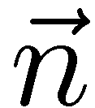
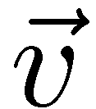
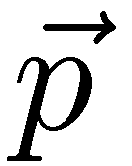
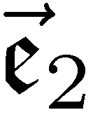
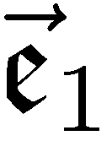
The Hessian normal form (HNF) represents, for instance, a line as a linear system in two variables (1/ 2)

Slide 4
The Hessian normal form (HNF) represents, for instance, a line as a linear system in two variables (2/ 2)

Slide 5
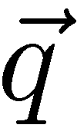
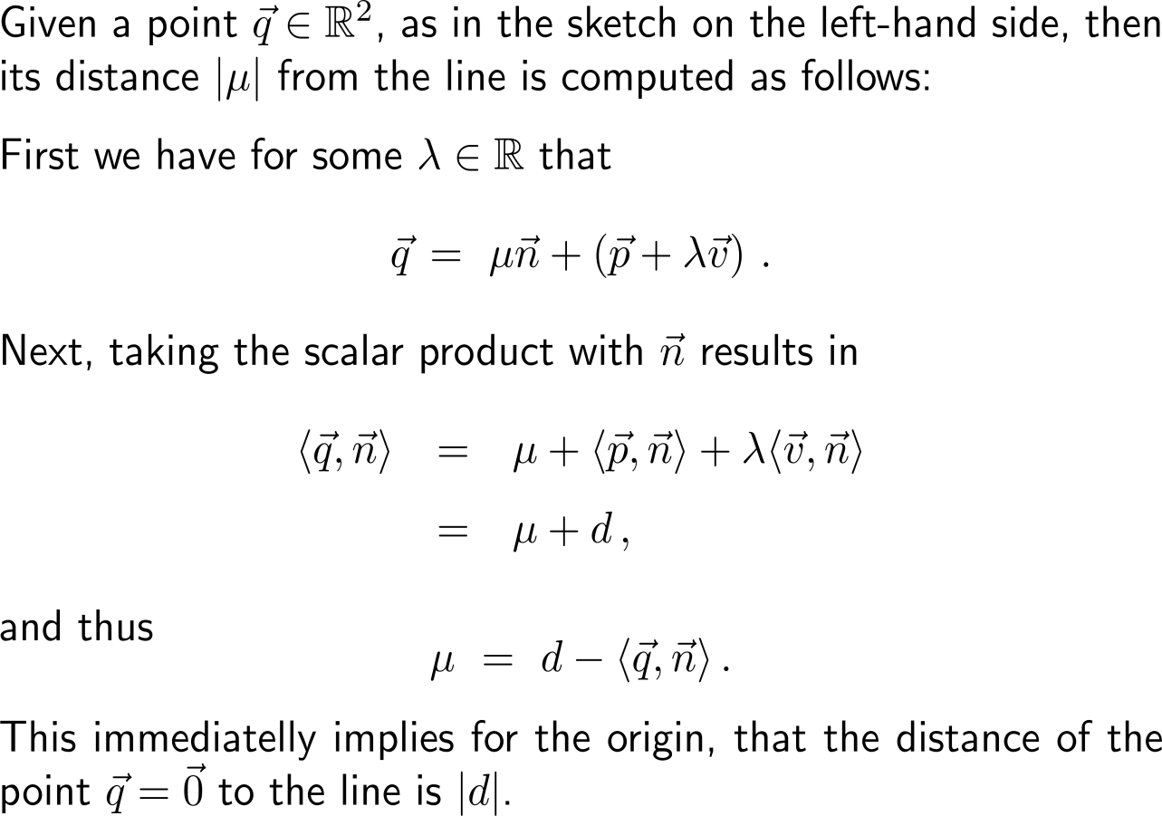
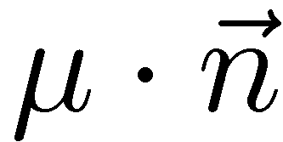
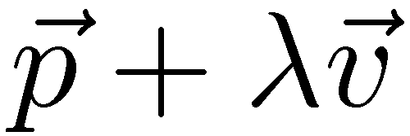
The HNF is a handy tool for determining the distance of a point from a given line (or plane)

Slide 6
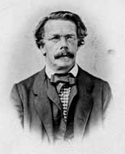
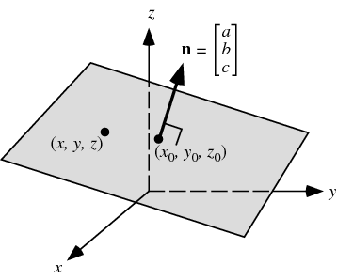
Analogously to our considerations the HNF of a plane in Euclidean 3D space is established
Otto Hesse
(1811 – 1874)

Slide 7
Example: Converting a parameter form into HNF
normal vector to the plane
(7,2,0)^{T}

Slide 8
Example: Converting a parameter form into HNF

Slide 9
The interplay between the parameter and the Hessian normal forms makes solving geometrical questions easy

Slide 10
Topics
Vector Algebra Revisited
Functions in Several Variables & Their Applications
Graphs of Functions of Two Variables
Level Curves & Their Use in Economics
Partial Derivatives

Slide 11
The concept of a function in two variables is a straightforward extension of that for functions in one variable (1/ 2)

Slide 12
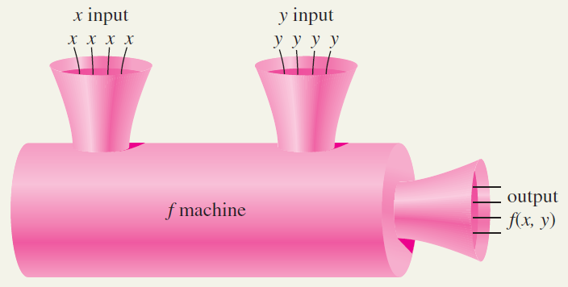
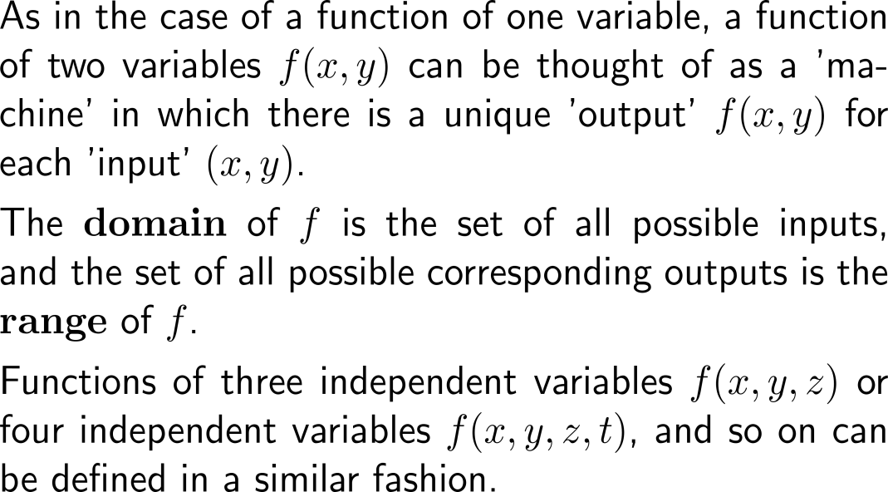
The concept of a function in two variables is a straightforward extension of that for functions in one variable (2/ 2)

Slide 13
Example: Evaluating a function of two variables

Slide 14
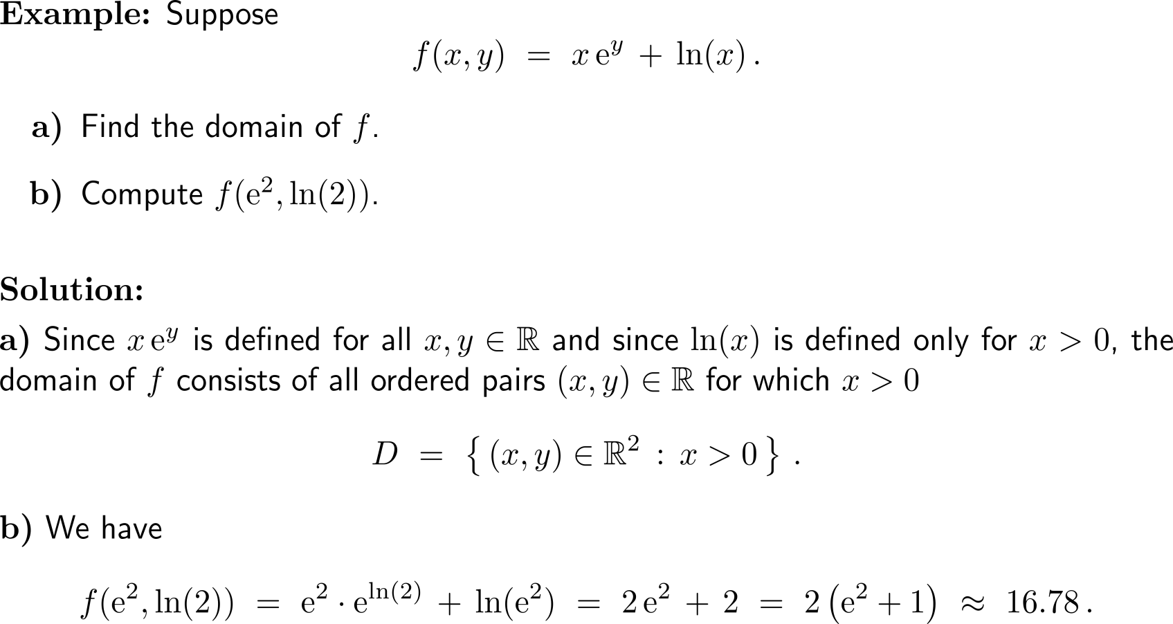
Example: Evaluating a function of two variables

Slide 15
Example: Application – revenue as a function of two variables

Slide 16
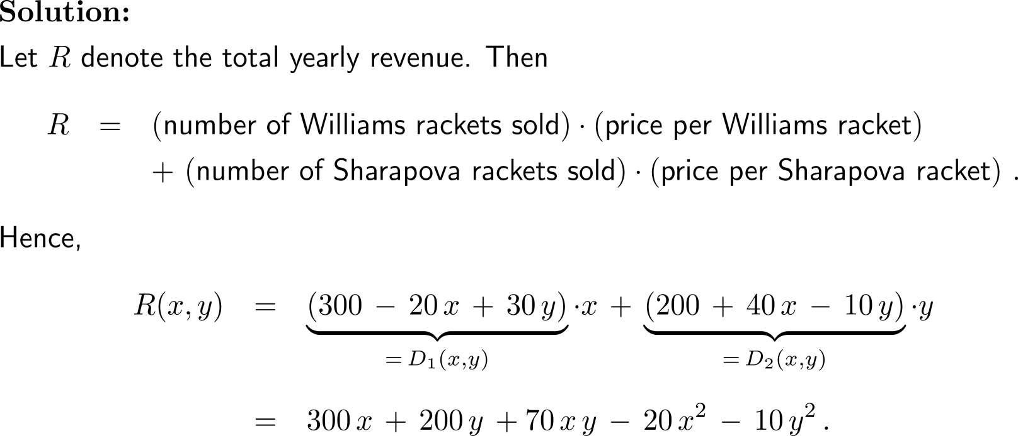
Example: Application – revenue as a function of two variables

Slide 17
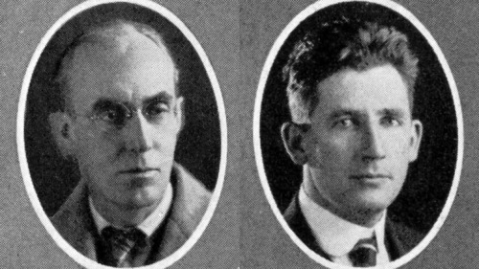
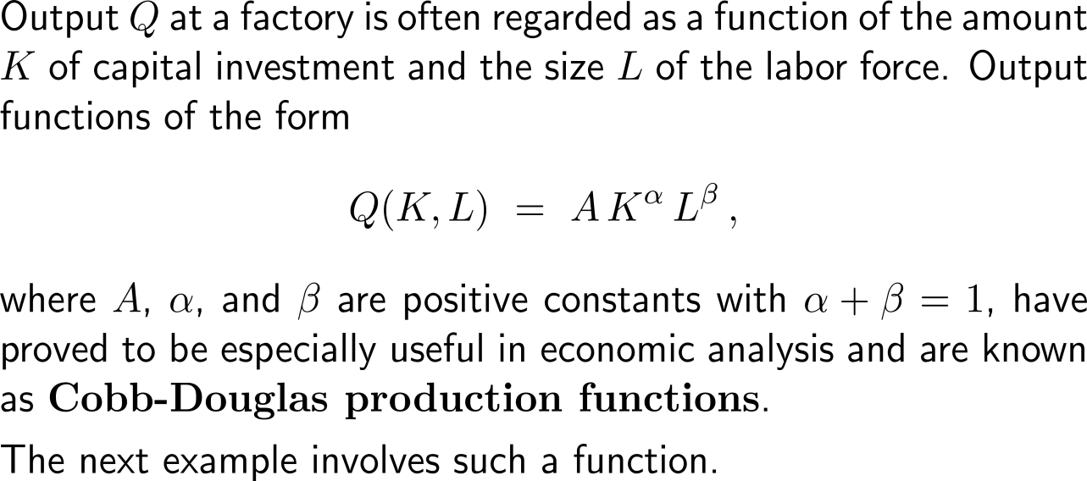
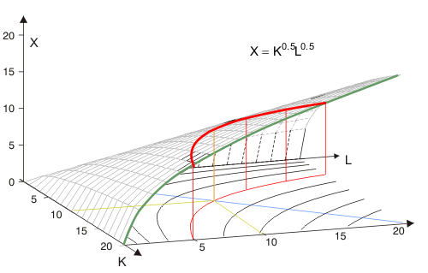
The Cobb-Douglas production function gives an output as a function of capital and labor forces with rational exponents summing to one
Charles W. Cobb & Paul H. Douglas

Slide 18
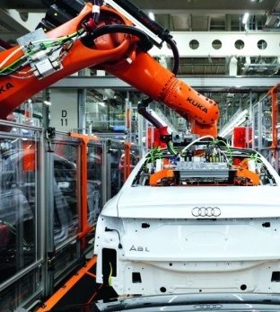
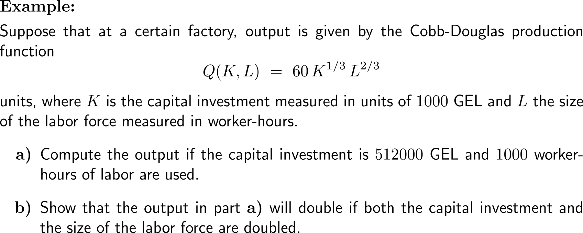
Example: Application – production as a function of two variables

Slide 19
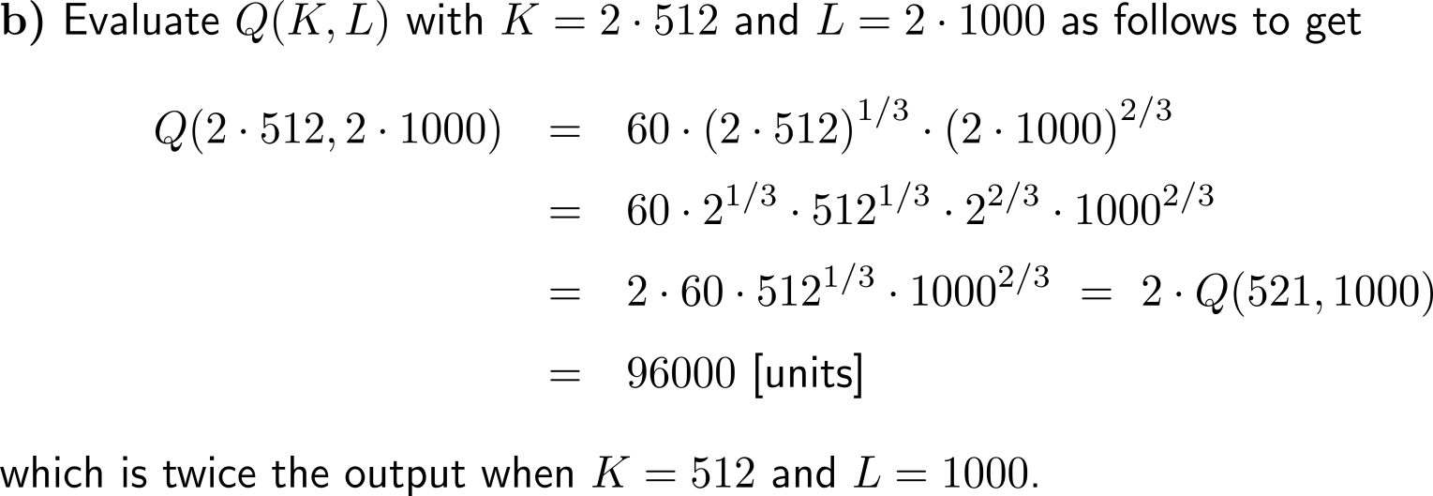
Example: Application – production as a function of two variables

Slide 20
Example: Application – present value as a function of four variables

Slide 21
Example: Application – population as a function of three variables

Slide 22
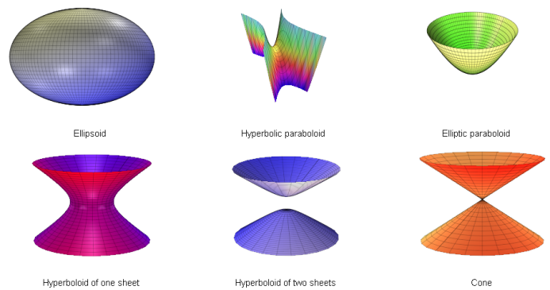
Topics
Vector Algebra Revisited
Functions in Several Variables & Their Applications
Graphs of Functions of Two Variables
Level Curves & Their Use in Economics
Partial Derivatives

Slide 23
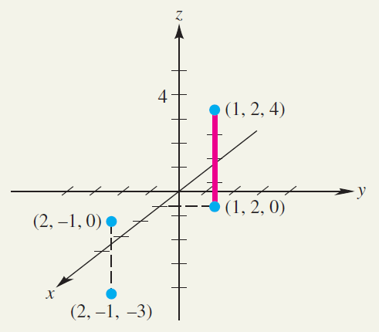
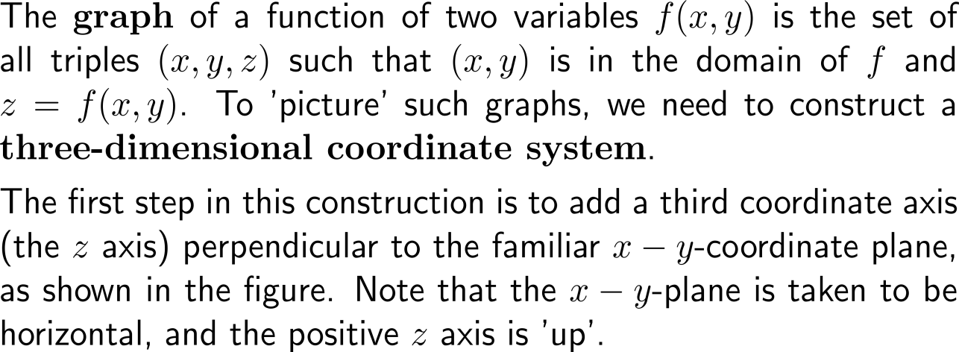
The graph of a function in two variables is represented by a surface in three dimensions (1/ 2)

Slide 24
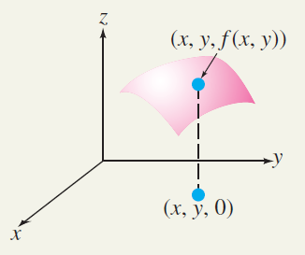
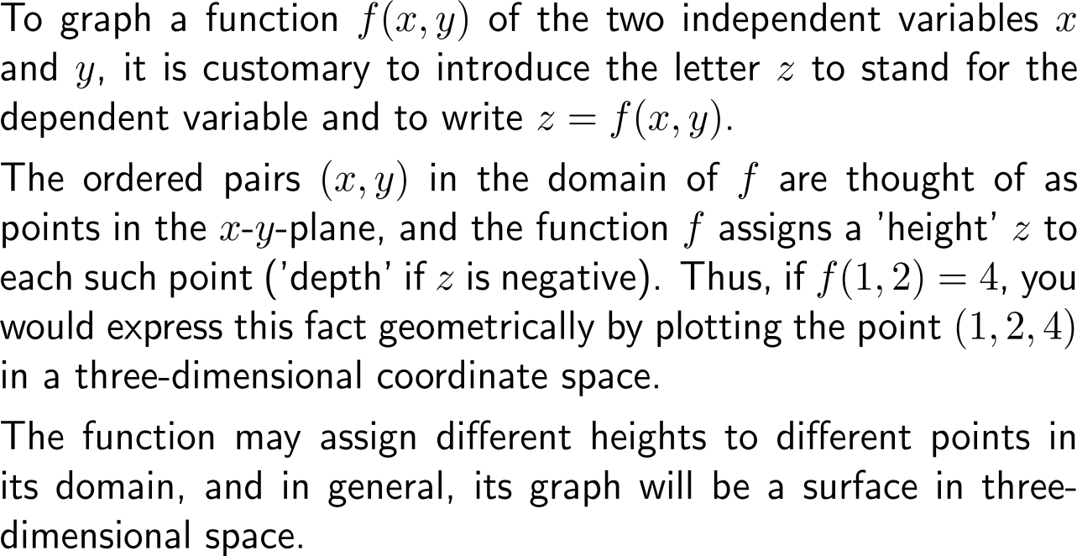
The graph of a function in two variables is represented by a surface in three dimensions (2/ 2)

Slide 25
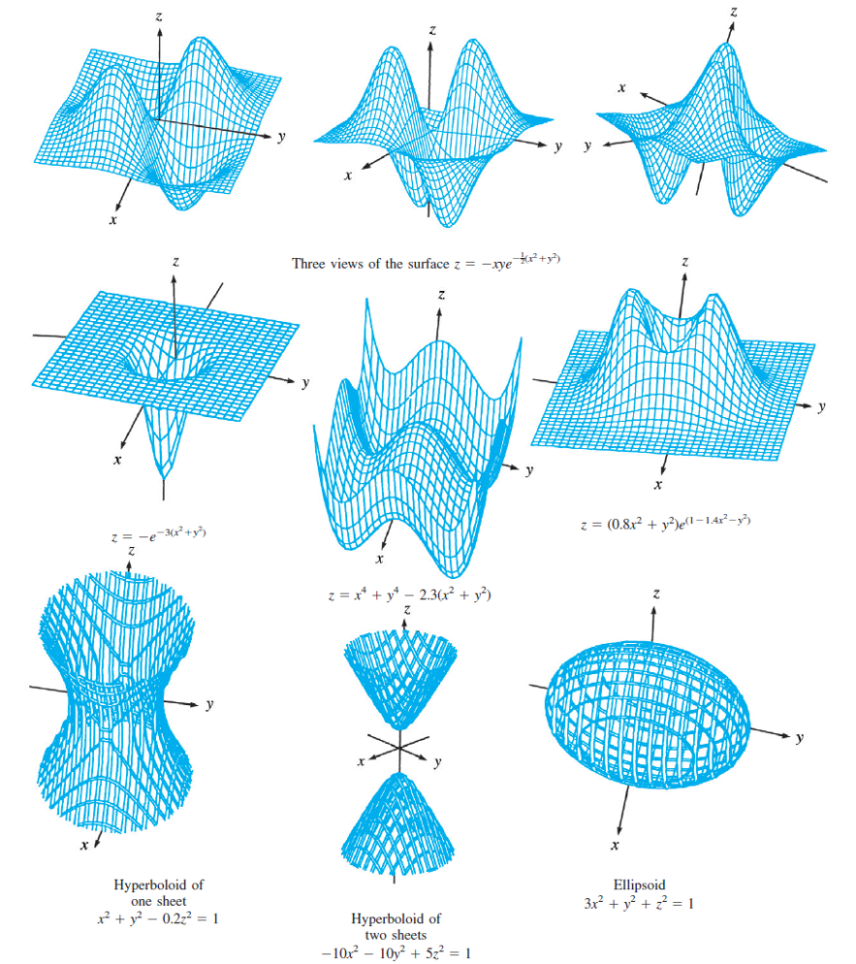
Example: Functions of two variables
Hyperboloid of one sheet
Hyperboloid of two sheets
Ellipsoid

Slide 26
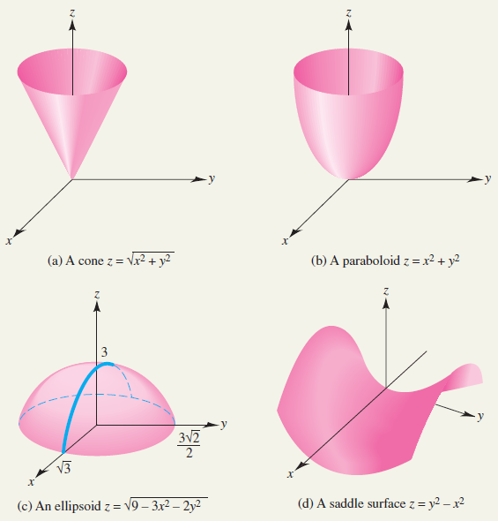
Example: Graphs of quadratic surfaces (1/ 2)

Slide 27
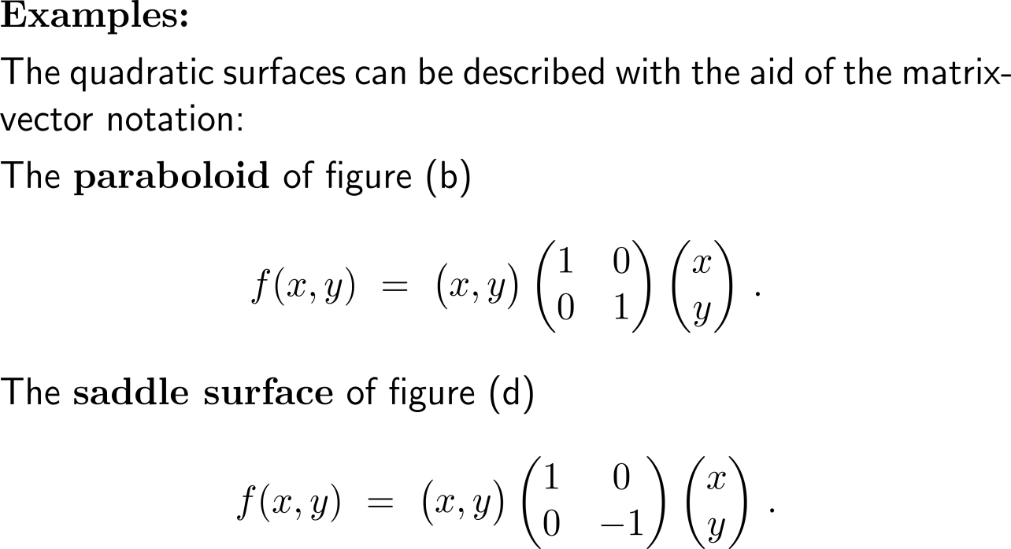
Example: Graphs of quadratic surfaces (2/ 2)

Slide 28
Topics
Vector Algebra Revisited
Functions in Several Variables & Their Applications
Graphs of Functions of Two Variables
Level Curves & Their Use in Economics
Partial Derivatives

Slide 29
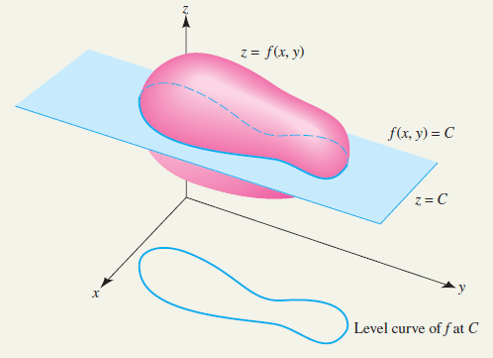
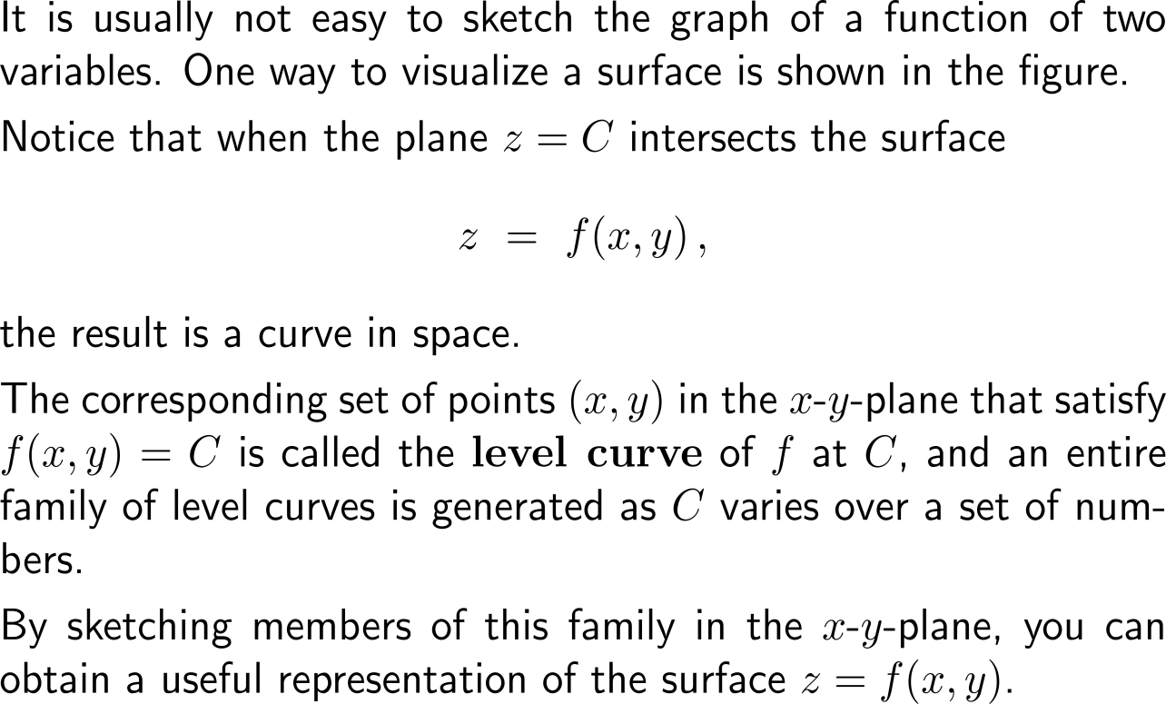
Level curves represent a way to illustrate the shape of a function of two variables (1/ 2)

Slide 30
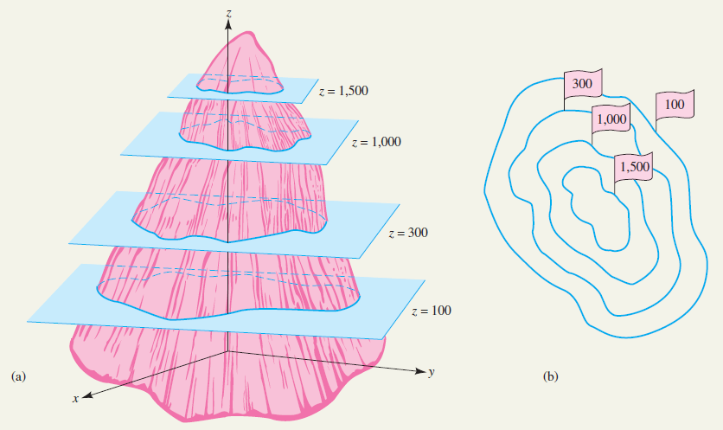
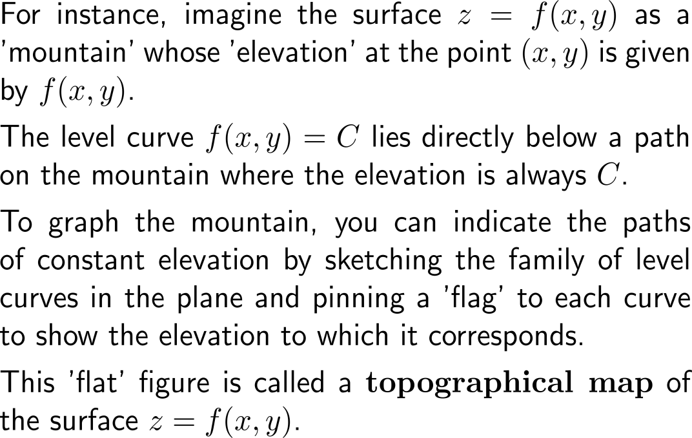
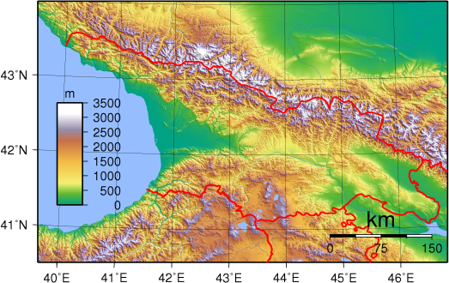
Level curves represent a way to illustrate the shape of a function of two variables (2/ 2)
topographical map with color codes

Slide 31
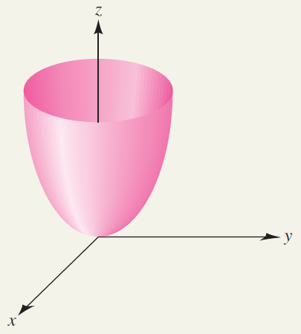
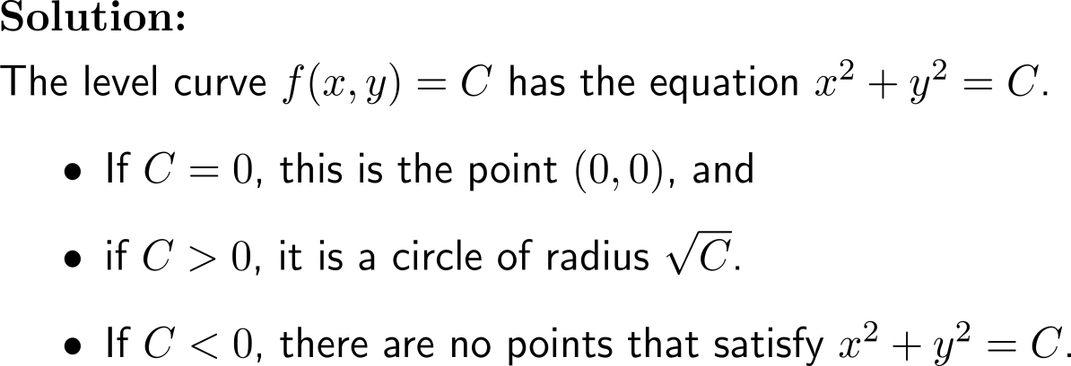
Example: Studying level curves

Slide 32
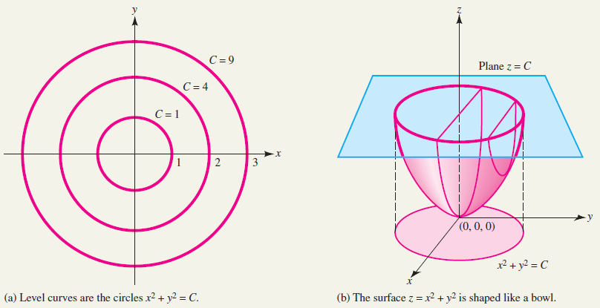
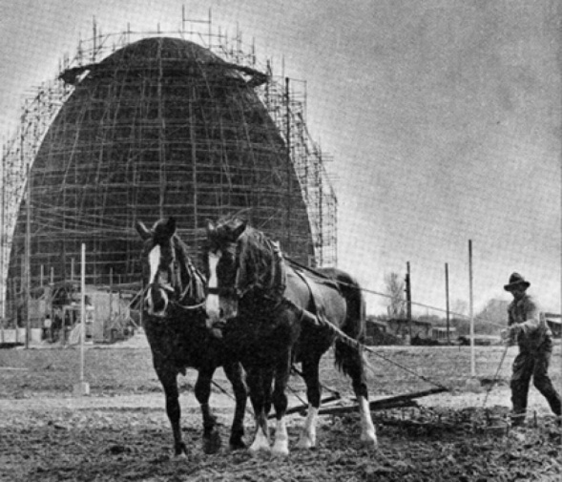
The level curves of a circular parabolic are concentric circles
The start of a TUM campus
“signs of the new and the old times”, 1957

Slide 33
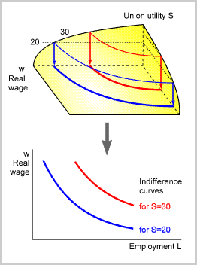
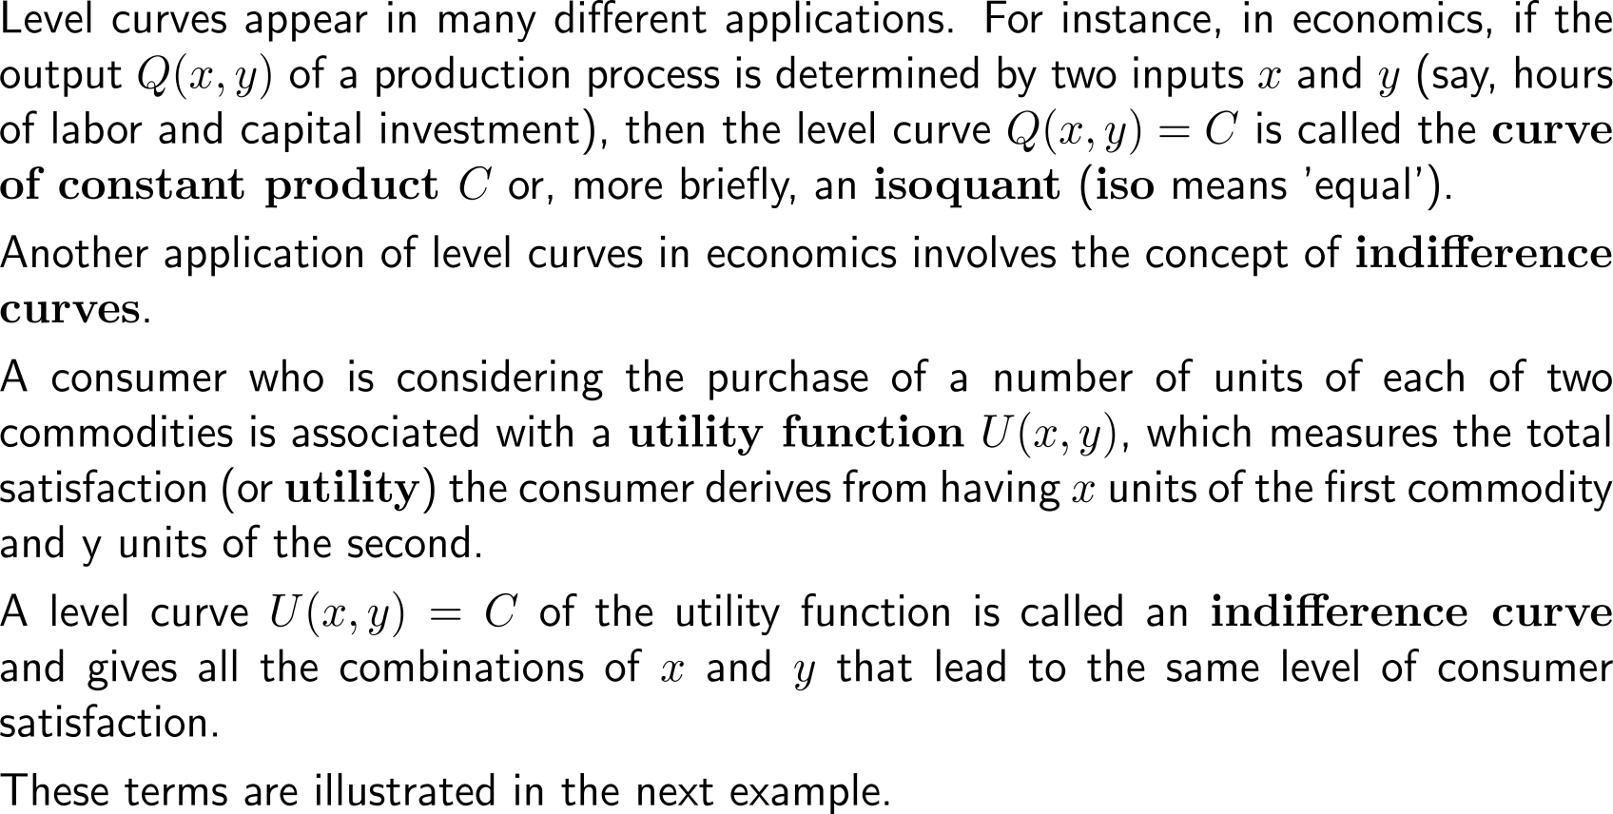
In economics, level curves occur as indifference curves when discussing the utility of consumers

Slide 34
Example: Applying level curves to economics

Slide 35
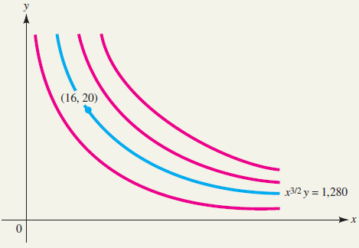
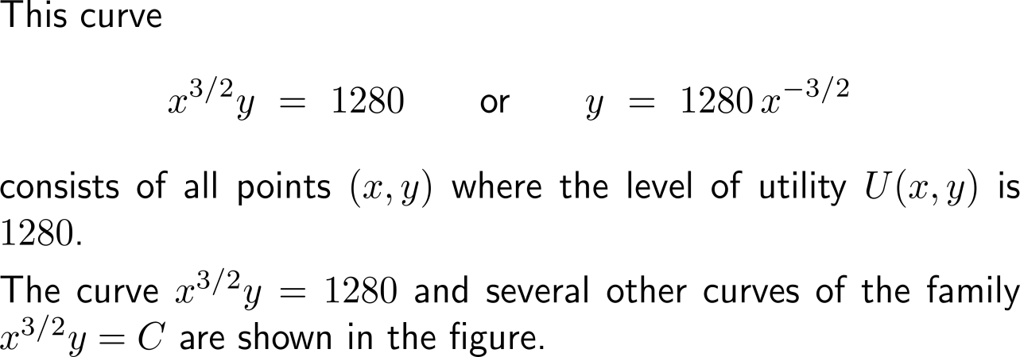
Example: Applying level curves to economics

Slide 36
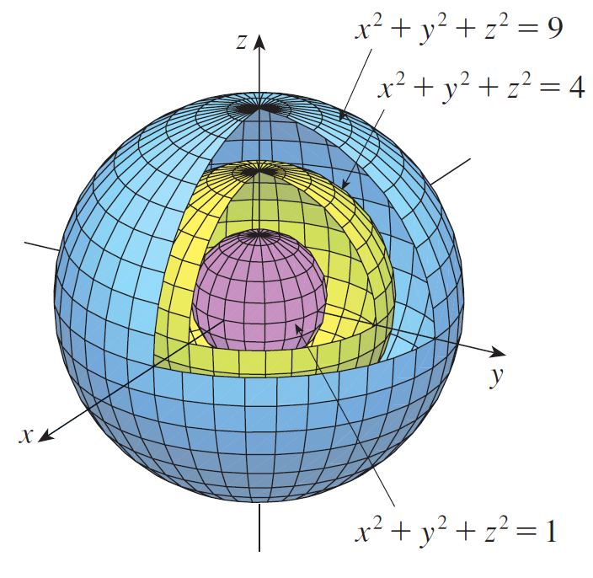
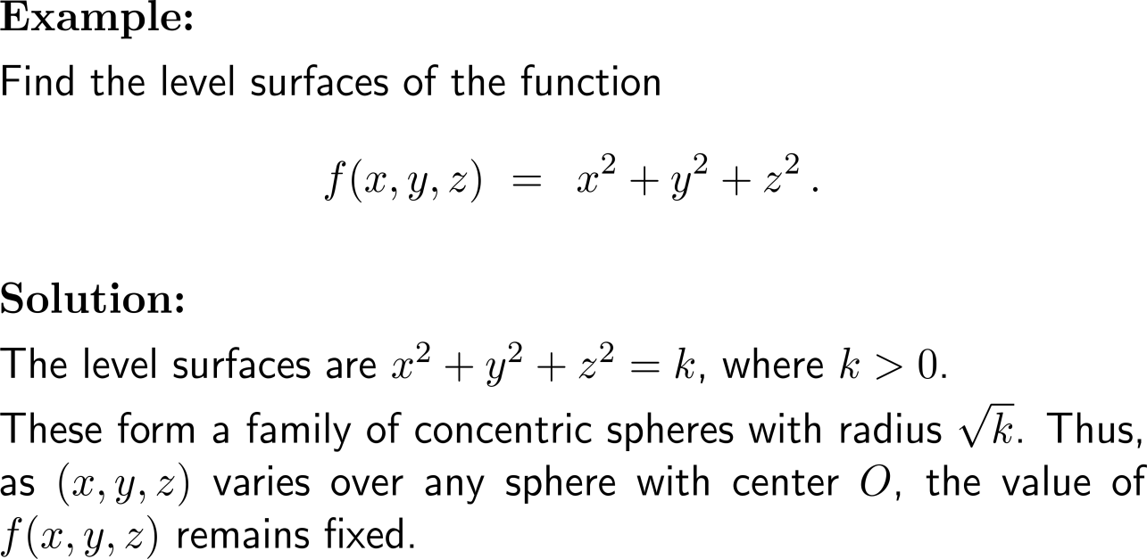
Example: Level surfaces of a function with three variables

Slide 37
Topics
Vector Algebra Revisited
Functions in Several Variables & Their Applications
Graphs of Functions of Two Variables
Level Curves & Their Use in Economics
Partial Derivatives

Slide 38
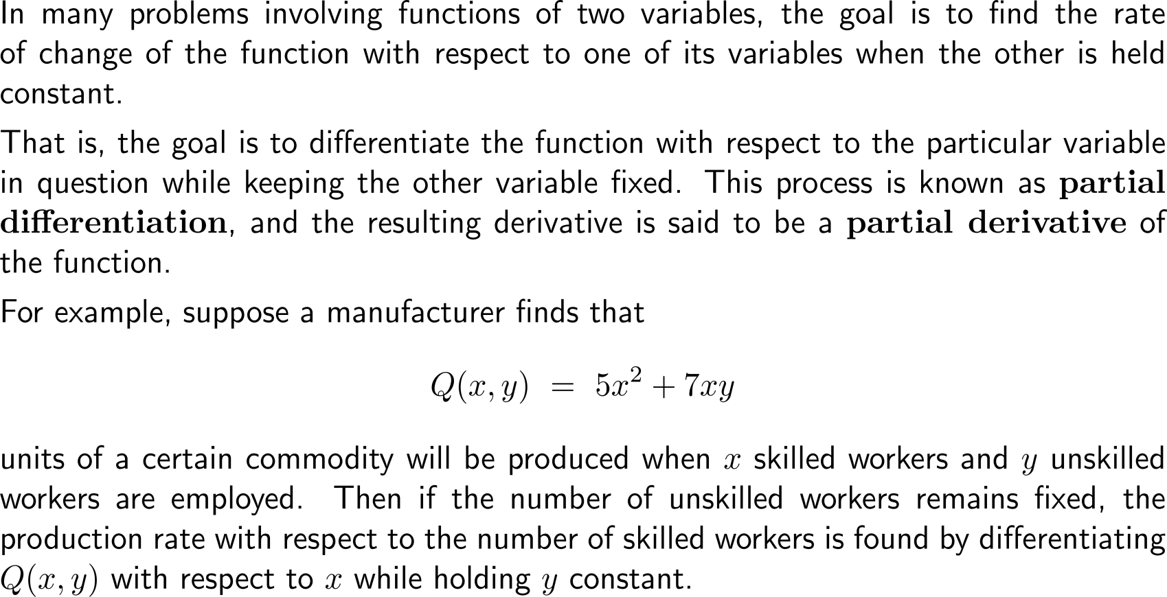
A partial derivative of a function of several variables is a derivative w.r.t. a specific variable (1/ 3)

Slide 39
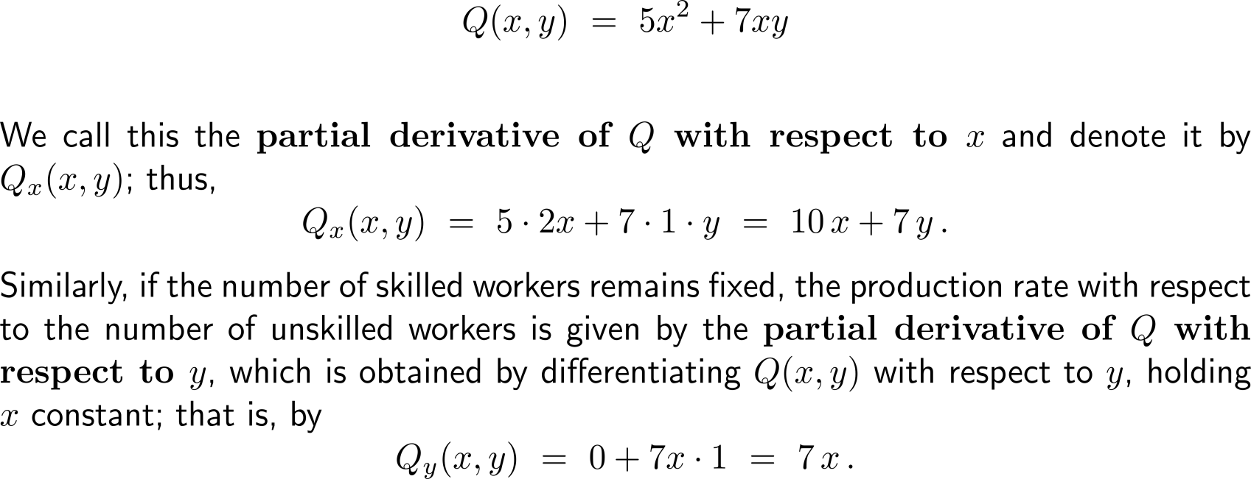
A partial derivative of a function of several variables is a derivative w.r.t. a specific variable (2/ 3)

Slide 40
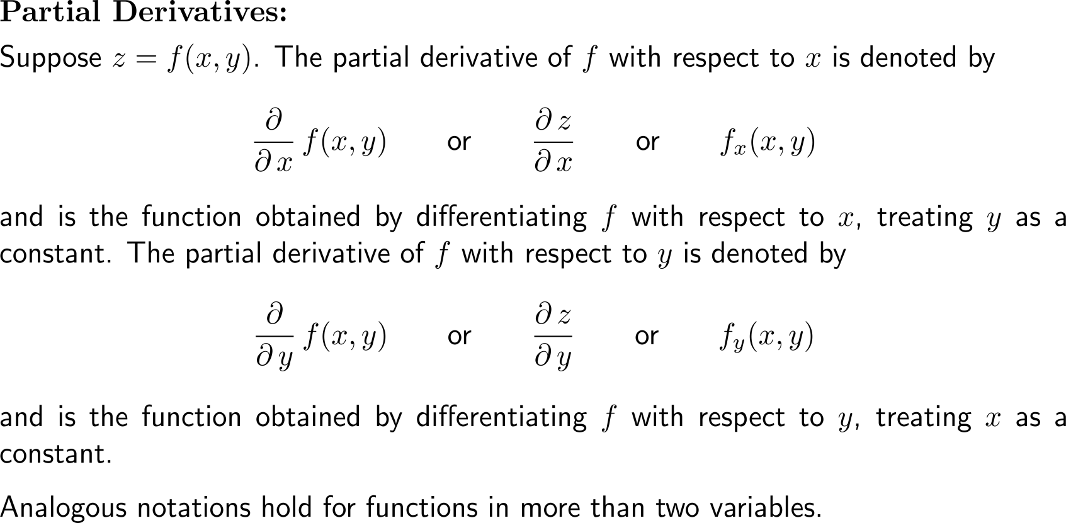
A partial derivative of a function of several variables is a derivative w.r.t. a specific variable (3/ 3)

Slide 41
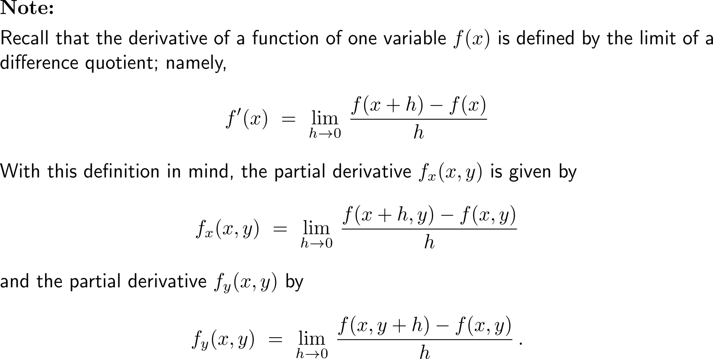
As for functions of one variable, partial derivatives are rigorously defined by limits of difference quotients …

Slide 42
… such that in particular no new differentiation rules are required for the computation with partial derivatives

Slide 43
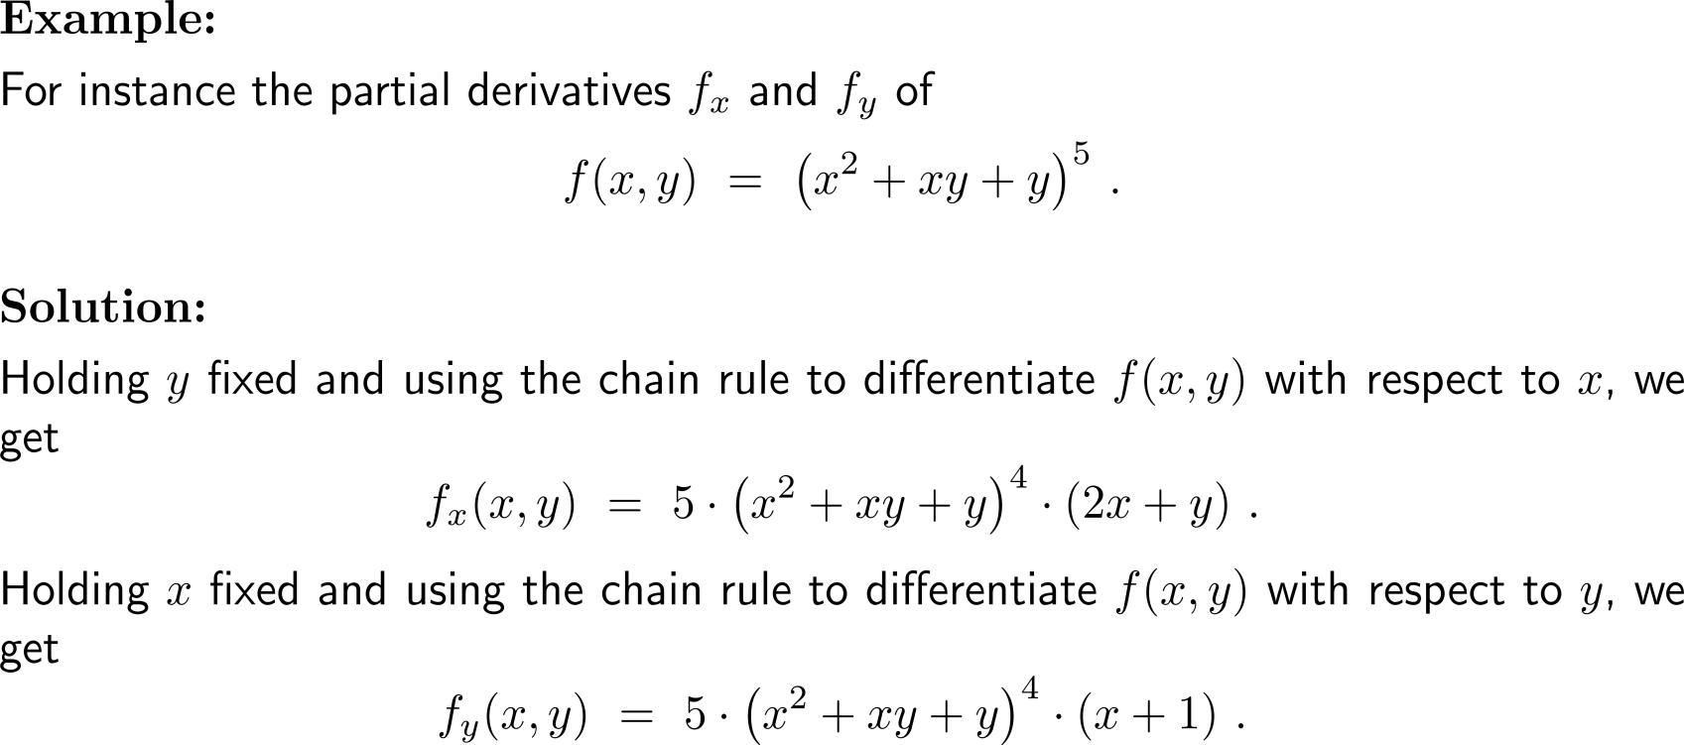
Example: Finding partial derivatives

Slide 44
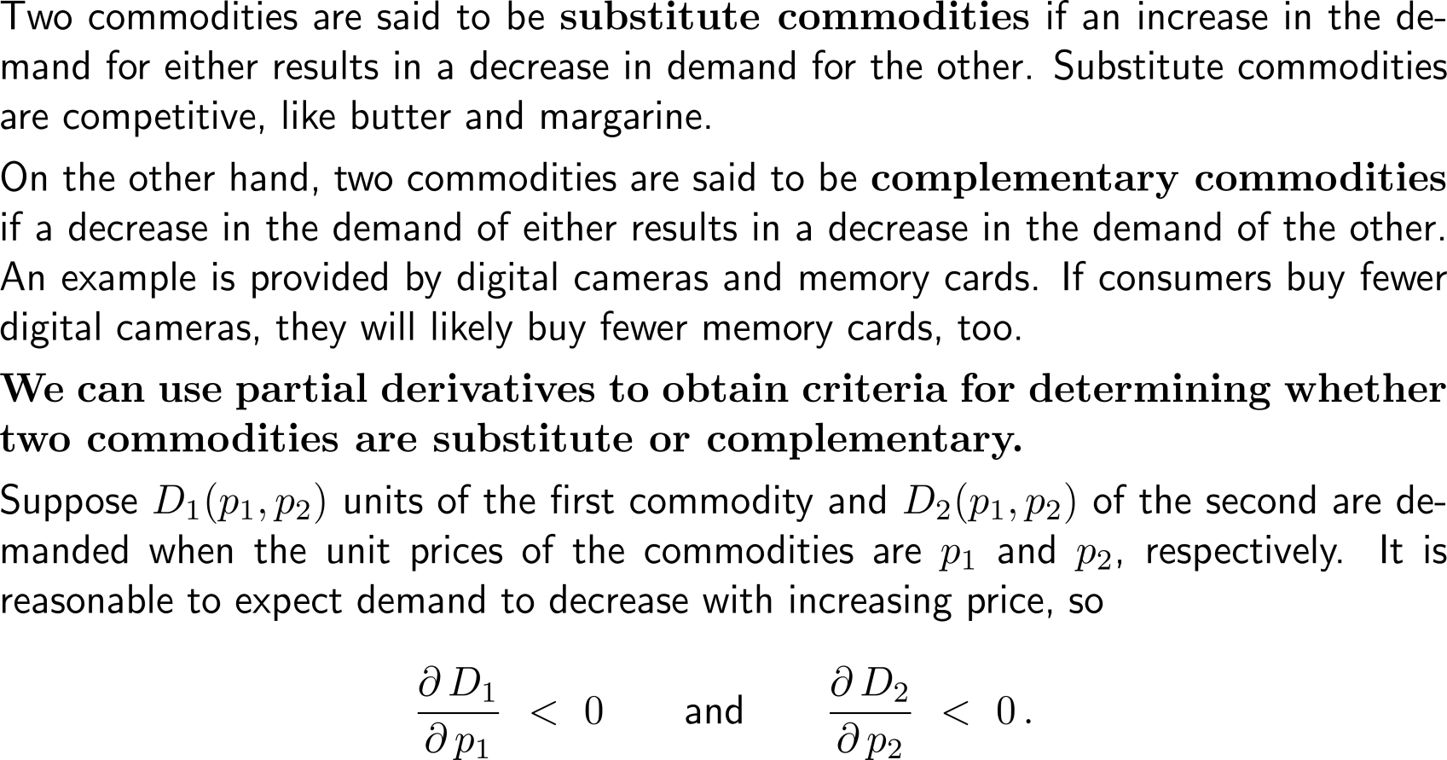
Application in economics: Substitute and complementary commodities (1/ 2)

Slide 45
Application in economics: Substitute and complementary commodities (2/ 2)

Slide 46
Example: Substitute and complementary commodities

Slide 47
Example: Substitute and complementary commodities

Slide 48
Geometric illustration of the partial derivatives f_{x} and f_{y} as slopes to the graph in the x and y direction, respectively

Slide 49
Explanation of the previous geometric illustration (1/ 2)

Slide 50
Explanation of the previous geometric illustration (2/ 2)

Slide 51
The partial derivatives f_{x}(a, b) and f_{y}(a, b) span the tangent plane to the graph of the function at the corresponding point (a, b)
Application of the HNF:
+

Slide 52
Example: Tangent plane to an elliptic paraboliod
+

Slide 53
Further Worked-Out Exercises:
Calculus II for Management
Topics
Partial derivatives
Tangent plane

Slide 54
Exercise: Finding partial derivatives of a function with two variables

Slide 55
Example: Evaluating a function of three variables and its partial derivatives

Slide 56
Exercise
5 minutes
self/ group work
please, upload your solutions to the chat

Slide 57
Exercise

Slide 58
Exercise

Slide 59
Match the graph and level curves
Exercise:
Consider the graphs and level curve plots given on the right-hand side.
Which graph belongs to which level curve plot?
5 minutes
self/ group work
please, upload your solutions to the chat

Slide 60
To visualize the shapes of graphs or solution sets of functions in several variables one can use one of the many online graphing tools
Surfer – for implicit surfaces
https://imaginary.org/de/program/surfer

Slide 61
Exercise

Slide 62
Exercise

Slide 63
Exercise

Slide 64
Calculus II for Management

