Slide 1
Calculus II for Management
Optimization & The Method of Least Squares
week 11
Lecture 11
Finding extreme values on a closed and bounded region
Matrix algebra revisited
The least-squares procedure & line
Least-squares prediction
Nonlinear curve-fitting

Slide 2
Topics
Finding Extreme Values on a Closed and Bounded Region
Matrix Algebra Revisited
The Least-Squares Procedure & Least-Squares Line
Least-Squares Prediction
Nonlinear Curve-Fitting

Slide 3
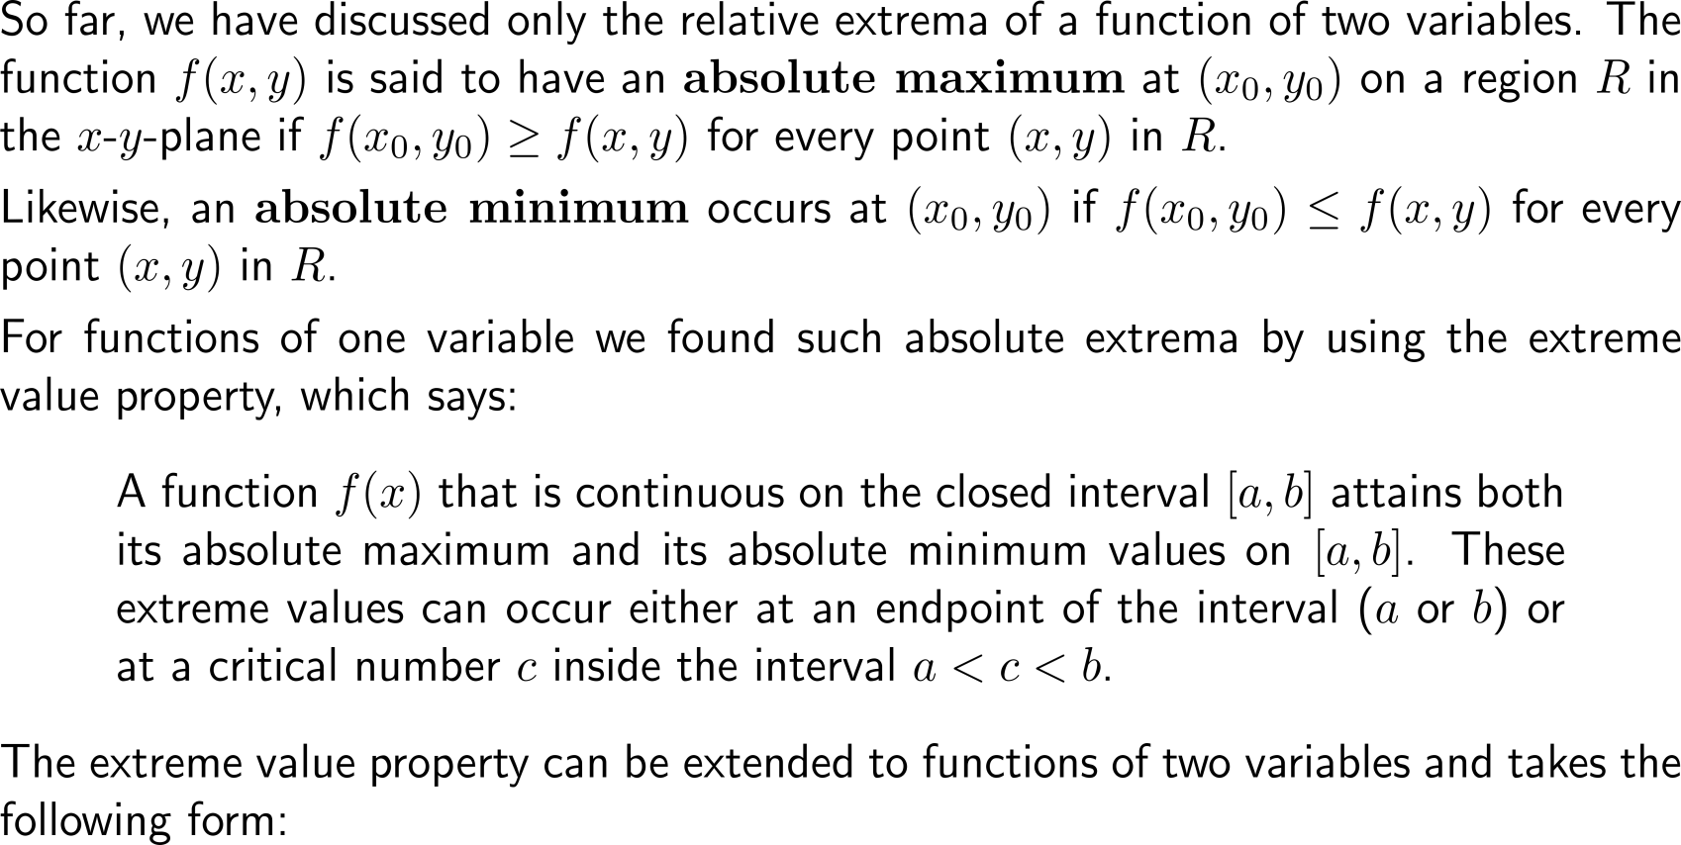
The extreme value property for functions of one …

Slide 4
… and two variables

Slide 5
What is a closed, bounded region?

Slide 6
With the extreme value property in mind, we can locate the absolute extrema of a continuous function on a closed, bounded region

Slide 7
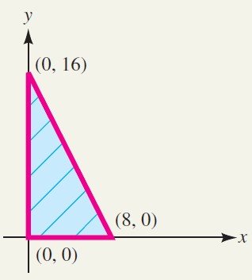
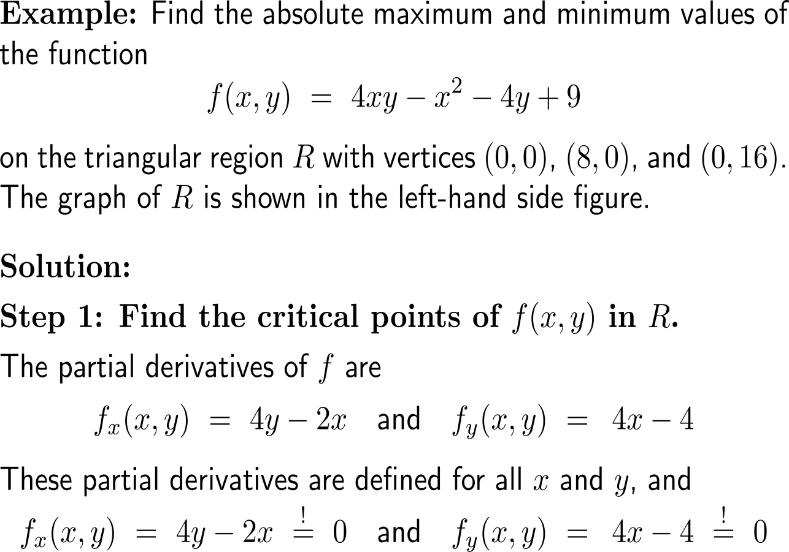
Example: Finding the absolute extrema of a function

Slide 8
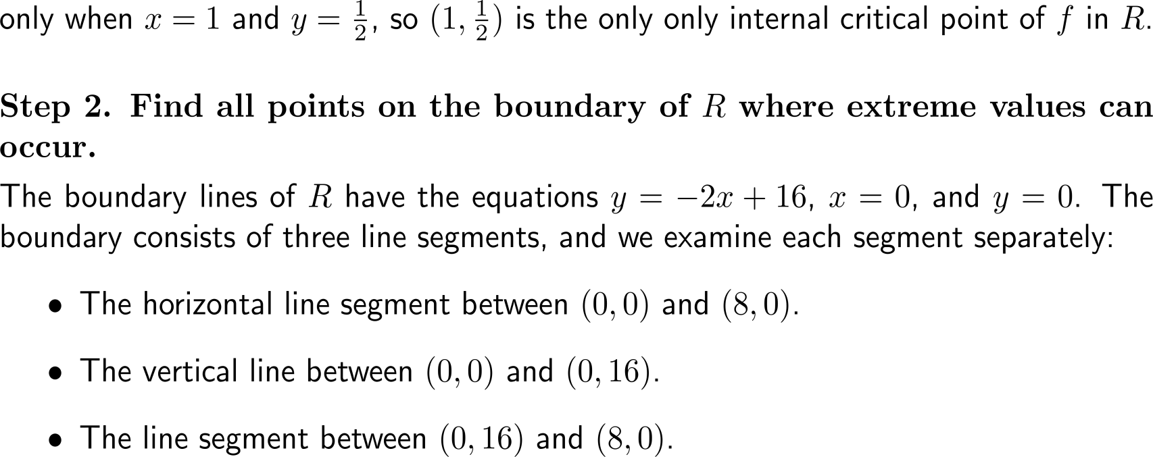
Example: Finding the absolute extrema of a function

Slide 9
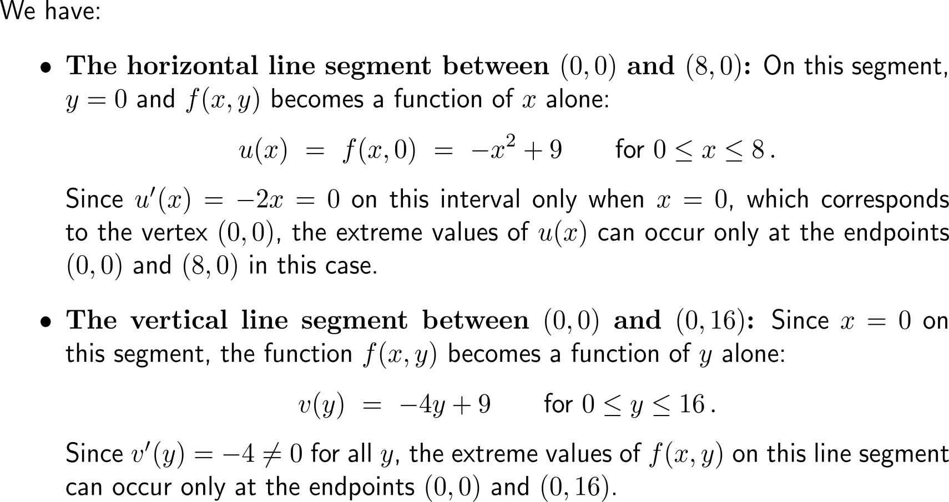
Example: Finding the absolute extrema of a function

Slide 10
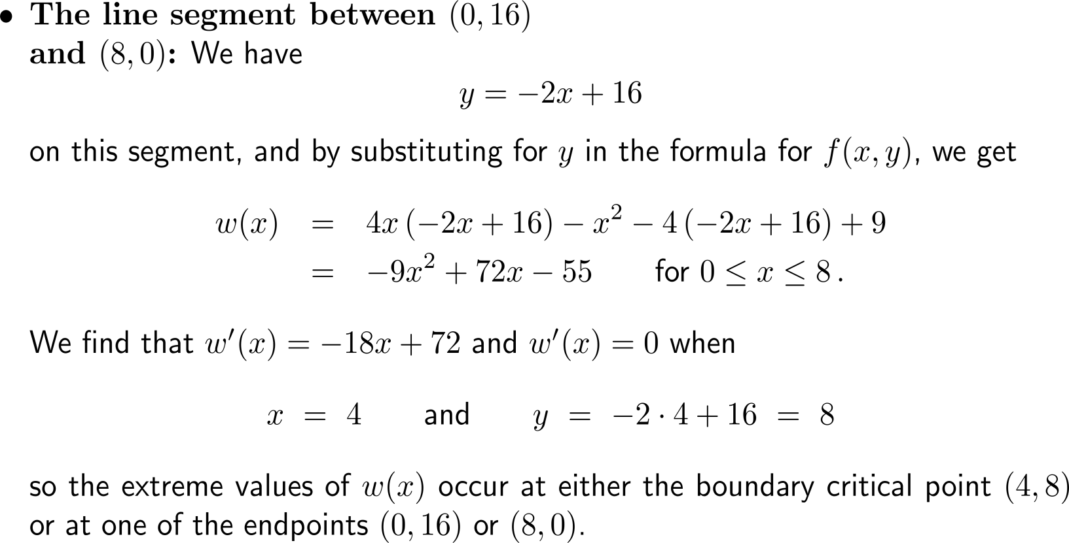
Example: Finding the absolute extrema of a function

Slide 11
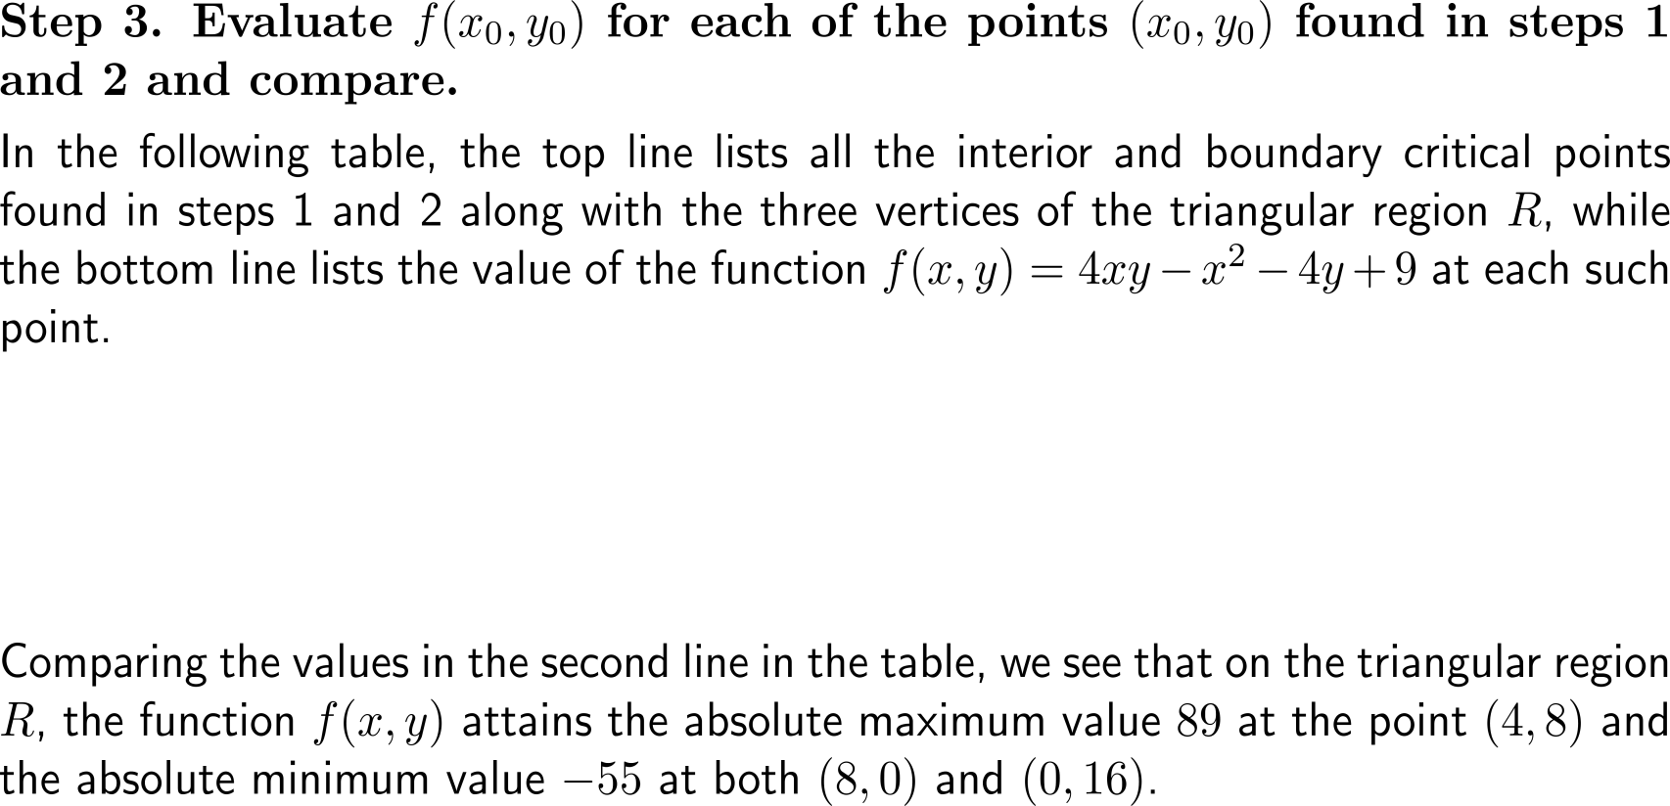
Example: Finding the absolute extrema of a function
point (x₀, y₀) | (1, 0.5) | (4, 8) | (0, 0) | (8, 0) | (0, 16)
value f(x₀, y₀) | 8 | 89 | 9 | -55 | -55

Slide 12
Topics
Finding Extreme Values on a Closed and Bounded Region
Matrix Algebra Revisited
The Least-Squares Procedure & Least-Squares Line
Least-Squares Prediction
Nonlinear Curve-Fitting

Slide 13
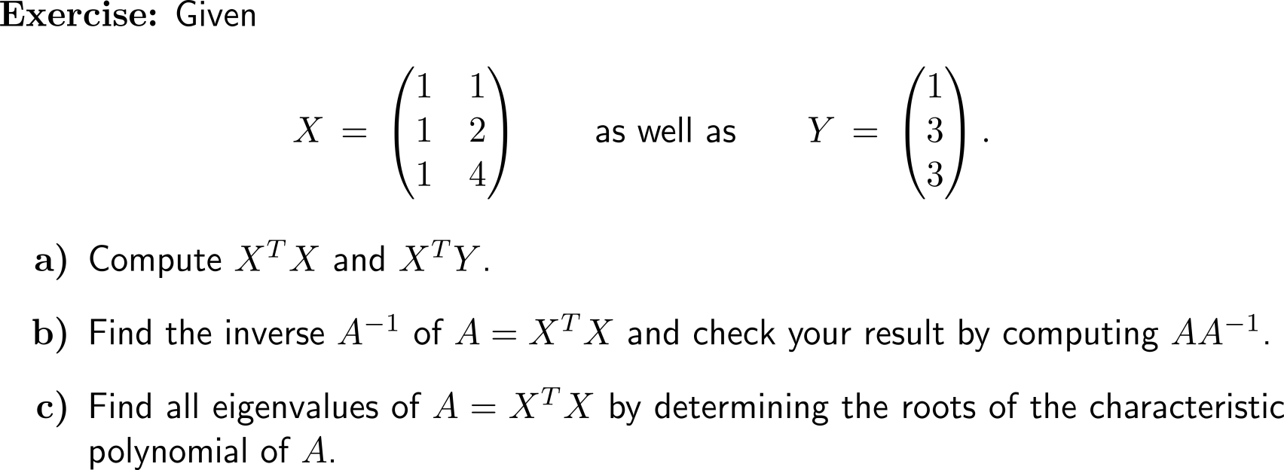
Recap Exercise: Matrix Algebra
A Short Review of Linear Algebra Topics:
Gaussian Elimination
Basis & Linear Independence
Determinants
Scalar- & Vector-Product
Matrix-Multiplication
Inverse Matrix
Eigenvalues & Eigenvectors

Slide 14
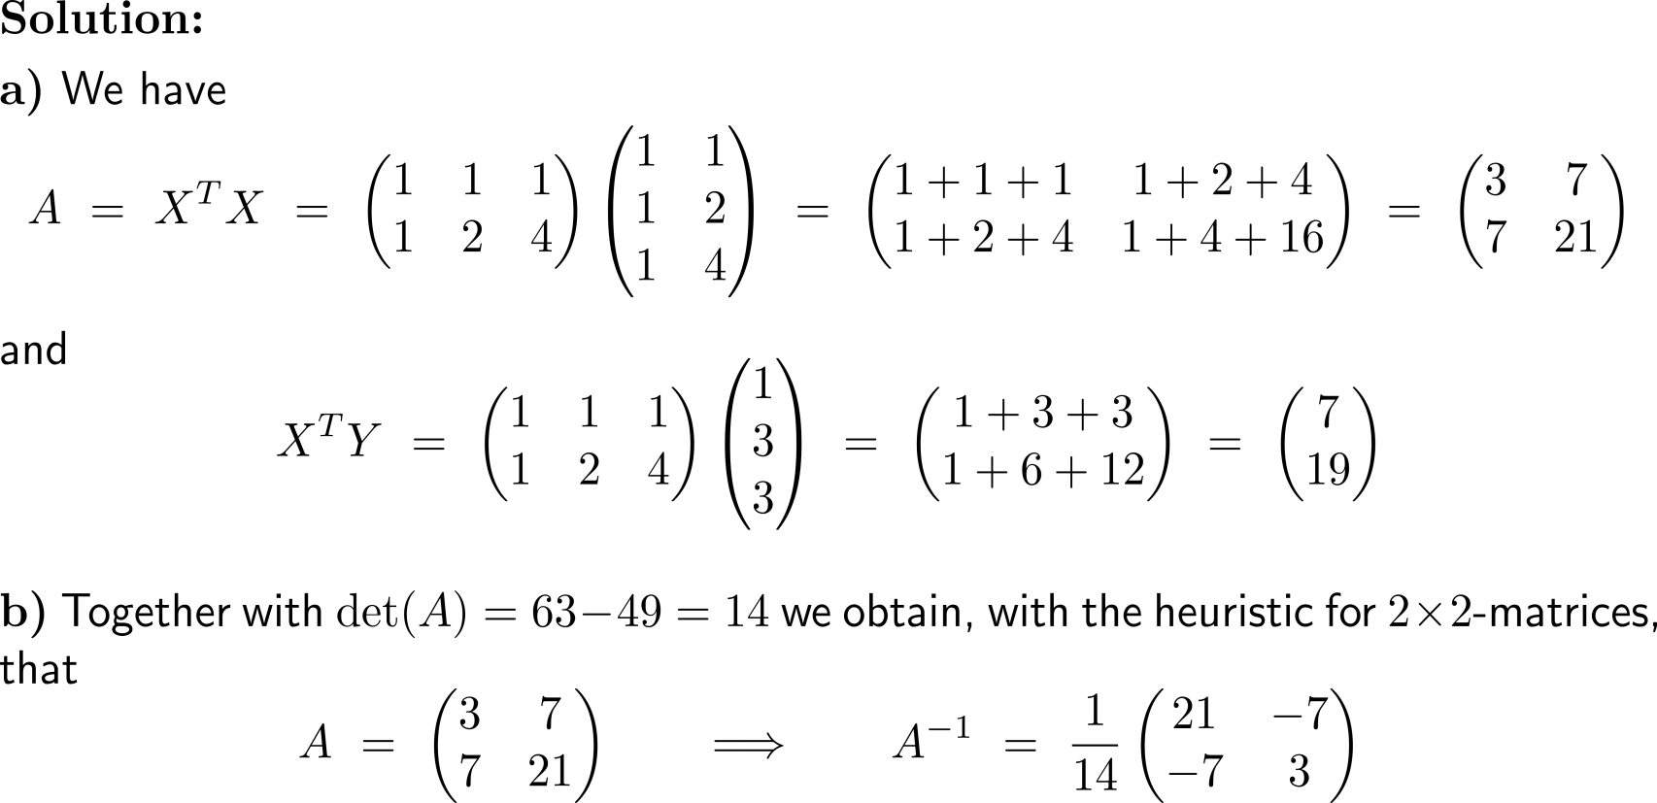
Recap Exercise: Matrix Algebra

Slide 15
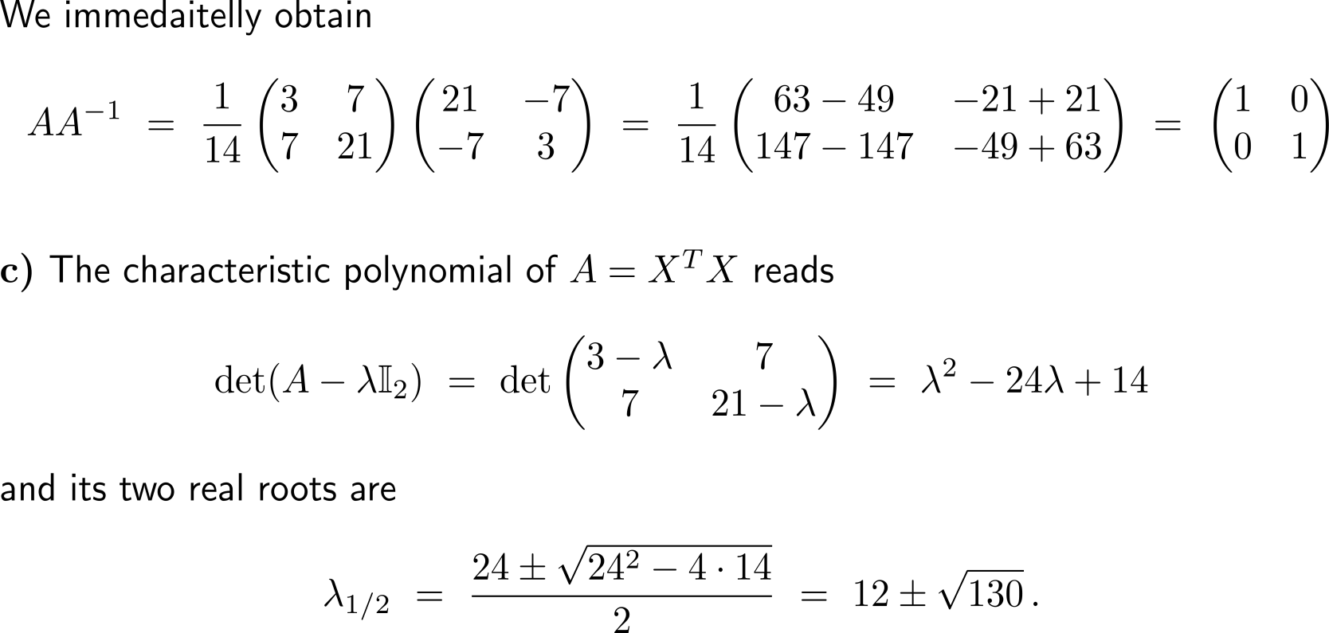
Recap Exercise: Matrix Algebra

Slide 16
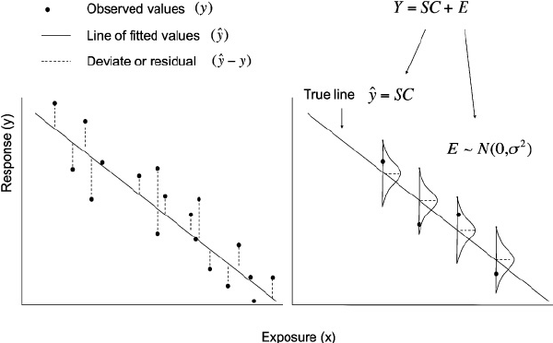
Topics
Finding Extreme Values on a Closed and Bounded Region
Matrix Algebra Revisited
The Least-Squares Procedure
& Least-Squares Line
Least-Squares Prediction
Nonlinear Curve-Fitting

Slide 17
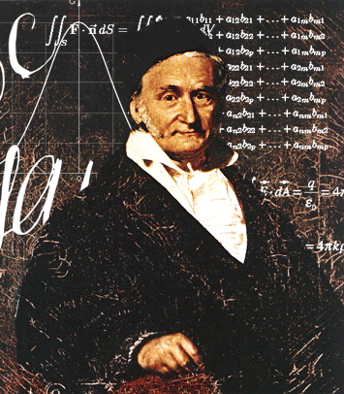
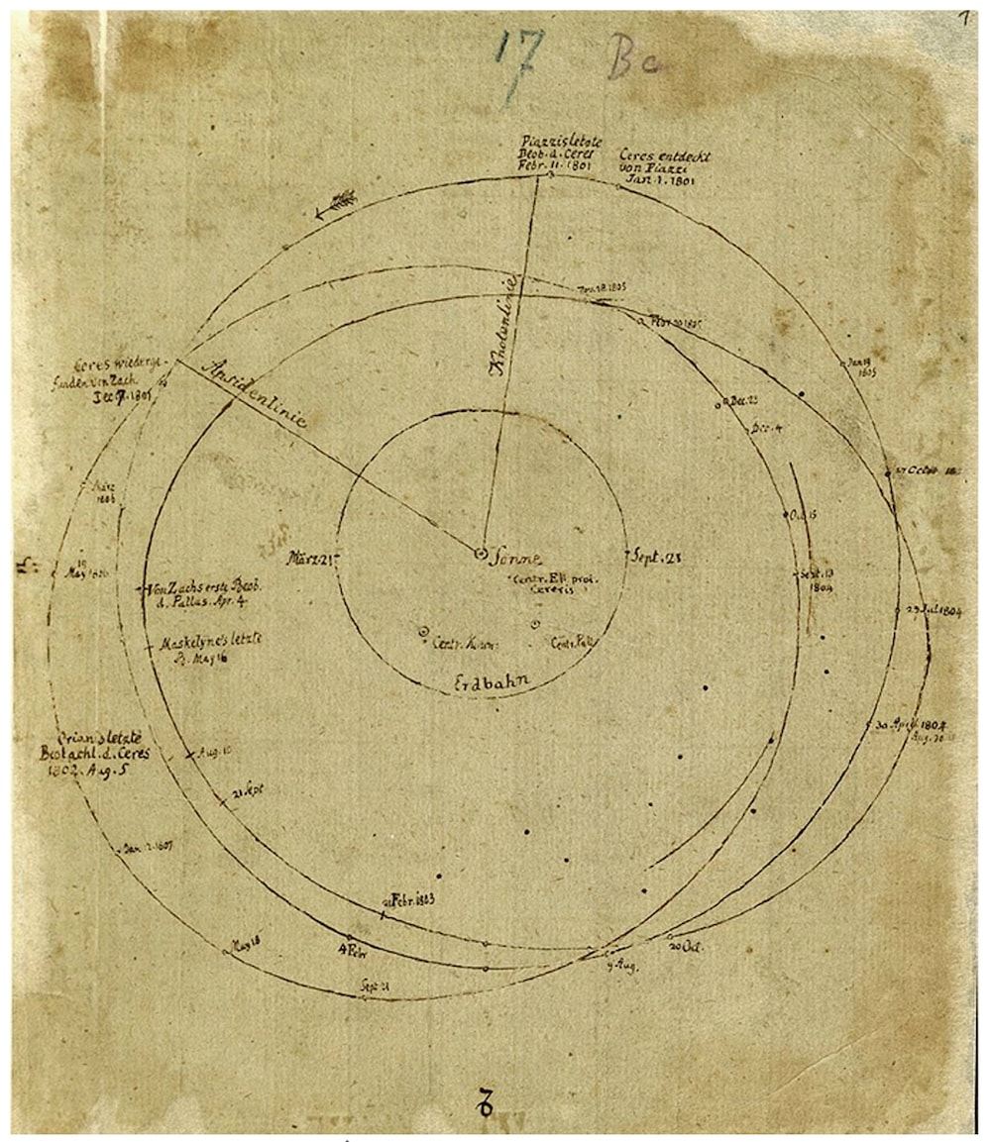
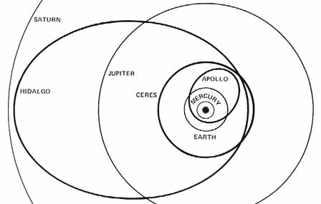
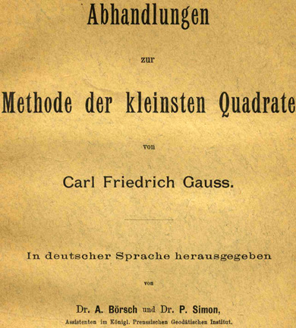
In 1801 the method of least-squares was developed to solve an astrophysical riddle and rediscover a ‘lost’ asteroid
Image of the original description by Carl Friedrich Gauss
The first minor planet (asteroid, dwarf planet) Ceres was found sweeping around the sun on January 1st, 1801.
However, it was lost in the sun’s rays after only 41 days and there was every reason to believe it would never be recognized again.
With the help of Gauss Ceres was rediscovered on the last day of 1801.

Slide 18
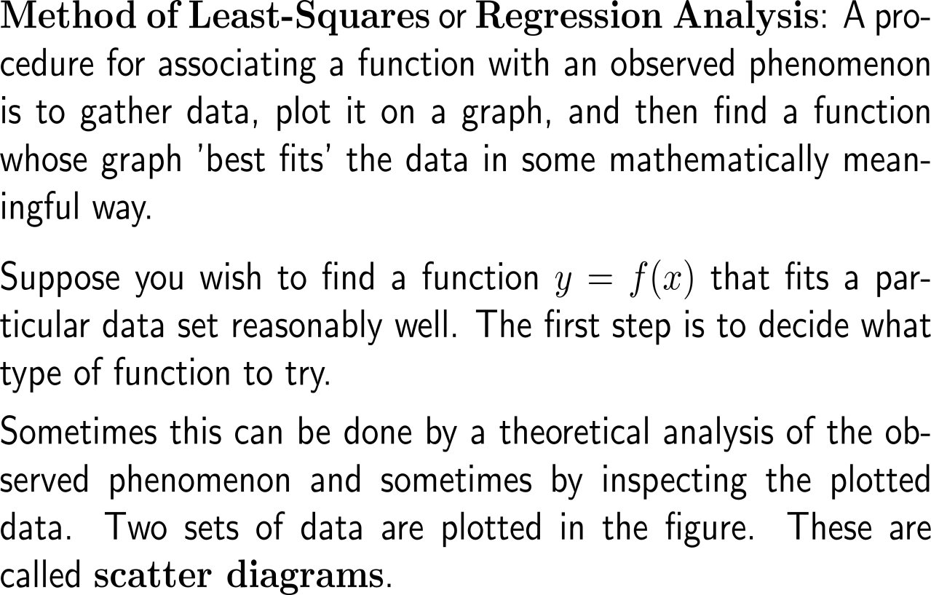
The method of least-squares aims to provide the best fitting curve through scatter diagrams (1/ 3)

Slide 19
The method of least-squares aims to provide the best fitting curve through scatter diagrams (2/ 3)

Slide 20
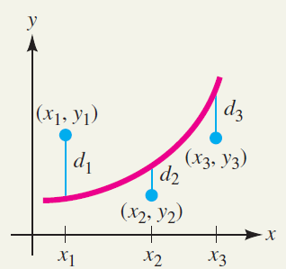
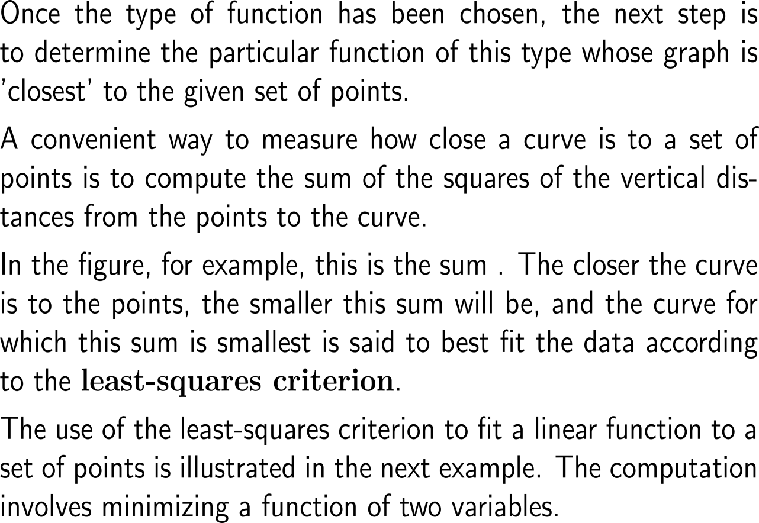
The method of least-squares aims to provide the best fitting curve through scatter diagrams (3/ 3)

Slide 21
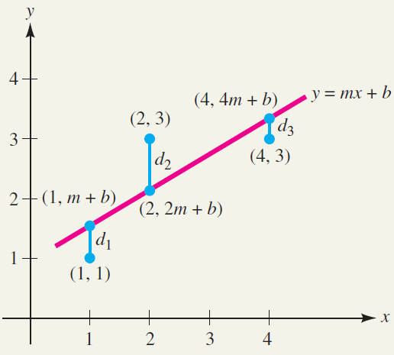
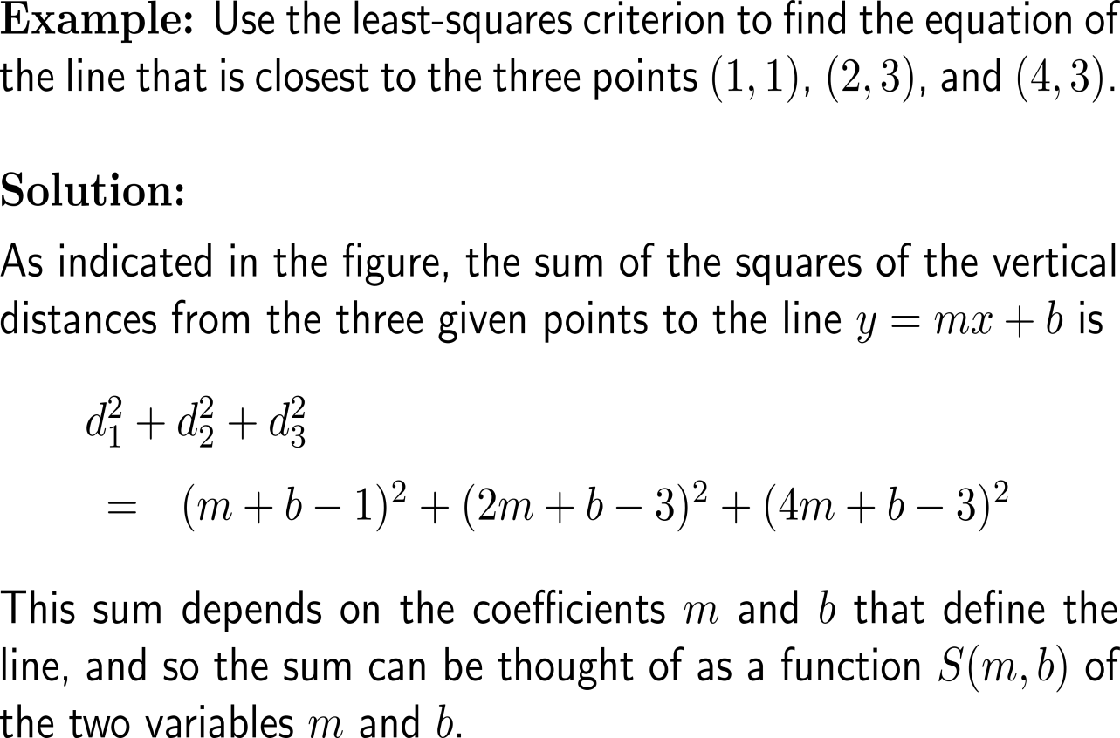
Example: Using the Least-Squares Criterion

Slide 22
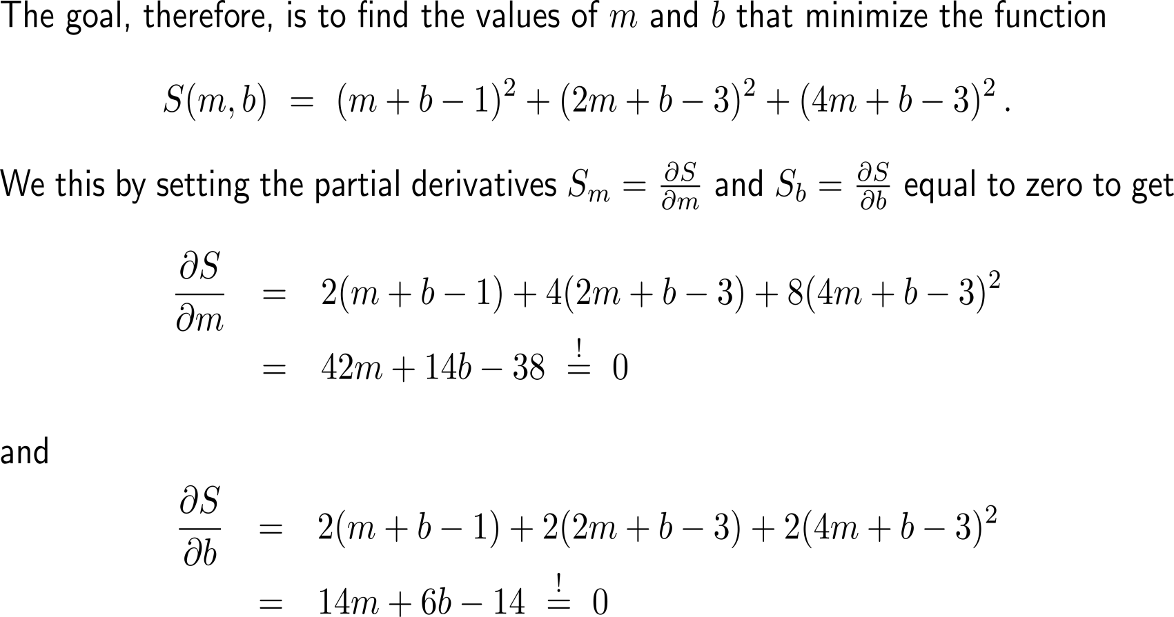
Example: Using the Least-Squares Criterion

Slide 23
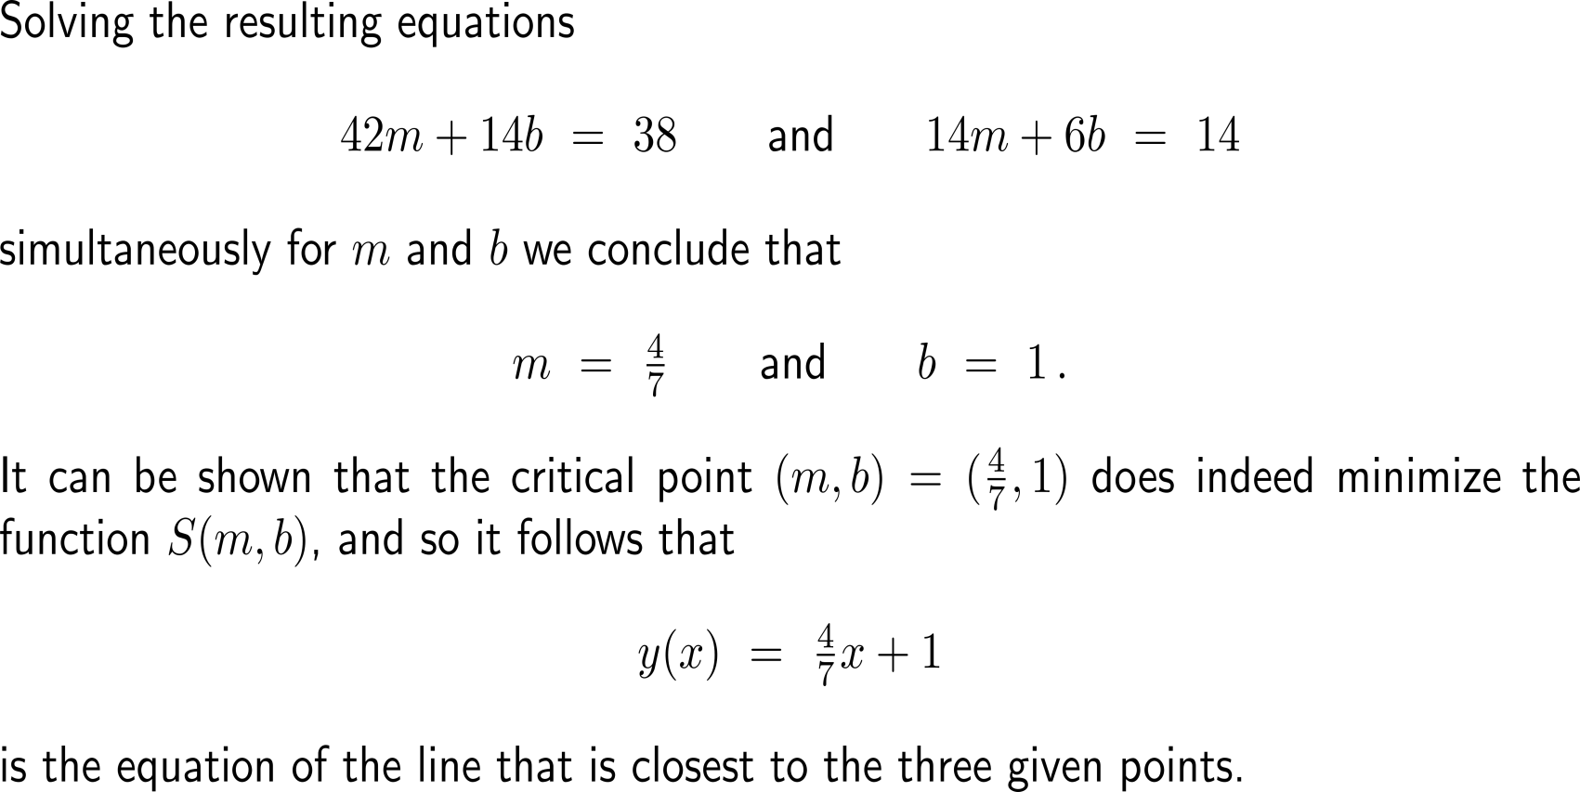
Example: Using the Least-Squares Criterion

Slide 24
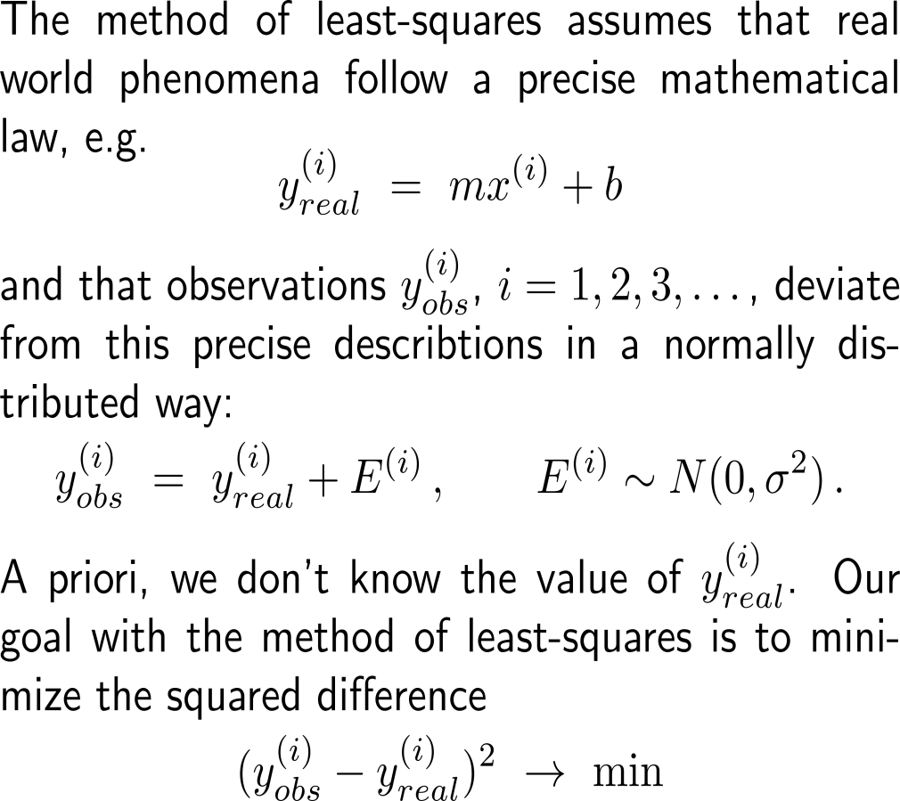
A typical application of the method of least-squares is the identification of the best fitting assuming normally distributed observation around this line

Slide 25
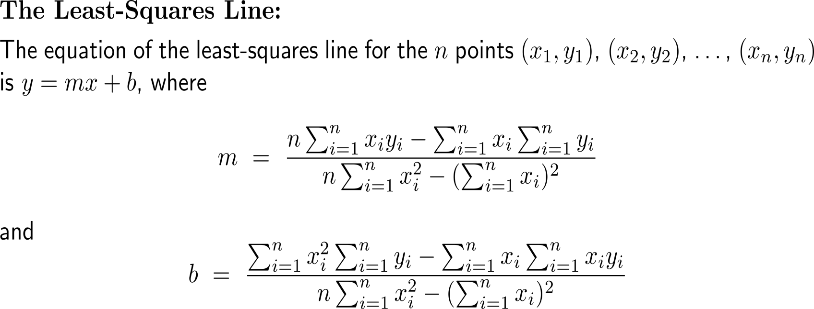
Based on the coordinates x_{i} and y_{i} of the measurements the parameters m and b of the least squares line y = mx + b are obtained

Slide 26
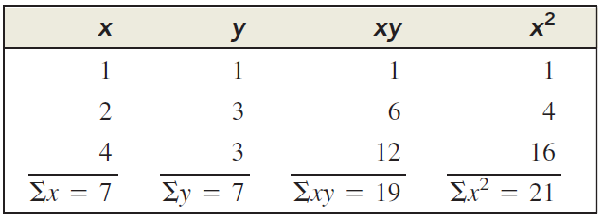
Example: Finding a least-squares line

Slide 27
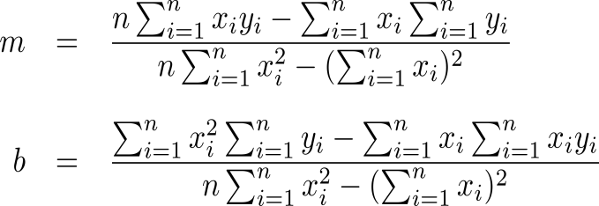
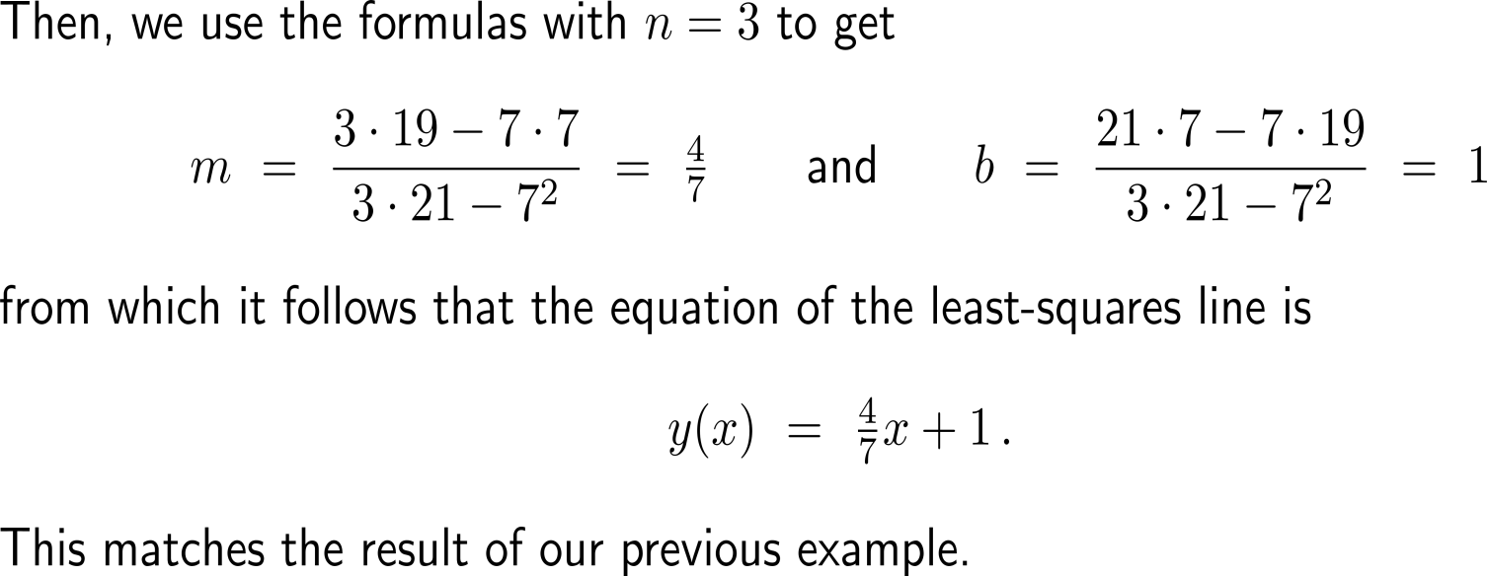
Example: Finding a least-squares line

Slide 28
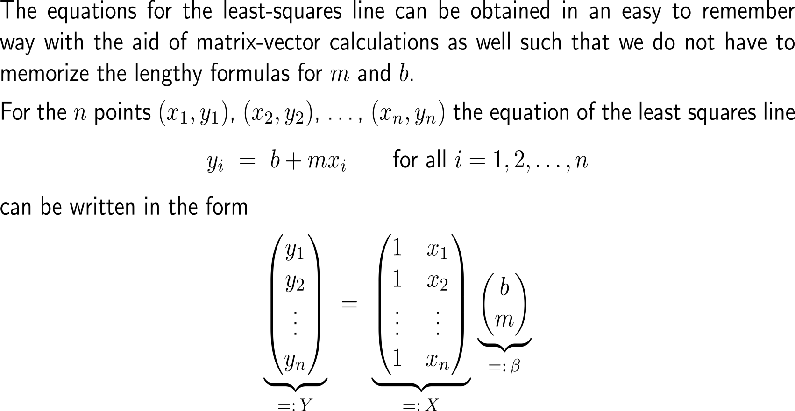
The parameters b and m of the least-squares line can also be obtained via matrix-vector calculus (1/ 3)

Slide 29
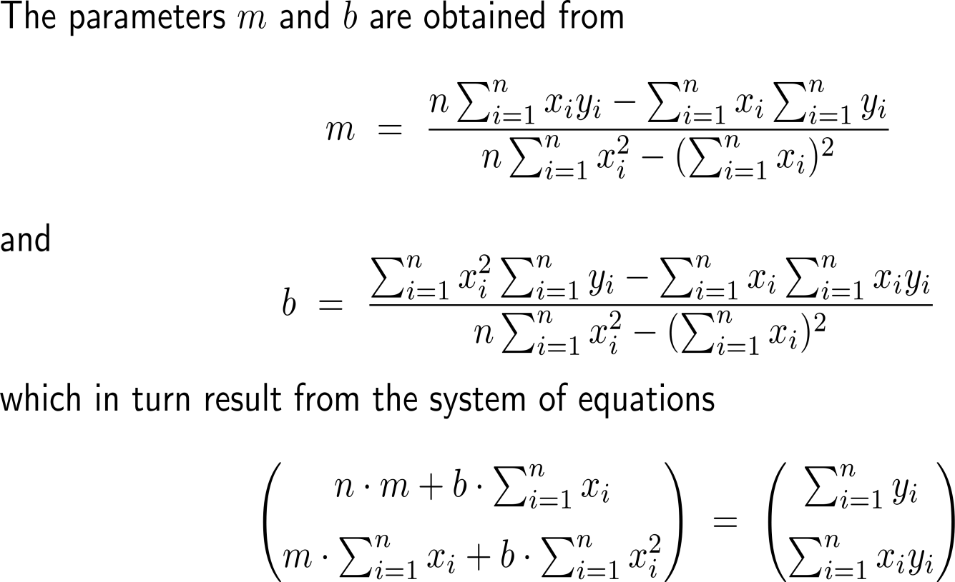
The parameters b and m of the least-squares line can also be obtained via matrix-vector calculus (2/ 3)

Slide 30
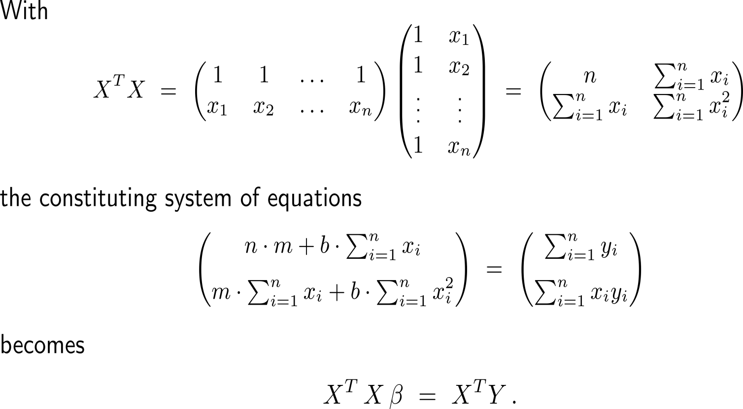
The parameters b and m of the least-squares line can also be obtained via matrix-vector calculus (3/ 3)

Slide 31
Example: Finding a least-squares line

Slide 32
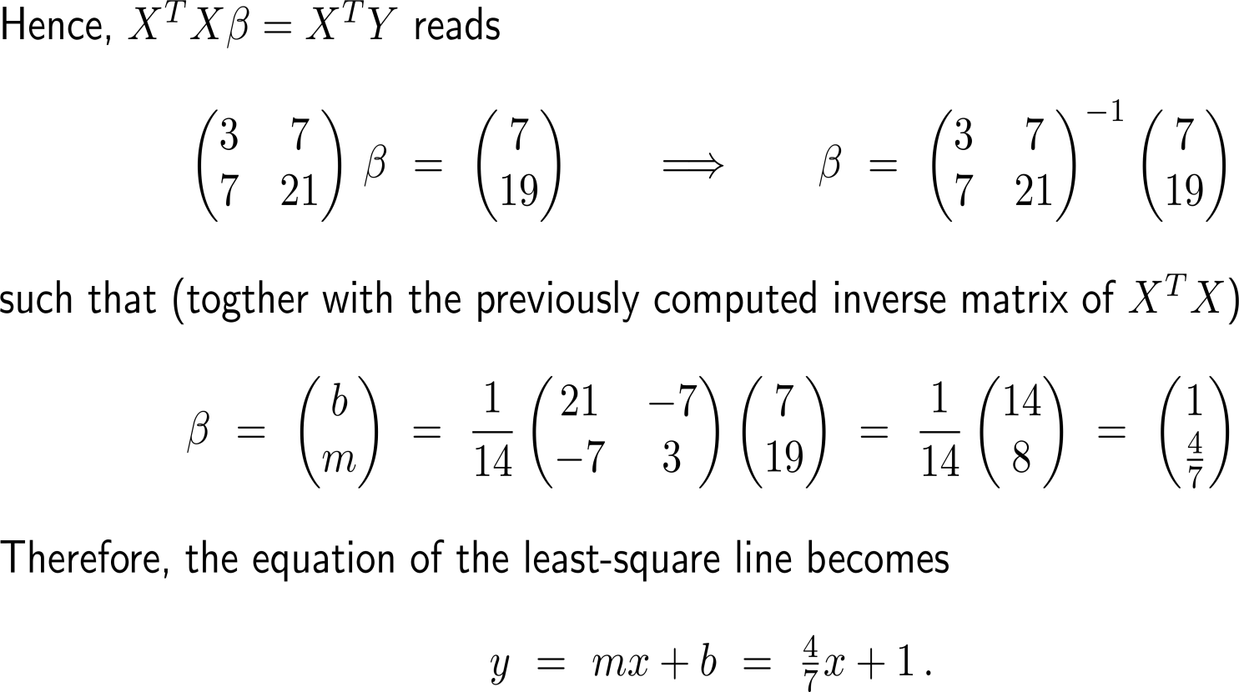
Example: Finding a least-squares line

Slide 33
Topics
Finding Extreme Values on a Closed and Bounded Region
Matrix Algebra Revisited
The Least-Squares Procedure & Least-Squares Line
Least-Squares Prediction
Nonlinear Curve-Fitting

Slide 34
Example: Making a least-squares prediction of GPA

Slide 35
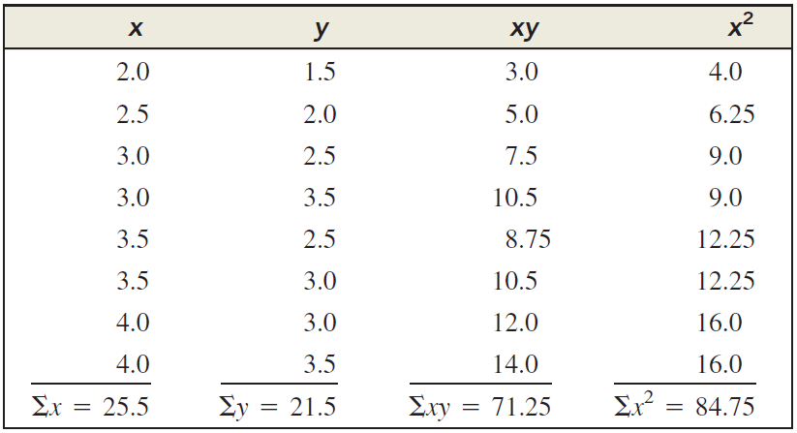
Example: Making a least-squares prediction of GPA

Slide 36
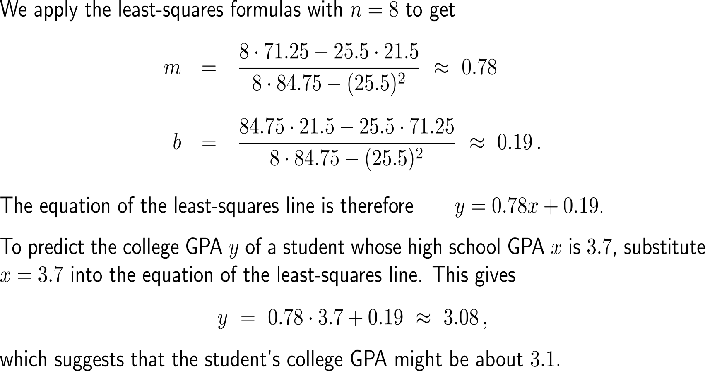
Example: Making a least-squares prediction of GPA

Slide 37
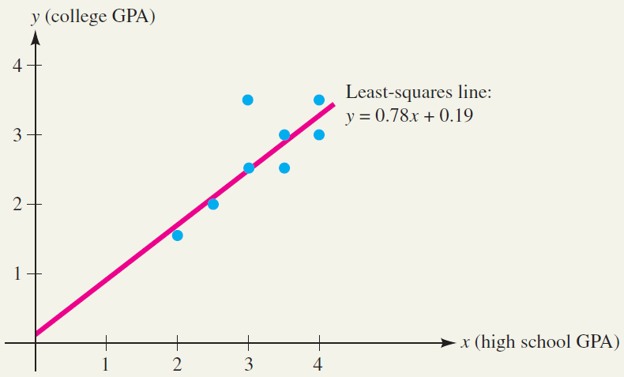
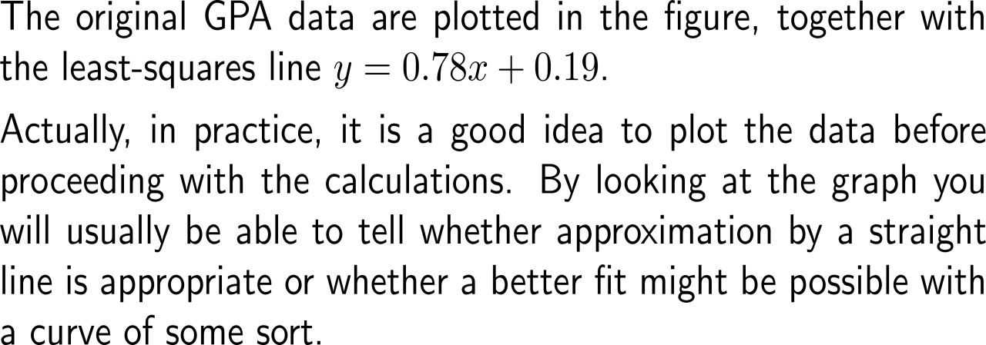
Example: Making a least-squares prediction of GPA

Slide 38
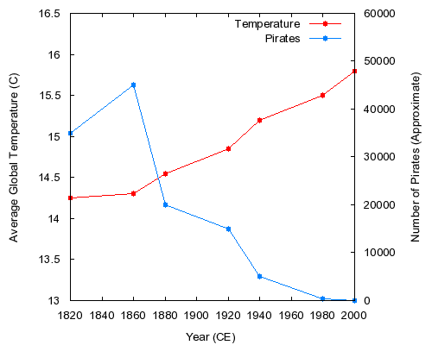
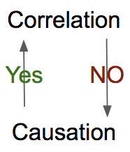
Very important remark: Correlation is not causation
the less pirates the higher the global temperatures
additional justification required beyond the correct usage of the method of least-squares

Slide 39
Topics
Finding Extreme Values on a Closed and Bounded Region
Matrix Algebra Revisited
The Least-Squares Procedure & Least-Squares Line
Least-Squares Prediction
Nonlinear Curve-Fitting

Slide 40
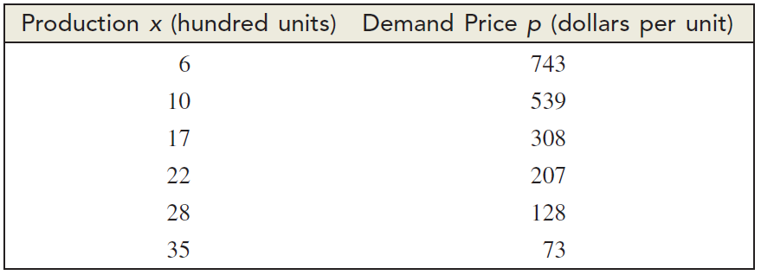
Example: Finding an exponential demand function

Slide 41
Example: Finding an exponential demand function

Slide 42
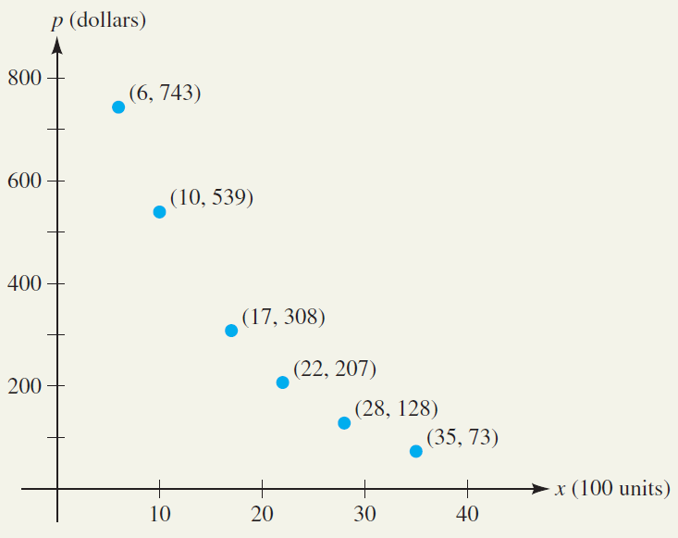
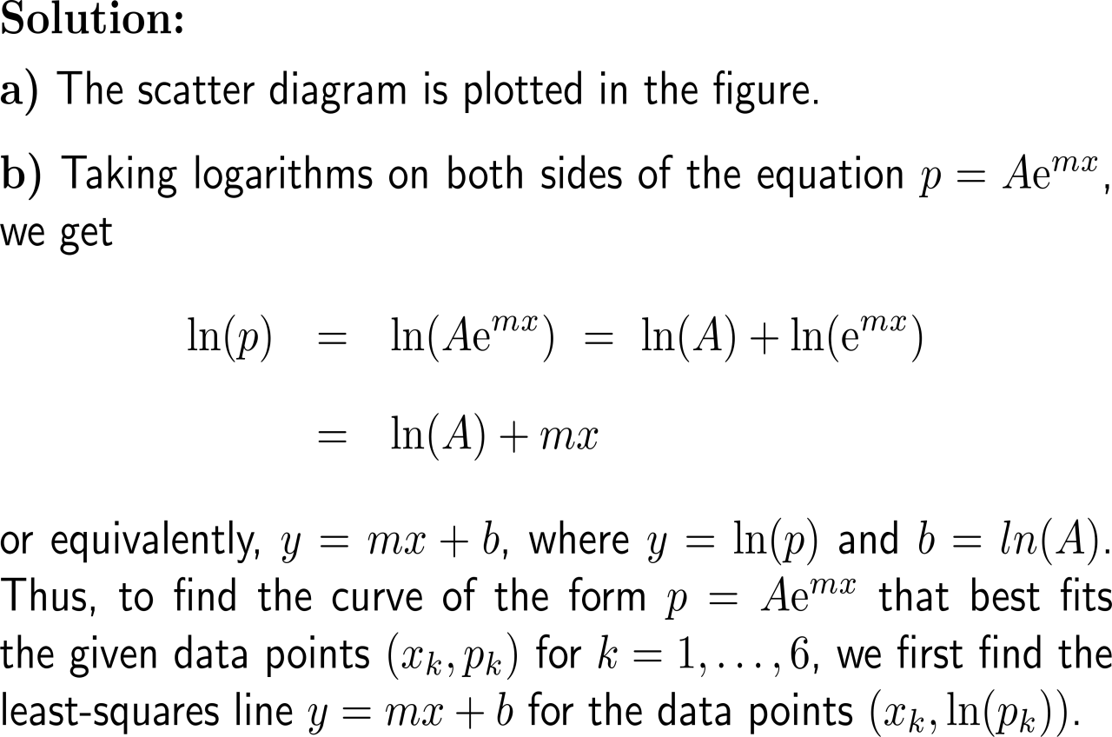
Example: Finding an exponential demand function

Slide 43
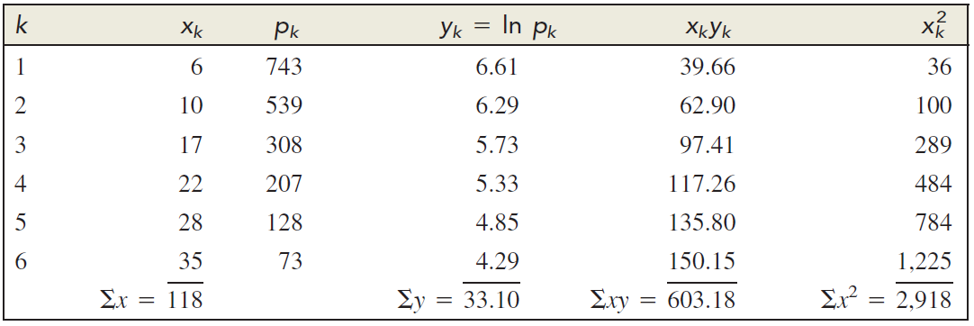
Example: Finding an exponential demand function

Slide 44
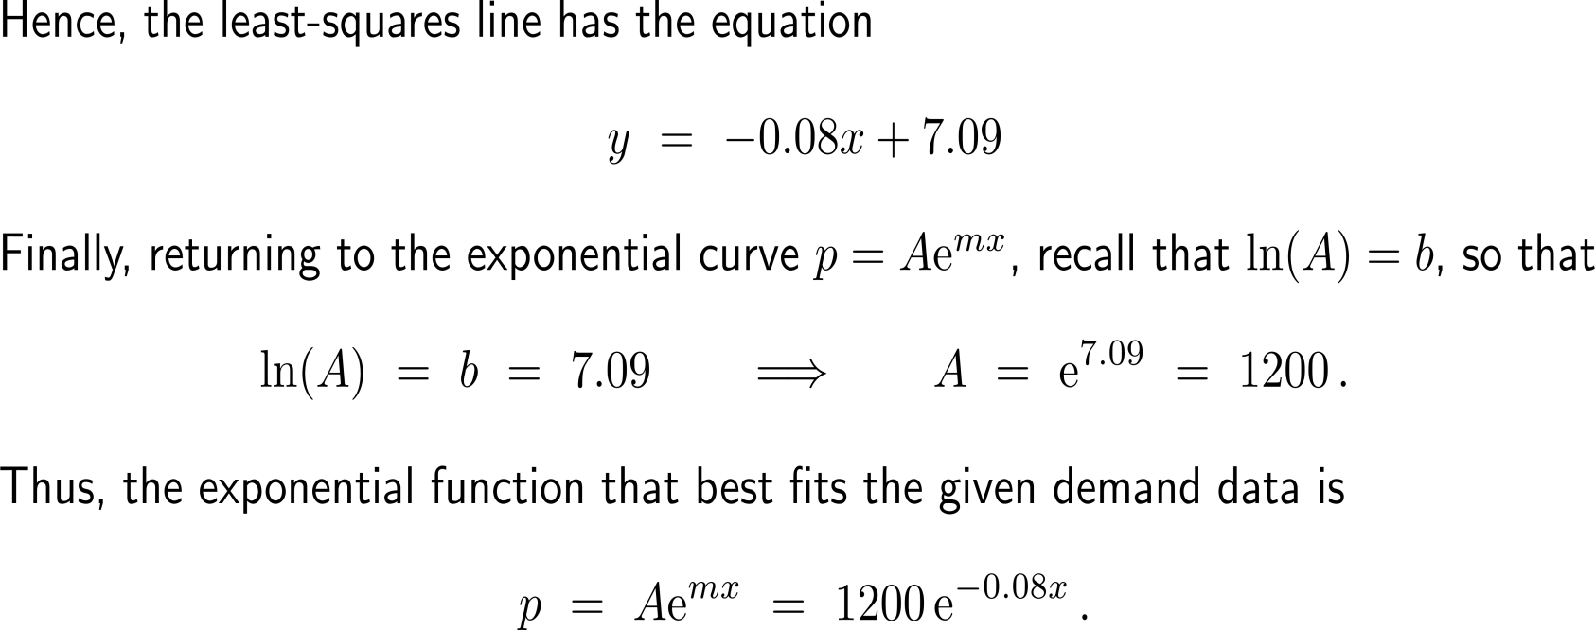
Example: Finding an exponential demand function

Slide 45
Example: Finding an exponential demand function

Slide 46
The illustrated procedure for fitting data to an exponential curve is sometimes called log-linear regression

Slide 47
Outlook: Neuronal Networks – Regression Analysis in the time of artificial intelligence
Machine Learning Types
Supervised Learning
Unsupervised Learning
Semi-Supervised Learning
Reinforcement Learning
H
…
H
Continuous Target Value
Categorical Target Value
Target Variable not Available
Categorical Target Variable
Categorical Target Value
Target Variable not Available
I
H
…
H
Regression
Classification
Clustering
Association
Classification
Clustering
Classification
Control
O
I
H
…
H
H
…
H
http://playground.tensorflow.org/

Slide 48
Further Worked-Out Exercises:
Calculus II for Management
Topics
Finding extreme values
Method of least-squares

Slide 49
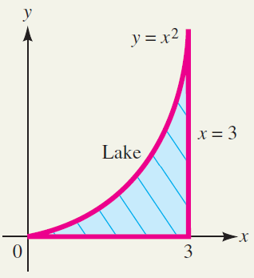
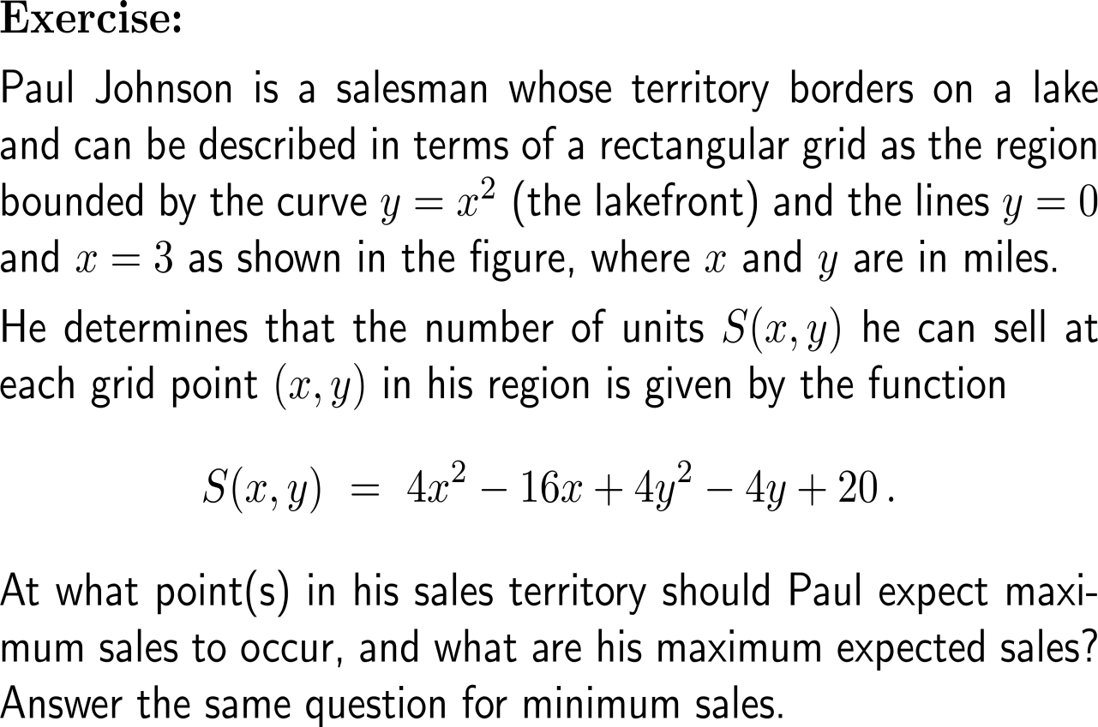
Exercise: Applying the extreme value property to a business problem

Slide 50
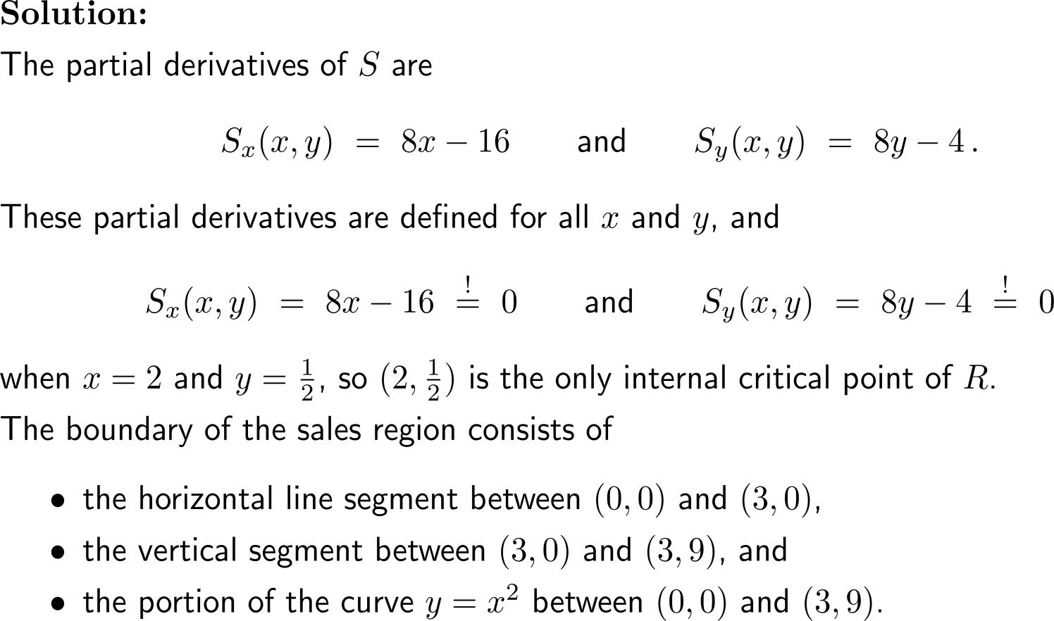
Exercise: Applying the extreme value property to a business problem

Slide 51
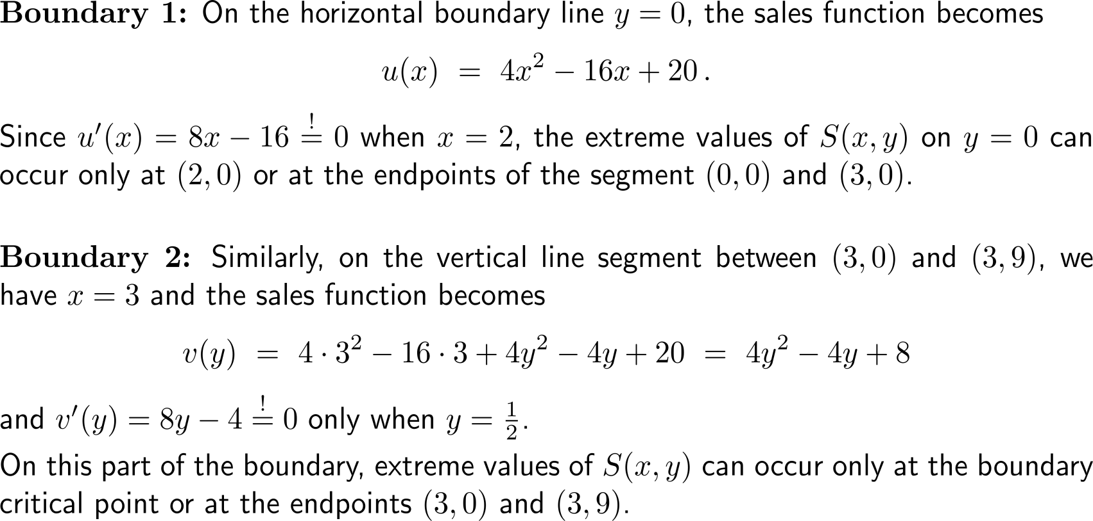
Exercise: Applying the extreme value property to a business problem

Slide 52
Exercise: Applying the extreme value property to a business problem

Slide 53
Exercise: Applying the extreme value property to a business problem
point (x₀, y₀) | (2, 0.5) | (0, 0) | (2, 0) | (3, 0) | (3, 0.5) | (3, 9) | (1, 1)
value f(x₀, y₀) | 3 | 20 | 4 | 8 | 7 | 296 | 8

Slide 54
Exercise: Determining a least-square line

Slide 55
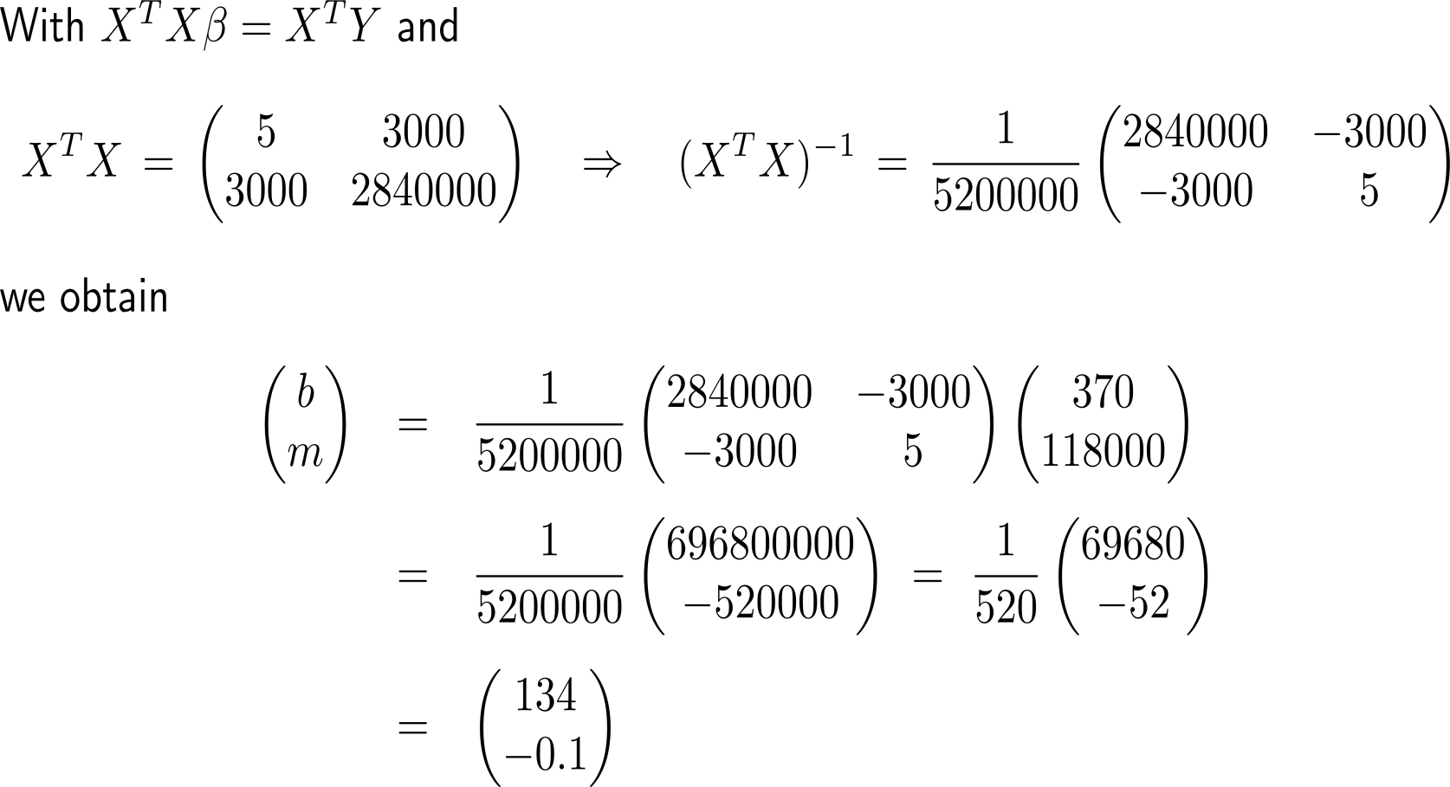
Exercise: Determining a least-square line

Slide 56
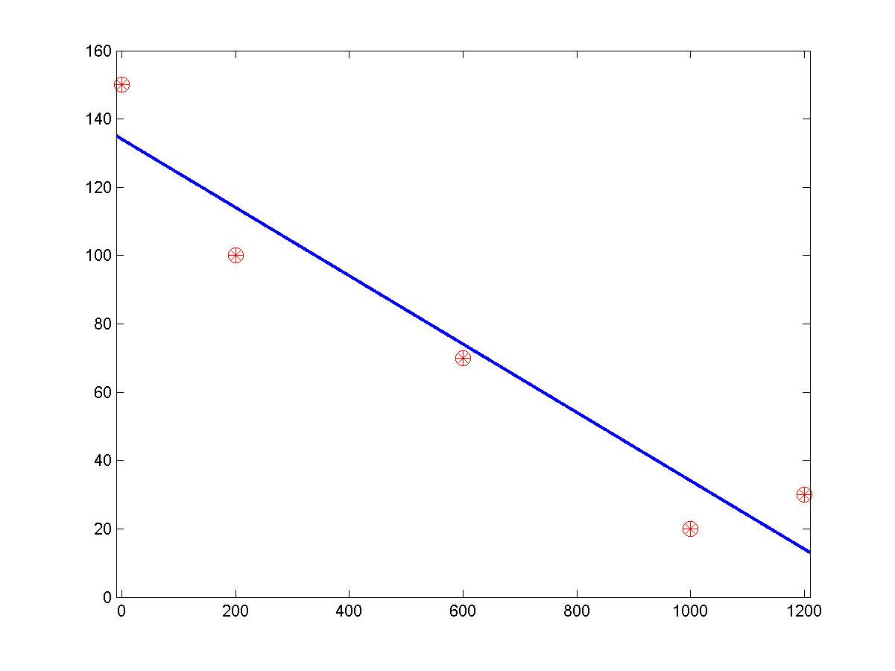
Exercise: Determining a least-square line

Slide 57
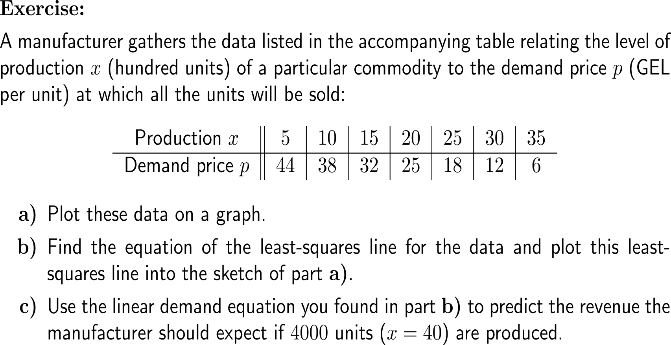
Exercise: Least-square prediction

Slide 58
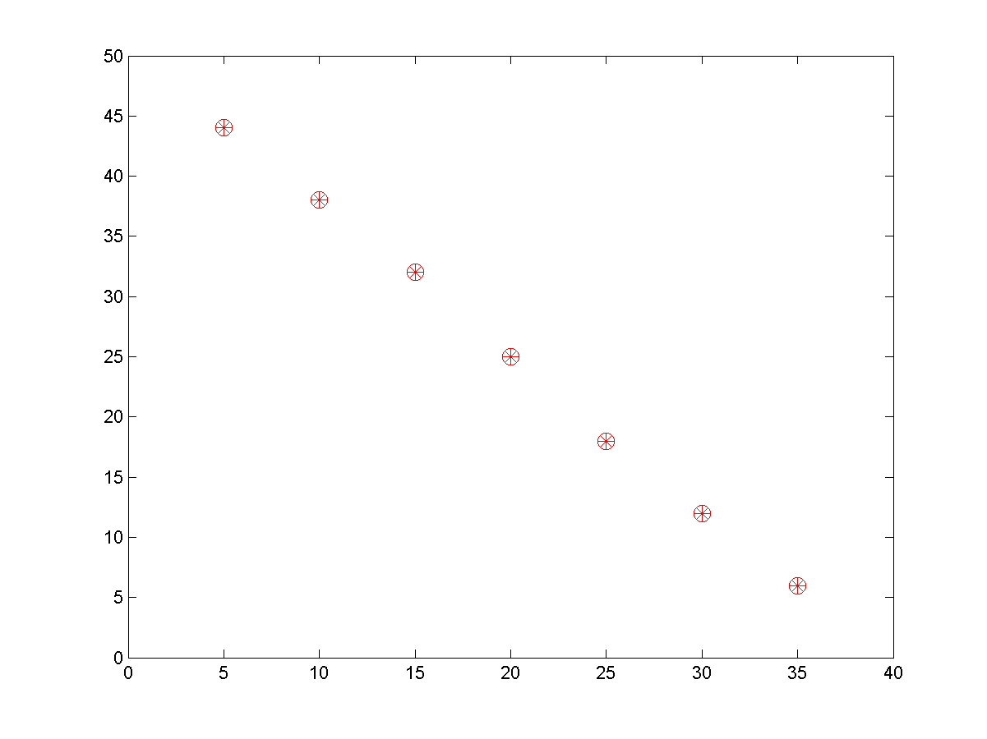
Exercise: Least-square prediction

Slide 59
Exercise: Least-square prediction

Slide 60
Exercise: Least-square prediction

Slide 61
Calculus II for Management

