Slide 1
Calculus II for Management
Constrained Optimization: The Method of Lagrange Multipliers
week 12
Lecture 12
Intro & applications in economics
The significance of the Lagrange multiplier
Why the method of Lagrange multipliers works
Application in 3D

Slide 2
Topics
Introduction to the Method of Lagrange Multipliers
Applications of the Lagrange Multiplier Method in Economics
The Significance of the Lagrange Multiplier
Why the Method of Lagrange Multipliers Works
Lagrange Multipliers for Functions of Three Variables

Slide 3
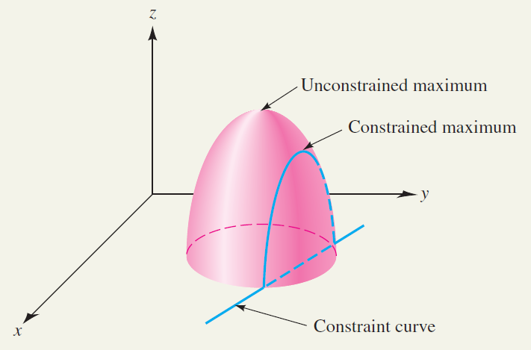
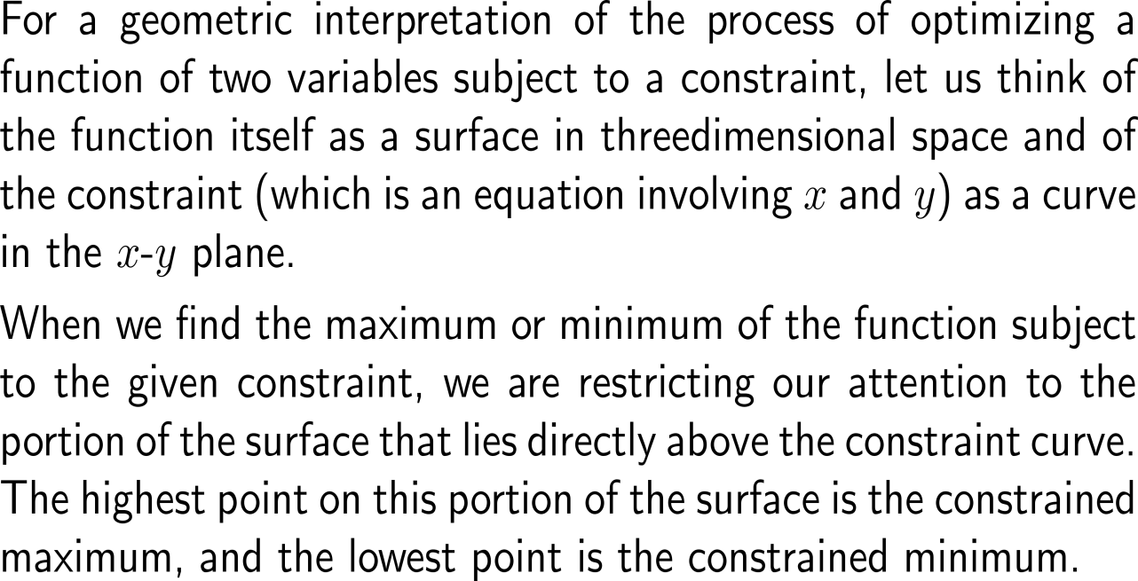
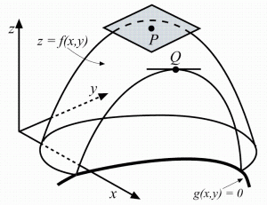
A geometric view on optimization with respect to constraints (1/3) …

Slide 4
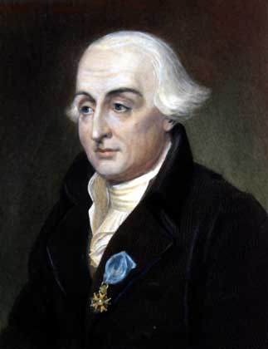
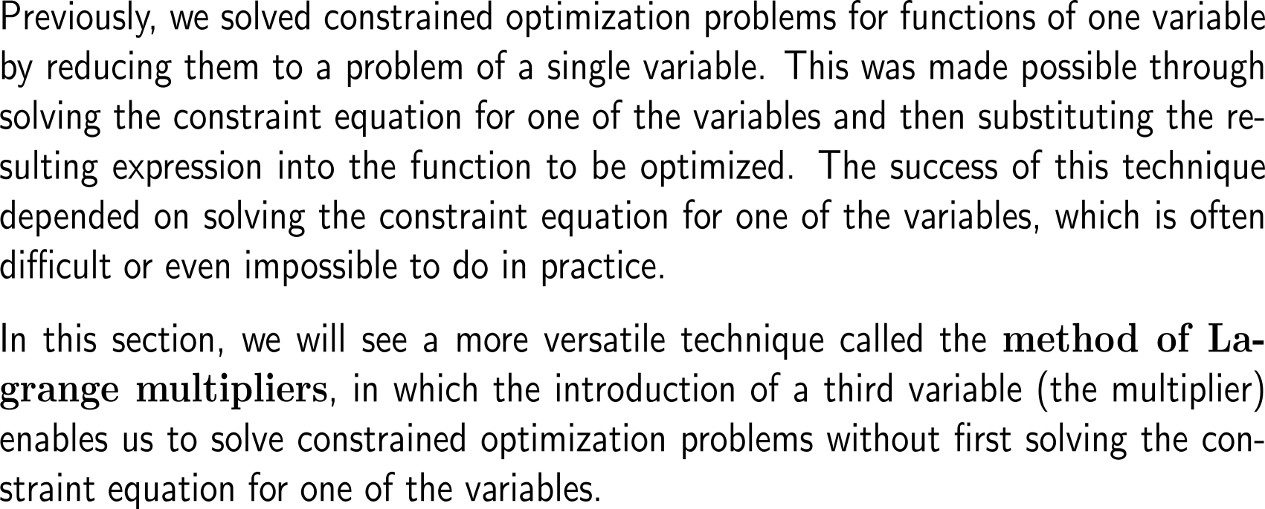
A geometric view on optimization with respect to constraints (2/3) …
Joseph-Louis de Lagrange
(1736 – 1813)

Slide 5
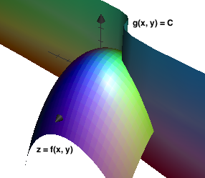
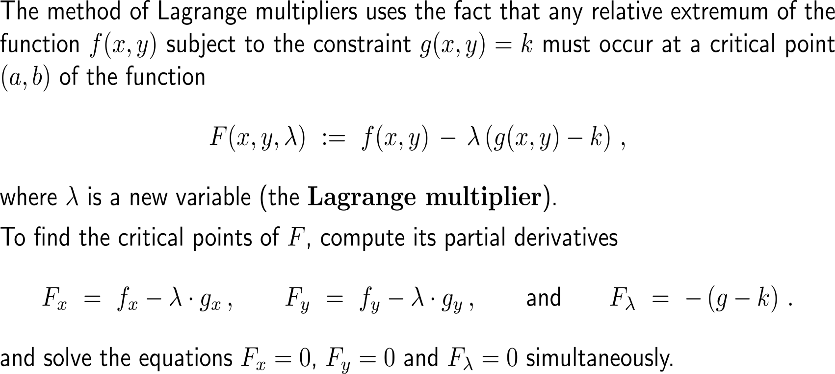
A geometric view on optimization with respect to constraints (3/3) …

Slide 6
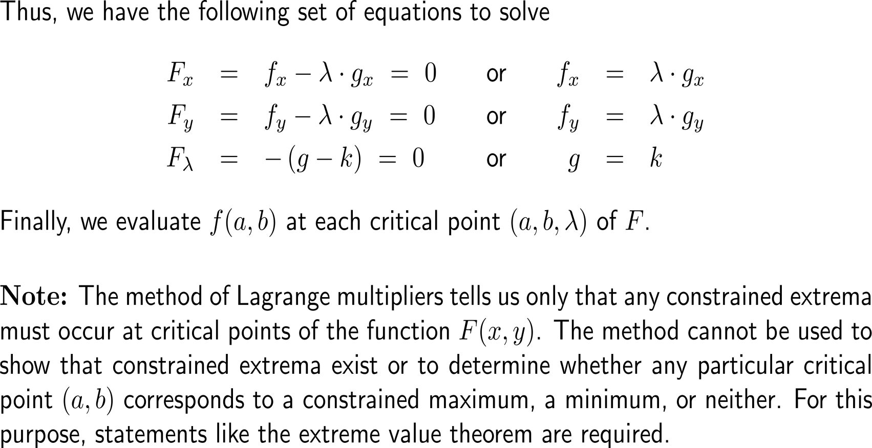
… leads to a set of equations that needs to be solved

Slide 7
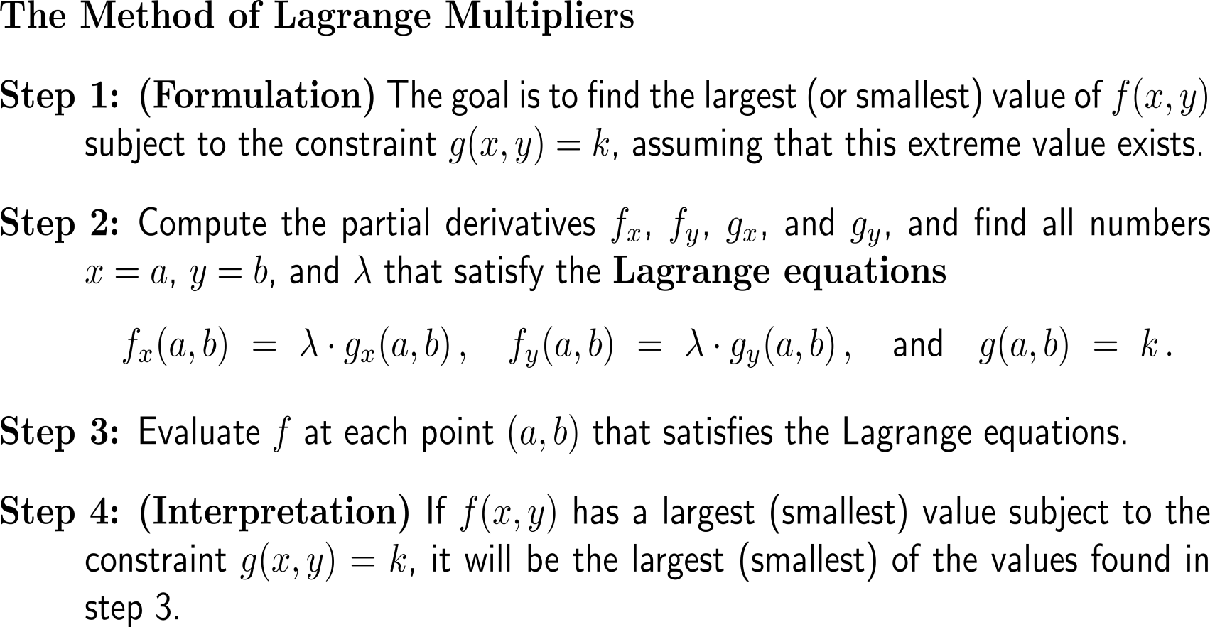
Summary: the Lagrange multiplier procedure for finding the largest and smallest values of a function of two variables subject to a constraint

Slide 8
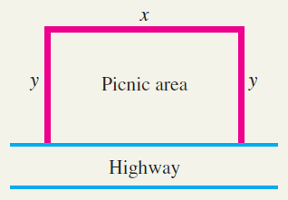
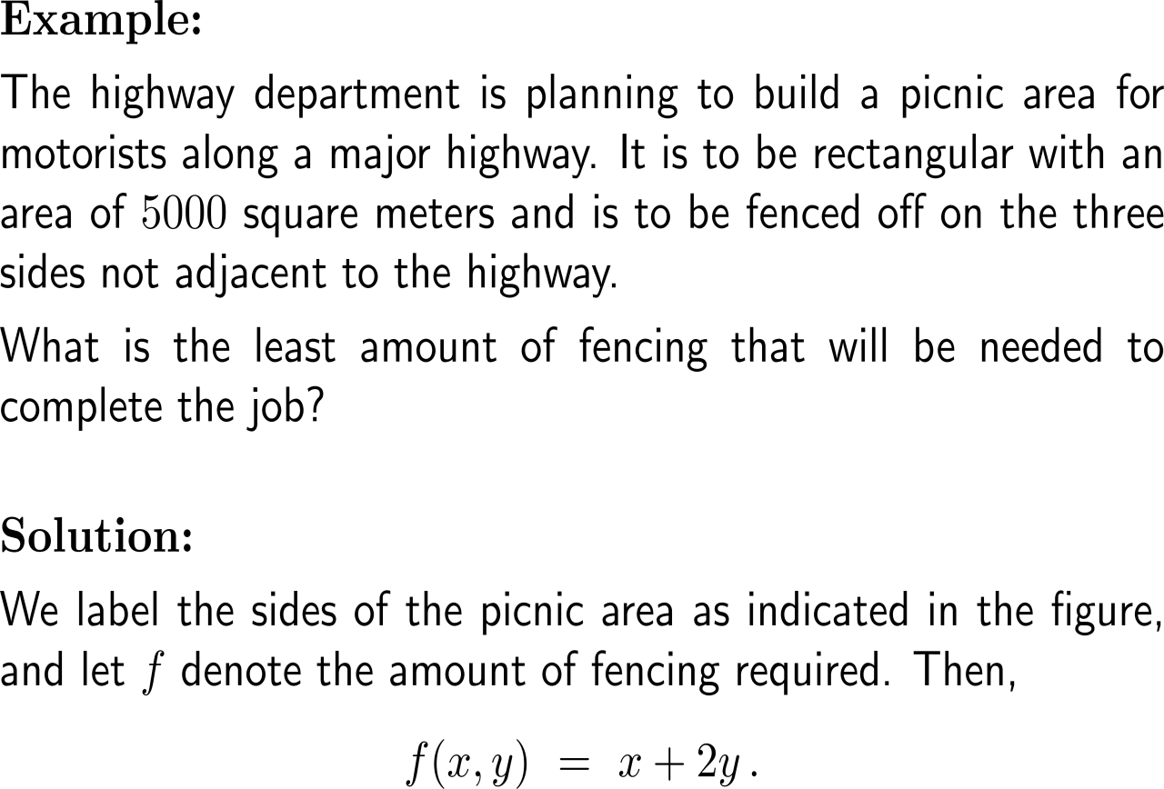
Example: Using Lagrange multipliers in construction

Slide 9
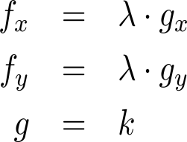
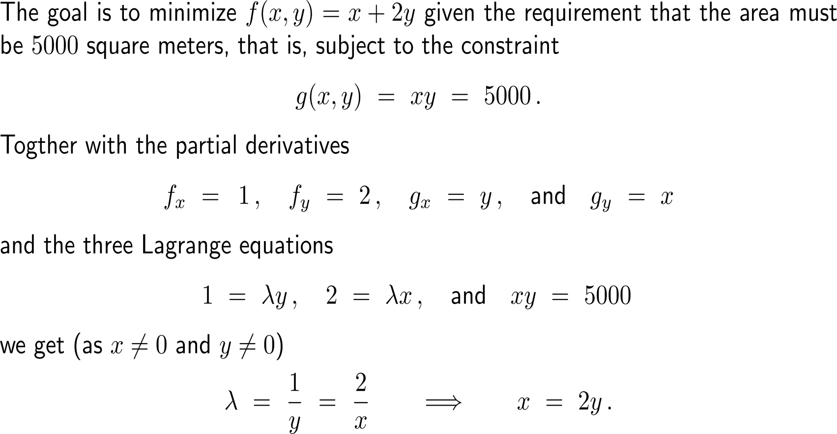
Example: Using Lagrange multipliers in construction

Slide 10
Example: Using Lagrange multipliers in construction

Slide 11
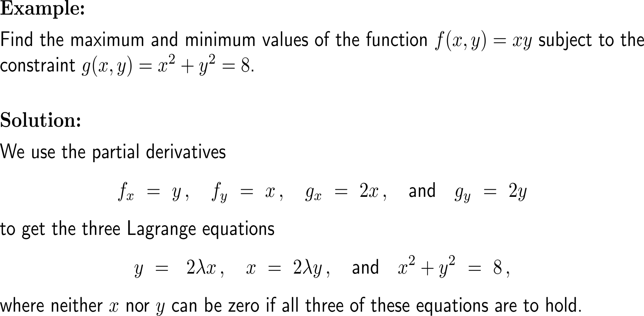
Example: Using Lagrange multipliers

Slide 12
Example: Using Lagrange multipliers

Slide 13
Example: Using Lagrange multipliers
y
f(x,y) < 0
f(x,y) > 0
x
f(x,y) > 0
f(x,y) < 0

Slide 14
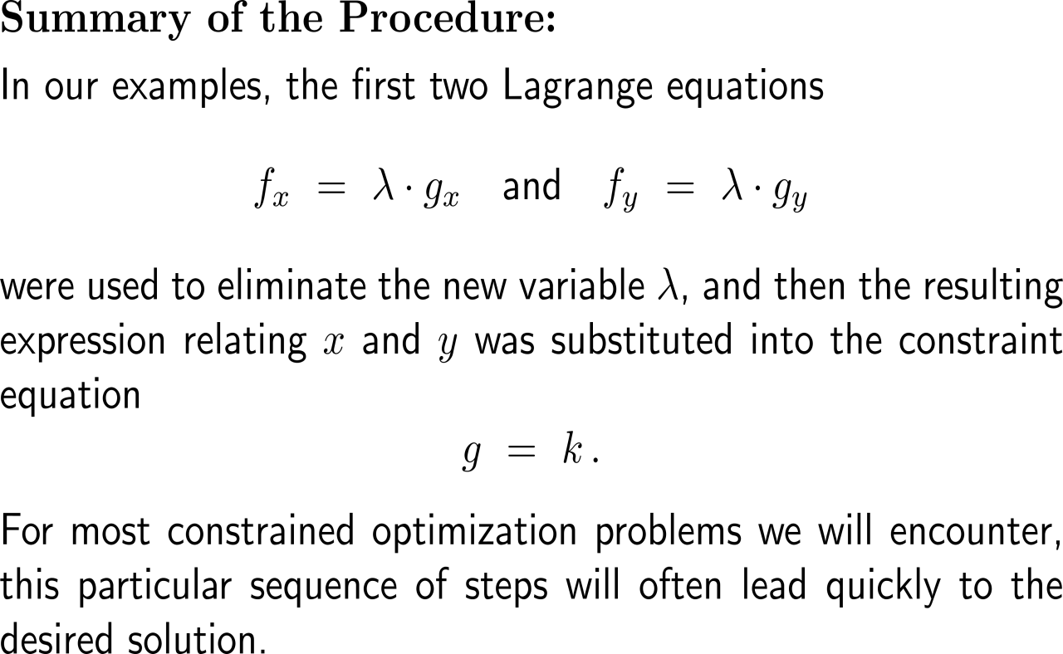
Summary: The method of Lagrange multipliers

Slide 15
Topics
Introduction to the Method of Lagrange Multipliers
Applications of the Lagrange Multiplier Method in Economics
The Significance of the Lagrange Multiplier
Why the Method of Lagrange Multipliers Works
Lagrange Multipliers for Functions of Three Variables

Slide 16
Example: Maximizing utility

Slide 17
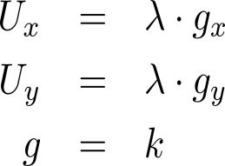
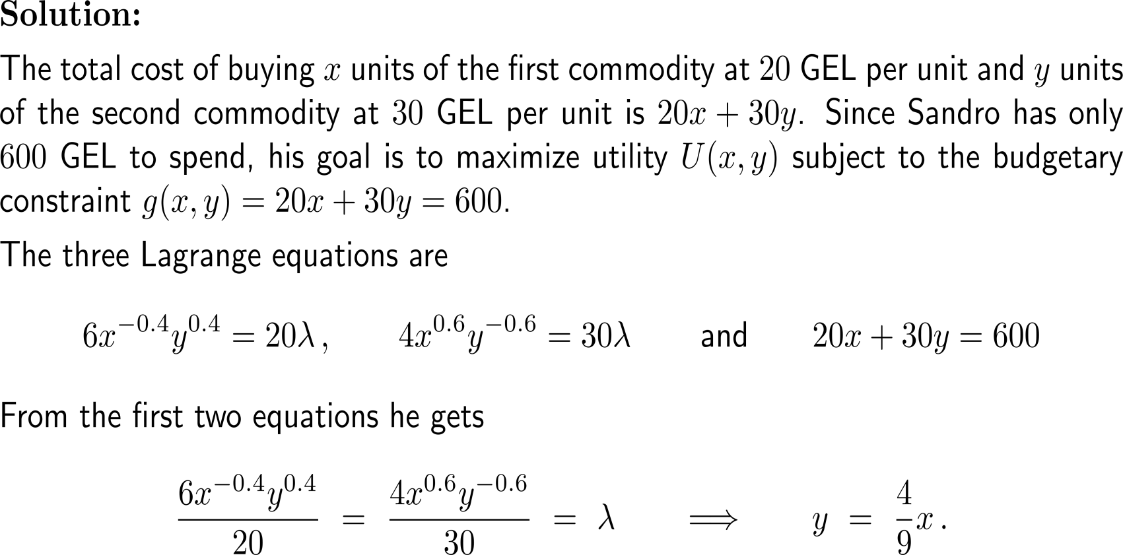
Example: Maximizing utility

Slide 18
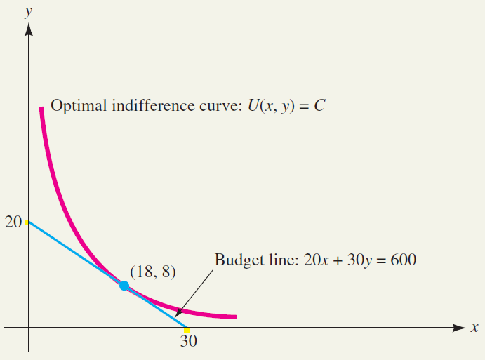
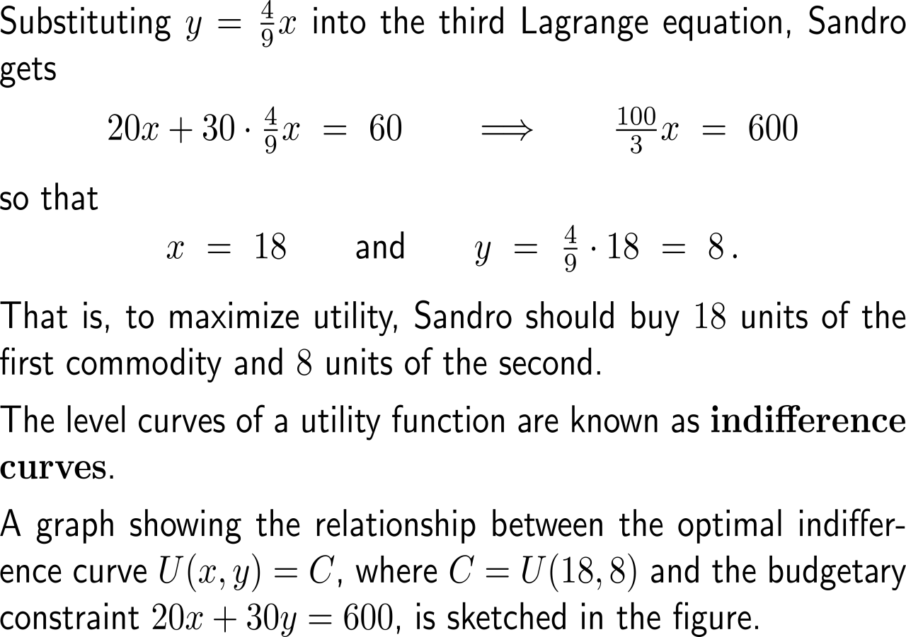
Example: Maximizing utility
Budgetary constraint and optimal indifference curve.

Slide 19
Example: Optimally allocating resources

Slide 20
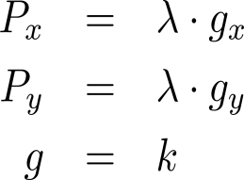
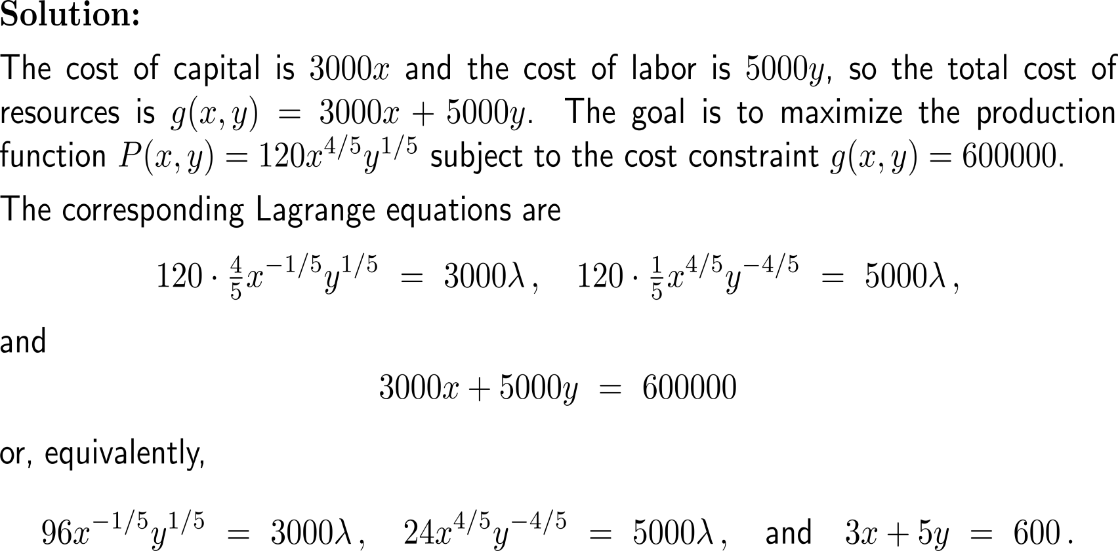
Example: Optimally allocating resources

Slide 21
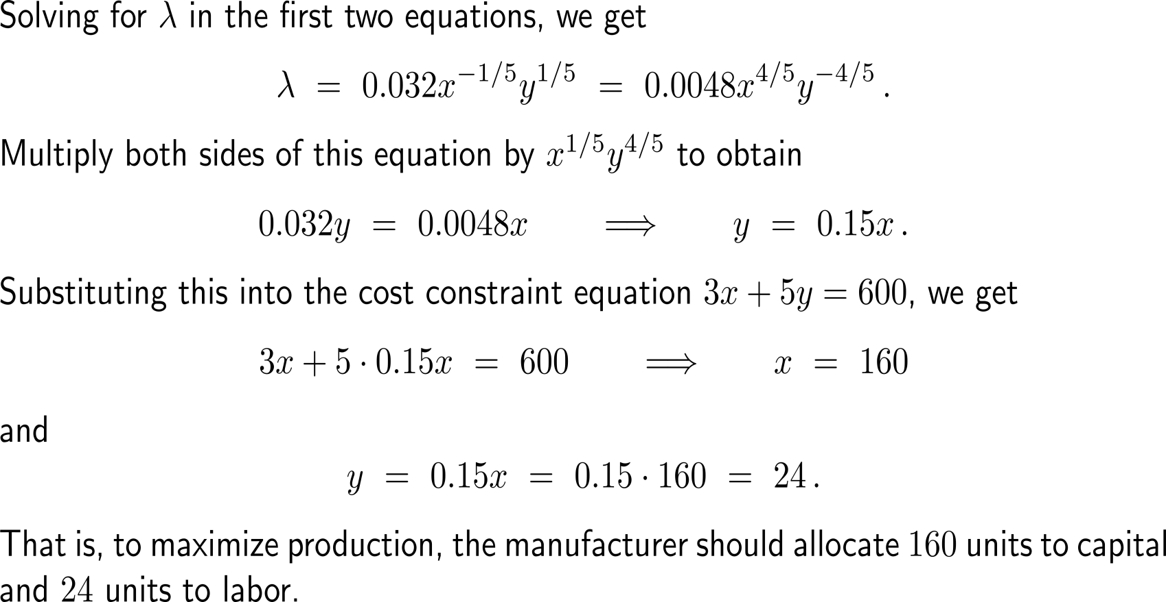
Example: Optimally allocating resources

Slide 22
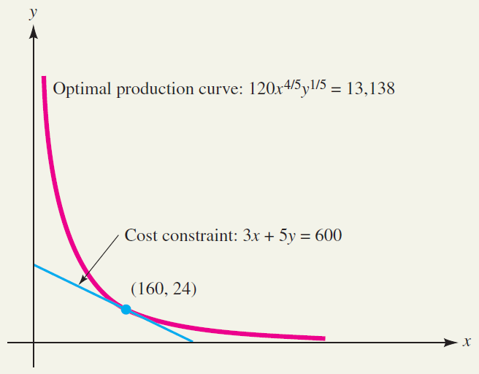
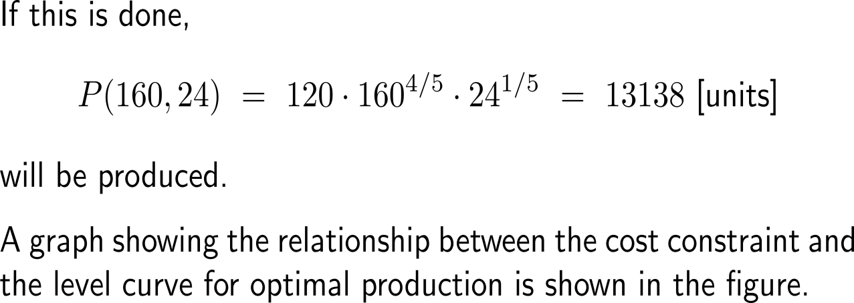
Example: Optimally allocating resources
Optimal production curve and cost constraint.

Slide 23
Topics
Introduction to the Method of Lagrange Multipliers
Applications of the Lagrange Multiplier Method in Economics
The Significance of the Lagrange Multiplier
Why the Method of Lagrange Multipliers Works
Lagrange Multipliers for Functions of Three Variables

Slide 24
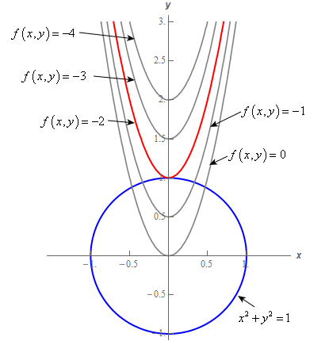
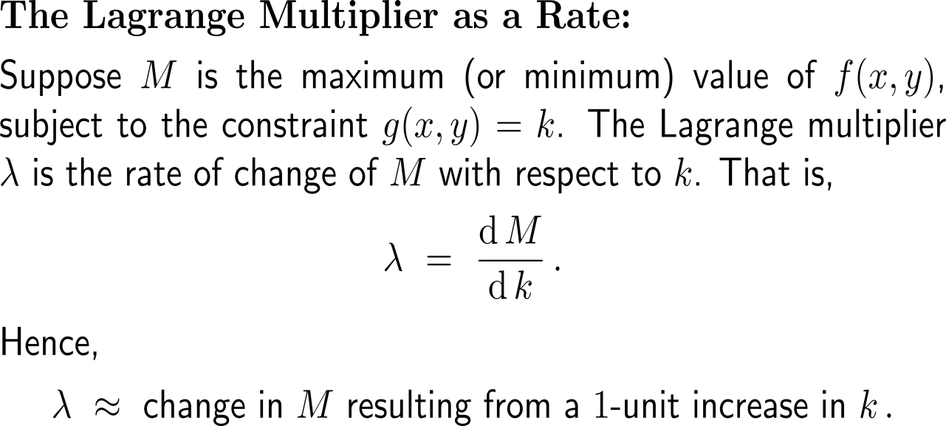
The Lagrange multiplier can be interpreted as the change of the extremum with respect to the value of the constraint

Slide 25
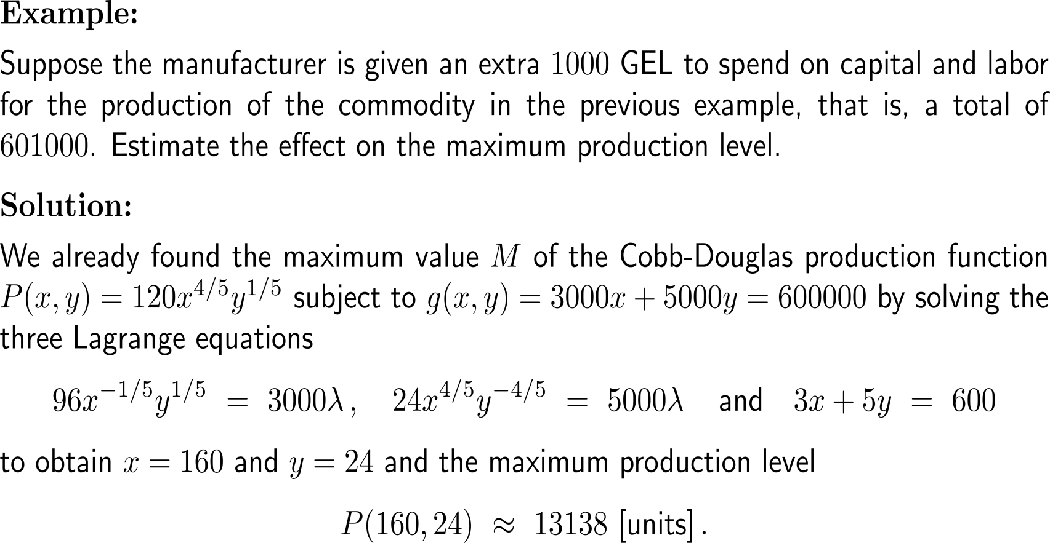
Example: Using the Lagrange multiplier as a rate

Slide 26
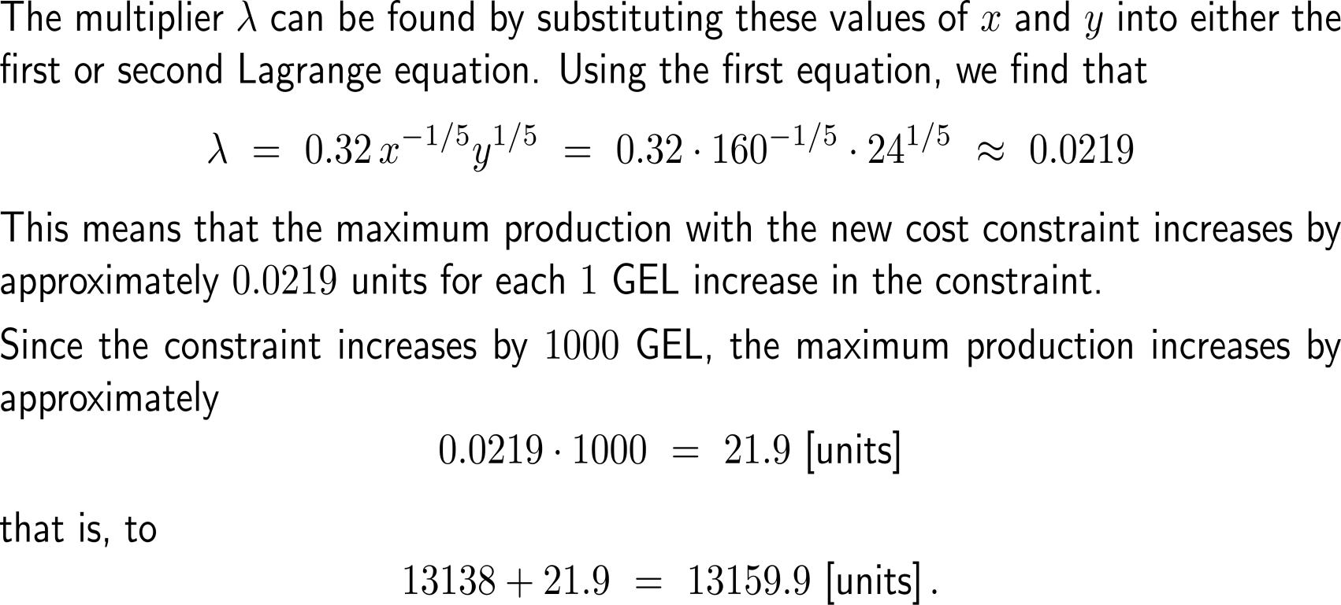
Example: Using the Lagrange multiplier as a rate

Slide 27
Example: Using the Lagrange multiplier as a rate

Slide 28
In economics, the Lagrange multiplier can be interpreted as the marginal productivity/ utility/ … of money

Slide 29
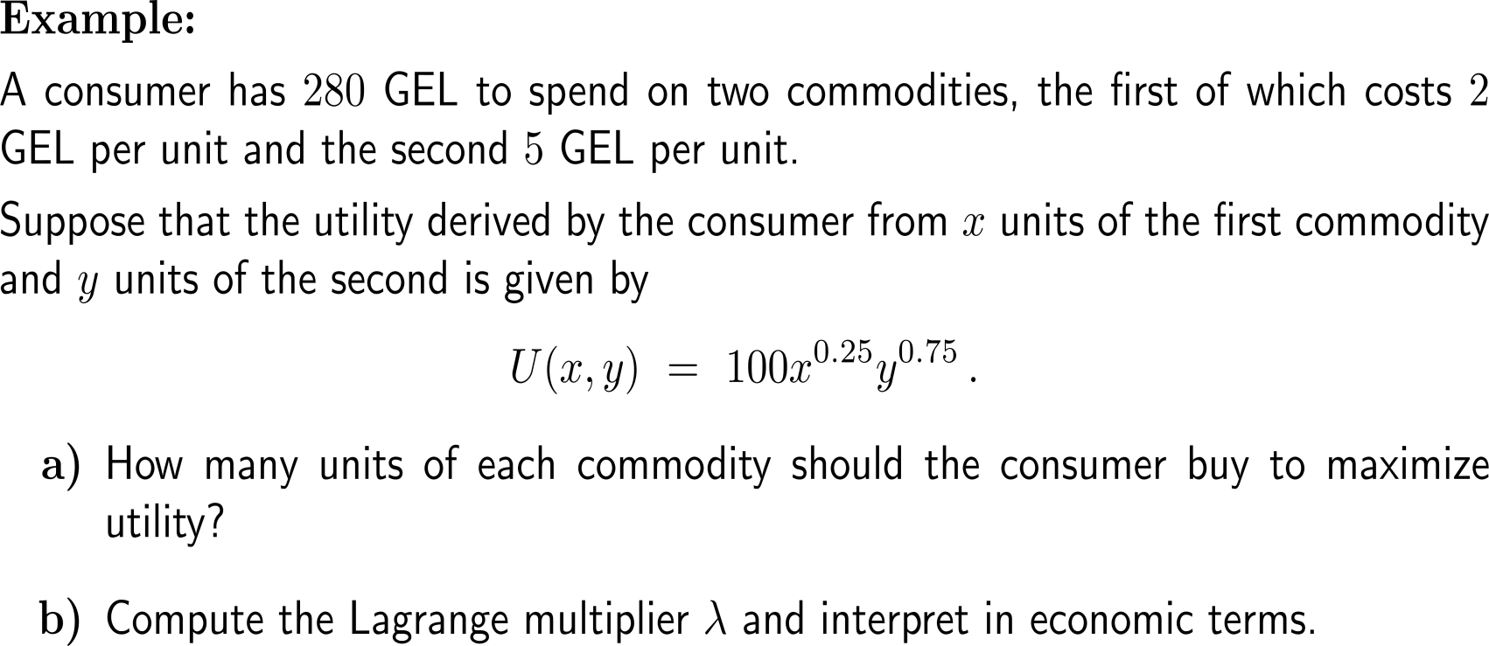
Example
10 minutes
self/ group work
please, upload your solutions to the chat

Slide 30
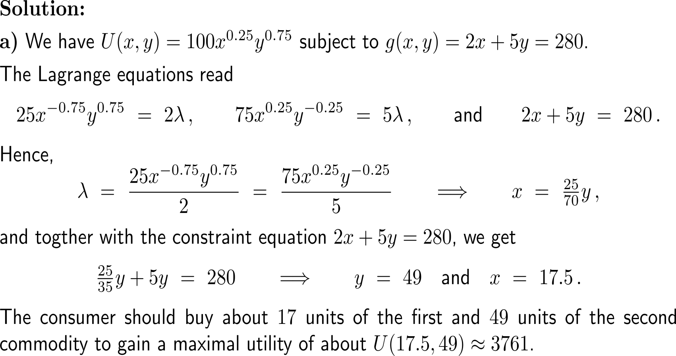
Example

Slide 31
Example

Slide 32
Topics
Introduction to the Method of Lagrange Multipliers
Applications of the Lagrange Multiplier Method in Economics
The Significance of the Lagrange Multiplier
Why the Method of Lagrange Multipliers Works
Lagrange Multipliers for Functions of Three Variables

Slide 33
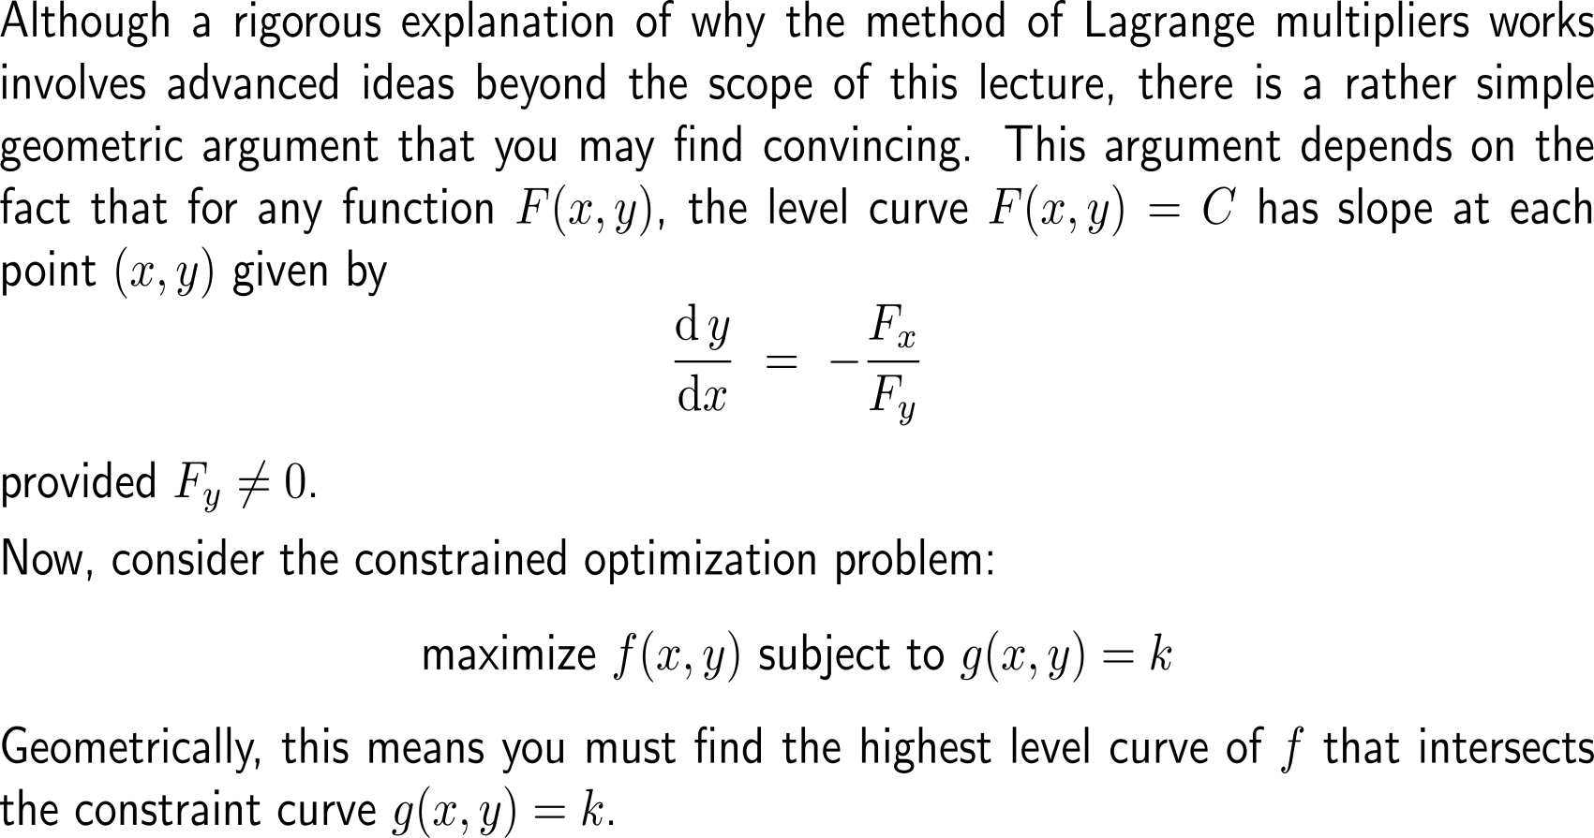
Geometrically, the Lagrange method finds the highest level curve of the function that intersects the constraint curve (1/ 3)

Slide 34
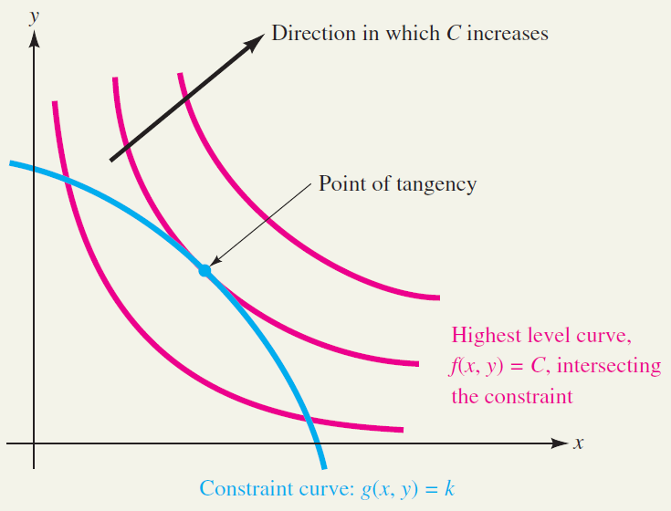
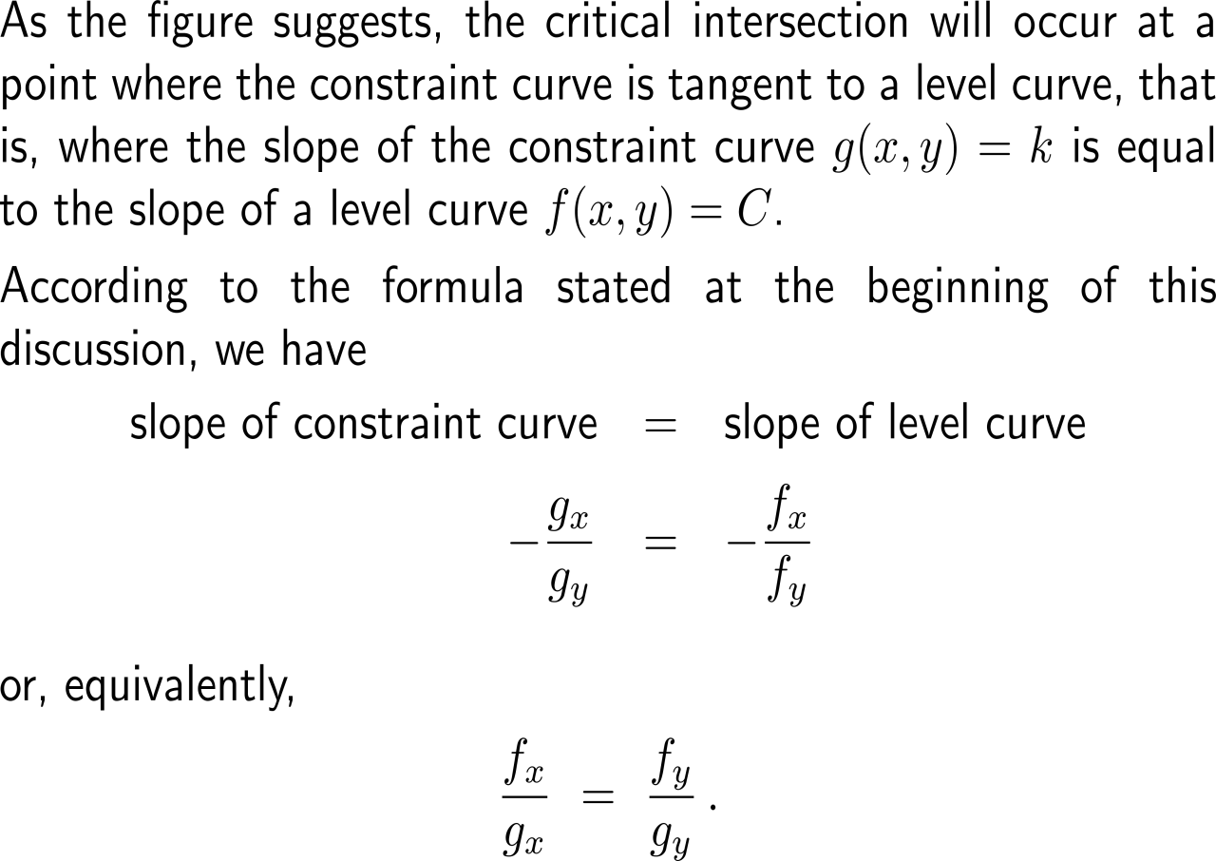
Geometrically, the Lagrange method finds the highest level curve of the function that intersects the constraint curve (2/ 3)

Slide 35
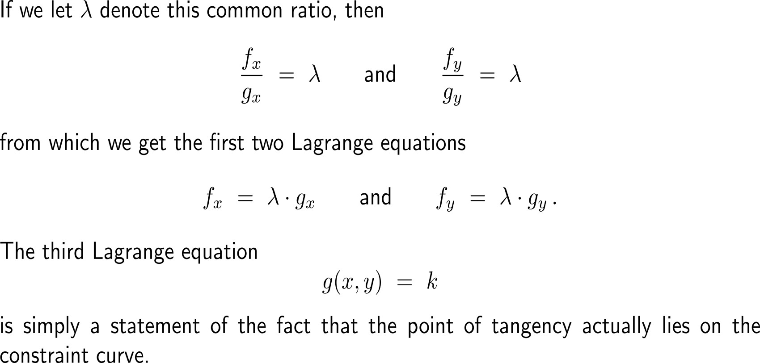
Geometrically, the Lagrange method finds the highest level curve of the function that intersects the constraint curve (3/ 3)

Slide 36
Topics
Introduction to the Method of Lagrange Multipliers
Applications of the Lagrange Multiplier Method in Economics
The Significance of the Lagrange Multiplier
Why the Method of Lagrange Multipliers Works
Lagrange Multipliers for Functions of Three Variables

Slide 37
The method of Lagrange multipliers can be extended to constrained optimization problems in more than two variables

Slide 38
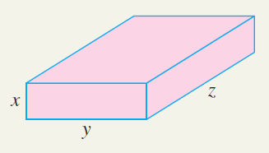
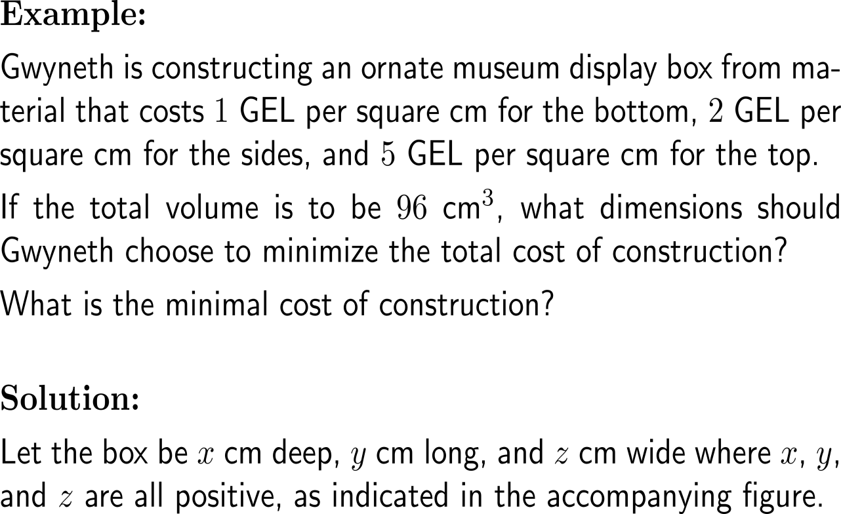
Example: Minimizing cost of construction

Slide 39
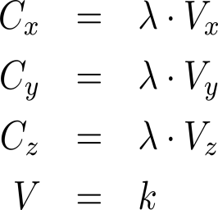
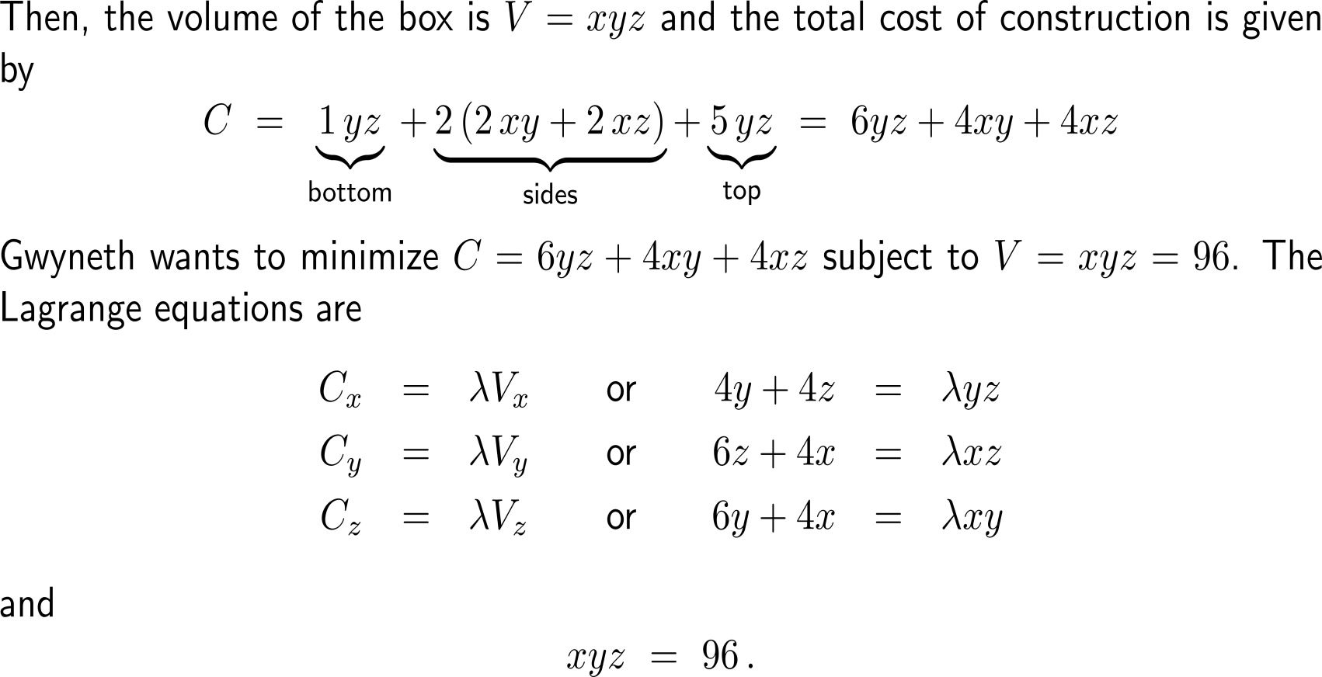
Example: Minimizing cost of construction

Slide 40
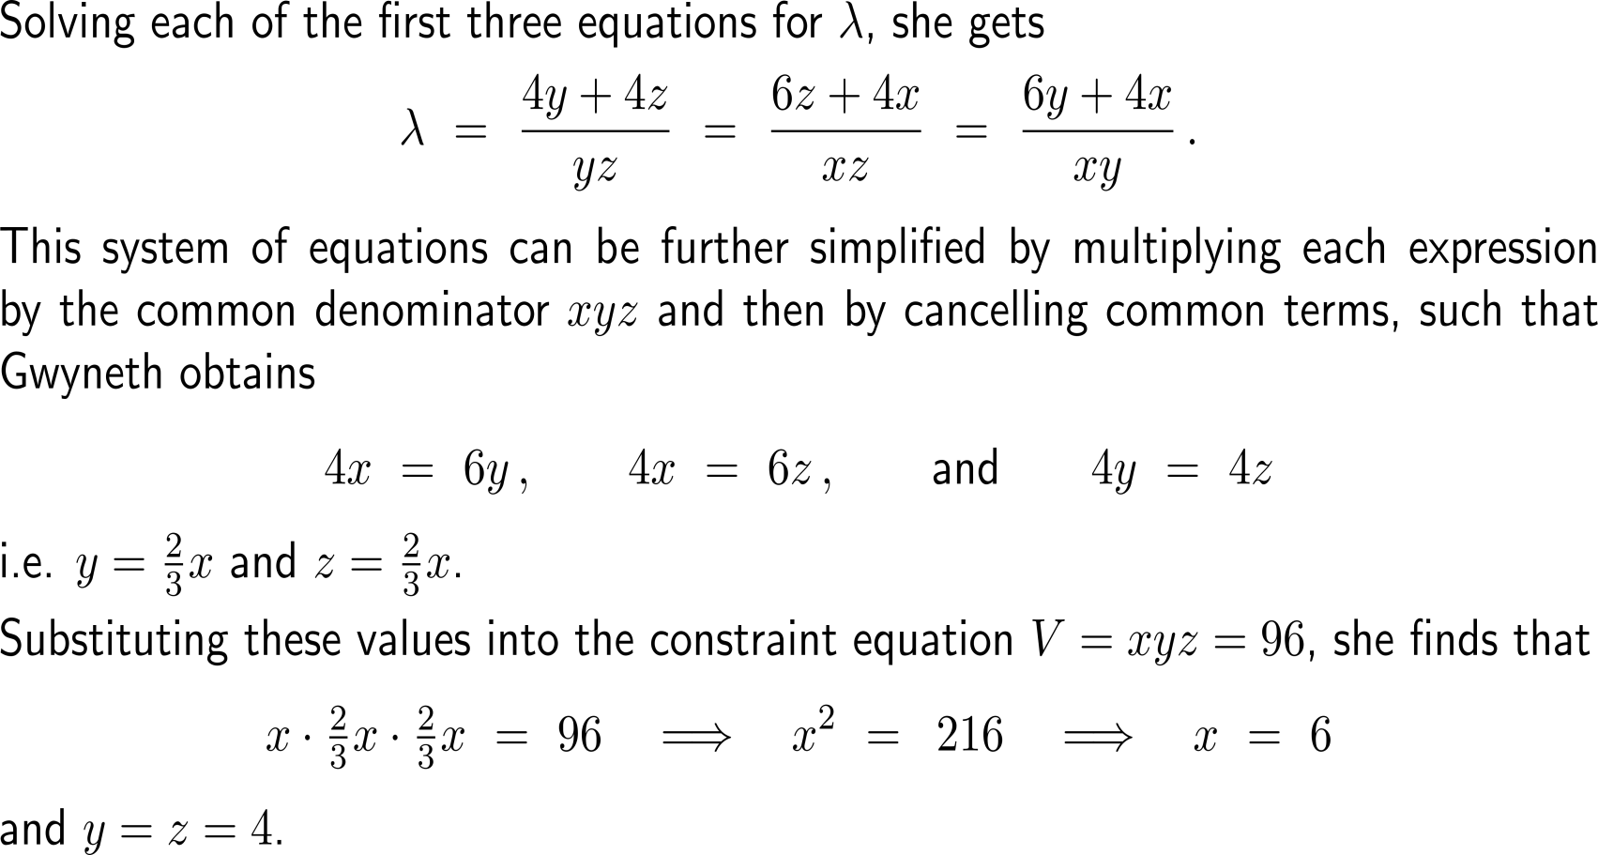
Example: Minimizing cost of construction

Slide 41
Example: Minimizing cost of construction

Slide 42
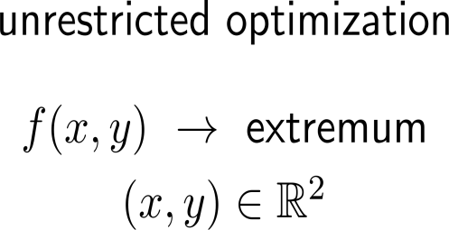
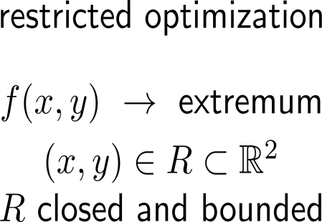
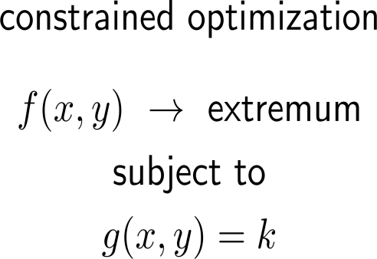
Summary: Types of optimization problems …
optimization problem
method
critical points
2nd partials test
extrem value theorem
interior extrema:
critical points
2nd partials test
boundary extrema:
parametrization of (the parts of) the boundary
1D optimization or Lagrange method
corners
method of Lagrange multipliers
Lagrange equations

Slide 43
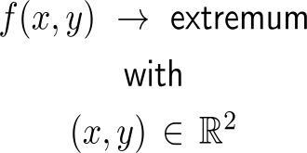
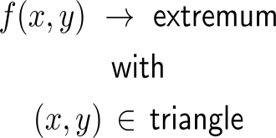
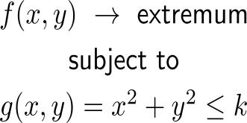
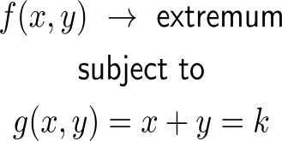
Summary: … and some prototypical examples
optimization problem
example

Slide 44
Further Worked-Out Exercises:
Calculus II for Management
Topics
Unconstraint & constraint optimization

Slide 45
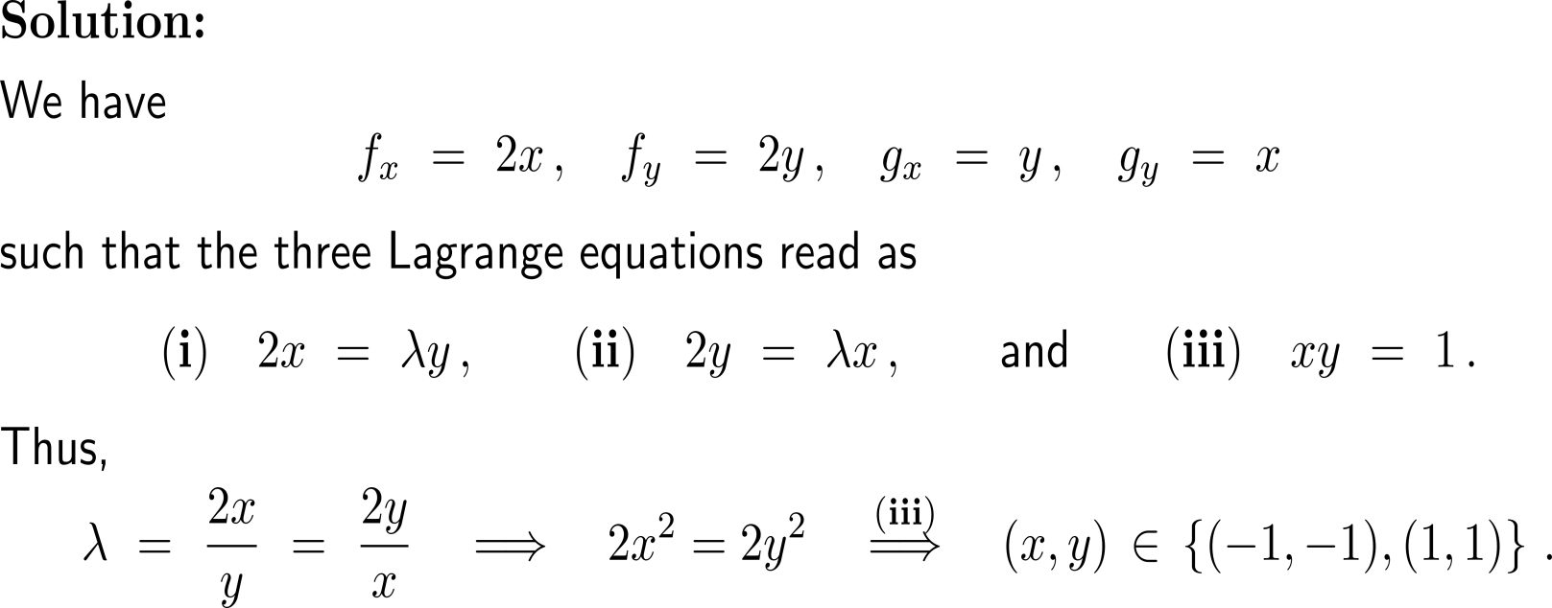
Exercise: Application of Lagrange multipliers

Slide 46
Exercise: Application of Lagrange multipliers

Slide 47
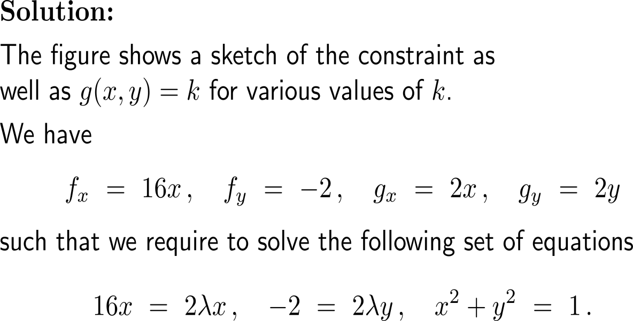
Exercise: Application of Lagrange multipliers
https://tutorial.math.lamar.edu/classes/calciii/lagrangemultipliers.aspx

Slide 48
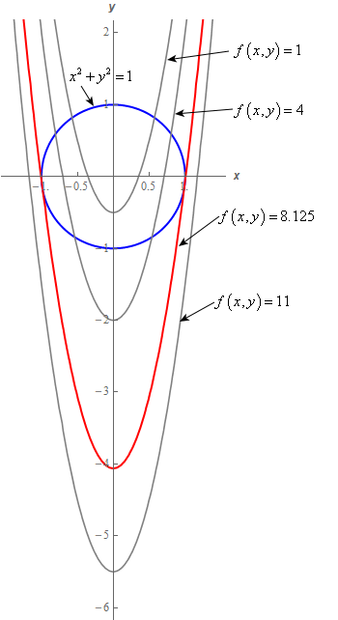
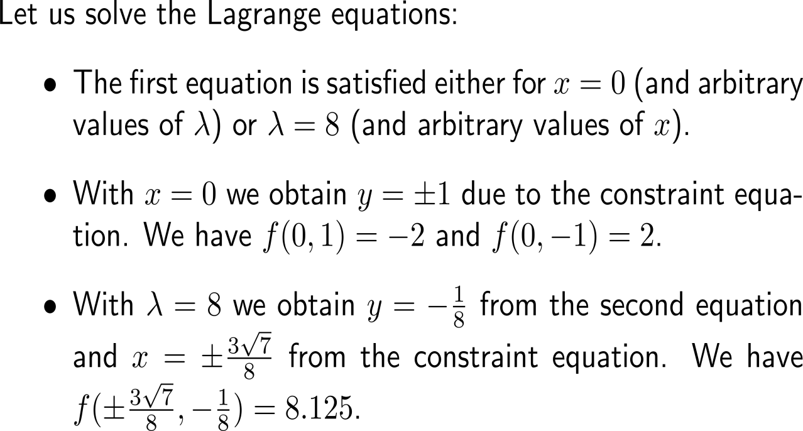
Exercise: Application of Lagrange multipliers

Slide 49
Exercise: Application of Lagrange multipliers

Slide 50
Exercise: Method of Lagrange multipliers

Slide 51
Exercise: Method of Lagrange multipliers

Slide 52
Exercise: Restricted optimization with a Lagrange boundary

Slide 53
Exercise: Restricted optimization with a Lagrange boundary

Slide 54
Exercise: Restricted optimization with a Lagrange boundary
y
-
+
sign of f
+
-
x

Slide 55
Exercise: Restricted optimization with a Lagrange boundary

Slide 56
Exercise: Restricted optimization with a Lagrange boundary

Slide 57
Exercise: Restricted optimization with a Lagrange boundary

Slide 58
Exercise: An old exam question
15 minutes
self/ group work
please, upload your solutions to the chat

Slide 59
Exercise: An old exam question

Slide 60
Exercise: An old exam question

Slide 61
Exercise: An old exam question

Slide 62
Calculus II for Management

