Slide 1
Calculus II for Management
Applications of Double Integrals
week 14
Lecture 14
Further examples of double integrals
Properties of double integrals
Double integrals in probability

Slide 2
Topics
Further Examples of Double Integrals
Properties of Double Integrals
Double Integrals in Probability

Slide 3
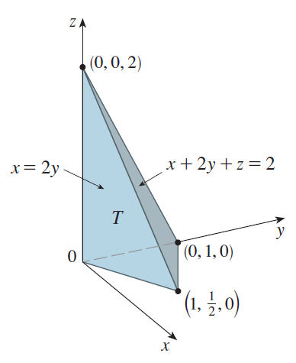
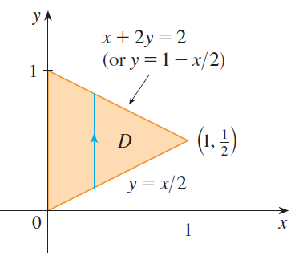
Example: Volume of a tetrahedron

Slide 4
Example: Volume of a tetrahedron

Slide 5
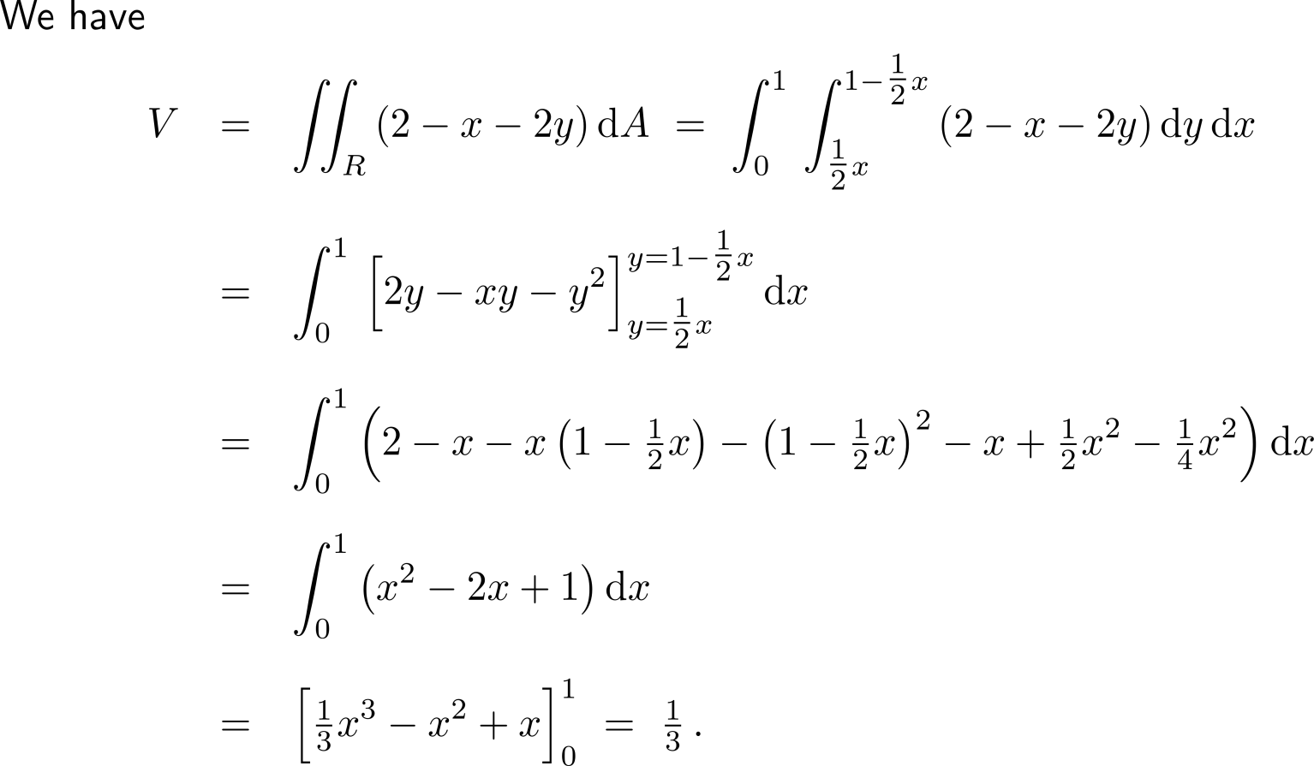
Example: Volume of a tetrahedron

Slide 6
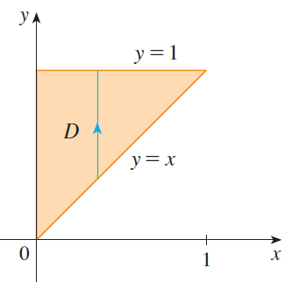
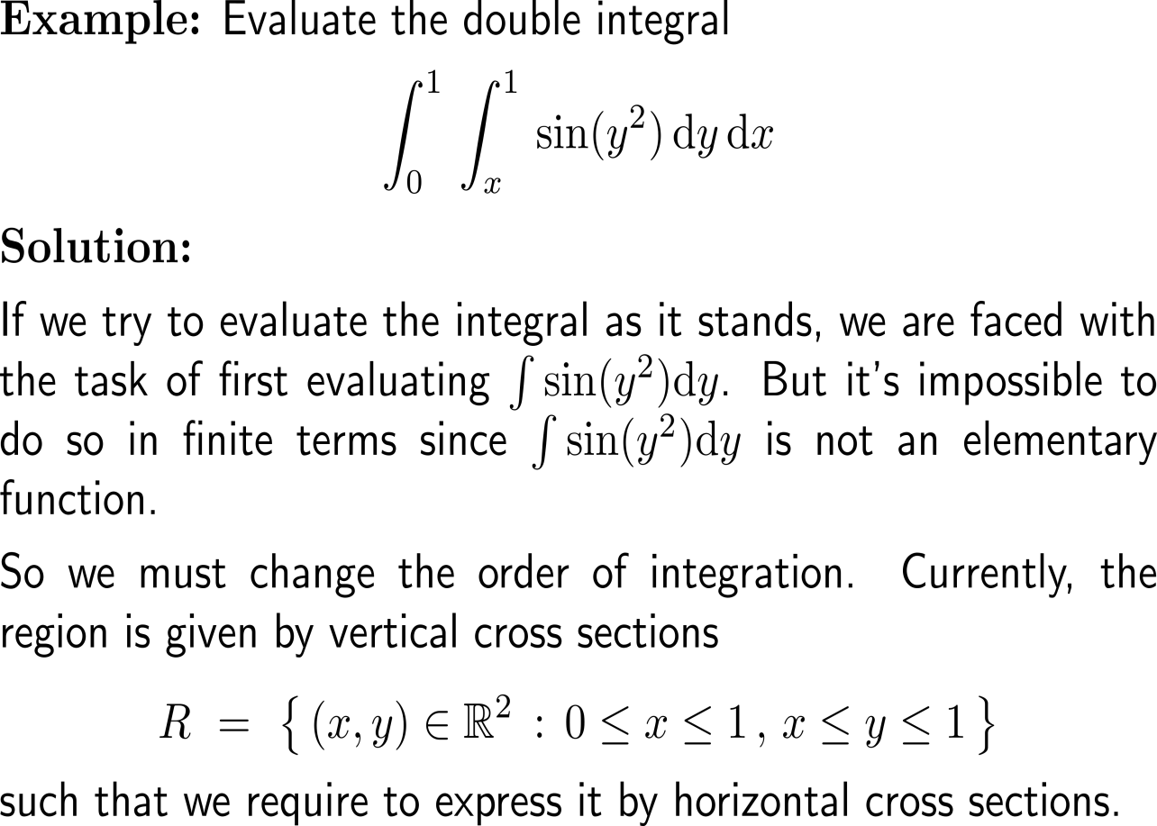
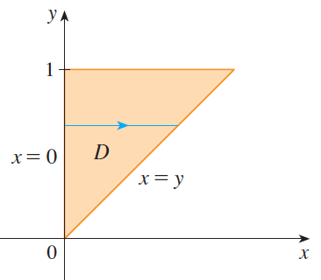
Example: Changing the order of integration

Slide 7
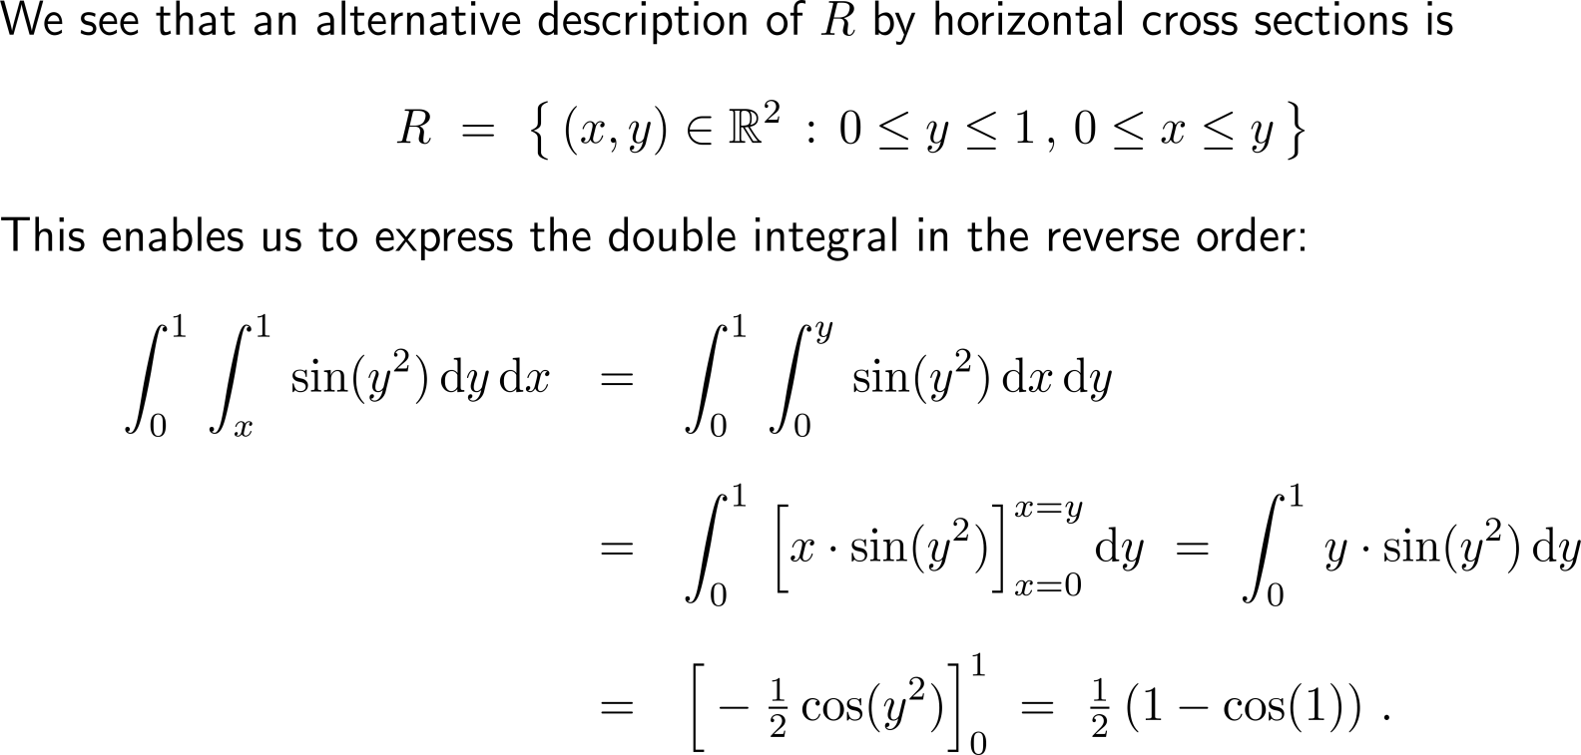
Example: Changing the order of integration

Slide 8
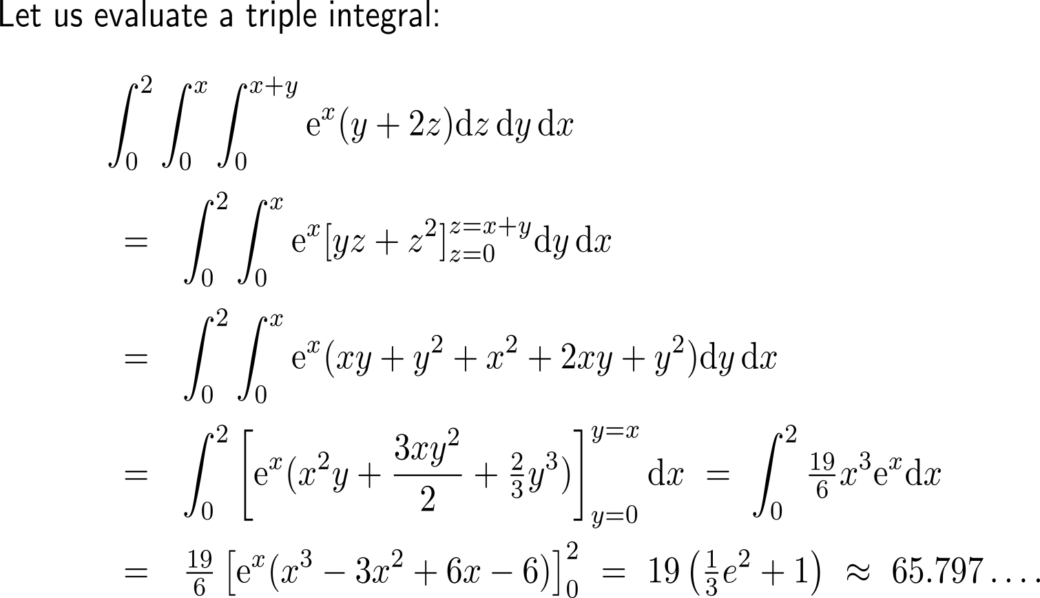
Of course, the idea of a double integral extends to a higher nesting of integrals, like triple integrals
just as Illustration

Slide 9
Topics
Further Examples of Double Integrals
Properties of Double Integrals
Double Integrals in Probability

Slide 10
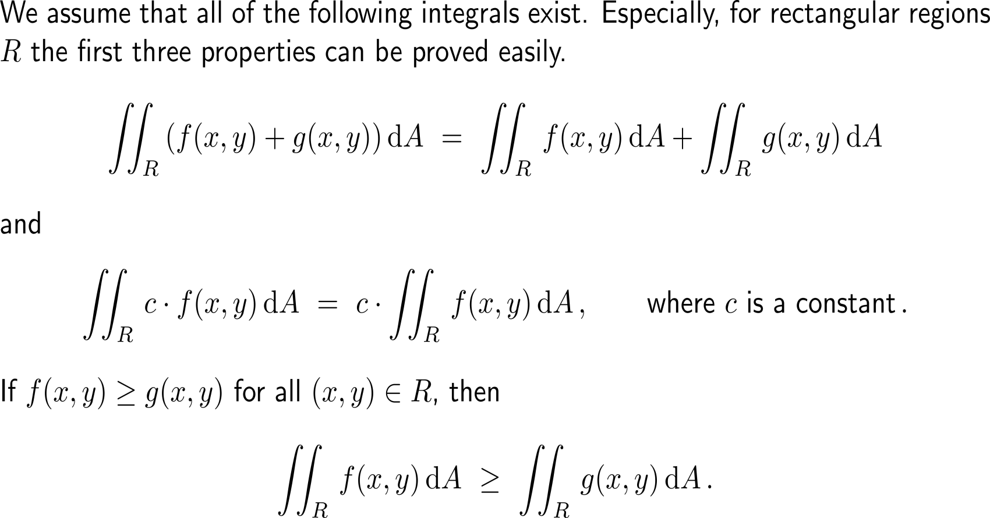
The properties of double integrals are analogous to those of integrals of functions in one variable (1/ 2)

Slide 11
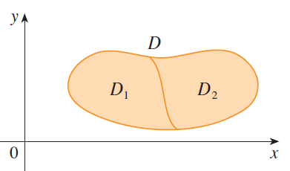
The properties of double integrals are analogous to those of integrals of functions in one variable (2/ 2)
R
R₁
R₂

Slide 12
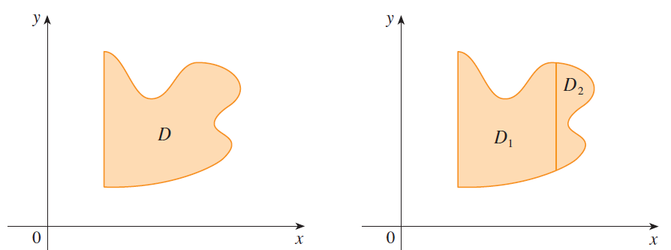
Being able to ‘slice’ regions allows an effective evaluation of integrals on sub-regions that can be expressed by vertical and horizontal cross sections
The region can neither be expressed by horizontal nor vertical cross sections.
R₁ can be expressed by vertical cross sections and R₂ can be expressed by horizontal cross sections
R₂
R
R₁

Slide 13
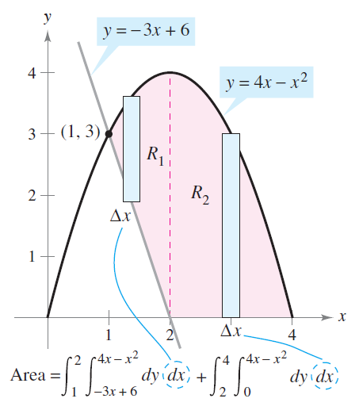
Example: Computation of an area

Slide 14
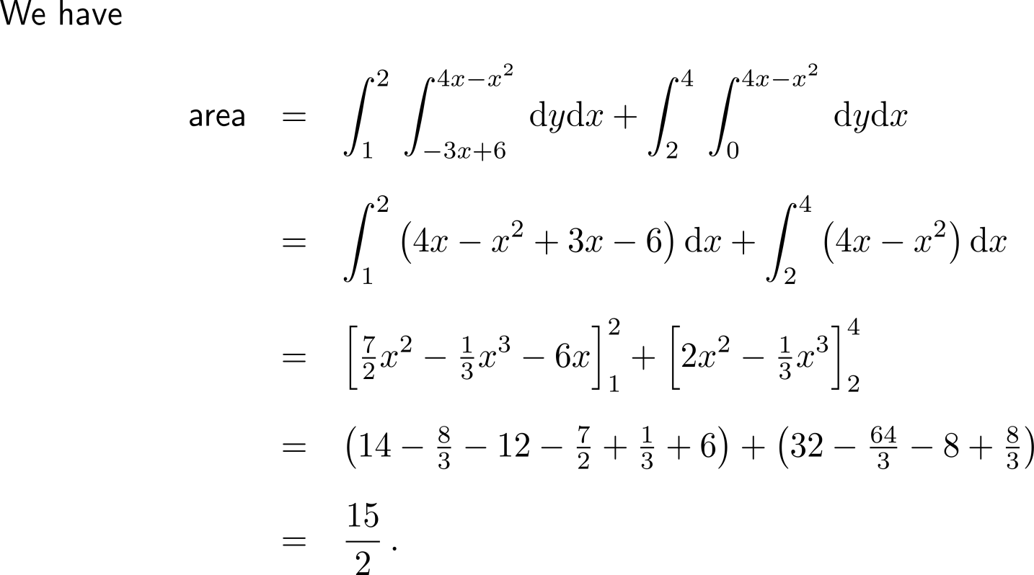
Example: Computation of an area

Slide 15
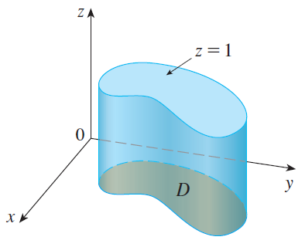
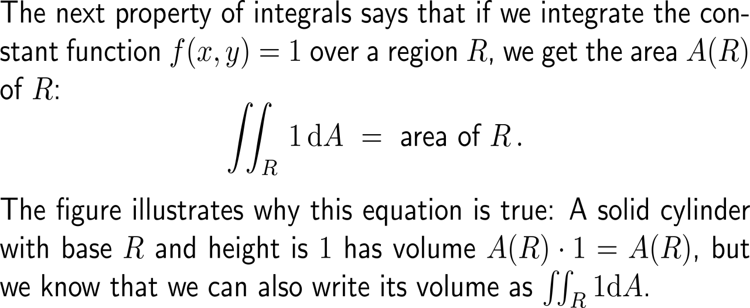
The double integral of the constant unit function over a region gives the area of this region
R

Slide 16
A bounded integrand function allows the setting of lower and upper bounds for the value of the integral

Slide 17
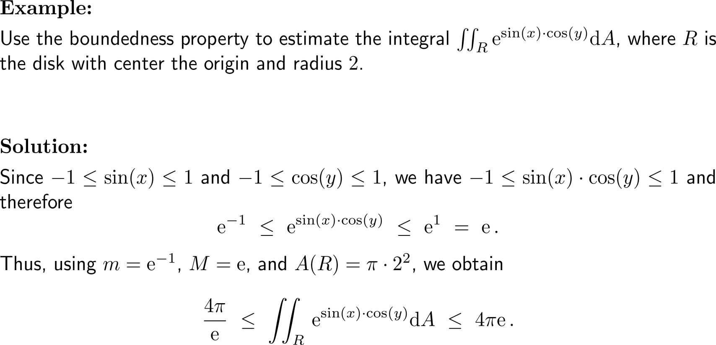
Example: Application of the boundedness property

Slide 18
Topics
Further Examples of Double Integrals
Properties of Double Integrals
Double Integrals in Probability

Slide 19
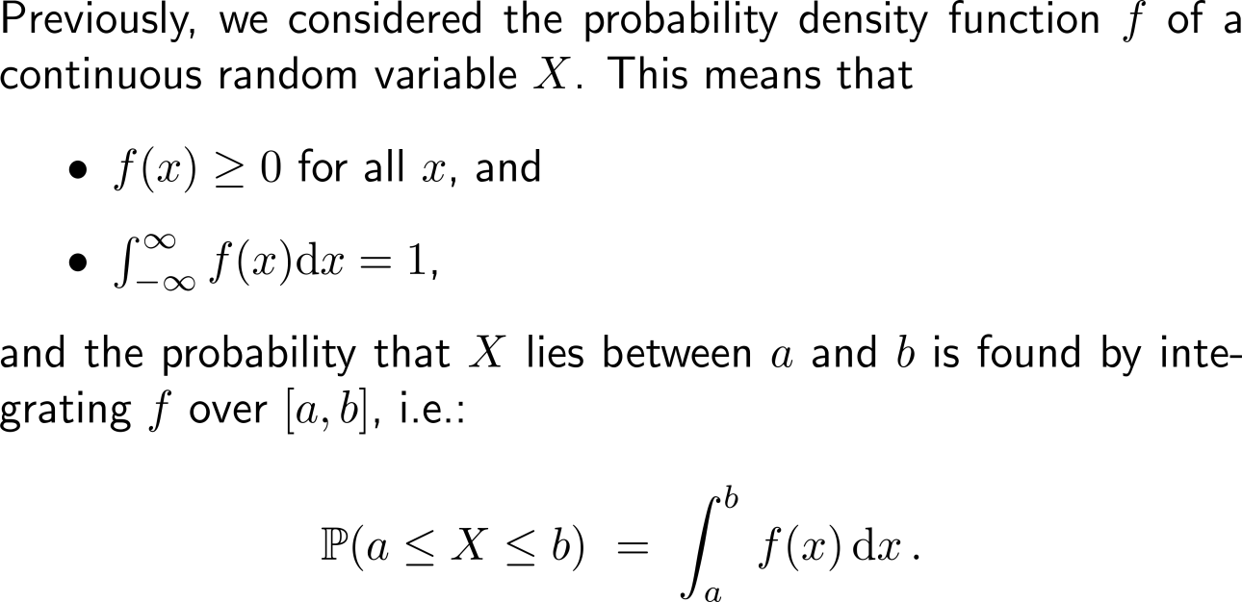
Recap: Density functions and probability
Sample Space
S
E
Cont. Random Variable
Probability

Slide 20
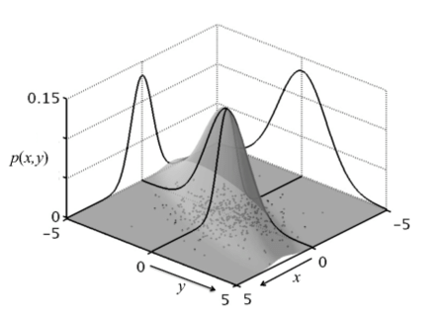
The joint density function of two random variables connects probabilities with double integrals

Slide 21
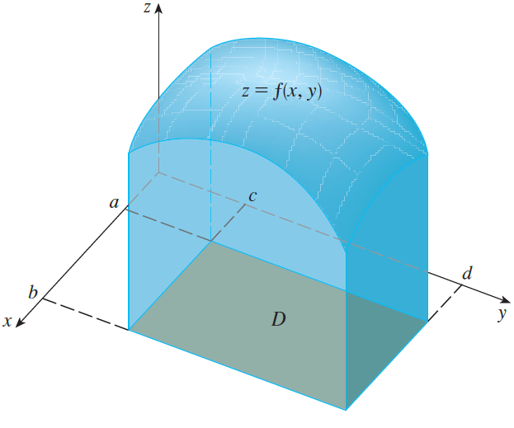
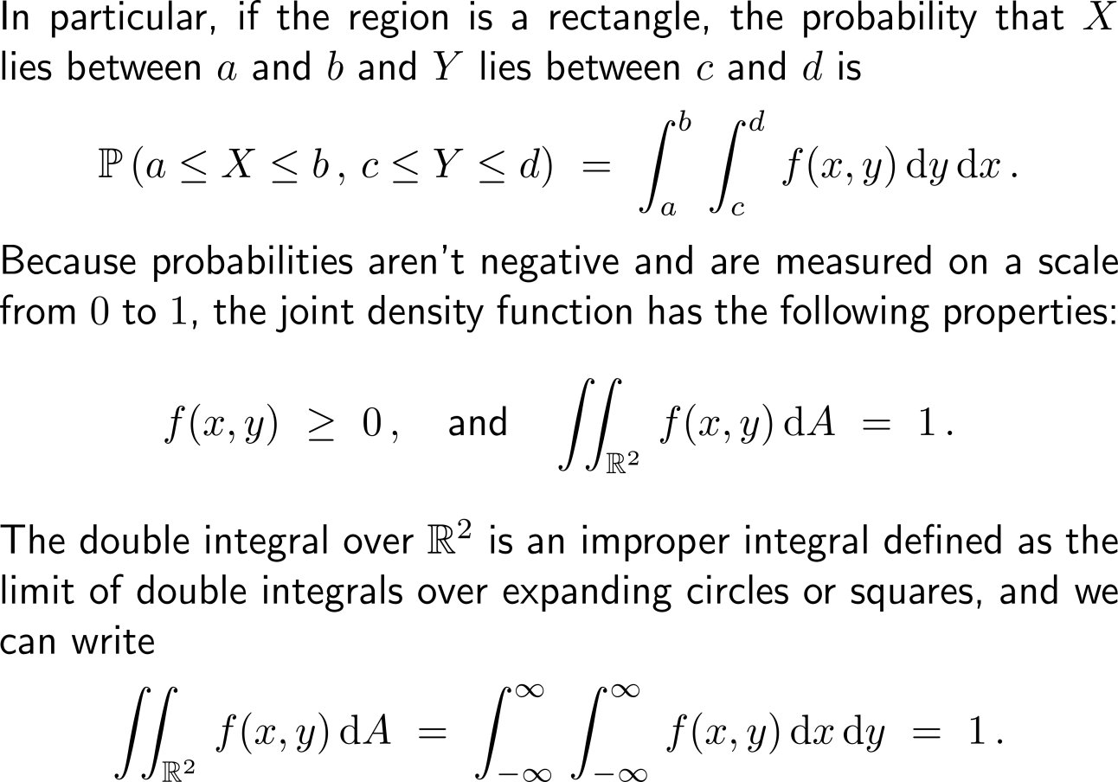
In analogy to density functions, the properties of a joint density function are non-negativity and normalization
R

Slide 22
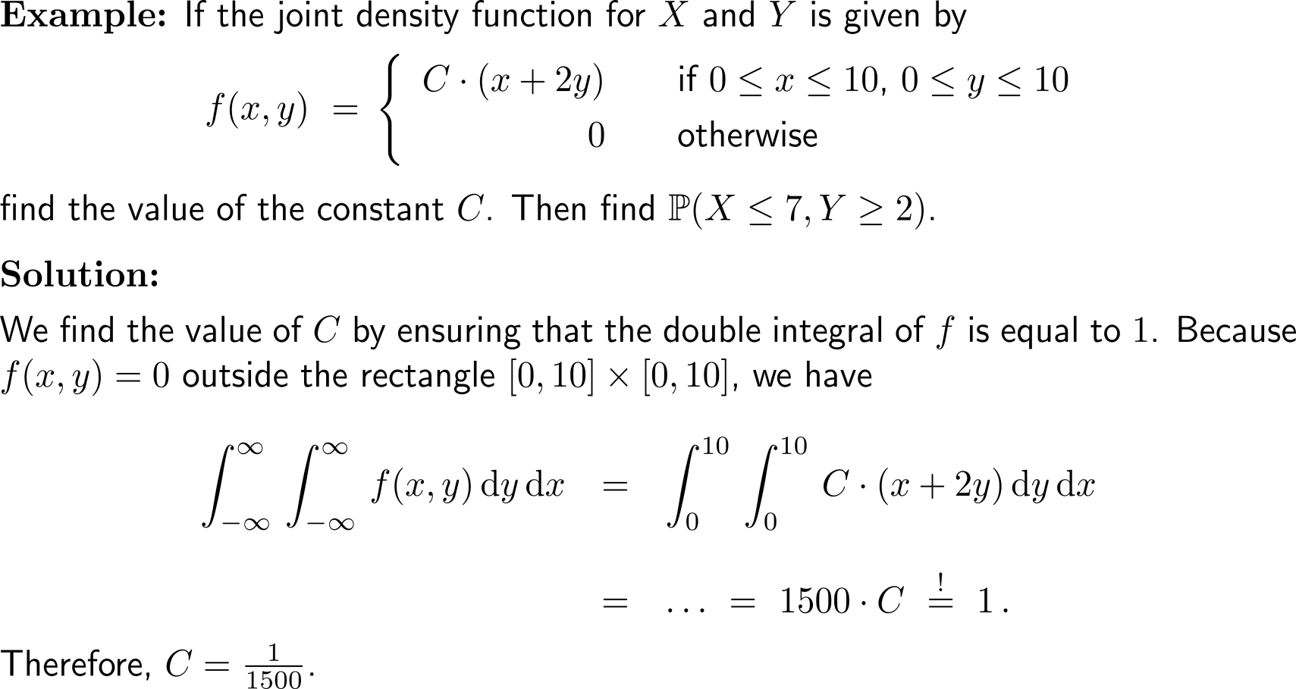
Example: Properties of the joint density function

Slide 23
Example: Properties of the joint density function

Slide 24
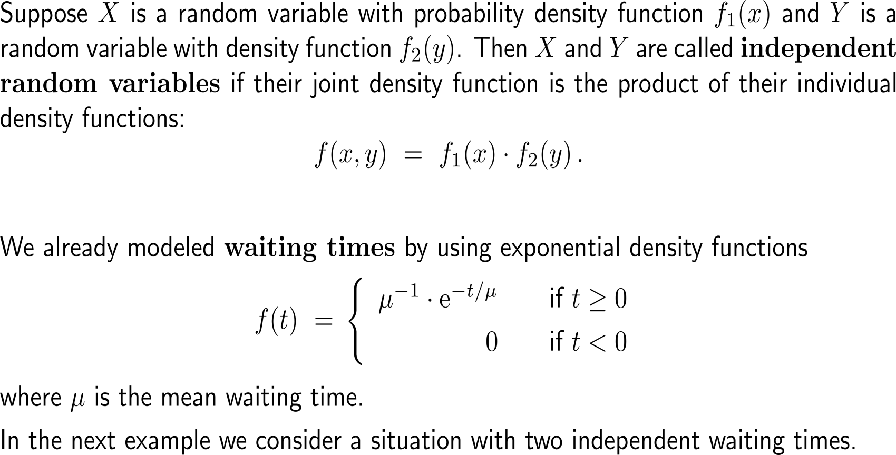
Two random variables are independent if their joint density function is the product of the individual density functions

Slide 25
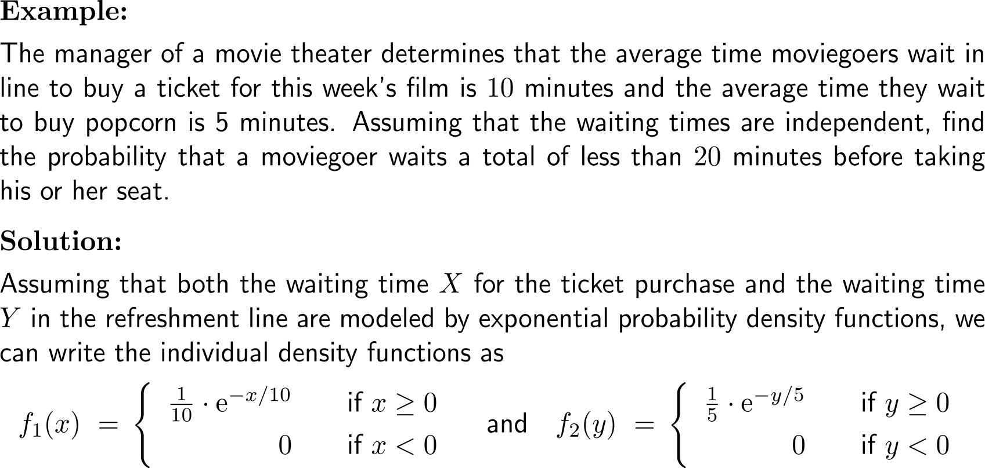
Example: Independent waiting times

Slide 26
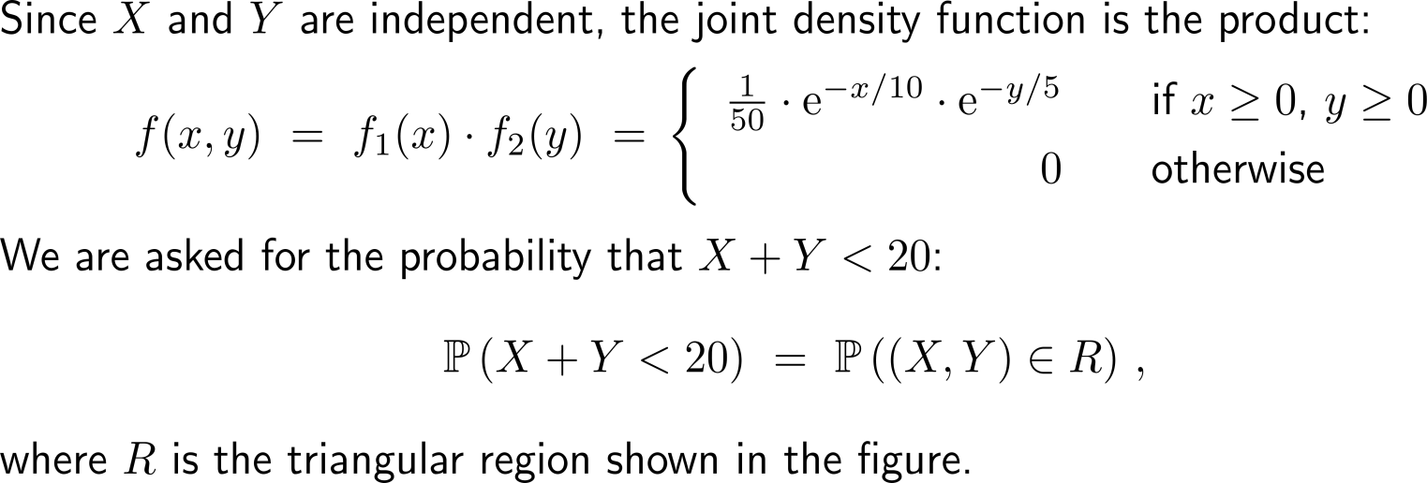
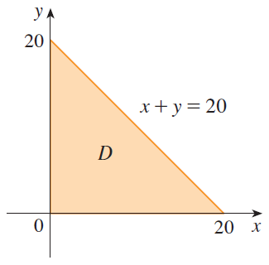
Example: Independent waiting times
R

Slide 27
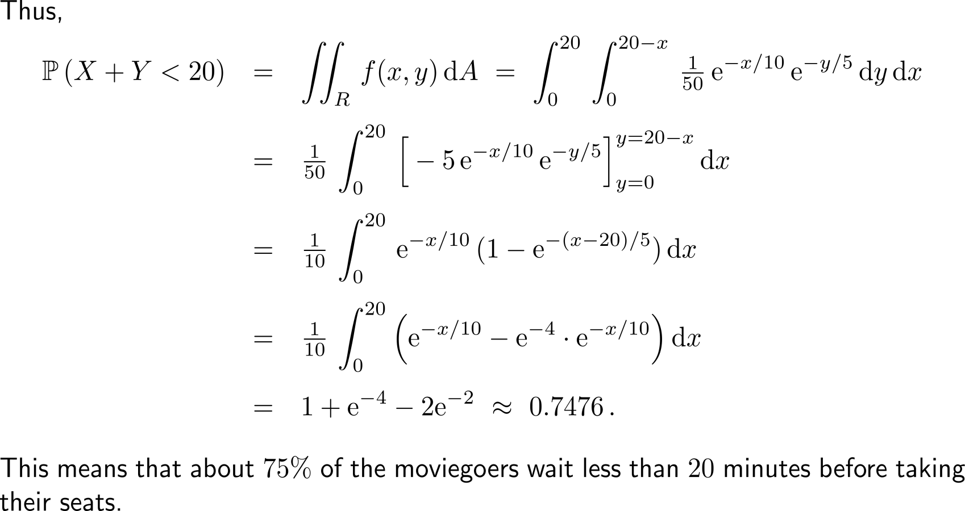
Example: Independent waiting times

Slide 28
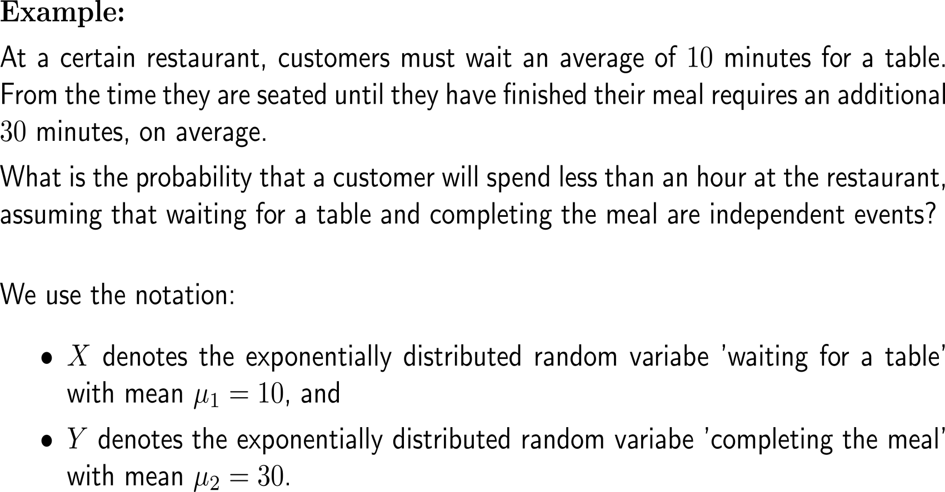
Example: Time at a restaurant
10 minutes
self/ group work
please, upload your solutions to the chat

Slide 29
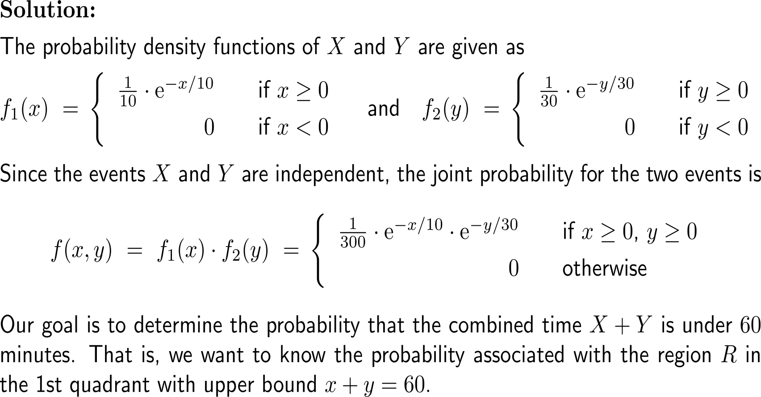
Example: Time at a restaurant

Slide 30
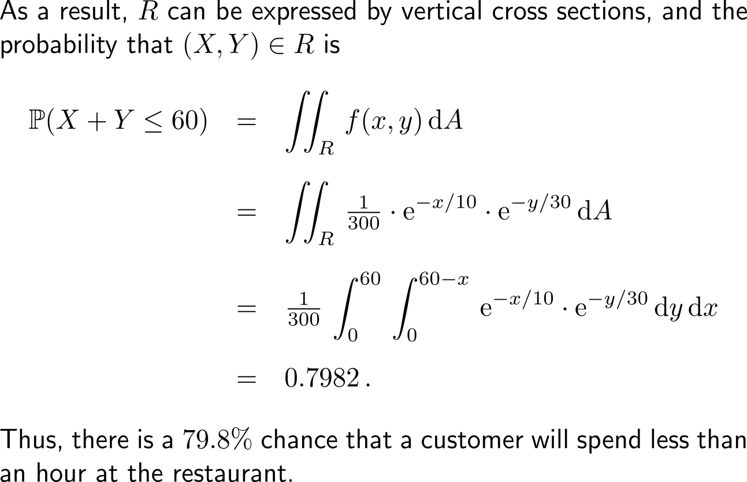
Example: Time at a restaurant
x
60
x + y = 60
R
0
60
y

Slide 31
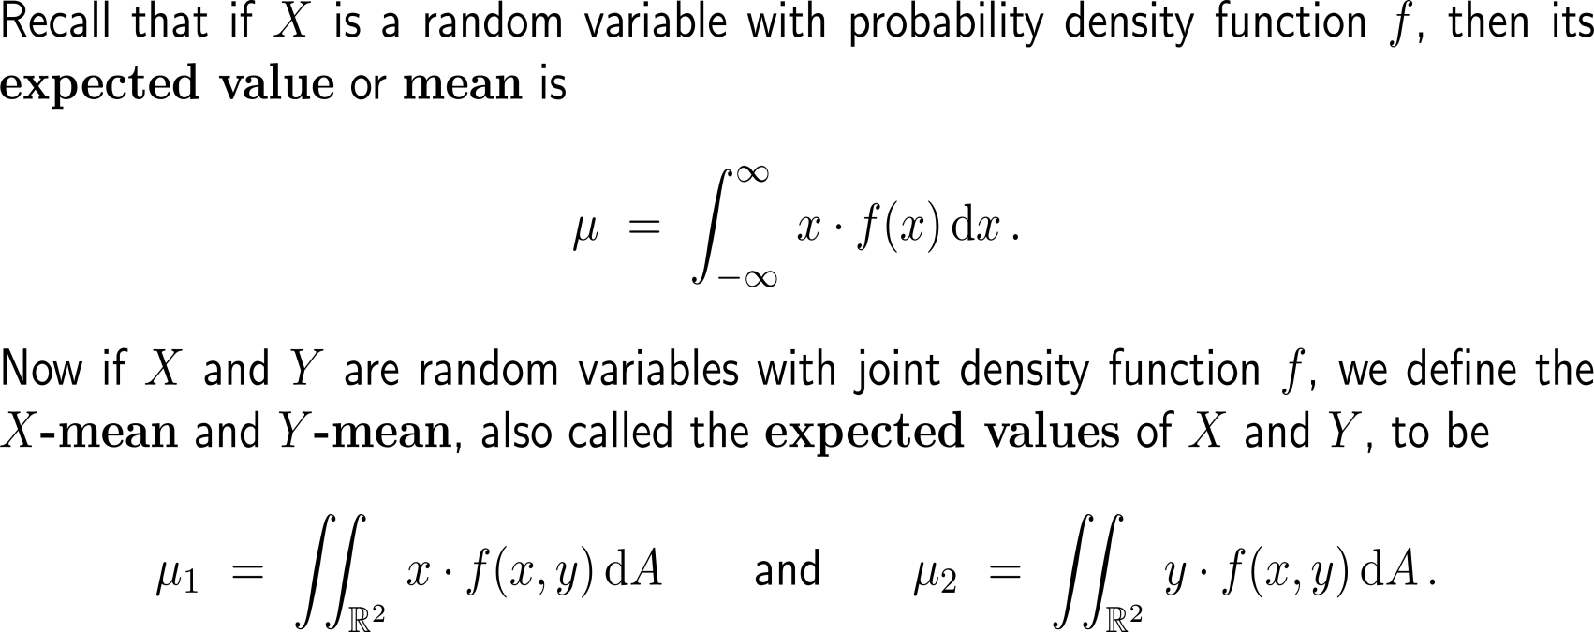
For probability density functions of two variables there is an x-mean and a y-mean

Slide 32
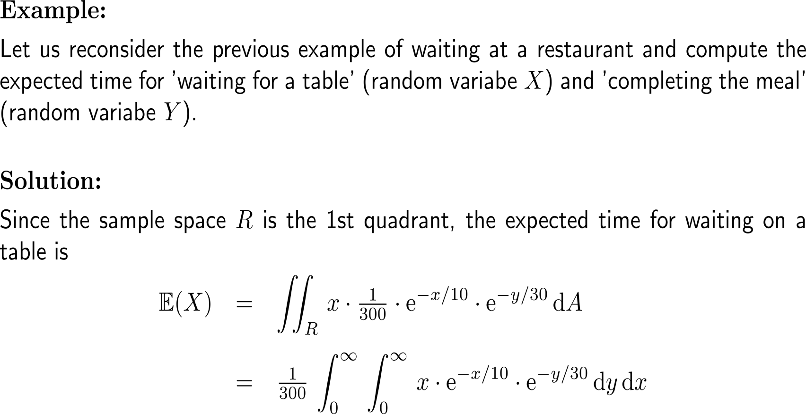
Example: Expected times at a restaurant

Slide 33
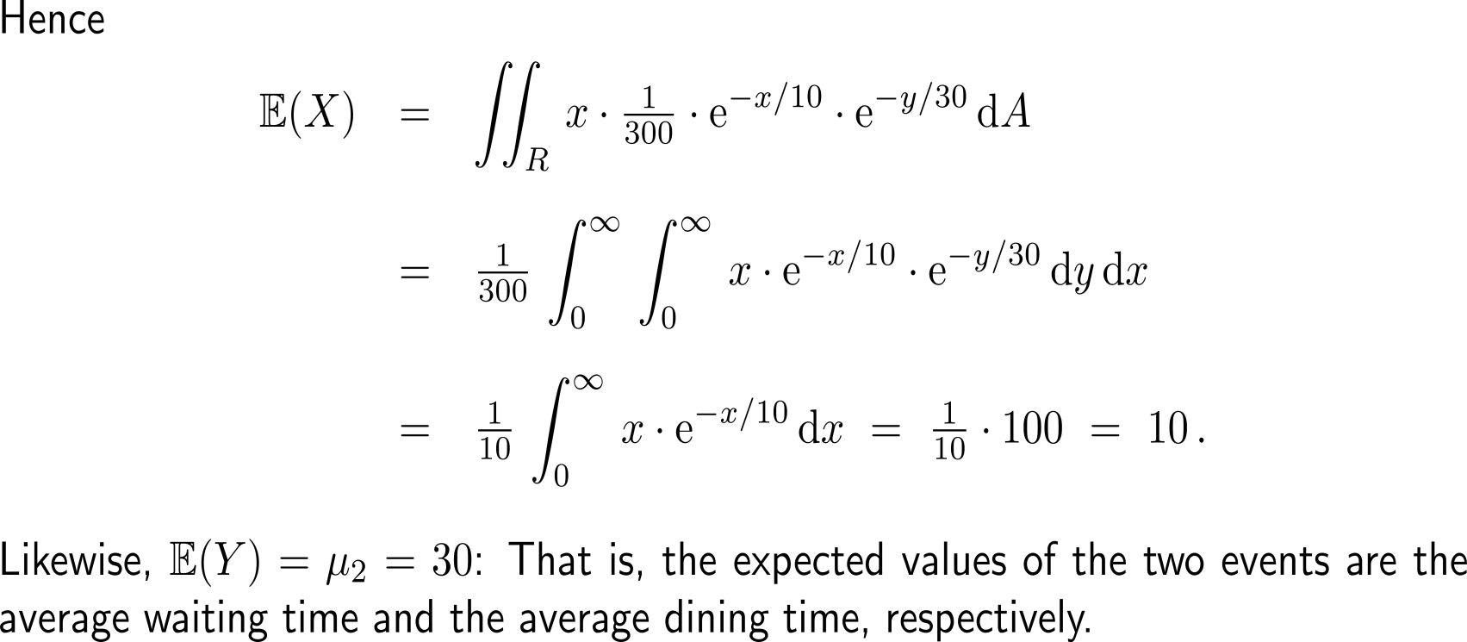
Example: Expected times at a restaurant

Slide 34
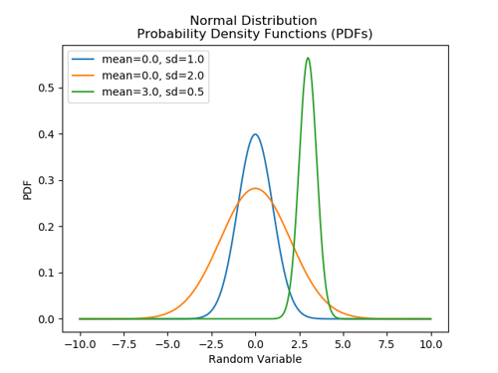
Recap: Probability density of a normally distributed random variable

Slide 35
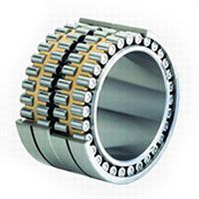
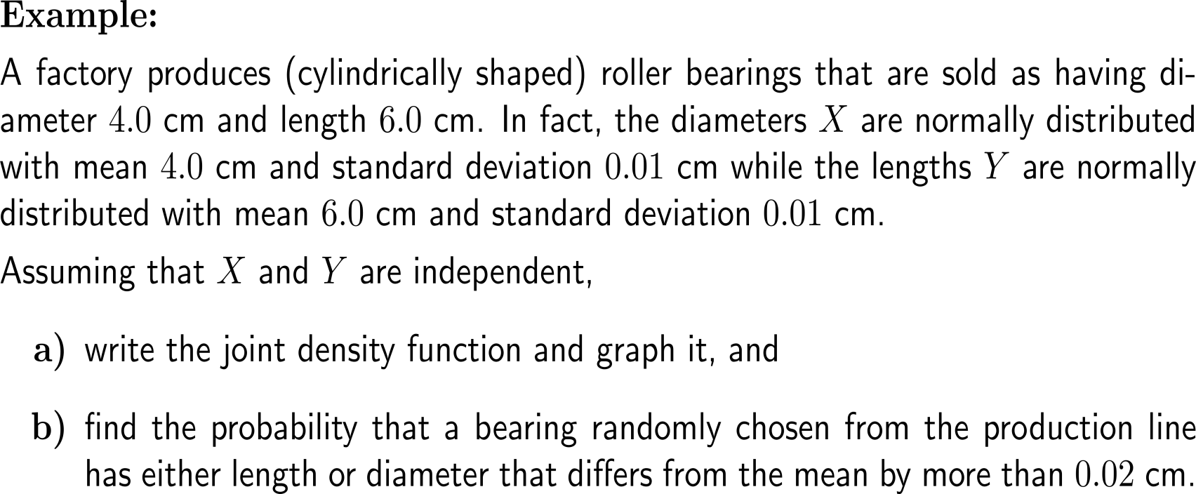
Example: Production accuracy

Slide 36
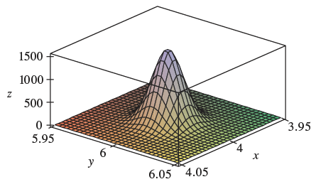
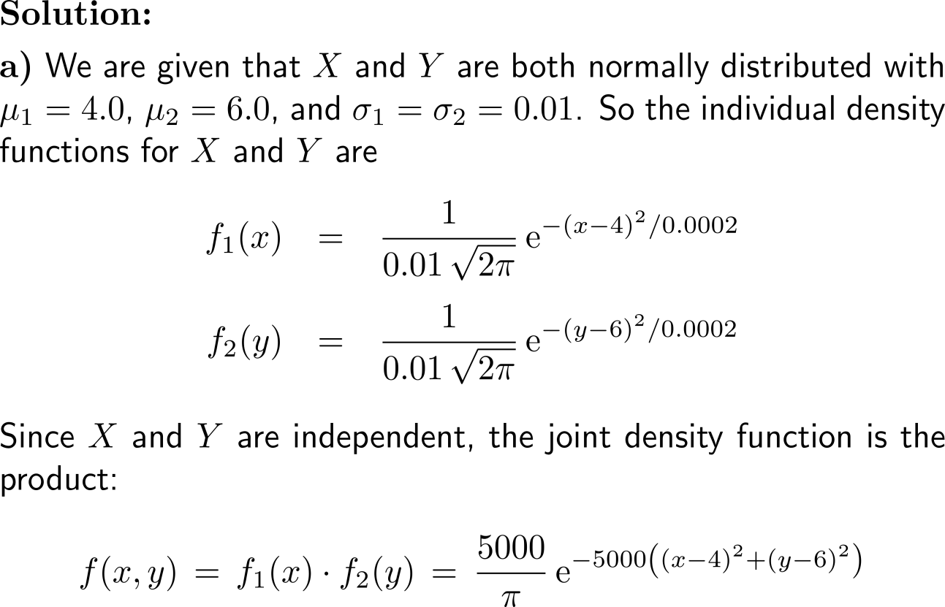
Example: Production accuracy

Slide 37
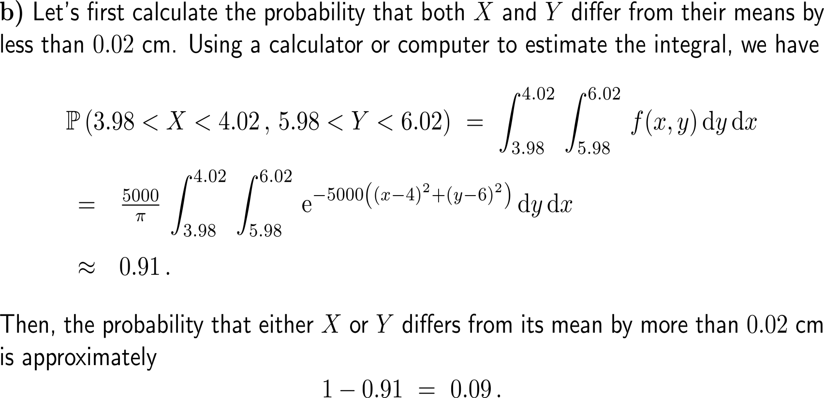
Example: Production accuracy

Slide 38
Further Worked-Out Exercises:
Calculus II for Management
Topics
Further examples of double integrals
Properties of double integrals
Double integrals in probability

Slide 39
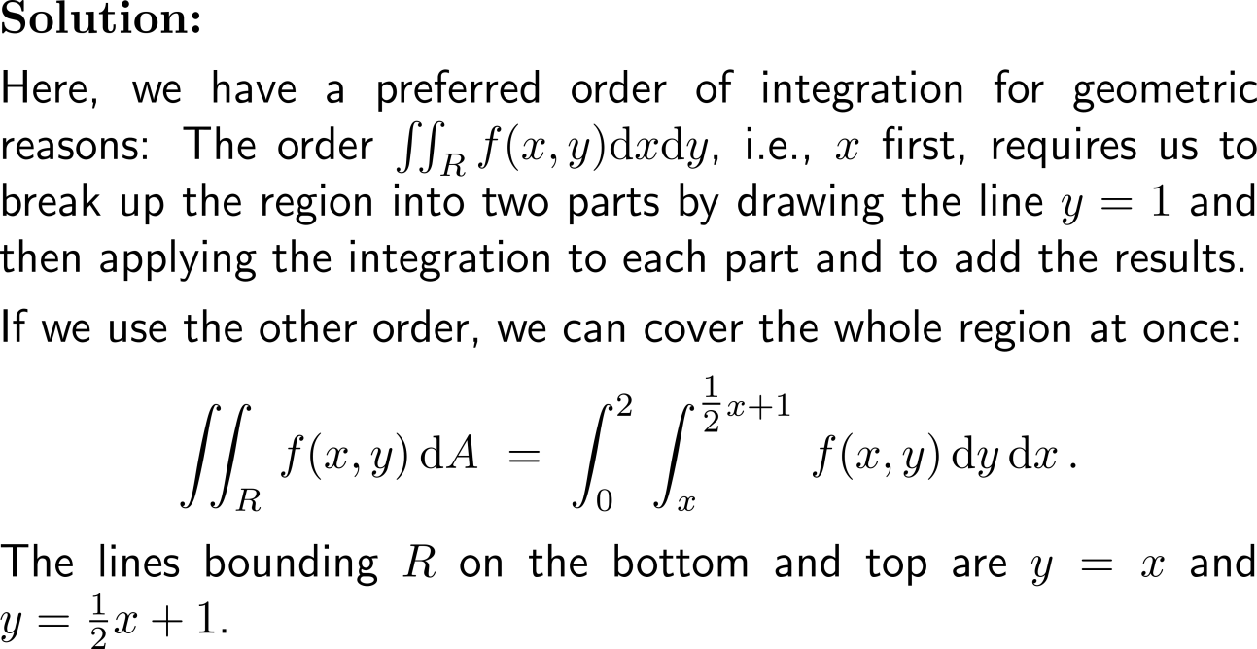
Exercise
y
(2,2)
(0,1)
R
(0,0)
x

Slide 40
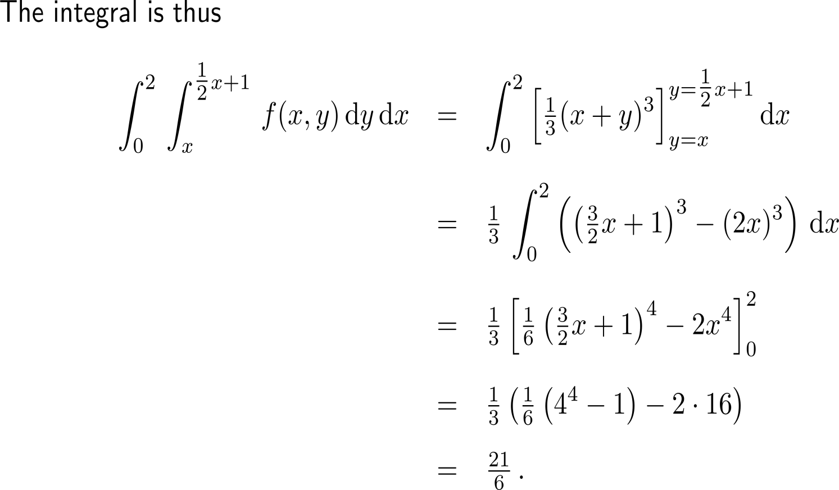
Exercise

Slide 41
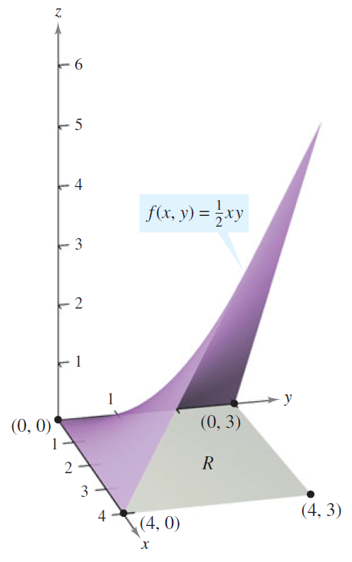
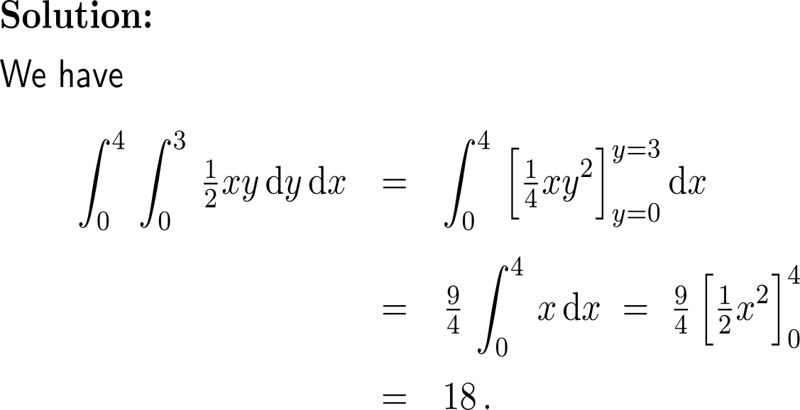
Exercise
10 minutes
self/ group work
please, upload your solutions to the chat

Slide 42
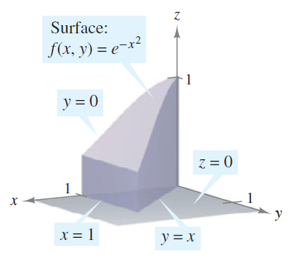
Exercise

Slide 43
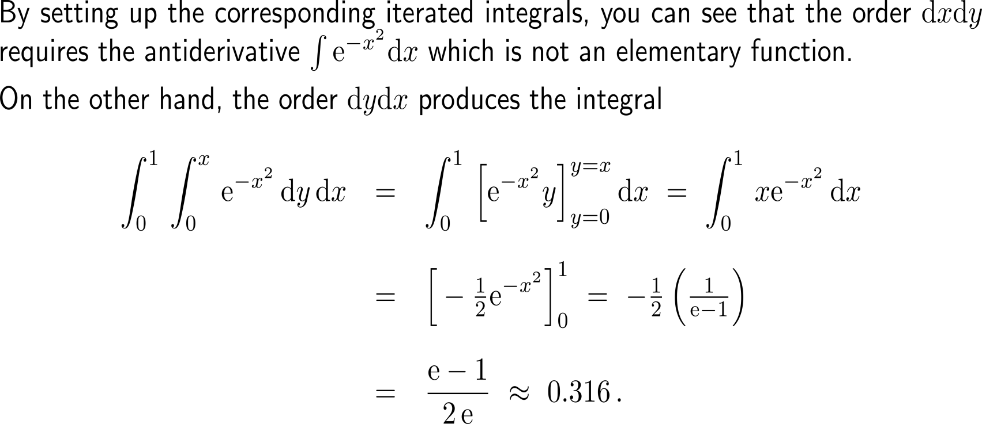
Exercise

Slide 44
Exercise

Slide 45
Exercise

Slide 46
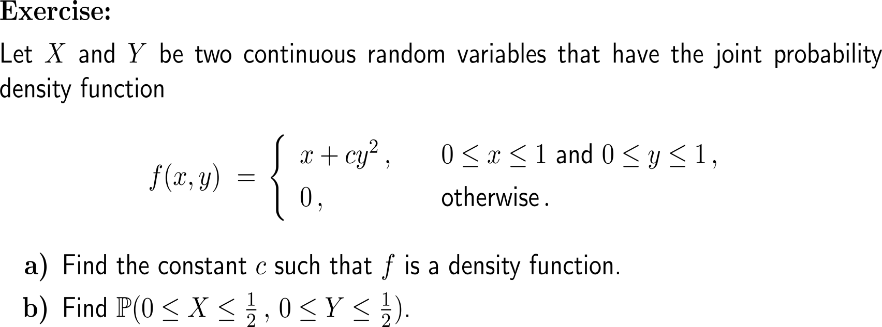
Exercise
10 minutes
self/ group work
please, upload your solutions to the chat

Slide 47
Exercise

Slide 48
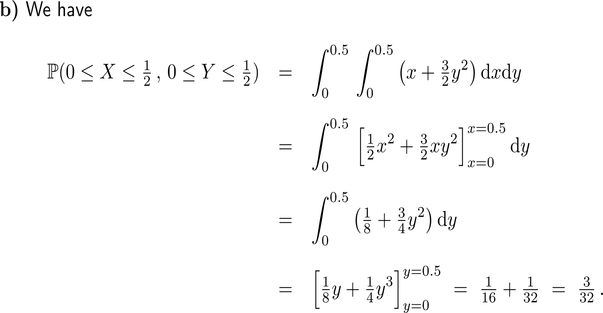
Exercise

Slide 49
Calculus II for Management

